Slide 1
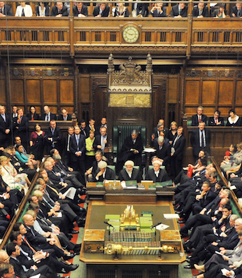

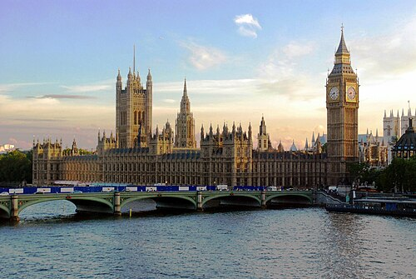
How emotive are politicians?
Yasmin Fox
D200 Project

Slide 2
Background
Politicians use emotion.
But how?
And how much?
Machine Learning techniques help us answer this.
Process very large datasets more quickly and efficiently
Calculate metrics without human discretion
Require computational resources, lacks interpretability and replicability
Example applications:
Gennaro & Ash (2022) – measure emotiveness of U.S. Congress speeches
Osnabrügge et al. (2021) – measure emotive rhetoric in UK and Irish Parliaments

Slide 3
How my project differs
Existing research often lacks a neutral benchmark.
Civil servants bound to ‘objectivity’ and ‘impartiality’ by the Civil Service Code can be this.
Project outline:
Collect UK government department annual reports & accounts
Compare forewords by politicians vs civil servants
Apply Gennaro & Ash (2022)’s model to calculate emotiveness
Validate using Claude Sonnet 4.6

Slide 4
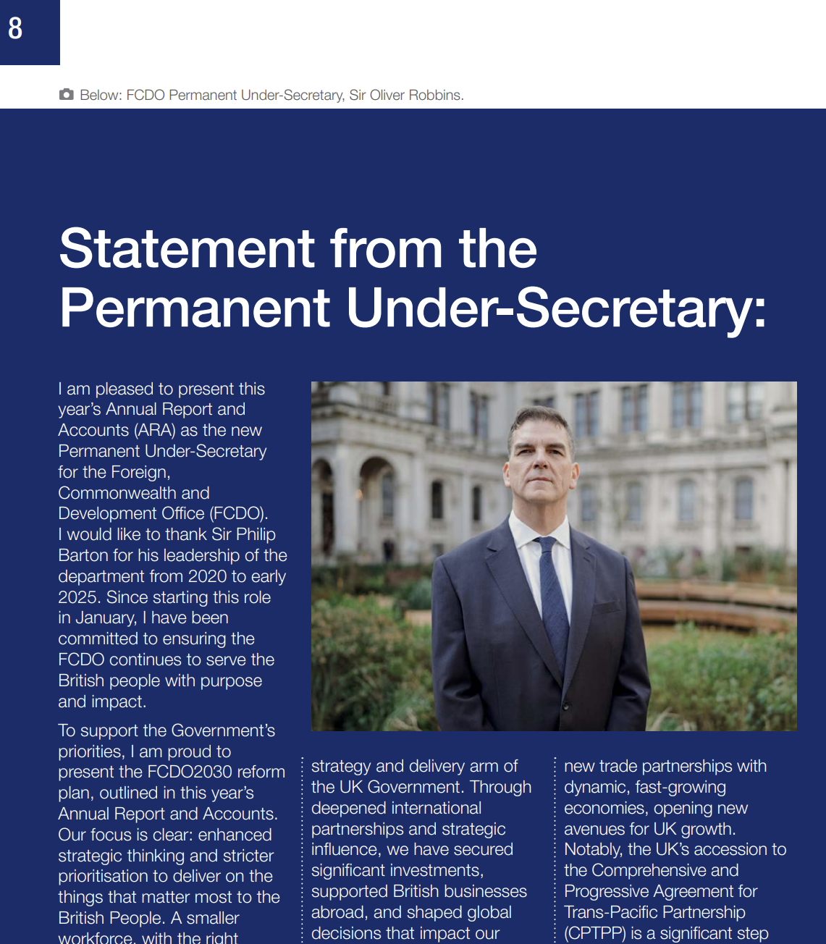
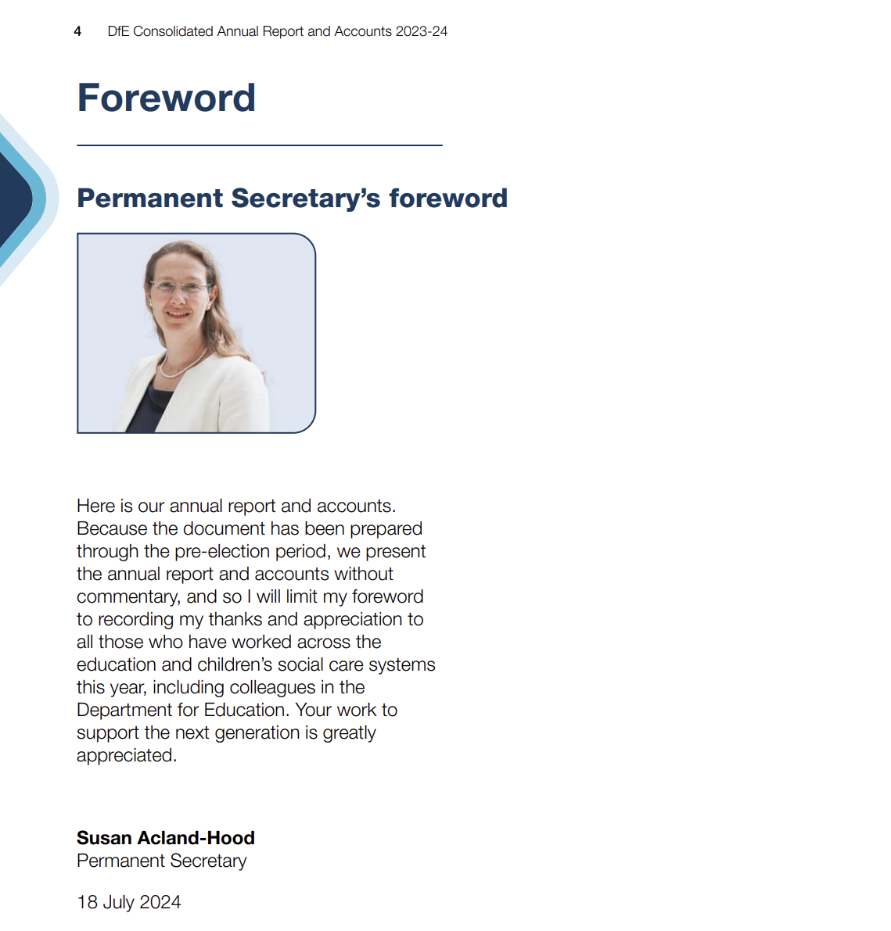
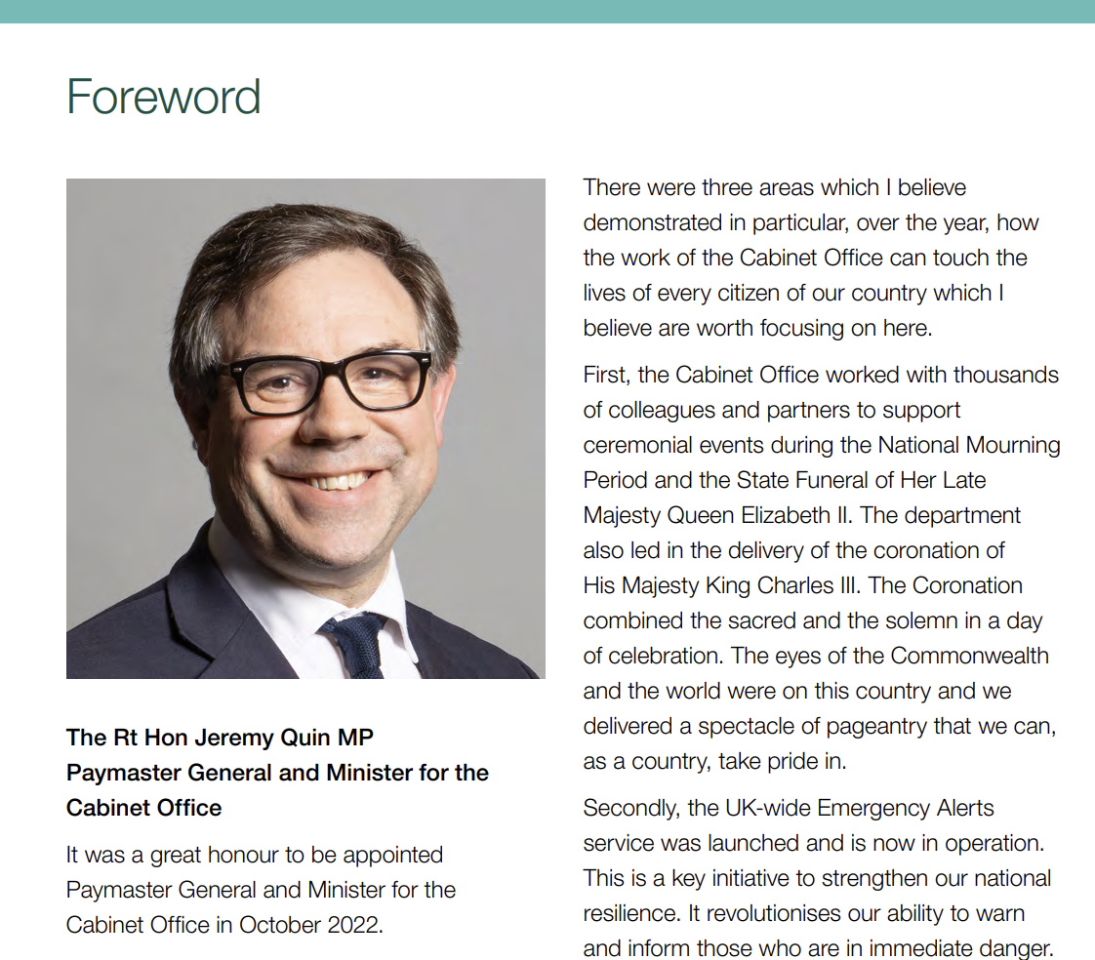
Data – Collection
I downloaded PDFs of the reports from GOV.UK and manually extracted the forewords.
FCDO, Minister, 2025
DfE, Permanent Secretary, 2024
Cabinet Office, Minister, 2023
Notes:
Manual inspection.
Formatting is very different.
Headings, titles, page numbers, multi-column layouts will all make processing difficult.
2024 should be dropped due to general election pre-election period.

Slide 5
Data – Drop unusable forewords
Merge authors to ‘politician’ vs ‘civil servant’
Drop 2023 to 2024 financial year
Total usable forewords: 54
Political affiliation distinguished by party in power
Conservatives
Labour
Author | 22/23 | 24/25
Civil Servant | 11 | 16
Politician | 12 | 16
Author distinguishes expected emotiveness
Annual report forewords, distributed by author and year

Slide 6
Data – Cleaning
Stage 1: Extract Sentences
Split by line
Remove page numbers, headers, footers and nonword strings such as “\n”
Segment sentences using NLTK’s “sent_tokenize” function
Drop the first two and final sentences and sentences with fewer than 4 words for safety
' \n5 \nStatement by the \nPermanent Secretary \nIt is a testament to its staff that HM Treasury has responded with agility \nand commitment to progress its key priorities through a busy past year.
…
thrive \nand contribute to the security and prosperity of the nation. My sincere \nthanks to everyone who has contributed to the Treasury’s delivery this \nyear. \n \n \n \nJames Bowler \nPermanent Secretary to the Treasury \n11 July 2023 \n \n \n \n'
'The Treasury took significant action to address the shocks caused by Russia’s invasion of Ukraine.’
…
'It is a privilege to be part of this diverse and inclusive workplace, where all colleagues can thrive and contribute to the security and prosperity of the nation.’
'My sincere thanks to everyone who has contributed to the Treasury’s delivery this year.'
HM Treasury, Civil Servant, 2023

Slide 7
Data – Cleaning
Stage 2: Tokenize, replicating Gennaro & Ash (2022)
Remove punctuation, capitalisation, digits and words 2 characters or fewer
Tag parts of speech using NLTK’s Perceptron Tagger, retaining only nouns, verbs and adjectives
Stem using Snowball Stemmer
Drop stopwords using NLTK’s inbuilt list
'The Treasury took significant action to address the shocks caused by Russia’s invasion of Ukraine.’
'My sincere thanks to everyone who has contributed to the Treasury’s delivery this year.'
['treasuri', 'took', 'signific', 'action', 'shock', 'caus', 'russia', 'invas', 'ukrain’]
['sincer', 'thank', 'everyon', 'contribut', 'treasuri', 'deliveri', 'year']
HM Treasury, Civil Servant, 2023

Slide 8
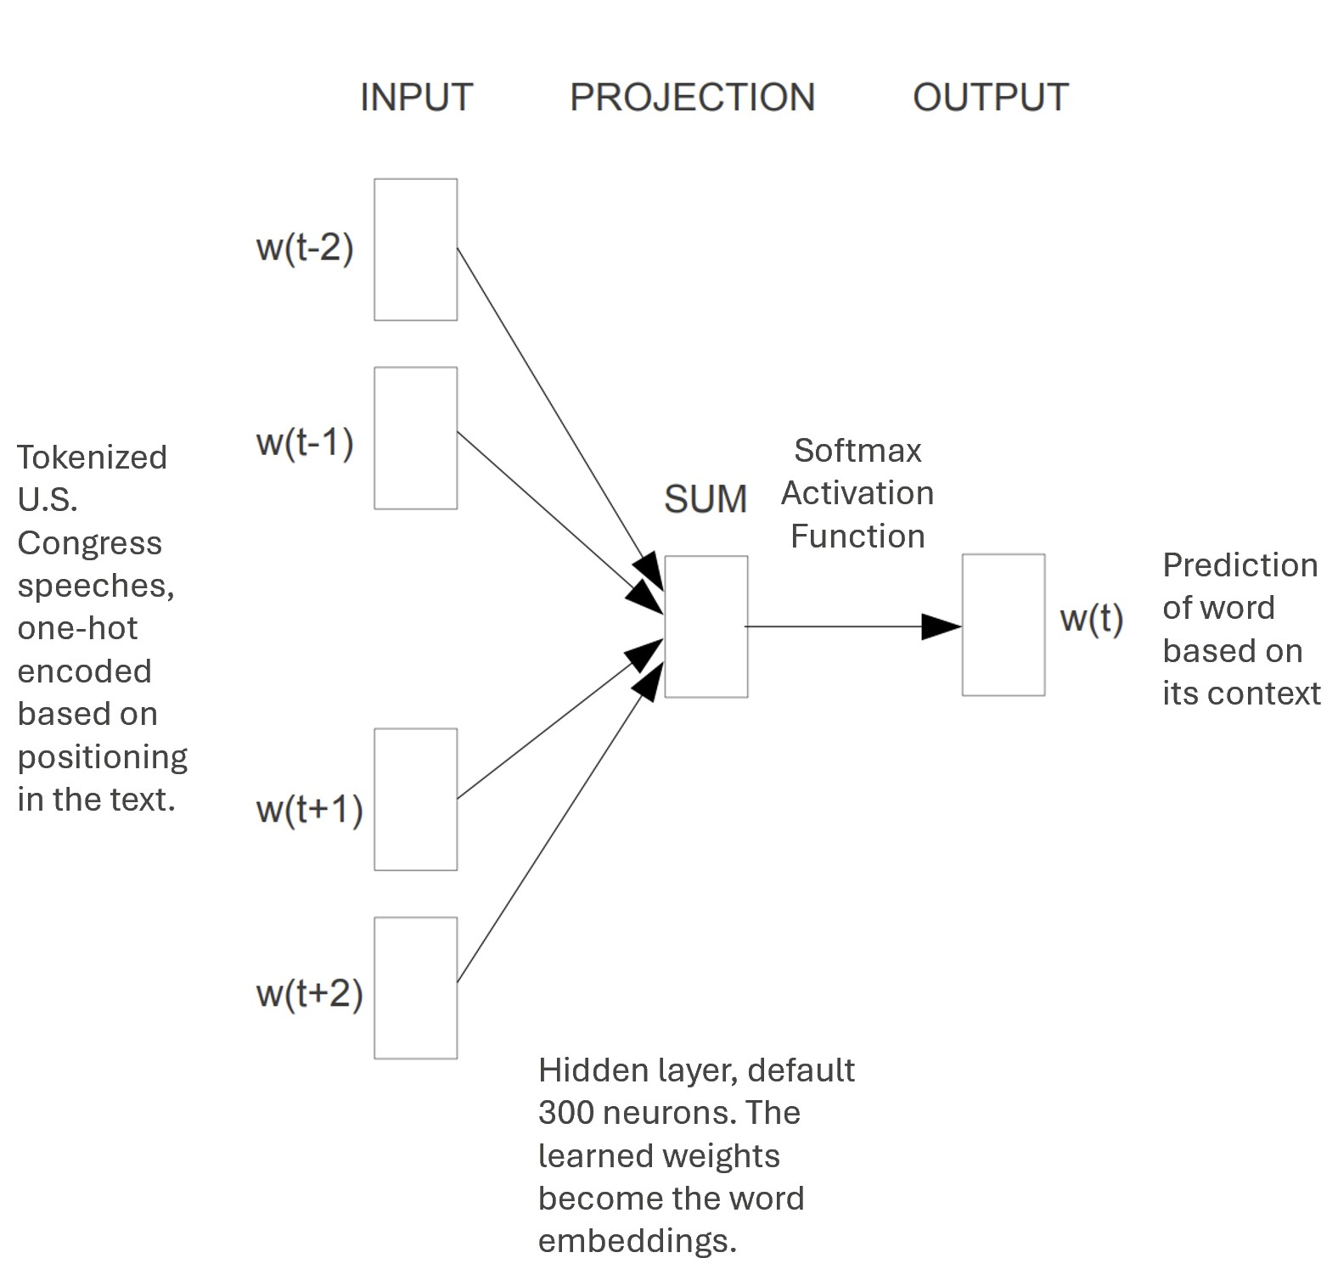
Methodology – Word2Vec
Word2Vec, adapted from Mikolov et al. (2013), applied
to Gennaro & Ash (2022)

Slide 9


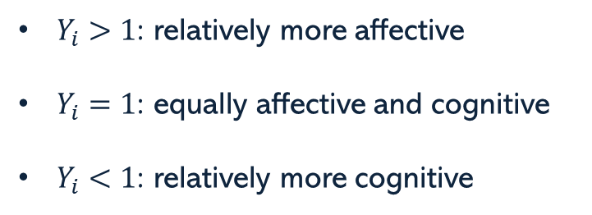
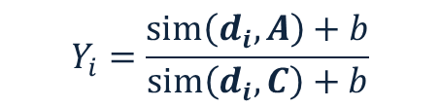
Methodology – Emotionality
Emotionality score of speech vector $i$is given by:
Cosine Similarity
Affect Pole
$Y_{i}>1$: relatively more affective
$Y_{i}=1$: equally affective and cognitive
$Y_{i}<1$: relatively more cognitive
$$Y_{i}=\frac{sim\left(d_{i}, A\right)+b}{sim\left(d_{i}, C\right)+b}$$
Smoothing constant = 1
Word Embedding
of speech $i$
from averaging over word vectors in the speech
Cognition Pole
Vectors weighted by smoothed inverse frequencies, upweighting words that appear relatively rarely.
Gennaro & Ash (2022)

Slide 10
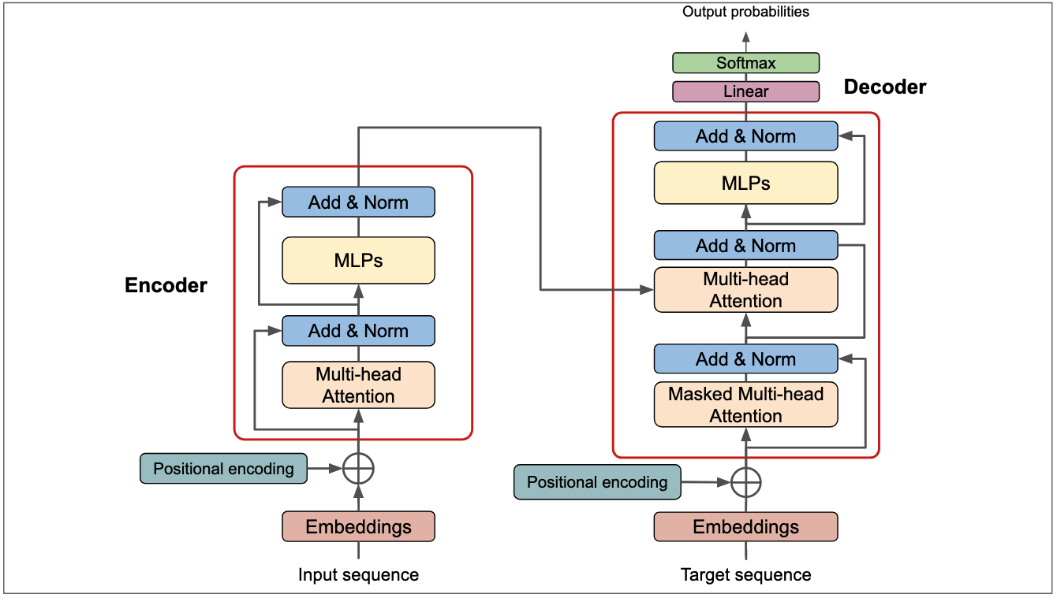
Validation Methodology
Sentiment analysis using Claude Sonnet 4.6
Exact architecture not publicly available
Limitations – Replicability, unknown biases
Rate the emotionality of the following text on a scale from 1 to 10, where: 1 = purely factual, technical, or administrative language with no emotional content, 5 = equally balanced in factual and emotional language, and 10 = highly emotional, charged, or affective language.
Rate the text a 0 if the text is not grammatically correct or is otherwise erroneous
Text: “input text”
Respond in this exact format:
SCORE: [number 0-10]
REASONING: [one sentence explanation]
[SCORE]
10: very high emotiveness
5: balanced
1: very low emotiveness
0: unrateable
+
[REASONING]
User prompt for Claude API
Example Transformer Architecture, from https://deeprevision.github.io/posts/001-transformer/.

Slide 11
Results – Emotionality scores
Politicians use significantly more affective language than civil servants.
The difference between politicians from different political parties was not significant.
Year | Emotionality Score
 | Politician | Civil Servant | Difference
22/23 | 1.175*** | 1.058* | 0.117***
24/25 | 1.195*** | 1.039 | 0.156***
All | 1.186*** | 1.047** | 0.139***
Mean Document-Level Emotionality Scores by author and year. T-tests were performed against a null hypothesis of 1 (equally affective and cognitive language). The difference in means calculated significance is based on an independent samples t-test. *, **, *** denotes significance at the 10%, 5% and 1% levels respectively.

Slide 12

Results – Claude ratings
Politicians use significantly more emotive language than civil servants.
Levels of emotiveness are lower than detected through the emotionality scores.
Year | Claude Ratings
 | Politician | Civil Servant | Difference
22/23 | 5.000 | 3.727*** | 1.273***
24/25 | 5.467 | 3.875*** | 1.592***
All | 5.259 | 3.815*** | 1.444***
Emotionality Score $Y_{i}$ vs Claude Rating $R_{i}$
$Y_{i}>1$: relatively more affective
Equivalent to $R_{i}→10$
$Y_{i}=1$: equally affective and cognitive
Equivalent to $R_{i}=5$
$Y_{i}<1$: relatively more cognitive
Equivalent to $R_{i}→1$
Mean Document-Level Claude ratings by author and year. T-tests were performed against a null hypothesis of 5 (equally emotive and factual language). The difference in means calculated significance is based on an independent samples t-test. *, **, *** denotes significance at the 10%, 5% and 1% levels respectively.

Slide 13
Challenges Improvements
Data Collection – Manual Search
Limited Sample Size
Text Extraction – Varied Formatting
Reduced Data Quality
Modelling – No training or fine-tuning
Required pre-trained values & frequencies
Validation – Used Claude Sonnet 4.6
Lacked replicability
Use LLMs/tools to automate search
Improve cleaning methods
Use LLMs/tools
Train/fine-tune the model to this context
If enough data is acquirable
Replicate alternative methods
E.g. Osnabrügge et al. (2021)

Slide 14
References
Gennaro, G. and Ash, E. Emotion and reason in political language. The Economic Journal, 132:1037–1059, 2022
Mikolov, T., Chen, K., Corrado, G., and Dean, J. Efficient estimation of word representations in vector space. Advances in Neural Information Processing Systems, 2013. URL https://arxiv.org/abs/1301.3781.
Osnabrügge, M., Hobolt, S., and Rodon, T. Playing to the gallery: Emotive rhetoric in parliaments. ¨ American Political Science Review, 115(3):885–899, 2021.
UK Civil Service. The Civil Service code, 2015. URL Civil Service Code. Accessed on 14/03/2026
Full list of all sources available in the report.
Disclaimer:
AI was used in this project to support code development and validation. Validation results may suffer unknown biases and not be replicable, as Claude’s architecture is not publicly available.

