Slide 1
RIDE Fall 2026
Midterm Presentation: Wi-Fi Sensing Using Channel State Information
Yusuf Shaikh, Thomas Alcorn, Karl Wara, Vihaan Vuppala
Notes:
Introduce the team and the project: detecting presence, motion, and eventually location in a room using only Wi-Fi signals, measured with low-cost ESP32-C6 boards.

Slide 2
Project Objectives
Detect presence, motion, and coarse location in a room using only Wi-Fi signals, with no cameras or wearables.
Build on low-cost ESP32-C6 boards (about $10 each) so receivers can be added freely.
Add receivers through configuration only, with no code changes.
1
Measurement platform
2
Presence and motion
3
Zone localization
Repeatable CSI capture on ESP32-C6 boards, characterized against known conditions.
Classify a recording as empty, occupied and still, or occupied and moving.
Identify which of 3 zones a person is in, using several receivers.
Working
First results
Planned
Notes:
Objective: contactless sensing with Wi-Fi only. Three modules from the Week 1 plan, each building on the last. Module 1 is working, Module 2 has first results, Module 3 needs more receivers.

Slide 3
Fundamental Theory: Multipath and CSI
A Wi-Fi signal reaches the receiver along many paths at once: direct, and reflected off walls, furniture, and people.
Wi-Fi (OFDM) spreads each frame over many narrow frequencies called subcarriers. The paths add up differently at each one.
The receiver estimates the channel on every subcarrier: its amplitude and phase. This is the Channel State Information (CSI).
A person moving changes the reflected paths, so the CSI changes over time. That change is what we detect.
wall
reflected by wall
TX
direct path
RX
Transmitter
Receiver
reflected by a person: changes as they move
Notes:
Key idea: the receiver sees the sum of many paths. OFDM splits a Wi-Fi frame across many subcarriers, and the paths add up differently at each frequency. The per-subcarrier channel estimate is the CSI. When a person moves, the reflected paths change, so the CSI changes over time.

Slide 4
What the Receiver Measures
A 20 MHz 802.11n frame gives 64 subcarrier slots. 56 carry signal; the rest are guard bands and the center slot.
Each slot is one complex value: amplitude √(I² + Q²) and phase.
The dip near slots 33–45 is multipath: paths cancel at those frequencies.
ESP32 phase shifts on every frame from clock offsets, so this project uses amplitude.
Each frame is divided by its mean amplitude to cancel the radio's automatic gain changes.
Notes:
This is one real frame from our receiver. 64 slots, 56 with signal. The dip in the middle of the band is multipath cancellation. We use amplitude because ESP32 phase is scrambled by clock offsets on every frame, and we normalize each frame to cancel the radio's automatic gain control.

Slide 5
System Design: Block Diagram
One transmitter broadcasts; every receiver captures CSI from each frame.
Receivers publish records over MQTT to a hub that logs and plots them.
All boards join the same 2.4 GHz Wi-Fi network, which sets the sensing channel.
Receiver 1
captures CSI
CSV log
one file per node
Laptop hub
mosquitto broker
csi_hub.py
stamps arrival time
one CSV per node
Transmitter
ESP32-C6
ESP-NOW broadcast
100 frames/s
Receiver 2
captures CSI
Live plot
motion score
Receiver N
added by configuration
Wi-Fi sensing frames through the room
MQTT reports over home Wi-Fi (topic csi/<node>/data)
Notes:
One transmitter broadcasts a short frame 100 times a second over ESP-NOW. Every receiver on the channel measures CSI from each frame and publishes one record per frame over MQTT. The hub stamps arrival time, writes one CSV per receiver, and drives the live plot. Change from the September design: everything now joins the same home Wi-Fi, so any number of receivers can share one transmitter.

Slide 6
Hardware and Software Configuration
Hardware
Software
ESP32-C6 boards (ESP32-C6-1-N4, 4 MB flash): 1 transmitter and 1 receiver now, 7 on hand
Single antenna, 2.4 GHz only, used in 802.11n 20 MHz mode
Powered over USB; flashed and configured through the COM (CH343) port
Placed 2–3 m apart at waist height with a clear line of sight
Firmware: C++ on ESP-IDF 5.5.5 (FreeRTOS), built with PlatformIO; one source file per board
Transmitter: ESP-NOW broadcast at 802.11n MCS0 from a fixed address
Receiver: hears every frame on the channel, keeps only the transmitter's, publishes over MQTT
Hub: mosquitto broker; Python with paho-mqtt, NumPy, and Matplotlib
Per-board settings are typed over USB serial and stored in flash: Wi-Fi name and password, node ID, hub address, and packet rate.
Notes:
Hardware: ESP32-C6 boards, one antenna, 2.4 GHz only. We flash and configure over the COM port. Software: firmware is C++ on ESP-IDF with FreeRTOS, one file per board. The hub is mosquitto plus Python. Every per-board setting is typed over serial and saved in flash, which is what makes adding receivers configuration-only.

Slide 7
Preliminary Results: Platform
100.1
99.3%
100%
85.7
frames/s at the receiver (target 100)
of gaps between frames exactly 10 ms
of kept frames from the transmitter, 128 values each
records/s logged by the hub over MQTT
First three: receiver serial output, Oct 8, broadcast design (1,139 frames). Last: hub log, Oct 8, original single-receiver design.
Observations
The full data path works: transmitter → receiver → MQTT → hub → CSV file and live plot.
Fixed in bring-up: the hub received only 1 record/s (now buffered and sent by a dedicated task); the transmitter ran at ~86 frames/s (now fixed-period timing); a crash from using a second CPU core the C6 does not have.
Moved from a one-to-one link to a broadcast design, so any number of receivers can share one transmitter.
Notes:
The platform works end to end. 100.1 frames per second at the receiver with almost perfectly even spacing. Three bring-up issues were found and fixed. The one number we still need is the hub delivery rate with the new broadcast design over home Wi-Fi.

Slide 8
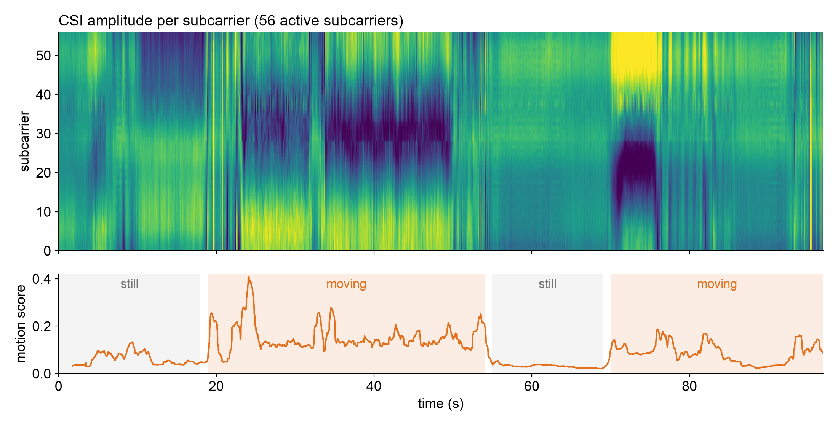
Preliminary Results: First Motion Recording
97 s recording on one transmitter–receiver link, about 52 transmitter frames/s (Oct 8).
Still periods give a steady pattern; movement breaks it up across subcarriers.
The motion score rises during movement and returns to baseline when still.
Notes:
Top: every subcarrier's amplitude over 97 seconds. Bottom: the motion score. When the room is still the pattern is steady and the score sits near its baseline; when someone moves, the pattern breaks up and the score rises. Shaded stretches were labeled from this timeline after the recording.

Slide 9
Preliminary Results: Still vs. Moving
3–4×
higher motion score while moving than while still
A simple threshold would separate still from moving in this recording.
Limitations: one 97 s recording; stretches labeled from the timeline afterwards, not logged during the test.
Next: labeled sessions (empty, still, moving) to measure accuracy on recordings not used for tuning.
Notes:
Median motion score per stretch. Moving stretches are 3 to 4 times higher than still ones, so even a simple threshold would separate them in this recording. This is one recording with stretches labeled afterwards; next we record labeled sessions to measure real accuracy.

Slide 10
Project Completion Plan
Milestone | Target | Status
Hardware platform working, first CSI captures | End of Sept | Done
Multi-receiver firmware: broadcast and Wi-Fi reporting | Mid-Oct | In progress
Labeled recordings: empty, still, moving | Late Oct | Planned
Channel characterization: distance, obstruction, position | Early Nov | Planned
Presence and motion detector, accuracy on held-out data | Mid-Nov | Planned
Add receivers; 3-zone classification | Late Nov | Planned
Live demonstration | Dec 7 | Planned
Final report | Dec 11 | Planned
Targets from the Week 1 plan. Channel characterization, first planned for mid-October, now follows the multi-receiver firmware.
Notes:
Milestones from the Week 1 plan with current status. The platform milestones are done or in progress; characterization now follows the multi-receiver firmware. Dates to confirm as a team.

Slide 11
Remaining Tasks
1
Hardware
2
Data collection
Verify multi-receiver reporting over home Wi-Fi
Add 2–3 receivers at fixed, marked positions
Measure delivery rate and dropped records per receiver
Labeled sessions: empty, still, and moving
Characterization: distance, obstruction, position
Per-run metadata: layout, people, notes
3
Analysis
4
Demo and report
Remove outliers; filter to human-motion rates
Reduce subcarriers to a few components (PCA)
Threshold first, then a trained classifier
Show detection output live on the hub plot
3-zone classifier with multiple receivers
Final report and documented code
Notes:
The work left, grouped. Hardware: confirm multi-receiver reporting and add receivers. Data: labeled sessions and characterization. Analysis: the Week 1 pipeline (clean, filter, reduce, decide). Then the demo and report.

Slide 12
Final Deliverables
1
Capture platform
2
Channel characterization
3
Presence and motion detector
ESP32-C6 firmware and hub with a documented data format
CSI across distance, obstruction, and receiver position
Accuracy on recordings not used for tuning
Working
Planned
First results
4
Zone classifier
5
Live demonstration
6
Final report
3 labeled zones with several receivers; tested on a separate session
Real-time detection running in the room
Methodology, results, and limitations, with the code
Planned
Partly working
Planned
Notes:
The six deliverables from Week 1, updated for the ESP32-C6 platform, with where each stands today.

