Slide 1
TMFGE: Temporal matrix factorization Based Graph Embedding
Yifan Song
ysong853@connect.hkust-gz.edu.cn

Slide 2
CONTENTS
Part1 Brief Introduction
Part2 Related Work
Part3 Methodology
Part4 Experiments
Part5 Conclusion
Our code is available at https://github.com/yfsong853/DSAA5002

Slide 3
Part 1: Brief Introduction

Slide 4

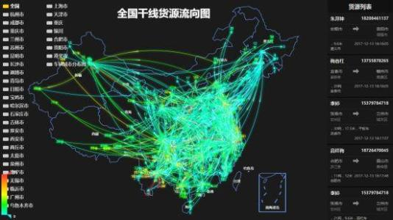

There are many data in the structure of graph in our daily life.
They contains many useful information, such as preferences of users in social network and features of email in logistics network.
Social Network
logistics network

Slide 5
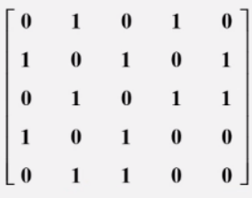
Shortcomings of traditional graph representation:
1.space-consuming 2.can not apply into many machine learning methods
$d$
$$V_{1} [1.54, 3.02, 5.71, …]$$
$$V_{2} [2.05, 1.07, 8.62, …]$$
$$V_{3} [1.21, 2.12, 4.78, …]$$
…
…
$$V_{n} [6.34, 4.12, 5.13, …]$$
Traditional Represenation
Graph Embedding
To deal with those problems, graph learning aims at embedding high-dimensional graph data into low-dimensional vector.
Then the embedding can be used in many downstream tasks like link prediction, node classification and recommended system.

Slide 6
Process of Graph Embedding Methods
k
Embed graph
As Input
Node classification
Link prediction
Recommended System
…
V
$$|V|×k$$
G=(V,E)
Graph embedding
graph embedding: The embedding vector should save as much information in original graph as possible. For example, two nodes who are close in origin should also be close in embedding space.

Slide 7
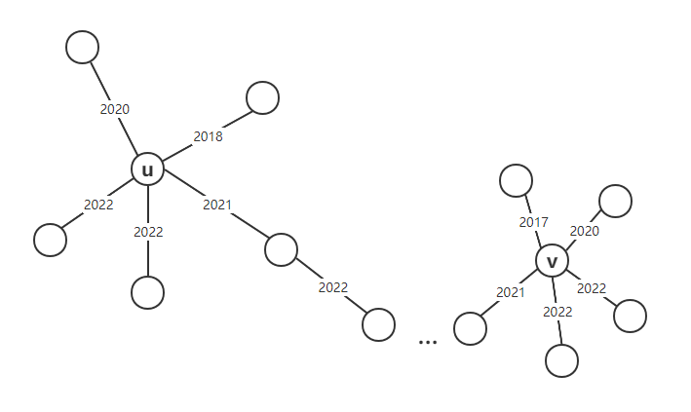
Motivation
Most of the static graph embedding methods are based on nodes and their neighbors.
Some existing dynamic methods, such as CTDNE[1], just simply give a temporal restriction on random walk, which can not describe the similarity between nodes and generation time. Just as shown in Figure 1.
Figure1: Highly similarity between nodes on the aspect of time segment distributions

Slide 8
Part 2：Related Work

Slide 9
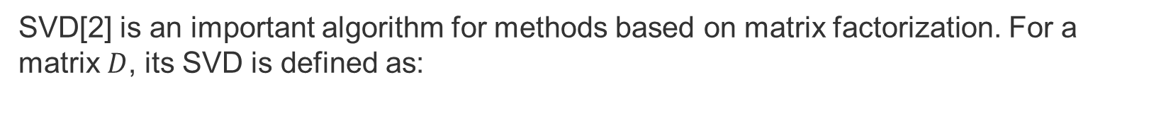
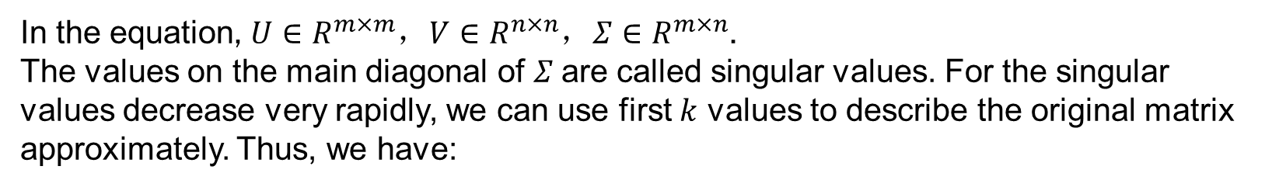
Singular Value Decomposition
SVD[2] is an important algorithm for methods based on matrix factorization. For a matrix $D$, its SVD is defined as:
$$D=UΣV^{T}$$
In the equation, $U∈R^{m×m}$，$V∈R^{n×n}$，$Σ∈R^{m×n}$.
The values on the main diagonal of $Σ$are called singular values. For the singular values decrease very rapidly, we can use first $k$ values to describe the original matrix approximately. Thus, we have:
$$D_{m×n}=U_{m×m}Σ_{m×n}V_{n×n}^{T}≈U_{m×k}Σ_{k×k}V_{k×n}^{T}$$
Because of the special properties of SVD, it always uses to get the embedding of graph.

Slide 10
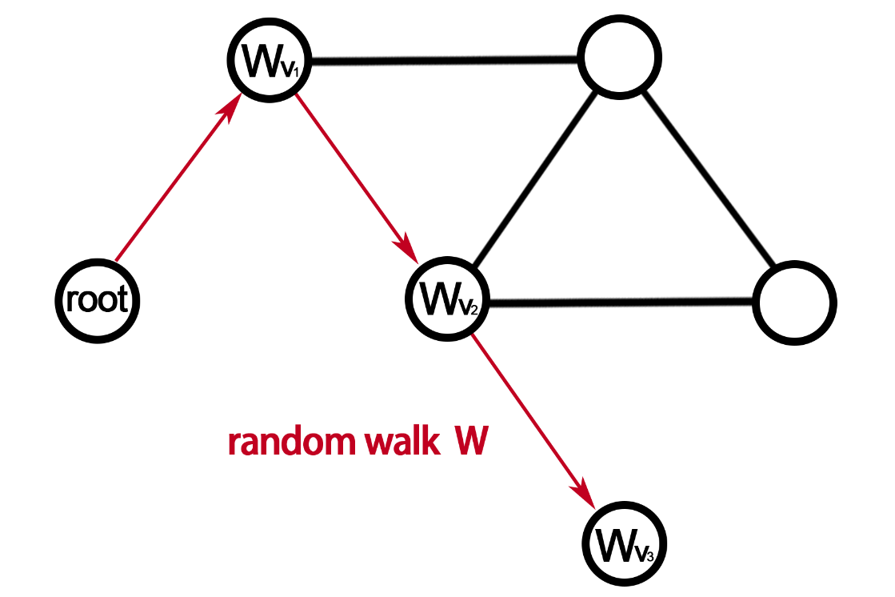
Random Walk
Random walk on graph：
Starting from a vertex, randomly select an edge from the edges connected to the current node according to a certain probability distribution to move to the next vertex or stay at the current node, and repeat this process until a set number of steps is reached. (Shown as Fig)
Example of Random Walk

Slide 11
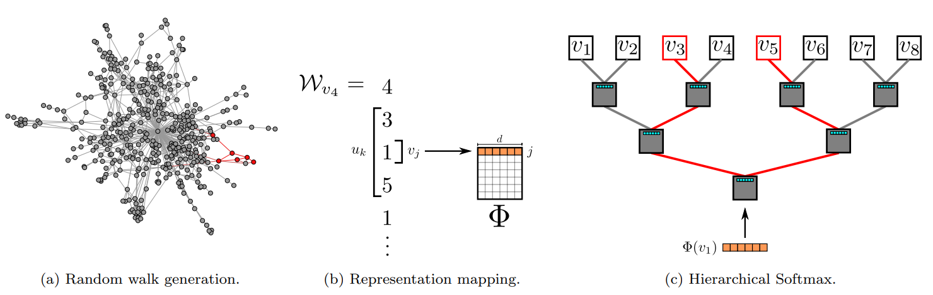
Deepwalk
According to the similarity between graph embedding and word embedding, node can be seen as word and random walk can be seen as sentence.
Deepwalk[3] apply random walk to generate node sequence and use them to train skip-gram[4], thus can get the embedding of graph.

Slide 12
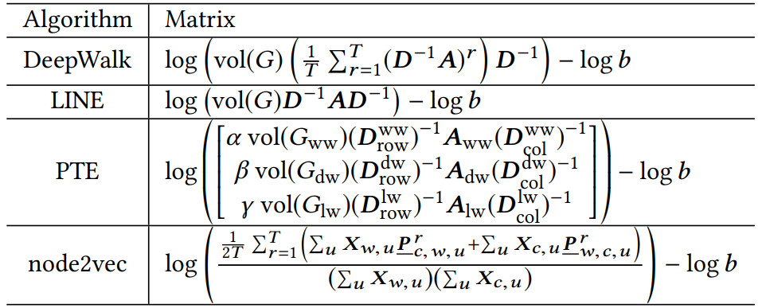
NetMF
NetMF[5] shows that many methods such as Deepwalk[3], LINE[6], node2vec[7] and PTE[8] can be unified into the matrix factorization framework with closed forms

Slide 13
Part 3：Methodology

Slide 14
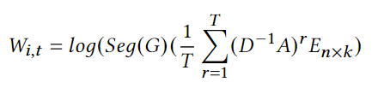

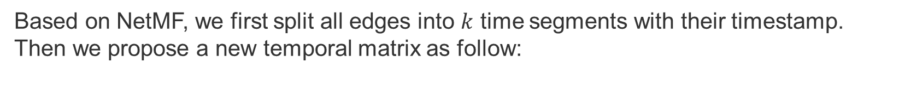
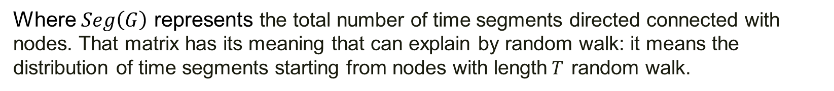
Temporal Matrix Construction
Based on NetMF, we first split all edges into $k$ time segments with their timestamp. Then we propose a new temporal matrix as follow:
Where $Seg\left(G\right)$ represents the total number of time segments directed connected with nodes. That matrix has its meaning that can explain by random walk: it means the distribution of time segments starting from nodes with length$T$ random walk.
In our method, we repeat $u$ random walk with length $T$ to approximately construct the temporal matrix $W_{i,j}$.

Slide 15
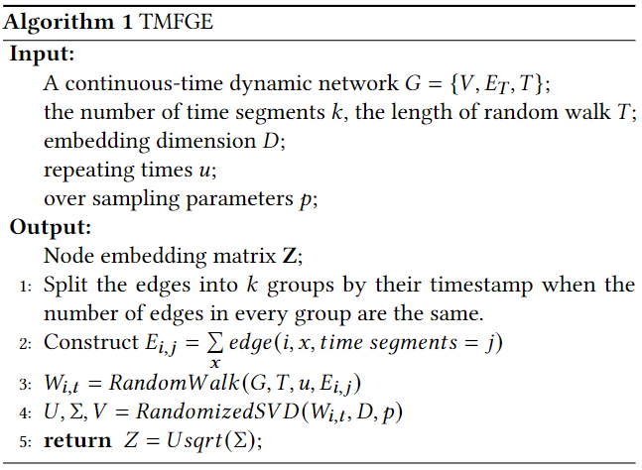
Process of TMFGE
1.Using random walk to construct the temporal matrix.
2.Using randomized SVD to factorization the matrix.

Slide 16
Part 4：Experiments

Slide 17
Datasets
 | Number of nodes |V| | Number of edges |E|
Enron | 150 | 2.6K
Forum | 899 | 33.7K
Reddit | 10.0K | 66.2K
Digg | 279.6K | 1.73M
Yelp | 424.4K | 2.61M

Slide 18
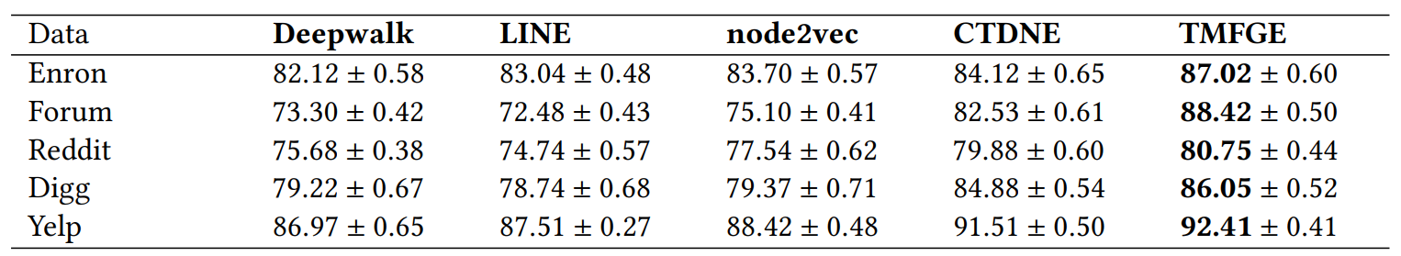
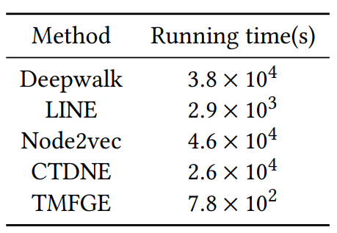
Experiment Results
AUC scores on link prediction task
Running Time:

Slide 19
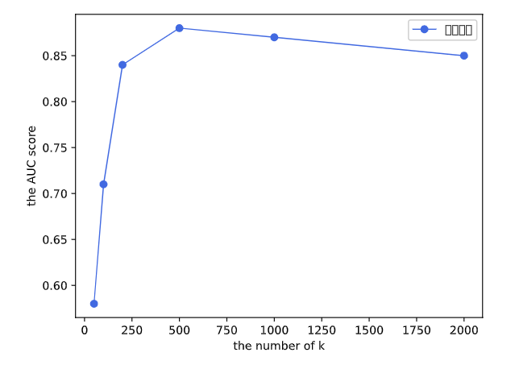
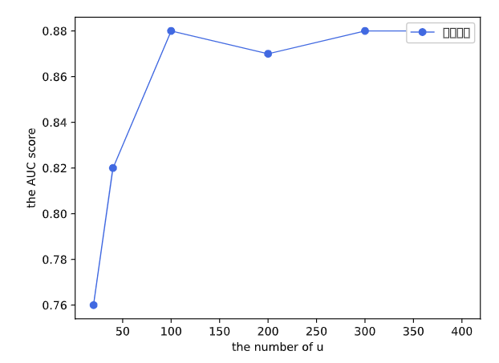


Parameters sensitivity analysis
The impact of parameter $k$
The impact of parameter $u$

Slide 20
Part 5：Conclusion

Slide 21
Conclusion
In this project, we proposed a new algorithm called TMFGE, which use random walk to construct temporal matrix and factorize that matrix to compute continuous-time graph embedding.
Results on five real-world datasets show that our method performs well than other graph embedding methods and can obtain the low-dimensional embedding in a very short time.
Further Research
Temporal heterogeneous graph embedding is a direction that can do more research on it, for how to combine temporal information and heterogeneous information is a challenge that has not been well studied.

Slide 22
Reference
[1] Nguyen, Giang Hoang, et al. "Continuous-time dynamic network embeddings." Companion proceedings of the the web conference 2018. 2018.
[2] Kalman, Dan. "A singularly valuable decomposition: the SVD of a matrix." The college mathematics journal 27.1 (1996): 2-23.
[3] Perozzi, Bryan, Rami Al-Rfou, and Steven Skiena. "Deepwalk: Online learning of social representations." Proceedings of the 20th ACM SIGKDD international conference on Knowledge discovery and data mining. 2014.
[4] Mikolov, Tomas, et al. "Efficient estimation of word representations in vector space." arXiv preprint arXiv:1301.3781 (2013)

Slide 23
Reference
[5] Qiu, Jiezhong, et al. "Network embedding as matrix factorization: Unifying deepwalk, line, pte, and node2vec." Proceedings of the eleventh ACM international conference on web search and data mining. 2018.
[6] Tang, Jian, et al. "Line: Large-scale information network embedding." Proceedings of the 24th international conference on world wide web. 2015.
[7] Grover, Aditya, and Jure Leskovec. "node2vec: Scalable feature learning for networks." Proceedings of the 22nd ACM SIGKDD international conference on Knowledge discovery and data mining. 2016.
[8] Tang, Jian, Meng Qu, and Qiaozhu Mei. "Pte: Predictive text embedding through large-scale heterogeneous text networks." Proceedings of the 21th ACM SIGKDD international conference on knowledge discovery and data mining. 2015.

Slide 24
Thanks

