Slide 2
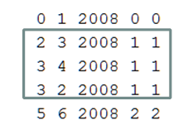
predict whether author1 will collaborate with author2 in 2010
2
Weight(2,3)=Weight(3,2)=pYear^(2010-2008)+pConf*1+pPaper*1
+ pYear^(2010-2008)+pConf*1+pPaper*1
3
4
Weight(3,4)=pYear^(2010-2008)+pConf*1+pPaper*1

Slide 3
Find all path length < BFSlimit
S
M
T
T
T
PathWeight = (Weight(S,M)+Weight(M,T))/PathLength

Slide 4
Query(S,T)
SumOfPathWeight>pThreshold ?Yes:No

Slide 5
Parameter
pYear
pConf
pPaper
pPredictYear
pNumofAuthor
pBFSlimit
pThreshold

