Slide 2
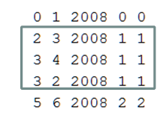
predict whether author1 will collaborate with author2 in 2010
2
Weight(2,3)=Weight(3,2)=pYear^(2010-2008)+pConf*1+pPaper*1
+ pYear^(2010-2008)+pConf*1+pPaper*1
3
4
Weight(3,4)=pYear^(2010-2008)+pConf*1+pPaper*1

Slide 3
Find all path length < BFSlimit
S
M
T
T
T
PathWeight = (Weight(S,M)+Weight(M,T))/PathLength

Slide 4
Query(S,T)
SumOfPathWeight>pThreshold ?Yes:No

Slide 5
Parameter
pYear
pConf
pPaper
pPredictYear
pNumofAuthor
pBFSlimit
pThreshold

Slide 6
原本想的作法
其實我原本是希望edge(i,j)的Weight代表的是i,j直接合作的機率
然後PathWeight就直接連乘edge weight
決定(i,j)有沒有合作則是把PathWeight取聯集看有沒有大於Threshold
不過這想法再決定edge weight的時候我有點卡住，就先寫成別的做法

