Slide 1
Final Project Coauthor Prediction Using Time-based Supervised Learning
R02921044 童宇凡
R02921074 吳家輝

Slide 2
Outline
Introduction
Problem Specification
Features
Our Framework
Cross-validation Result
Difficulties Encountered
Summary

Slide 3
Introduction
Coauthor relationship has long been a popular problem in linkage prediction
Two types of prediction:
Homogeneous
Heterogeneous

Slide 4
Problem Specification
Data we have: authors, year, conference
Data we don’t have: paper keyword, paper with single author
Coauthor relationship prediction for given pairs. (CN3_query.txt)
All pairs in testing set have cooperated at least once in training set.

Slide 5
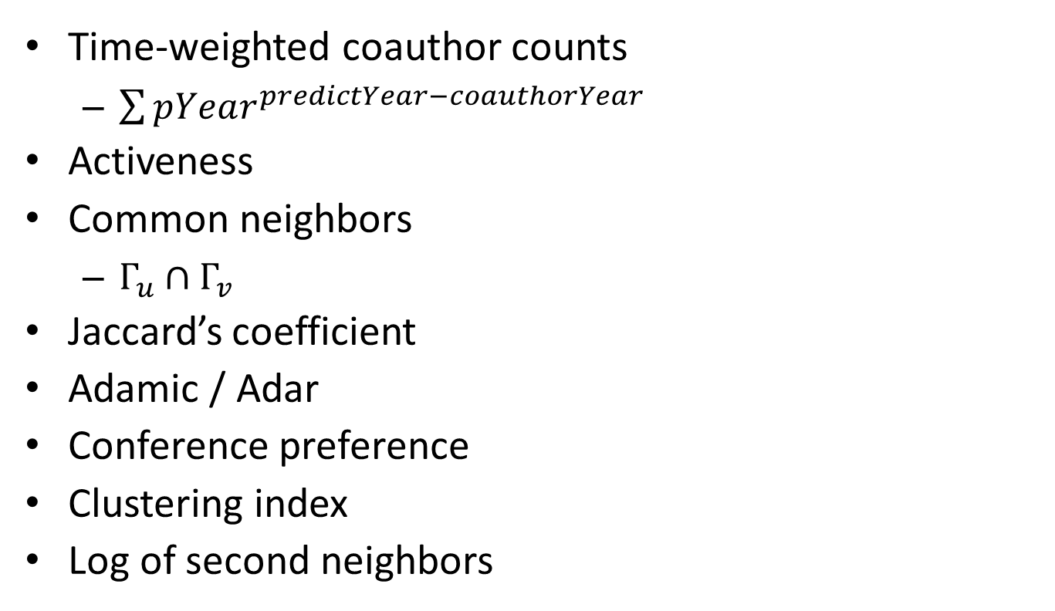
Features (TODO)
Time-weighted coauthor counts
$\sum{pYear^{predictYear−coauthorYear}}$
Activeness
Common neighbors
$Γ_{u}∩Γ_{v}$
Jaccard’s coefficient
Adamic / Adar
Conference preference
Clustering index
Log of second neighbors

Slide 6
Our Framework
Input: CN3.txt (2008?~2012)
Output: Prediction from CN3_query.txt (2013)
u
u
v
v
Feature Vector
Network
Prediction

Slide 7
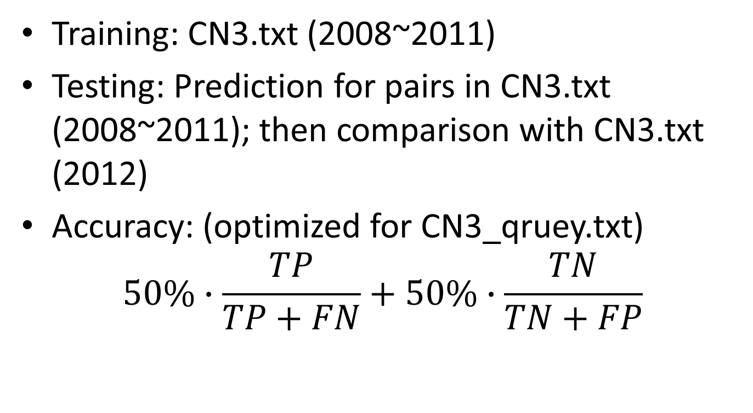
Our Framework
Training: CN3.txt (2008~2011)
Testing: Prediction for pairs in CN3.txt (2008~2011); then comparison with CN3.txt (2012)
Accuracy: (optimized for CN3_qruey.txt) $50\%∙\frac{TP}{TP+FN}+50\%∙\frac{TN}{TN+FP}$

Slide 8
Cross-validation Result

Slide 9
Difficulties Encountered
Memory issues
Adjacency list instead of adjacency matrix
Problem characteristic
All testing pairs were linked before
Many features do not work (e.g. shortest path)

Slide 10
Summary

Slide 11
Hypothesis
u與v合作過，u與v可能繼續合作
u與v近幾年合作過，u與v可能繼續合作
u與i合作過，i與v合作過， u與v可能合作
u跟很多人合作過，v跟很多人合作過，u與v可能合作
u有發表paper在conference A，v 有發表paper在conference A，u跟v可能合作

Slide 12
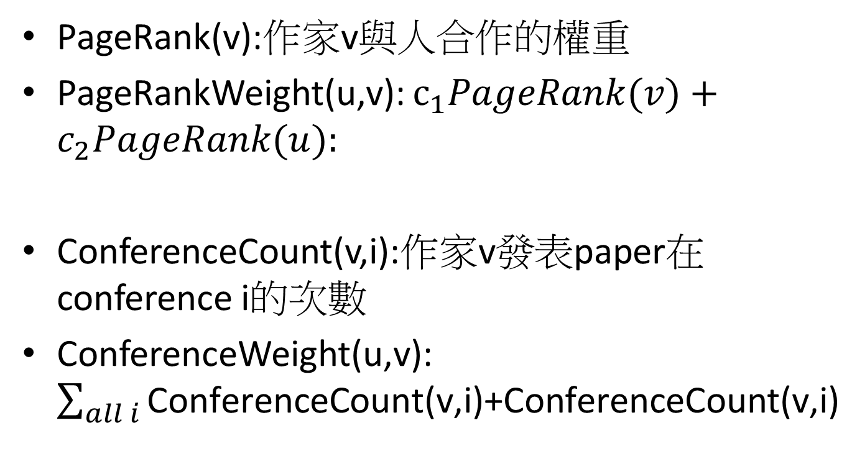
Node Information
PageRank(v):作家v與人合作的權重
PageRankWeight(u,v): $c_{1}PageRank(v)+c_{2}PageRank(u):$
ConferenceCount(v,i):作家v發表paper在conference i的次數
ConferenceWeight(u,v):$\sum_{all i}{\text{ConferenceCount}\text{(}\text{v}\text{,}\text{i}\text{)+}\text{ConferenceCount}\text{(}\text{v}\text{,}\text{i}\text{)} }$

Slide 13

Node Weight
$NodeWeight\left(u,v\right)=pPageRank∗PageRankWeight\left(u,v\right)+pConference∗ConferenceWeight(u,v)$

Slide 14
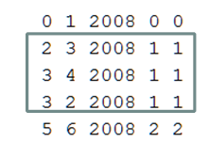
Edge Weight
predict whether author1 will collaborate with author2 in 2010
2
Weight(2,3)=Weight(3,2)=pYear^(2010-2008)+ pYear^(2010-2008)
3
4
Weight(3,4)=pYear^(2010-2008)

Slide 15
Find all path length < BFSlimit
S
M
T
T
T
$$PathWeight =\frac{Weight\left(S,M\right)+Weight\left(M,T\right)+NodeWeight(S,T)}{αPathLength+β^{PathLength}}$$

Slide 16
Query(S,T)
SumOfPathWeight>pThreshold ?Yes:No

Slide 17
Parameter
pYear
pConf
pPaper
pPredictYear
pPageRank
pNumofAuthor
pBFSlimit
pThreshold

Slide 18
原本想的作法
其實我原本是希望edge(i,j)的Weight代表的是i,j直接合作的機率
然後PathWeight就直接連乘edge weight
決定(i,j)有沒有合作則是把PathWeight取聯集看有沒有大於Threshold
不過這想法再決定edge weight的時候我有點卡住，就先寫成別的做法

