Slide 1
Final Project Coauthor Prediction Using Time-based Supervised Learning
R02921044 童宇凡
R02921074 吳家輝

Slide 2
Outline
Introduction
Problem Specification
Features
Our Framework
Cross-validation Result
Difficulties Encountered
Summary

Slide 3
Introduction
Coauthor relationship has long been a popular problem in linkage prediction
Two types of prediction:
Homogeneous
Heterogeneous

Slide 4
Problem Specification
Data we have: authors, year, conference
Data we don’t have: paper keyword, paper with single author
Coauthor relationship prediction for given pairs. (CN3_query.txt)
All pairs in testing set have cooperated at least once in training set.

Slide 5
Features
Sum of Papers (2006Hasan)
Sum of Common Neighbors (2006Hasan)
Weighted Sum of Common Neighbors (2011Sá)
Sum of Conferences
Coauthor Counts
Inner Product of Conferences
Sum of log(Second Neighbors Count) (2006Hasan)
Clustering Index (2006Hasan)
Weighted Clustering Index (2011Sá)
Salton Index (2010Lü)
Jaccard Index (2010Lü)
Weighted Jaccard Index (2011Sá)

Slide 6
Features
Hub Promoted Index (2010Lü)
Hub Depressed Index (2010Lü)
Leicht-Holme-Newman Index (2010Lü)
Preferential Attachment Index (2010Lü)
Weighted Preferential Attachment Index (2011Sá)
Adamic-Adar Index (2010Lü)
Weighted Adamic-Adar Index (2011Sá)
Resource Allocation Index (2010Lü)
Weighted Resource Allocation Index (2011Sá)
Maximal/Minimal PageRank
Maximal/Minimal Weighted PageRank

Slide 7
Feature Selection

Slide 8
Our Framework
Input: CN3.txt (2008~2012)
Output: Prediction from CN3_query.txt (2013)
u
u
v
v
Feature Vector
Network
Prediction

Slide 9
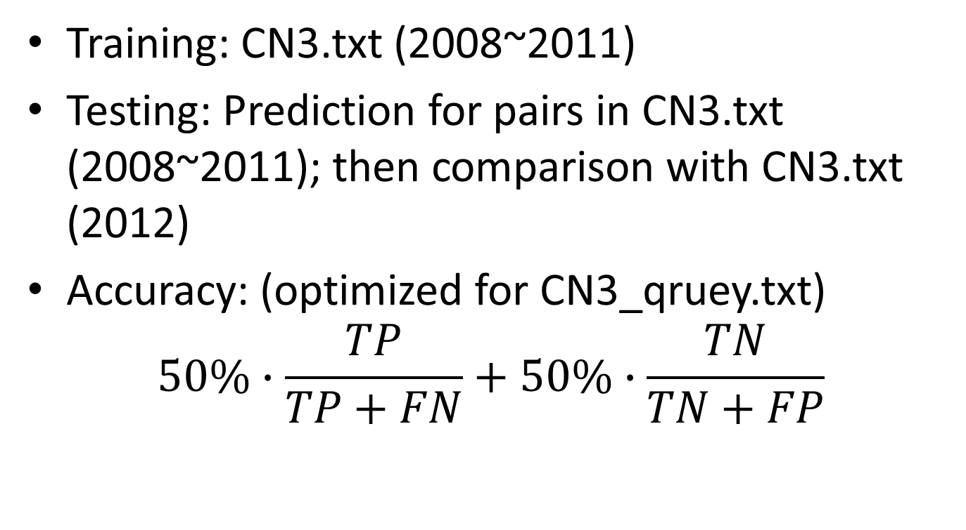
Our Framework
Training: CN3.txt (2008~2011)
Testing: Prediction for pairs in CN3.txt (2008~2011); then comparison with CN3.txt (2012)
Accuracy: (optimized for CN3_qruey.txt) $50\%∙\frac{TP}{TP+FN}+50\%∙\frac{TN}{TN+FP}$

Slide 10
Result

Slide 11
Time Decay

Slide 12
Parameter c

Slide 13
Difficulties Encountered
Memory issues
Adjacency list instead of adjacency matrix
Problem characteristic
All testing pairs were linked before
Many features do not work (e.g. shortest path)

Slide 14
Summary
Most important feature

