Slide 1
Protype
Text content feed in
Table Image feed in
Plot on PDF
Return image
Return text position
PRD
Content
Script
LaTeX
Post-Processing
scrapy
Images & Annotations
TeX Engine
NLG
XeTex Script Generator
PDF/IMG Proc
Script Parsing
GPT2
Format
Table
Figure
Encoding
Text bounding box
Table Position
Figure Position
Text Content Infomation
Scigen
Font
Generation
Rmarkdown book
Imagemagick++
GraphViz alike
PG
Redis
Docker
TF/TORCH

Slide 2
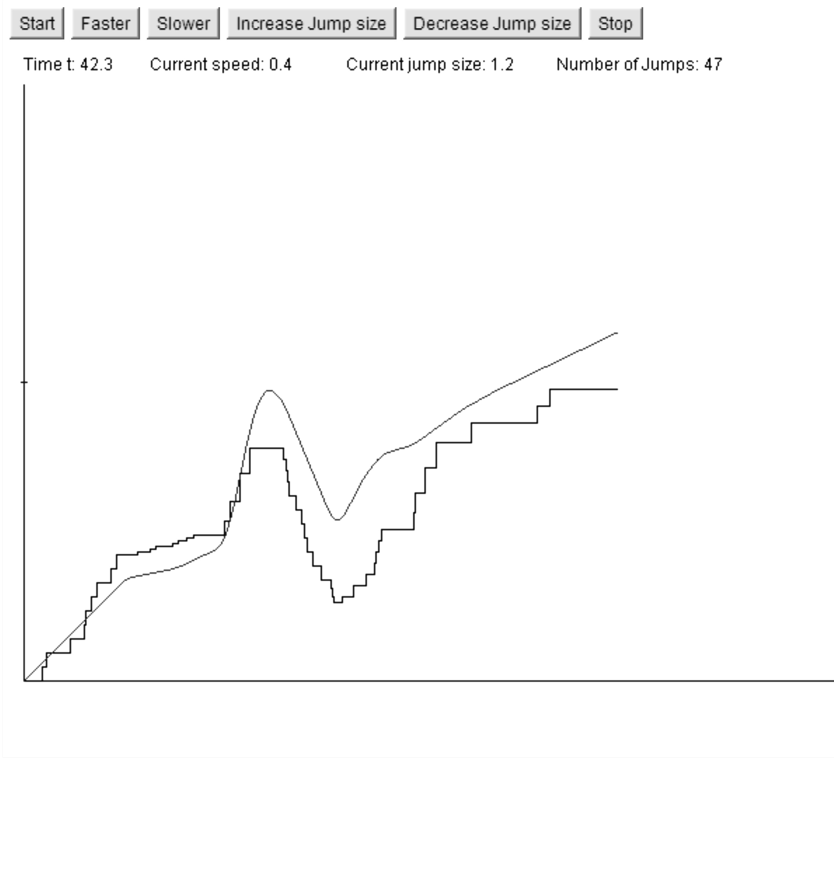

Slide 4
