Slide 1
Multimodal Sensing-Assisted User Association and Tracking in Vehicular Networks
Yifeng YUAN · MPhil in Internet of Things
Supervisors: Shijian GAO and Jia YAN · June 2026

Slide 2
V2I Beam Alignment
Narrow beams provide the array gain required by high-frequency V2I links, but vehicle motion, blockage, and path evolution rapidly age beam and CSI information.
Repeated SSB and CSI-RS measurements improve reliability. The same measurements consume resources otherwise available for data. Measurement reliability ↔ Measurement overhead

Slide 3
Target-to-User Association
A target-level beam prediction is useful only when it is applied to the intended communication user.
SENSING DOMAIN
Physical vehicles
Detections
Perception tracks
COMMUNICATION DOMAIN
VUE identities
Beam measurements
Downlink transmission
Which track corresponds to which VUE?
Visible vehicles, active VUEs, and maintained tracks are not naturally one-to-one.

Slide 4
Research Objectives and Contributions
Objective Close the sensing-to-communication loop while reducing beam-measurement overhead and preserving user-specific decisions.
1 Distributed multimodal BEV perception and beam prediction Joint vehicle detection and per-target CSI beam classification. 2 Target-to-user association with IMM-based tracking Beam measurements establish associations; tracking preserves target continuity. 3 Multimodal V2I simulation and NR-oriented evaluation One chain connects sensing use, fallback, overhead, and effective user rate.
Perception → Association → Communication evaluation

Slide 5
System Model
01
What information is available to the BS, and how does a beam candidate affect user rate?

Slide 6
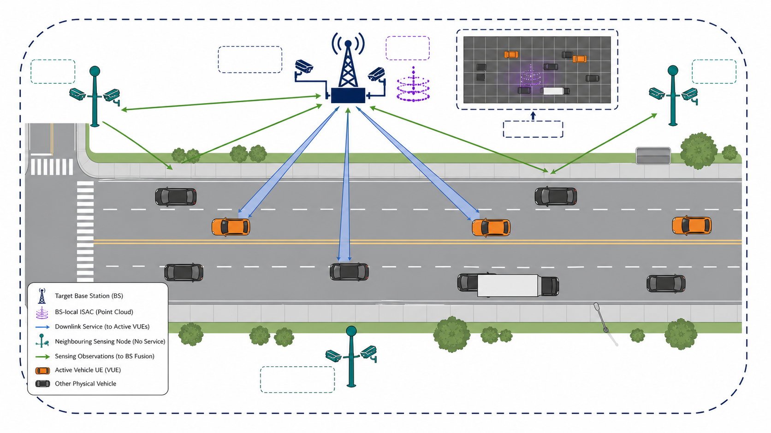
Network and Sensing Model
The target BS combines BS-local ISAC sensing with distributed camera coverage from neighbouring sensing nodes.
Target BS b serves U_b[n] Neighbouring nodes add viewpoints but not communication cells All inputs are aligned in the target-BS BEV frame O_b,n = {I_b,n, I_Nb,n, P_b,n}

Slide 7
Communication and Rate Model
Candidate beams affect both the measured channel and the resources remaining for data transmission.
SSB coarse direction → CSI-RS candidate measurement → CSI feedback → RZF precoding and data Selected measured beam k* = arg maxₖ γ̂ᶜˢⁱ(k), k ∈ 𝒞(b,u,n) Effective user rate Rᵉᶠᶠ = ηdata B ηDL log₂(1 + γRZF)
Missing a useful beam reduces SINR; measuring fewer successful candidates increases the data-resource fraction.

Slide 8
Design Requirements
A sensing-assisted beam-management policy must respect three information boundaries.
1 TARGET-LEVEL PREDICTION Predict beams for an observed physical target, not a known VUE. 2 MEASUREMENT-GROUNDED ASSOCIATION Establish which perception track belongs to each VUE. 3 MEASURED SERVICE-BEAM SELECTION Use sensing to narrow CSI-RS candidates; use measured quality to select service.
No oracle VUE identity · No direct service-beam declaration

Slide 9
Proposed Framework
02
How does unbound sensing evidence become a VUE-specific CSI-RS decision?

Slide 10
DMSA-BM Architecture
1 DISTRIBUTED MULTIMODAL PERCEPTION
Cameras + BS-local ISAC
Vehicle detections
Per-target beam posteriors
2 IMM-BASED TRACKING
CV and CT motion models
Detection-to-track assignment
Physical-target continuity
3 TARGET-TO-USER ASSOCIATION
VUE-indexed beam measurements
One-to-one matching
Accepted or unmatched
4 CANDIDATE MEASUREMENT
Accepted + observed
Top-K predicted beams
Otherwise
SSB-guided refinement
Multimodal observations → detections and beam posteriors → physical-target tracks → VUE-track associations → CSI-RS candidates

Slide 11
Cross-Node Fusion
Cross-node attention selects complementary viewpoints at each BEV location while preserving the target-BS perspective.
Target-BS BEV
Node 1 BEV
Node 2 BEV
···
Validity masks
GEOMETRY-AWARE
MASKED ATTENTION
αⱼ(x) = softmaxⱼ
[q(x)ᵀkⱼ(x)/√d + b(gⱼ→b)]
Target-BS-centred
distributed camera BEV
Neighbouring evidence dominates only where valid.
Target-BS-conditioned queries preserve the serving-link view; geometry-aware keys distinguish node locations; masks exclude invalid projections.

Slide 12
Multimodal Fusion
Gated local and global attention adapt camera–ISAC fusion to spatial and scene-wide observation conditions.
CAMERA BEV
Semantics and visibility
ISAC BEV
Complementary geometry
GATED ATTENTION
βq(x) ∝ exp
[ℓlocal,q(x) + ℓglobal,q]
Availability mask
FUSED BEV
Local weights respond to occlusion and sparsity.
Global weights respond to illumination and visibility.
The fusion weights are learned from sensing features; availability masks only exclude missing inputs.

Slide 13
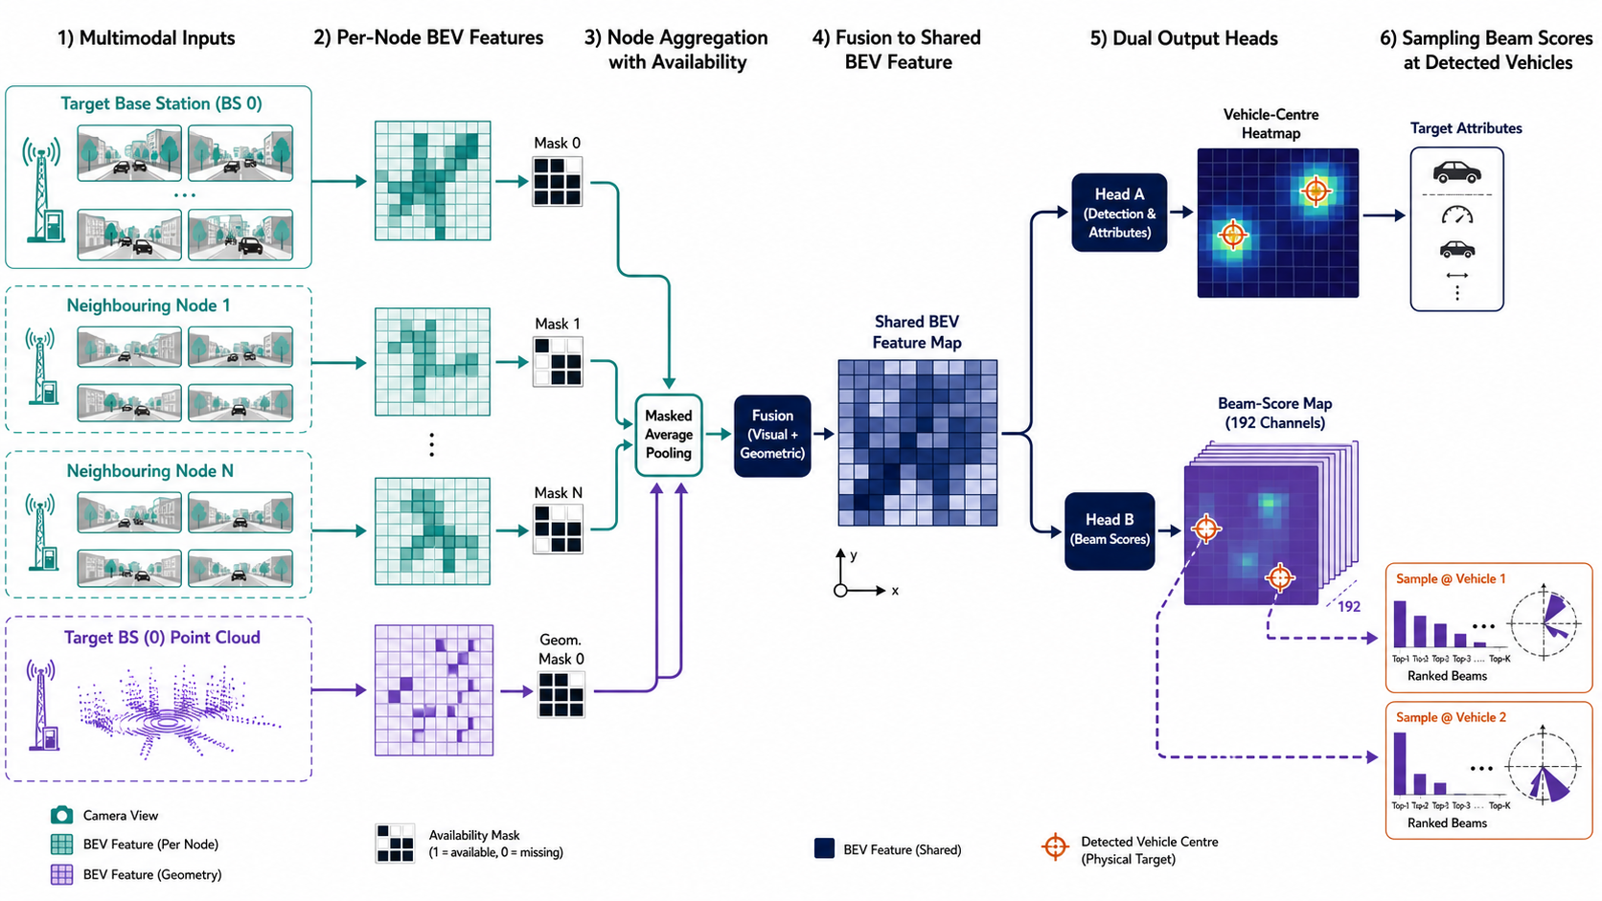
Joint Detection and Beam Prediction
A shared BEV representation produces vehicle detections and a per-target posterior over 192 CSI beams.
Detection output r̂ᵢ, attributes, confidence Beam output pᵢ = softmax(logits at r̂ᵢ) Training Top-1 cross-entropy Use Full posterior retained for ranking

Slide 14
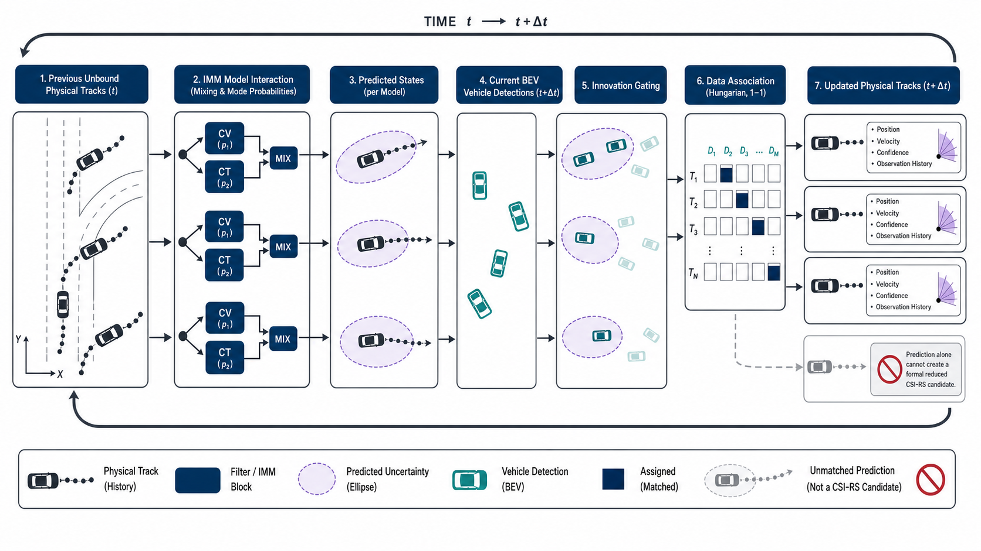
IMM-Based Tracking
IMM estimation preserves physical-target continuity across straight and turning motion.
CV state [x, y, vₓ, vᵧ]ᵀ CT state [x, y, v, ψ, ω]ᵀ IMM cycle Mix → predict/update → mode likelihood → fuse Mahalanobis gating + Hungarian assignment

Slide 15
Initial Target-to-User Association
Conventional beam measurements anchor the mapping between VUE identities and currently observed tracks.
VUE-INDEXED EVIDENCE
VUE 1 measured beam κ₁
VUE 2 measured beam κ₂
···
VUE U measured beam κᵤ
Serving SSB parent
TRACK-INDEXED POSTERIORS
cᵤᵣ = −log[pᵣ(κᵤ)+ε]
──────────────
log MCSI
Filter infeasible pairs
Form bipartite cost matrix
ONE-TO-ONE ASSIGNMENT
Hungarian matching
+ unmatched option
Accept only if
• cost ≤ threshold
• margin ≥ threshold
Otherwise remain unbound
Feasible pair Current observation SSB-parent consistency Accepted association Low cost + sufficient margin One-to-one assignment Unmatched option retained

Slide 16
Candidate Beam Selection
Only an accepted association with a current observation can reduce the CSI-RS scan.
Accepted VUE–track pair
AND
current target observation?
YES
Top-K posterior beams
or adaptive cumulative-mass set
(minimum Top-1)
NO
SSB-guided CSI-RS refinement
(conventional fallback)
In both branches, the service beam is selected from measured CSI-RS quality.

Slide 17
Algorithm Summary
The framework separates sensing computation from air-interface measurement cost.
1 Construct distributed multimodal BEV features. 2 Decode detections and beam-class posteriors. 3 Predict, assign, and update physical-target tracks. 4 Reassociate only when an association event occurs. 5 Select sensing-derived or SSB-guided CSI-RS candidates.
Scaling drivers Views and BEV resolution · targets and tracks · assignment size · M_CSI · K_scan

Slide 18
Experimental Evaluation
03
Does the complete decision chain improve communication performance after measurement cost is included?

Slide 19
Experimental Setup
A common multimodal and communication protocol links perception results to effective user rate.
SCENARIOS
Four roadside BSs
Clear
Rain/Fog
Night
Disjoint train, validation, and test sequences
MULTIMODAL DATA
Target-BS cameras
Neighbouring-node cameras
BS-local ISAC point clouds
Vehicle trajectories
Ray-traced channels
RADIO PROFILE
48 SSB beams
192 CSI-RS beams
SSB period 100 ms
CSI-RS period 20 ms
Common power, noise, Doppler, RZF, and overhead accounting
EVALUATION CHAIN
Detection
→ Beam ranking
→ Association-conditioned use
→ CSI-RS overhead
→ Effective user rate
Rain/Fog margin is a fixed test-tuned operating point.

Slide 20
Perception and Beam Prediction
Distributed multimodal attention improves target availability without uniformly dominating every beam-ranking metric.
Blue Distributed multimodal attention
Gray Local camera–ISAC fusion
Proposed
AP 78.73%
Recall 81.51%
Top-4 power ratio 97.01%
Local fusion
Top-1 71.54%
Top-4 94.66%
Target observability and beam ranking are distinct objectives.

Slide 21
Cooperative Sensing Nodes
Additional roadside viewpoints primarily improve detection and localisation.
Blue AP@2m Orange Recall@2m Olive Beam Top-4@2m Fixed trained model Available nodes varied only at test time 0 → 5 nodes AP 38.59% → 80.41% Recall 52.34% → 83.15% Beam Top-4 approaches saturation.

Slide 22
Ablation and Tracking Results
Local multimodal complementarity provides most of the gain; distributed sensing improves the final operating point.
CSI-RS overhead Camera 1.86% ISAC 1.81% Local fusion 1.80% DMSA-BM 1.56% Tracker check IMM 146.332 KF-CV 146.373 KF-CT 145.880 Mbps Similar rates do not establish universal IMM superiority.

Slide 23
Conclusion
04
What has been established, and what remains before deployment?

Slide 24
Conclusions and Future Work
Distributed sensing becomes useful for beam management through a user-specific measurement interface.
□ Distributed multimodal BEV perception jointly detects vehicles and ranks per-target CSI beams. □ IMM tracking preserves physical-target continuity without treating a track as a VUE identity. □ Beam measurements establish target-to-user associations; only accepted, currently observed pairs reduce CSI-RS scanning. □ Under the stated operating point, DMSA-BM achieves 146.332 Mbps with 1.56% CSI-RS overhead.
NEXT STEPS Real-world validation Protocol-level NR evaluation Online and domain adaptation Cooperative multi-BS association QUESTIONS AND DISCUSSION

