Slide 1
Multimodal Sensing-Assisted User Association and Tracking in Vehicular Networks
Yifeng YUAN · MPhil in Internet of Things
Supervisors: Shijian GAO and Jia YAN · June 2026
Notes:
Introduce the thesis question: when can roadside sensing safely reduce beam measurements for the intended V2I user?

Slide 2
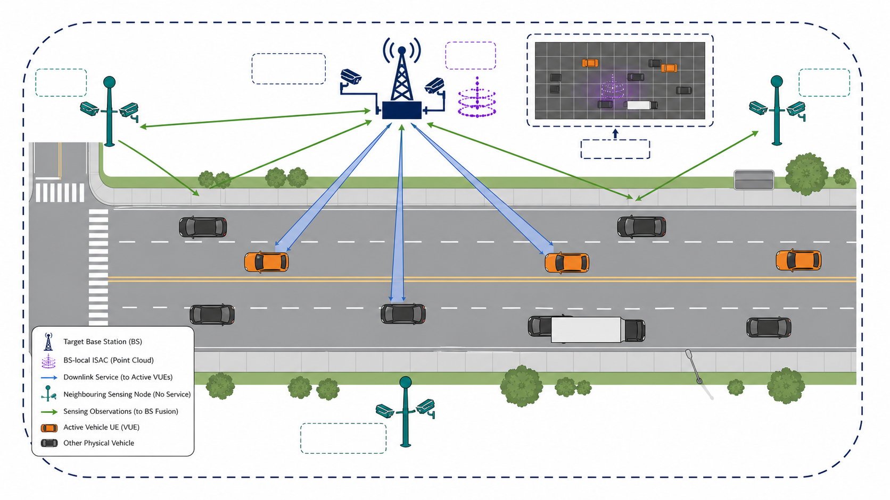
Background
Connected mobility and intelligent transportation rely on reliable V2I connectivity.
Vehicular networks connect moving vehicles, roadside infrastructure, and network services.
Roadside operating conditions
High mobility · rapidly changing geometry · intermittent blockage
Communication requirements
High data rate · low latency · reliable connectivity
Notes:
Start from the application setting. Vehicular networks must support high-throughput, low-latency, reliable roadside connectivity despite fast motion and changing geometry.

Slide 3
V2I Beam Management Problem
High-frequency V2I links use narrow beams to obtain array gain. Mobility, blockage, and path evolution rapidly age beam information.
SSB access
CSI-RS candidates
CSI feedback
Data transmission
More frequent or wider CSI-RS measurements improve alignment reliability, but consume time-frequency resources.
Measurement reliability ↔ Measurement overhead
Notes:
Explain that narrow beams are valuable but require recurrent SSB and CSI-RS actions. The tension is reliable alignment versus measurement overhead.

Slide 4
Sensing-Assisted Beam Prediction: Single-Candidate Scenario
Multimodal sensing can predict or rank beams for a known physical target.
Camera · position · radar · LiDAR → physical-scene observations
Known physical target
Multimodal scene observation
Top-K beam candidates
Single-candidate assumption: a specified or visually isolated target is treated as the intended communication user.
Beam prediction: fθ(O[n]) → Top-K candidates
Prediction narrows the CSI-RS search; measured CSI quality selects the service beam.
Notes:
Explain the common single-candidate formulation: once the physical target is known, multimodal scene observations can produce a short beam list.

Slide 5
Sensing-Assisted Beam Prediction: Multi-Candidate Scenario
When several vehicles are visible, prediction must first identify the intended transmitter.
User-conditioned prediction: fθ(O[n], g[u,n]) → VUE-specific Top-K beams
Multiple visible vehicles
Sensing + user side information
VUE-specific Top-K beams
O[n]: scene-level sensing observations
g[u,n]: location or other user-specific side information
Location can be unavailable, inaccurate, stale, or misaligned.
Candidate scoring is conditioned on every active VUE.
Whose candidate list is it?
Notes:
Now remove the single-target assumption. With multiple visible vehicles, the prediction must be conditioned on the intended VUE, often using location or another side-information cue.

Slide 6
Sensing-Target-to-User Association
Sensing observes physical vehicles, while beam management serves VUE identities.
SENSING DOMAIN
Physical vehicles
Detections
Perception tracks
Target-level beam posteriors
COMMUNICATION DOMAIN
VUE identities
SSB / CSI-RS measurements
User-specific downlink
Which sensing target provides candidate beams for VUE u?
A visible vehicle may not be active; the intended VUE may be unobserved; several targets may be plausible.
Notes:
Emphasise the domain mismatch: perception names physical targets, while communication schedules VUE identities. This slide defines the association problem; it does not yet propose the tracker.

Slide 7
Research Objectives and Contributions
Objective Reduce CSI-RS measurement overhead while preserving user-specific beam-management decisions.
1 Distributed multimodal BEV perception for joint vehicle detection and beam prediction
Multi-view cameras + BS-local ISAC yield vehicle detections and per-target beam posteriors.
2 Measurement-assisted target-to-user association and tracking
VUE-indexed beam measurements establish credible UE-track pairs.
3 NR-oriented end-to-end evaluation
Sensing use, fallback, CSI-RS overhead, and effective user rate are evaluated together.
Perception → Association → User-specific beam management
Notes:
State the three contributions in order: joint BEV perception and beam prediction, measurement-assisted association and tracking, then end-to-end communication evaluation.

Slide 8
System Model
01
What information is available to the BS, and how does a beam candidate affect user rate?
Notes:
Transition to the system model. The next three slides define what information is available and what a valid beam-management action must respect.

Slide 9
Network Architecture and Information Domains
Target BS b makes local decisions; neighbours only extend sensing coverage.
Communication: identified VUEs u ∈ U_b[n] | Sensing: unlabelled physical targets
U_b[n]: VUEs served by b • N_b: sensing-only neighbours • BEV: target-BS-centred
Notes:
Define the local architecture before introducing sensing equations. The target BS serves the VUE set U_b[n] and makes every communication decision. Neighbouring nodes only add camera viewpoints. The key distinction is that communication identifiers refer to VUEs, whereas sensing observes unlabelled physical targets; all evidence is aligned in the target-BS BEV frame.

Slide 10
ISAC Sensing Model
Known ISAC symbols enable BS-local extraction of dynamic vehicle evidence from static clutter.
Known transmission
xᶳᵉⁿ_{b,n}[p,l] = √Pᶳᵉⁿ_{b,n} fᶳᵉⁿ_{b,n}[p,l] sᶳᵉⁿ_{b,n}[p,l]
Echo model
yᵉᶜʰᵒ_{b,n}[p,l] = (Hˢᵗᵃ_b[p] + Hᵈʸⁿ_{b,n}[p,l]) xᶳᵉⁿ_{b,n}[p,l] + zᶳᵉⁿ_{b,n}[p,l]
H̃_{b,n} = Ĥᵉᶜʰᵒ_{b,n} − Ĥˢᵗᵃ_b → Z_{b,n}(ρ, θ, ν) = Tᴿᴬᴰ(H̃_{b,n}), |Z_{b,n}|² > ηᶜᶠᴬᴿ_{b,n}
Output: P_{b,n} = {(q_{b,m,n}, a_{b,m,n})}ᵐ⁼¹ᴺ ᵖᶜ_{b,n}
Notes:
Follow the physical sensing chain. Known ISAC symbols are transmitted through a sensing beam. The echo consists of static and vehicle-related dynamic components. After estimating and subtracting the static background, range-angle-Doppler processing and CFAR retain the cells that form the BS-local point cloud P_b,n.

Slide 11
Downlink Communication Model
From multi-user data streams to CSI-RS-based equivalent-channel feedback.
1. Multi-user downlink
x_{b,n} = Σ_{u∈𝒰_b[n]} √P_{b,u,n} w_{b,u,n} s_{b,u,n}
2. CSI-RS scan over a candidate set |𝒞_{b,u,n}| = K
yᶜˢᴵ_{b,u,k,n}[l] = √Pᶜˢᴵ_{b,k,n} (hᴴ_{b,u,n}fᶜˢᴵ_{b,k}) c_{b,k,n}[l] + zᶜˢᴵ_{b,u,k,n}[l] , hᵉᵠ_{b,u,k,n} = hᴴ_{b,u,n}fᶜˢᴵ_{b,k}
k*_{b,u,n} = arg max_{k∈𝒞_{b,u,n}} γ̂ᶜˢᴵ_{b,u,k,n} , ĥᵉᵠ_{b,u,k*,n} = Corr(yᶜˢᴵ_{b,u,k*,n}, c_{b,k*,n})
3. Hybrid RZF construction
Fᴿᶠ_b[n] = [fᶜˢᴵ_{b,k*_{b,u₁,n}}, …, fᶜˢᴵ_{b,k*_{b,u|𝒰_b[n]|,n}}]
Vᴿᶻᶠ_b[n] = Ĥᵉᶠᶠᴴ_b[n](Ĥᵉᶠᶠ_b[n] Ĥᵉᶠᶠᴴ_b[n] + λ_b I)⁻¹D_b[n]
Wᴿᶻᶠ_b[n] = Fᴿᶠ_b[n]Vᴿᶻᶠ_b[n]
Notes:
First, the target BS transmits independent data streams to all VUEs. For every VUE, CSI-RS beams are then scanned only within the candidate set C, whose width is K. The VUE selects the measured beam with the largest reported CSI-RS quality and estimates its equivalent channel by correlating the reference observation with the known CSI-RS symbol. These feedback-based equivalent-channel estimates build the RF beam matrix and the digital RZF precoder; thus sensing can narrow C but never replaces CSI-RS feedback.

Slide 12
Downlink Communication Model
The selected hybrid precoder determines both downlink quality and beam-management cost.
1. Precoded received signal
y_{b,u,n} = √P_{b,u,n} hᴴ_{b,u,n}wᴿᶻᶠ_{b,u,n}s_{b,u,n}
+ Σ_{v∈𝒰_b[n],v≠u} √P_{b,v,n} hᴴ_{b,u,n}wᴿᶻᶠ_{b,v,n}s_{b,v,n} + z_{b,u,n}
2. Post-RZF SINR and achievable rate
γᴿᶻᶠ_{b,u,n} = P_{b,u,n}|hᴴ_{b,u,n}wᴿᶻᶠ_{b,u,n}|² / [Σ_{v≠u}P_{b,v,n}|hᴴ_{b,u,n}wᴿᶻᶠ_{b,v,n}|² + σ²_{b,u,n}]
Rᴰᴸ_{b,u,n} = B_bηᴰᴸ_b log₂(1 + γᴿᶻᶠ_{b,u,n})
3. Beam-management resources and effective rate
τᵗᵒᵗ_{b,n} = τˢˢᴮ_{b,n} + τᶜˢᴵ⁻ᴿˢ_{b,n} + τᶜᵗʳˡ_{b,n} + τᵈᵃᵗᵃ_{b,n}
τᶜˢᴵ⁻ᴿˢ_{b,n} = Σ_{e∈𝓔_b[n]} ⌈K_e/M⌉δᵖʳᵒᵇᵉ , ηᵈᵃᵗᵃ_{b,n} = τᵈᵃᵗᵃ_{b,n}/τᵗᵒᵗ_{b,n}
Rᵉᶠᶠ_{b,u,n} = ηᵈᵃᵗᵃ_{b,n}Rᴰᴸ_{b,u,n} = ηᵈᵃᵗᵃ_{b,n}B_bηᴰᴸ_b log₂(1 + γᴿᶻᶠ_{b,u,n})
Notes:
The hybrid RZF precoder from the previous slide now determines the received signal: desired data, residual multi-user interference, and noise. This produces the post-RZF SINR and the gross downlink rate. Separately, measuring K_e CSI-RS beams consumes resource in acquisition event e; after SSB, CSI-RS, control, and data allocations, eta-data is the remaining data fraction. Effective rate multiplies gross rate by this remaining fraction, exposing the beam-quality versus measurement-overhead trade-off.

Slide 13
Design Requirements
A sensing-assisted beam-management policy must respect three information boundaries.
1 TARGET-LEVEL PREDICTION Predict beams for an observed physical target, not a known VUE. 2 MEASUREMENT-GROUNDED ASSOCIATION Establish which perception track belongs to each VUE. 3 MEASURED SERVICE-BEAM SELECTION Use sensing to narrow CSI-RS candidates; use measured quality to select service.
No oracle VUE identity · No direct service-beam declaration
Notes:
Use these requirements as guardrails: target observability, association correctness, and conservative fallback when the evidence is insufficient.

Slide 14
Proposed Framework
02
How does unbound sensing evidence become a VUE-specific CSI-RS decision?
Notes:
Introduce DMSA-BM as the framework that connects perception evidence to a user-specific candidate measurement decision.

Slide 15
DMSA-BM Architecture
1 DISTRIBUTED MULTIMODAL PERCEPTION
Cameras + BS-local ISAC
Vehicle detections
Per-target beam posteriors
2 IMM-BASED TRACKING
CV and CT motion models
Detection-to-track assignment
Physical-target continuity
3 TARGET-TO-USER ASSOCIATION
VUE-indexed beam measurements
One-to-one matching
Accepted or unmatched
4 CANDIDATE MEASUREMENT
Accepted + observed
Top-K predicted beams
Otherwise
SSB-guided refinement
Multimodal observations → detections and beam posteriors → physical-target tracks → VUE-track associations → CSI-RS candidates
Notes:
Walk left to right through the architecture: distributed sensing, BEV fusion, joint target output, tracking, association, and candidate selection.

Slide 16
Cross-Node Fusion
Cross-node attention selects complementary viewpoints at each BEV location while preserving the target-BS perspective.
Target-BS BEV
Node 1 BEV
Node 2 BEV
···
Validity masks
GEOMETRY-AWARE
MASKED ATTENTION
αⱼ(x) = softmaxⱼ
[q(x)ᵀkⱼ(x)/√d + b(gⱼ→b)]
Target-BS-centred
distributed camera BEV
Neighbouring evidence dominates only where valid.
Target-BS-conditioned queries preserve the serving-link view; geometry-aware keys distinguish node locations; masks exclude invalid projections.
Notes:
Explain why neighbouring viewpoints improve observability without creating additional communication cells. All evidence is fused in the target-BS BEV frame.

Slide 17
Multimodal Fusion
Gated local and global attention adapt camera–ISAC fusion to spatial and scene-wide observation conditions.
CAMERA BEV
Semantics and visibility
ISAC BEV
Complementary geometry
GATED ATTENTION
βq(x) ∝ exp
[ℓlocal,q(x) + ℓglobal,q]
Availability mask
FUSED BEV
Local weights respond to occlusion and sparsity.
Global weights respond to illumination and visibility.
The fusion weights are learned from sensing features; availability masks only exclude missing inputs.
Notes:
Describe local camera and ISAC fusion as complementary inputs before cross-node BEV fusion.

Slide 18
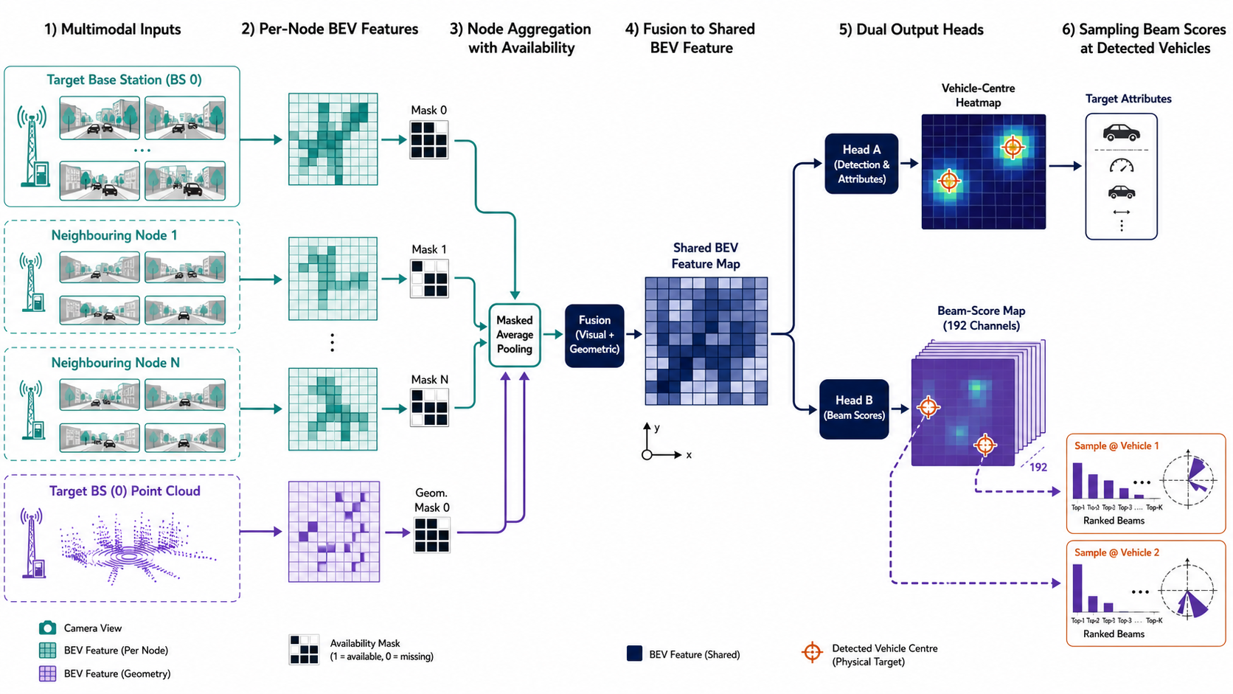
Joint Detection and Beam Prediction
A shared BEV representation produces vehicle detections and a per-target posterior over 192 CSI beams.
Detection output r̂ᵢ, attributes, confidence Beam output pᵢ = softmax(logits at r̂ᵢ) Training Top-1 cross-entropy Use Full posterior retained for ranking
Notes:
Highlight the joint output: vehicle detections and a beam posterior for every detected target, rather than a beam chosen without a physical target.

Slide 19
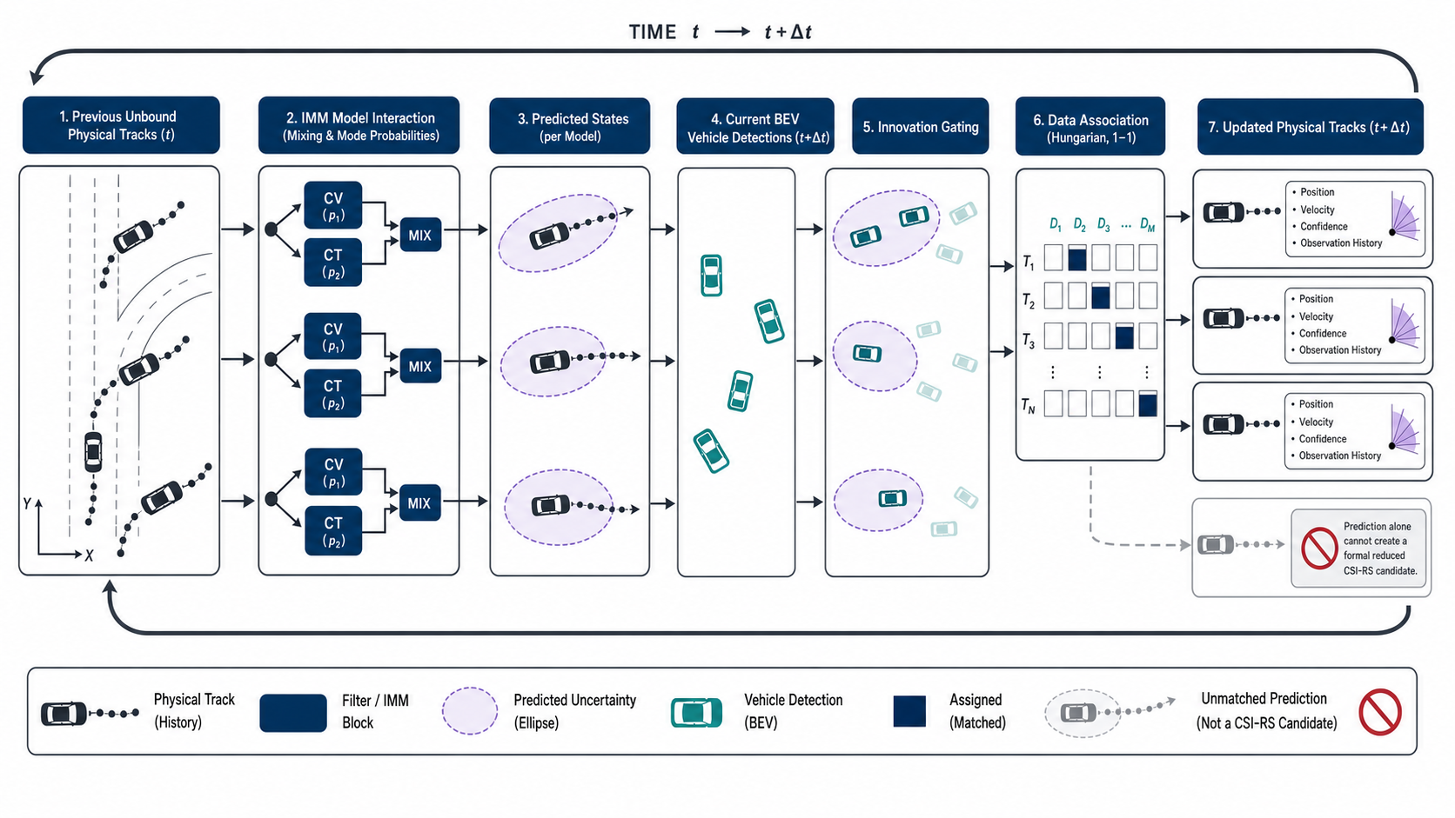
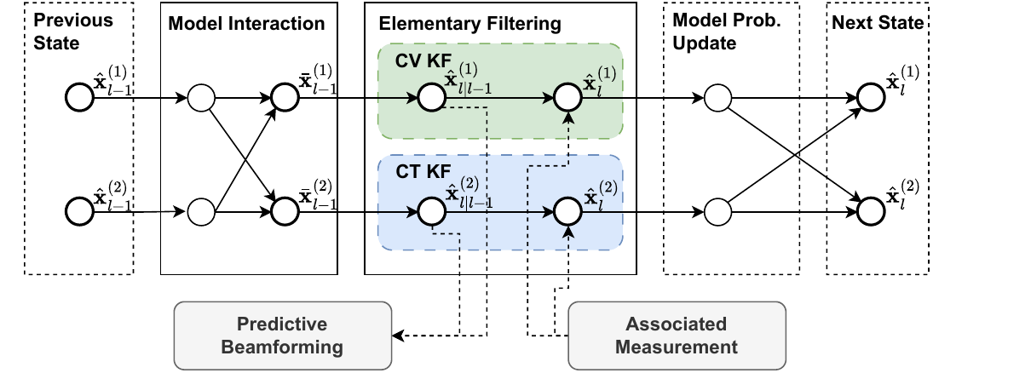
IMM-Based Physical-Target Tracking
IMM estimation maintains physical-target continuity across straight and turning motion.
CV model
CT model
x^(CV) = [x, y, v_x, v_y]^T
x^(CT) = [x, y, v, ψ, ω]^T
Model-posterior update
μ^(ℓ)_(r,n) = [Λ^(ℓ)_(r,i,n) μ̄^(ℓ)_(r,n)] / [Σ_(j∈{CV, CT}) Λ^(j)_(r,i,n) μ̄^(j)_(r,n)]
μ̄: model probability after mixing
μ^(ℓ)_(r,n) ∝ Λ^(ℓ)_(r,i,n) μ̄^(ℓ)_(r,n)
Mix → model-conditioned filtering → likelihood reweighting → fused physical-target state
Notes:
Introduce the tracker as a physical-target state estimator, not a VUE-identity estimator. Contrast the CV and CT state vectors, then explain that innovation likelihood updates the model posterior. Use the bottom diagram only to orient the IMM cycle. Predicted-only tracks preserve continuity but cannot reduce the CSI-RS scan.

Slide 20
Measurement-Grounded Target–User Association
Beam-measurement agreement links a VUE to a currently observed physical track.
1 Compatibility from a VUE-indexed beam measurement
c^assoc_(u,r,n) = − log[p^obs_(r,n)(κ_(b,u,n))+ε] / log M_CSI
Lower cost ⇔ stronger agreement between the VUE measurement and the current track posterior.
2 Partial one-to-one assignment with an unmatched option
σ̂ = arg min_σ Σ_(u∈U^evt_b[n]) c^assoc_(u,σ(u),n), σ(u)∈R^obs_(b,n) ∪ {∅}
Feasible edges: current observation + SSB-parent consistency; real tracks are one-to-one.
3 Accept only when the match is confident
A_(u,r,n) = 1{ c^assoc_(u,r,n) ≤ τ_assoc, Δ_(u,r,n) ≥ τ_margin }
∅ and Δ prevent forced ambiguous matching.
Notes:
Explain the three equations in order: beam-measurement compatibility cost, partial one-to-one assignment with an unmatched option, and cost-plus-margin acceptance. Stress that the procedure uses a conventional VUE-indexed measurement and a current track posterior, without user location or ground-truth identities.

Slide 21
Association-Gated Beam Candidate Selection
A sensing posterior reduces CSI-RS scanning only when the VUE–track mapping is accepted and current.
1 Candidate-use gate
G_(u,n) = A_(u,r,n), if π_(b,n)(u) = r ∈ R^obs_(b,n)
G_(u,n) = 0, otherwise
A predicted-only track gives G=0 and cannot reduce the measurement set.
2 Measurement-set policy
C_(b,u,n) = TopK_Kscan(p^obs_(π_(b,n)(u),n)), G_(u,n)=1
C_(b,u,n) = C^ref_(b,u,n)(K_ref), G_(u,n)=0
Adaptive width: choose the smallest Kscan whose leading posterior mass reaches ζ.
Measurement safeguard
The posterior ranks CSI-RS candidates; the service beam is selected from measured CSI-RS quality.
Notes:
Explain that candidate reduction requires both an accepted target-to-user association and a current observation. A predicted-only track makes the gate zero and triggers conventional SSB-guided refinement. The posterior ranks measurement candidates only; the service beam remains selected from measured CSI-RS quality.

Slide 22
Algorithm Summary
The framework separates sensing computation from air-interface measurement cost.
1 Construct distributed multimodal BEV features. 2 Decode detections and beam-class posteriors. 3 Predict, assign, and update physical-target tracks. 4 Reassociate only when an association event occurs. 5 Select sensing-derived or SSB-guided CSI-RS candidates.
Scaling drivers Views and BEV resolution · targets and tracks · assignment size · M_CSI · K_scan
Notes:
Summarise the full decision loop and identify the guarded interface between sensing evidence and CSI-RS measurement.

Slide 23
Experimental Evaluation
03
Does the complete decision chain improve communication performance after measurement cost is included?
Notes:
Transition from method to evidence. The question is whether the complete chain improves the stated communication operating point.

Slide 24
Experimental Setup
A common multimodal and communication protocol links perception results to effective user rate.
SCENARIOS
Four roadside BSs
Clear
Rain/Fog
Night
Disjoint train, validation, and test sequences
MULTIMODAL DATA
Target-BS cameras
Neighbouring-node cameras
BS-local ISAC point clouds
Vehicle trajectories
Ray-traced channels
RADIO PROFILE
48 SSB beams
192 CSI-RS beams
SSB period 100 ms
CSI-RS period 20 ms
Common power, noise, Doppler, RZF, and overhead accounting
EVALUATION CHAIN
Detection
→ Beam ranking
→ Association-conditioned use
→ CSI-RS overhead
→ Effective user rate
Rain/Fog margin is a fixed test-tuned operating point.
Notes:
Briefly state the scenario, modalities, channel and protocol assumptions, and the metrics reported on the following slides.

Slide 25
Perception and Beam Prediction
Distributed multimodal attention improves target availability without uniformly dominating every beam-ranking metric.
Blue Distributed multimodal attention
Gray Local camera–ISAC fusion
Proposed
AP 78.73%
Recall 81.51%
Top-4 power ratio 97.01%
Local fusion
Top-1 71.54%
Top-4 94.66%
Target observability and beam ranking are distinct objectives.
Notes:
Explain the perception and per-target beam-prediction results, distinguishing detection quality from communication-level decisions.

Slide 26
Cooperative Sensing Nodes
Additional roadside viewpoints primarily improve detection and localisation.
Blue AP@2m Orange Recall@2m Olive Beam Top-4@2m Fixed trained model Available nodes varied only at test time 0 → 5 nodes AP 38.59% → 80.41% Recall 52.34% → 83.15% Beam Top-4 approaches saturation.
Notes:
Explain the contribution of cooperative sensing nodes under the reported viewpoints and conditions.

Slide 27
Communication Performance
DMSA-BM achieves the highest reported effective user rate with the lowest CSI-RS overhead among the compared schemes.
CSI-RS overhead
SSB-guided, Kref = 4 1.90%
SSB-guided, Kref = 12 5.71%
DMSA-BM 1.56%
Sensing use
Clear 76.35% · Rain/Fog 56.65% · Night 30.07%
Fallback: retain SSB-guided refinement when sensing is not used.
Notes:
Use this slide to read the communication result directly: DMSA-BM combines the lowest reported CSI-RS overhead with the highest reported effective user rate among the compared schemes.

Slide 28
Ablation and Tracking Results
Local multimodal complementarity provides most of the gain; distributed sensing improves the final operating point.
CSI-RS overhead Camera 1.86% ISAC 1.81% Local fusion 1.80% DMSA-BM 1.56% Tracker check IMM 146.332 KF-CV 146.373 KF-CT 145.880 Mbps Similar rates do not establish universal IMM superiority.
Notes:
Interpret ablation and tracker comparisons cautiously: the result identifies the reported operating point rather than a universal ordering.

Slide 29
Conclusion
04
What has been established, and what remains before deployment?
Notes:
Recap what has been established before the final slide: the association gate is the bridge between target-level sensing and VUE-specific measurement.

Slide 30
Conclusions and Future Work
Distributed sensing becomes useful for beam management through a user-specific measurement interface.
□ Distributed multimodal BEV perception jointly detects vehicles and ranks per-target CSI beams. □ IMM tracking preserves physical-target continuity without treating a track as a VUE identity. □ Beam measurements establish target-to-user associations; only accepted, currently observed pairs reduce CSI-RS scanning. □ Under the stated operating point, DMSA-BM achieves 146.332 Mbps with 1.56% CSI-RS overhead.
NEXT STEPS Real-world validation Protocol-level NR evaluation Online and domain adaptation Cooperative multi-BS association QUESTIONS AND DISCUSSION
Notes:
Close with the central conclusion and the stated future-work directions, then pause for questions.

