Slide 1


Open Model Hub: A Database for Models and Datasets
LIN, Yufeng 123090342 TENG, Yimeng 123090540
LIN, Wentao 123090337 GAN, Linyong 123090120
LIU, Yuxuan 123090377 ZHANG, Shuhan 123090823
ZHENG, Zirun 123090891

Slide 2
Motivation
- We are motivated by huggingface (https://huggingface.co/), one of the most influential platform in the AI community that facilitates the sharing and collaboration of machine learning models and datasets.
- Therefore, we want to build a database to store models and datasets, with a graphic interface for user and administrators to perform a variety of operations, including uploading/downloading models and datasets, making efficient queries with the help of an AI agent. Security is also guaranteed by encryption.

Slide 3
Basic Entities
model
User
Dataset
Affiliation

Slide 4
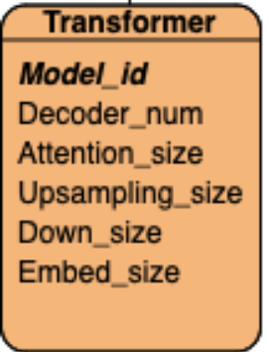
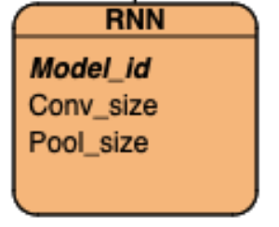
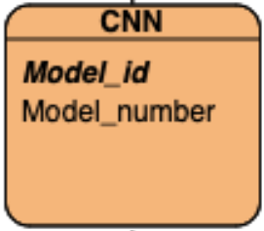
Attributes
model
dataset
user
Affiliation
Model_id
Dataset_id
User_id
Affiliation_id
Model_name
Dataset_name
User_name
Affil_name
Media_type
Media
Model_id
Arch_name
Dataset_size
Dataset_id
Param_num
Create_time
Affiliation
Password_hash
parameter
Is_admin

Slide 5
relationship
model
user
Affiliation
Model_id
User_id
Affiliation_id
Model_name
User_name
Media_type
Model_id
Affil_name
Arch_name
Dataset_id
Param_num
Affiliation
Password_hash
parameter
Is_admin
dataset
Dataset_id
Dataset_name
Media
Dataset_size
Create_time

Slide 6
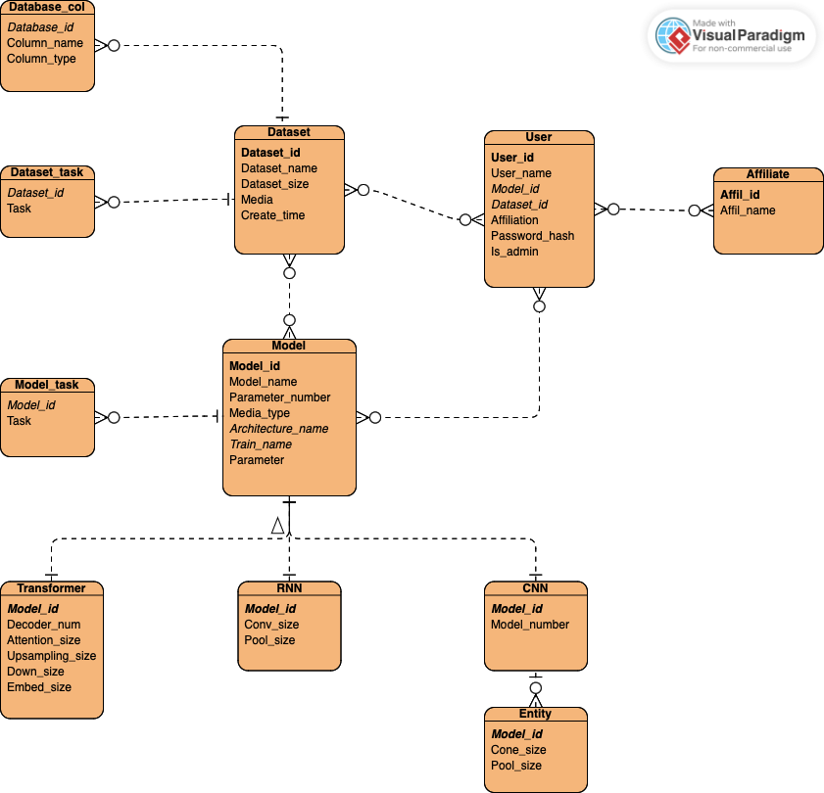
E-R Diagram

Slide 7
Relational Schemas
Model(model_id PK, model_name, param_num, media_type FK, arch_name FK, train_name FK, param)
ModelTask(model_id FK, task_name)
Model_id | Model_name | Param_num | Media_type | Arch_name | Train_name | Parameter
Model_id | Task_name
Transformer(model_id PK, decoder_num, attn_size, up_size, down_size, embed_size)
CNN(model_id PK, module_num)
Module(model_id FK, conv_size, pool_type)
RNN(model_id PK, criteria, batch_size, input_size)
Model_id | Decoder_num | Attn_size | Up_size | Down_size | Embed_size
Model_id | Model_num
Model_id | Conv_size | Pool_type
Model_id | Criteria | Batch_size | Input_size

Slide 8
Relational Schemas
Dataset(ds_id PK, ds_name, ds_size, media, created_at)
Dataset_TASK(ds_id FK, task)
DsCol(ds_id PK, col_name, col_datatype)
Dataset_id | Dataset_name | Dataset_size | Media | Created_time
Dataset_id | Task
Dataset_id | Col_name | Col_datatype
User(user_id PK, user_name, model_id FK, ds_id FK, affiliate, password_hash, is_admin)
Affil(affil_id PK, affil_name)
User_id | User_name | Model_id | Dataset_id | Affiliate | Password_hash | Is_admin
Affil_id | Affil_name

Slide 9
Relational Schemas
UserAffil(user_id FK, affil_id FK)
UserDataset(user_id FK, ds_id FK)
ModelAuthor(model_id FK, user_id FK)
ModelDataset(model_id FK, ds_id FK)
User_id | Affil_id
User_id | Dataset_id
Model_id | User_id
Model_id | Dataset_id

Slide 10
Realistic Data Demo
"dataset": [
{
"ds_name": "JovialValley/syllable_totaldataset",
"ds_size": 487,
"media": "audio",
"task": ["classification"],
"columns": [
{"col_name": "name",
"col_datatype": "string"},
{"col_name": "audio",
"col_datatype": "Audio"},
{"col_name": "label",
"col_datatype": "string"},
{"col_name": "emotion",
"col_datatype": "string"},
{"col_name": "emotion_str",
"col_datatype": "string"}
]
},
……
]
"model":[
{
"model_name": "ResNet-50",
"param_num": 23500000,
"media_type": "image",
"arch_name": "CNN",
"trainname": "pretrain",
"task": ["classification", "detection"],
"module_num": 5,
"modules": [
{"conv_size": 64, "pool_type": "max"},
{"conv_size": 128, "pool_type": "avg"},
{"conv_size": 256, "pool_type": "max"},
],
"param": 15
},
…
]
Derived from HuggingFace
92 for datasets
100 for models

Slide 11
Sample SQL Queries
CREATE TABLE affiliate (
affil_id INT AUTO_INCREMENT PRIMARY KEY,
affil_name VARCHAR(50)
);
INSERT INTO
user (user_id, user_name, Affiliation, password_hash, is_admin)
VALUES (0, “Alice”, “The Chinese University of Hong Kong, Shenzhen”, “ILoveCSC3170”, False)
UPDATE model SET Media_type=“audio” WHERE Media_type=“Music”
SELECT
Train_name,
COUNT(*) AS TOT_TRAIN_NAME
FROM
model
GROUP BY Train_name
HAVING COUNT(*) > 15

Slide 12
Demo Time

Slide 13
Conclusion
Reference

Slide 14
Reference

