Slide 1


Open Model Hub: Database for Models and Datasets
LIN, Yufeng 123090342, TENG, Yimeng 123090540,
LIN, Wentao 123090337, GAN, Linyong 123090120,
LIU, Yuxuan 123090377, ZHANG, Shuhan 123090823,
ZHENG, Zirun 123090891

Slide 2





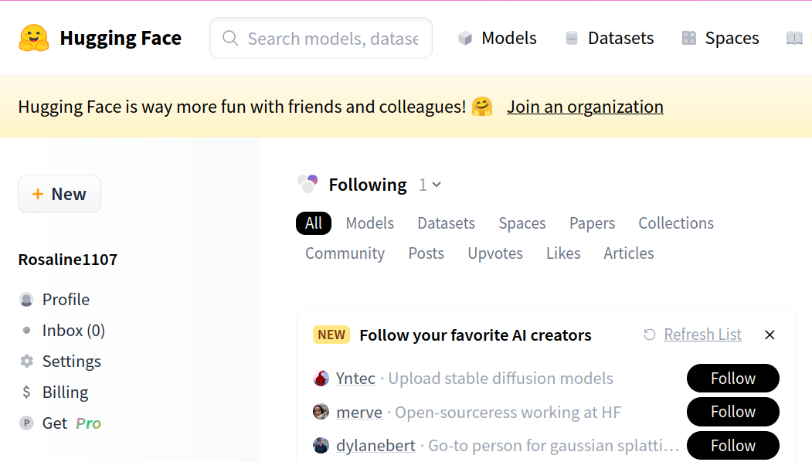
Motivation
Motivation:
We are motivated by huggingface (https://huggingface.co/), one of the most influential platform in the AI community for sharing machine learning models and datasets.
Goal:
Build a database to store models and datasets
with a graphic interface for users and administrators to perform a variety of operations
Supports uploading/downloading models and datasets
Supports efficient queries with the help of an AI agent.
Guarantees data security by encryption.
Support concurrent transactions.

Slide 3
Entities
User
model
Affiliation
Dataset

Slide 4
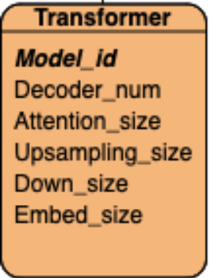
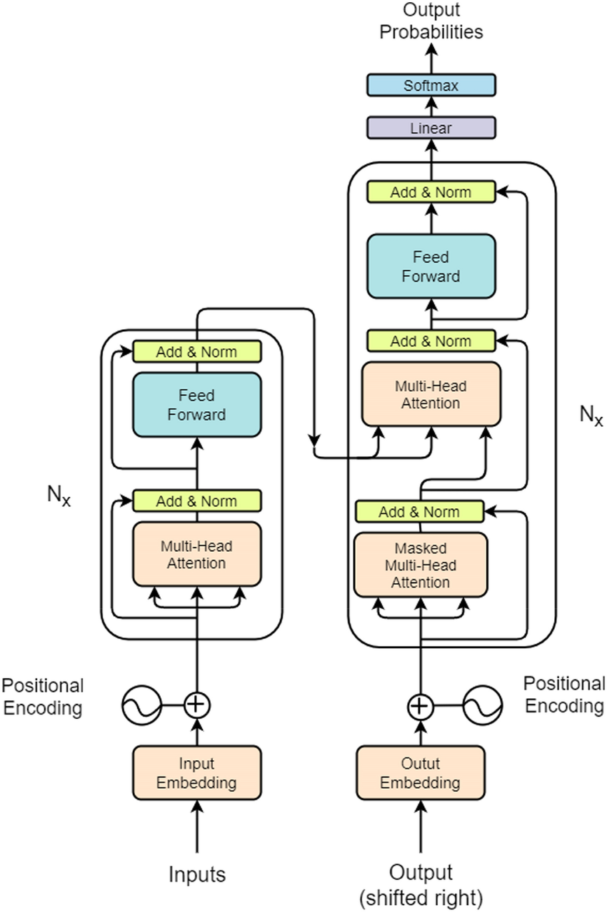
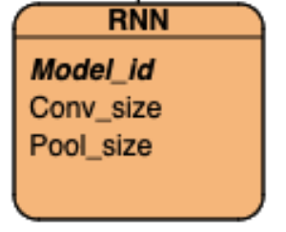
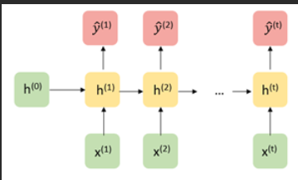
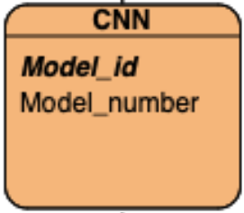
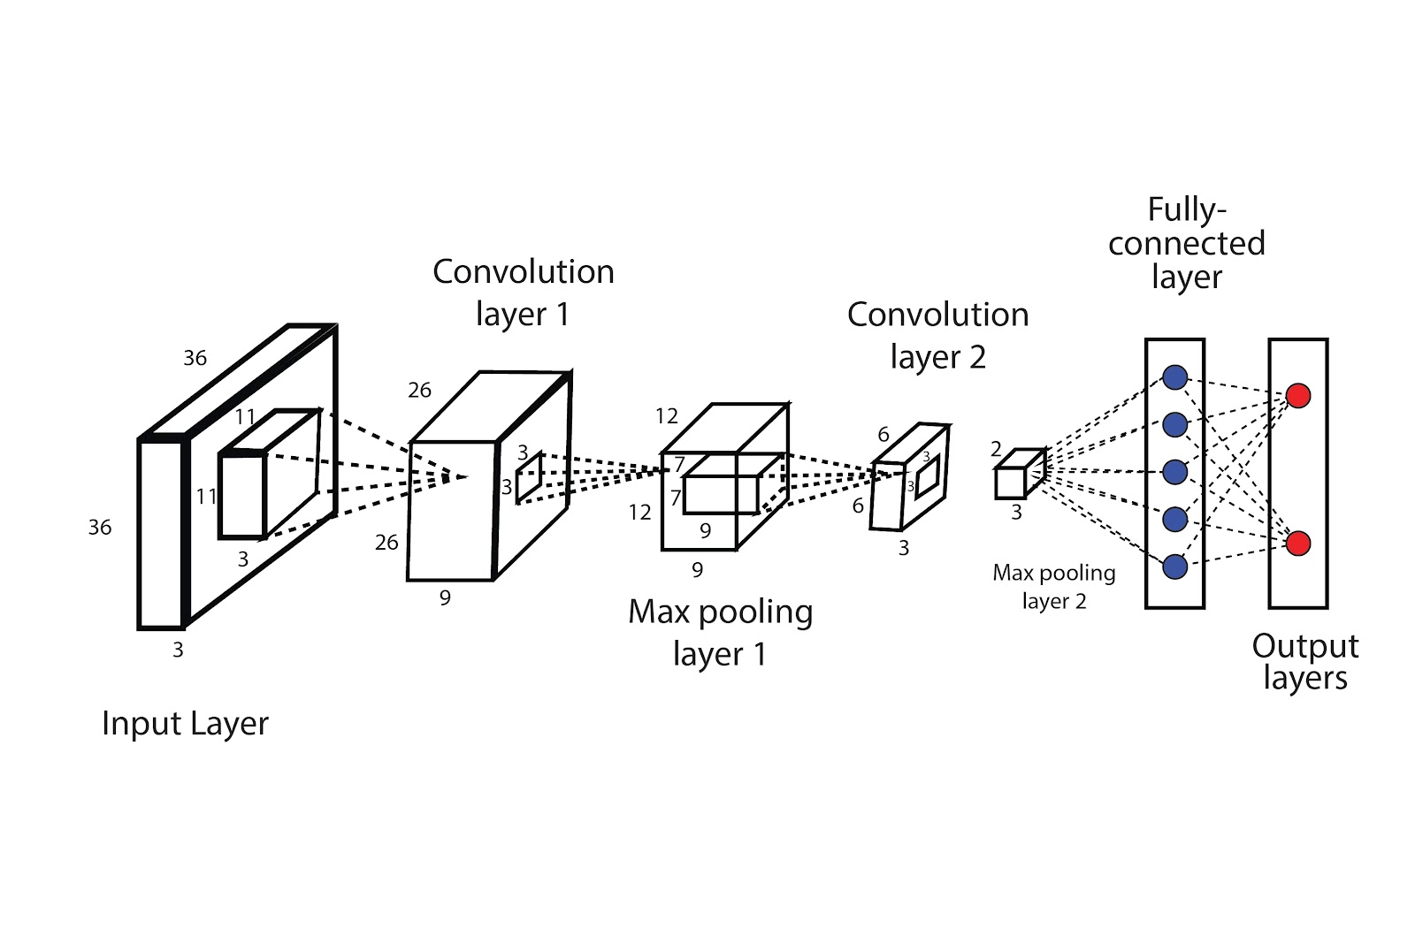
Attributes
model
user
ç
User_id
Model_id
User_name
Model_name
Model_id
Media_type
Dataset_id
Arch_name
ç
Affiliation
RNN
Param_num
Password_hash
Is_admin
parameter
Specification
Model_id
Input_size
Affiliation
dataset
Affiliation_id
Dataset_id
Dataset_name
Module
Affil_name
Media_type
Moduel_id
Dataset_size
module_num
Create_time
Conv_size
Pool_size
Pool_type

Slide 5
Model_ds
One (model) to many (user)
(model) fully parcitipate
One model has at least one author
relationship
model
user
Affiliation
Model_id
User_id
Affiliation_id
Model_name
User_name
Media_type
Model_id
Affil_name
Arch_name
Dataset_id
Param_num
Affiliation
User_affil
Many to many
A user can be affiliated to an affiliation
Password_hash
parameter
Is_admin
dataset
model_ds
Many to many
This model can run on this dataset.
Dataset_id
Dataset_name
Ds_user
One (dataset) to many (user)
(dataset) fully participate
One dataset has at least one author.
Media
Dataset_size
Create_time

Slide 6
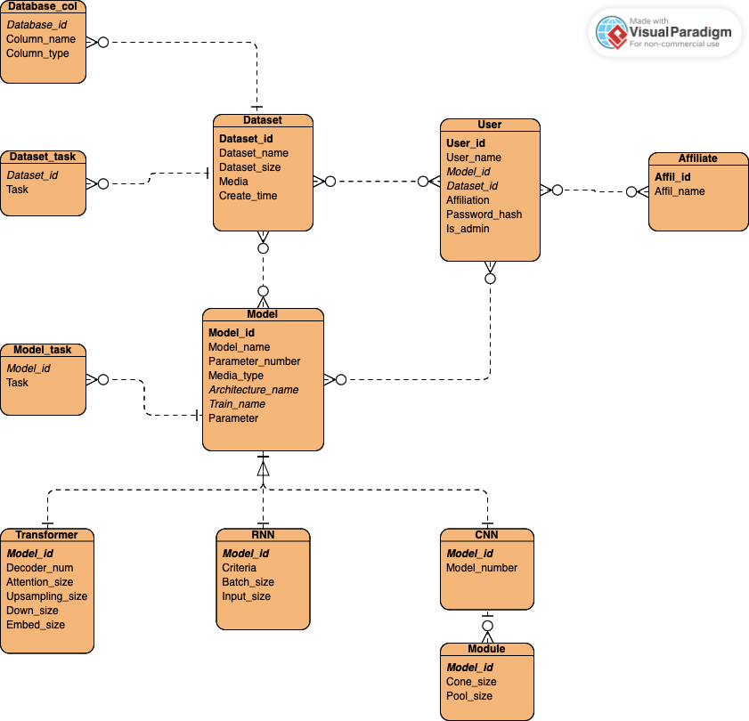
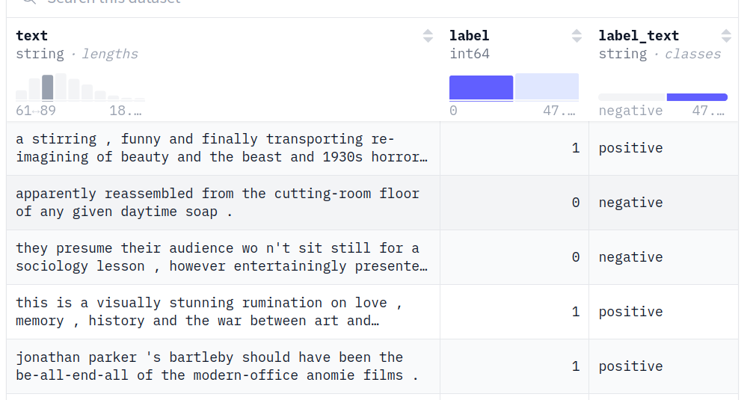
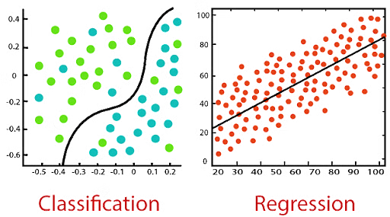
E-R Diagram
ç

Slide 7
Relational Schemas
Model(model_id PK, model_name, param_num, media_type FK, arch_name FK, train_name FK, param)
ModelTask(model_id FK, task_name)
Model_id | Model_name | Param_num | Media_type | Arch_name | Train_name | Parameter
Model_id | Task_name
Transformer(model_id PK, decoder_num, attn_size, up_size, down_size, embed_size)
CNN(model_id PK, module_num)
Module(model_id FK, conv_size, pool_type)
RNN(model_id PK, criteria, batch_size, input_size)
Model_id | Decoder_num | Attn_size | Up_size | Down_size | Embed_size
Model_id | Model_num
Model_id | Conv_size | Pool_type
Model_id | Criteria | Batch_size | Input_size

Slide 8
Relational Schemas
Dataset(ds_id PK, ds_name, ds_size, media, created_at)
Dataset_TASK(ds_id FK, task)
DsCol(ds_id PK, col_name, col_datatype)
Dataset_id | Dataset_name | Dataset_size | Media | Created_time
Dataset_id | Task
Dataset_id | Col_name | Col_datatype
User(user_id PK, user_name, model_id FK, ds_id FK, affiliate, password_hash, is_admin)
Affil(affil_id PK, affil_name)
User_id | User_name | Model_id | Dataset_id | Affiliate | Password_hash | Is_admin
Affil_id | Affil_name

Slide 9
Relational Schemas
UserAffil(user_id FK, affil_id FK)
UserDataset(user_id FK, ds_id FK)
ModelAuthor(model_id FK, user_id FK)
ModelDataset(model_id FK, ds_id FK)
User_id | Affil_id
User_id | Dataset_id
Model_id | User_id
Model_id | Dataset_id

Slide 10
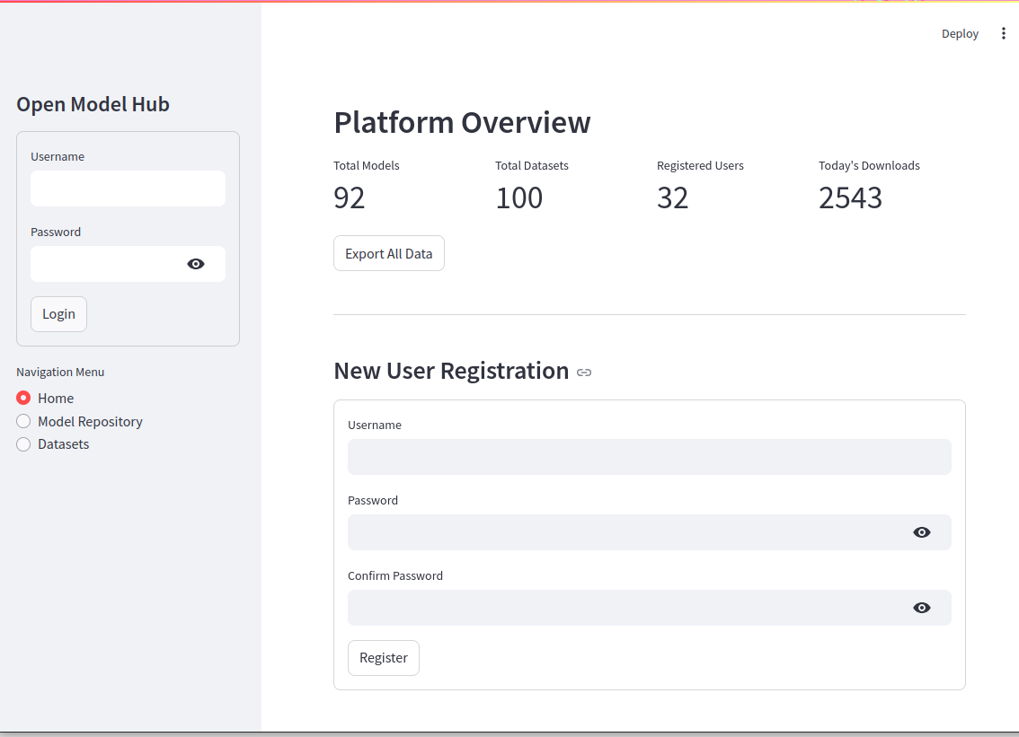
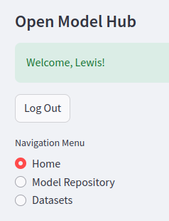
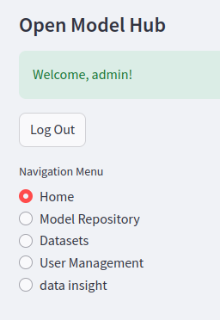
GUI demonstration
1. User log in
overview
User log in /registration
If user log in: user type?
Administrator
general user
(different privilege)
çç
2. User registrationc
c
Features exclusively belonging to admin
general user
admin

Slide 11
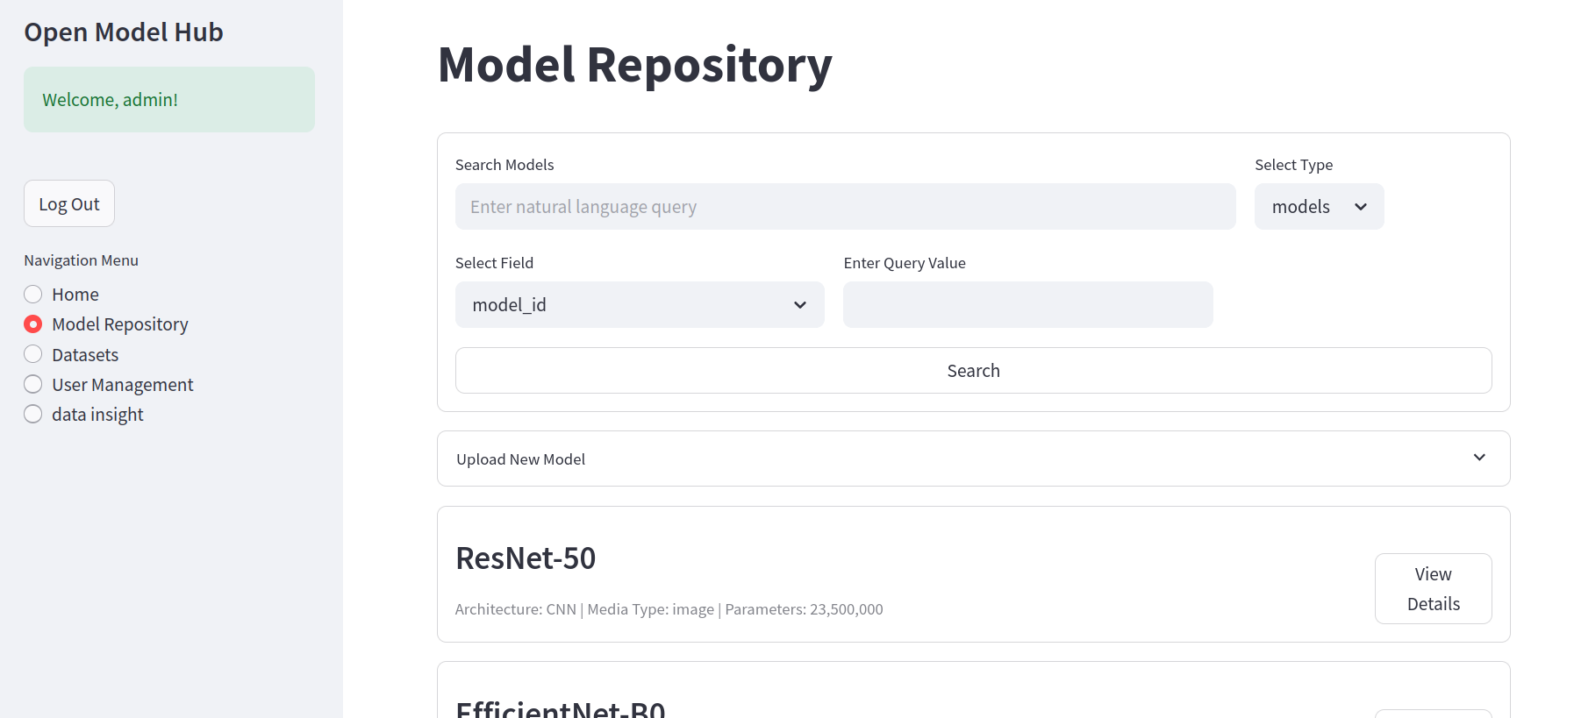
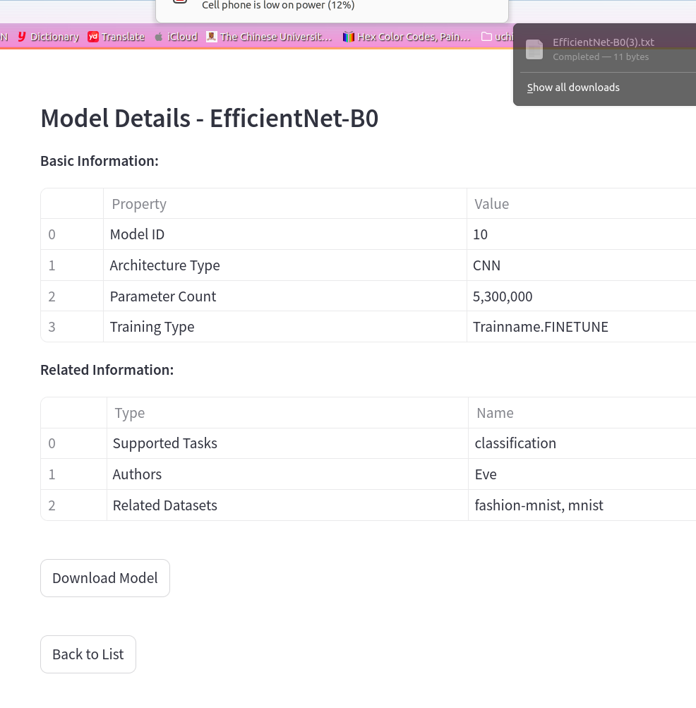
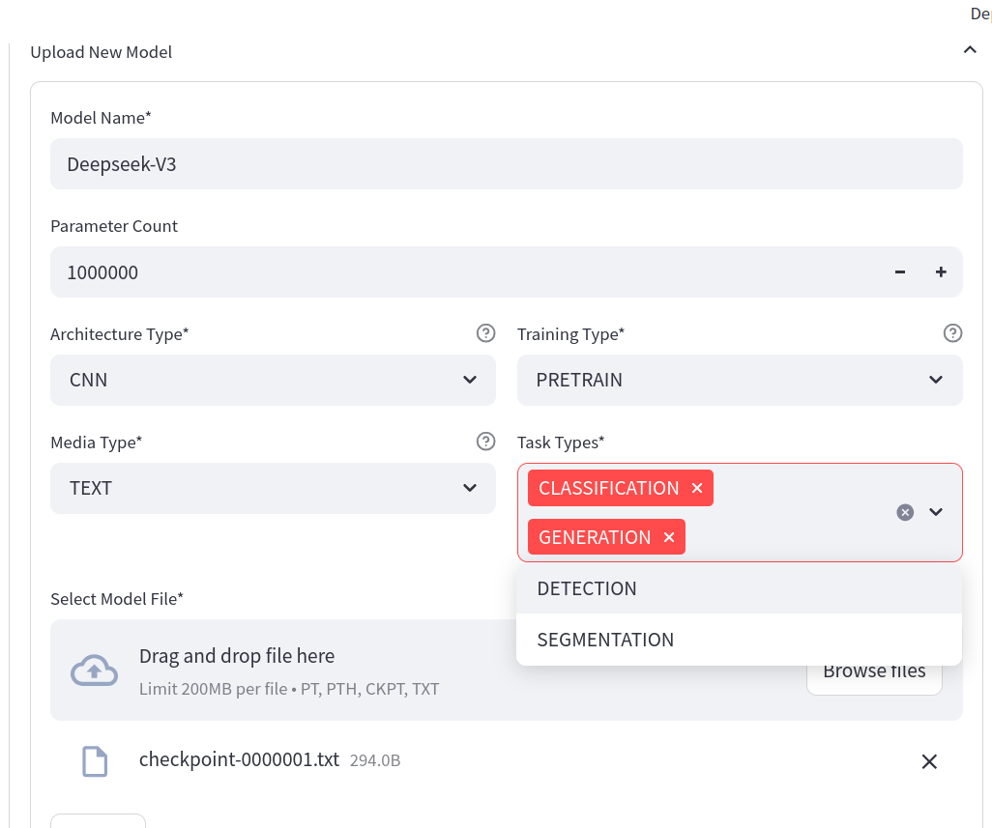
Successfully downloaded
Search secetion
ç
Model section
ççç
Upload new model
View details
Download model

Slide 12
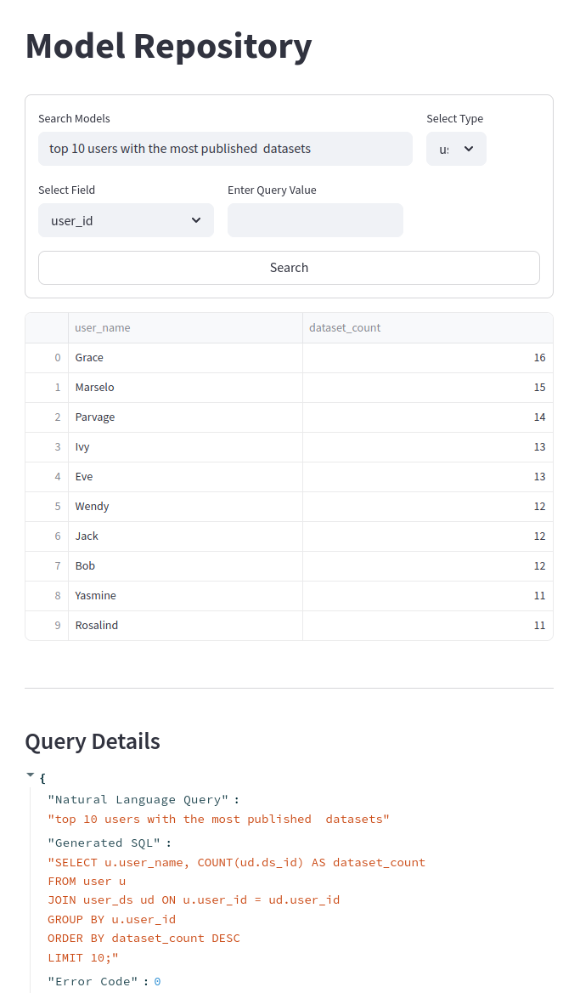
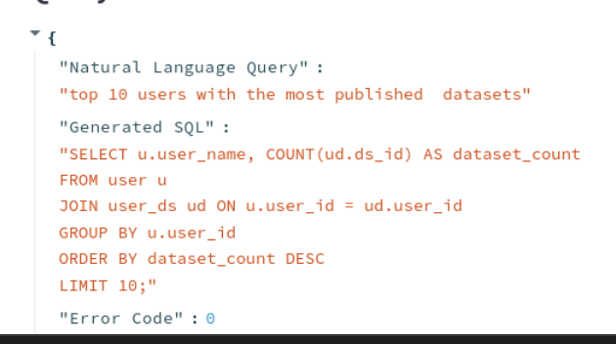
GUI demonstration: LLM Agent
Natural Language Query:
top 10 users with the most published models.
çç
we incorporated an LLM agent to translate users’ natural language query to SQL.
çç
Result of the SQL query is formatted and displayed in table.
Generated SQL query
çç

Slide 13
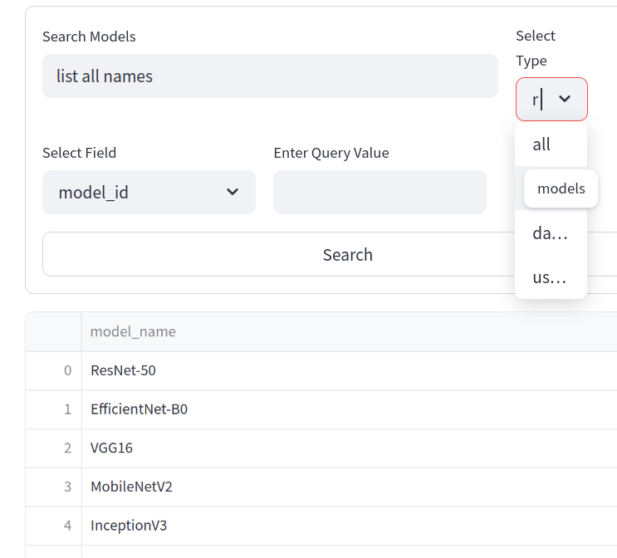
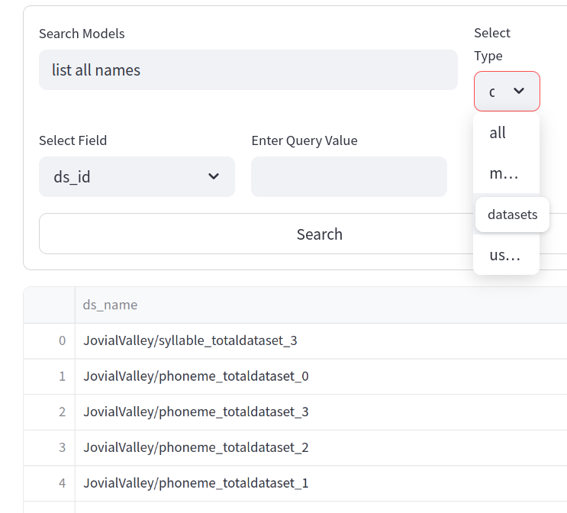
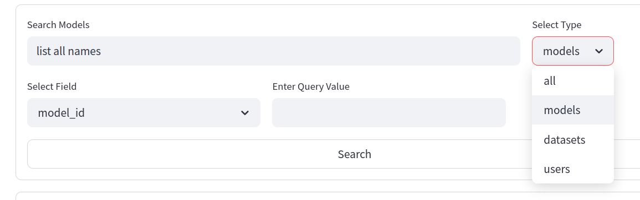
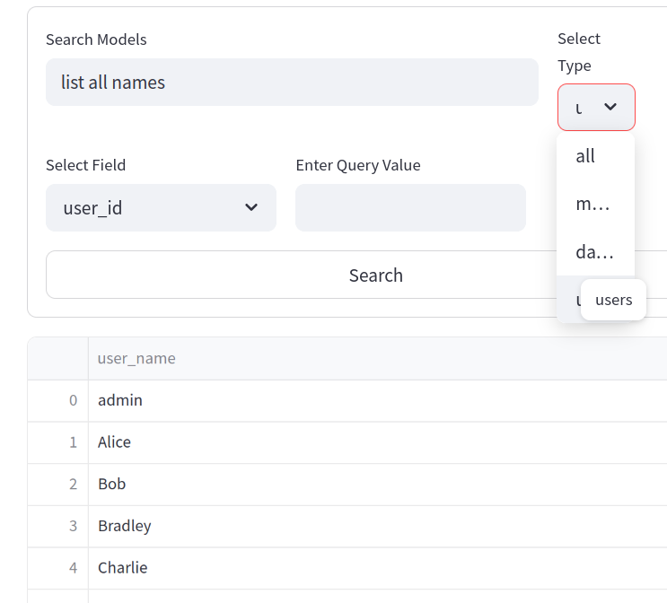
GUI demonstration: LLM Agent
We support specifying (or not specifying) a certain entity to search on.
models
datasets
Natural language query:
list all names
Can demand the outcome instances to be of a certain entity.
Display:
The same natural language query
+ demanding different entities
= different query results
users

Slide 14
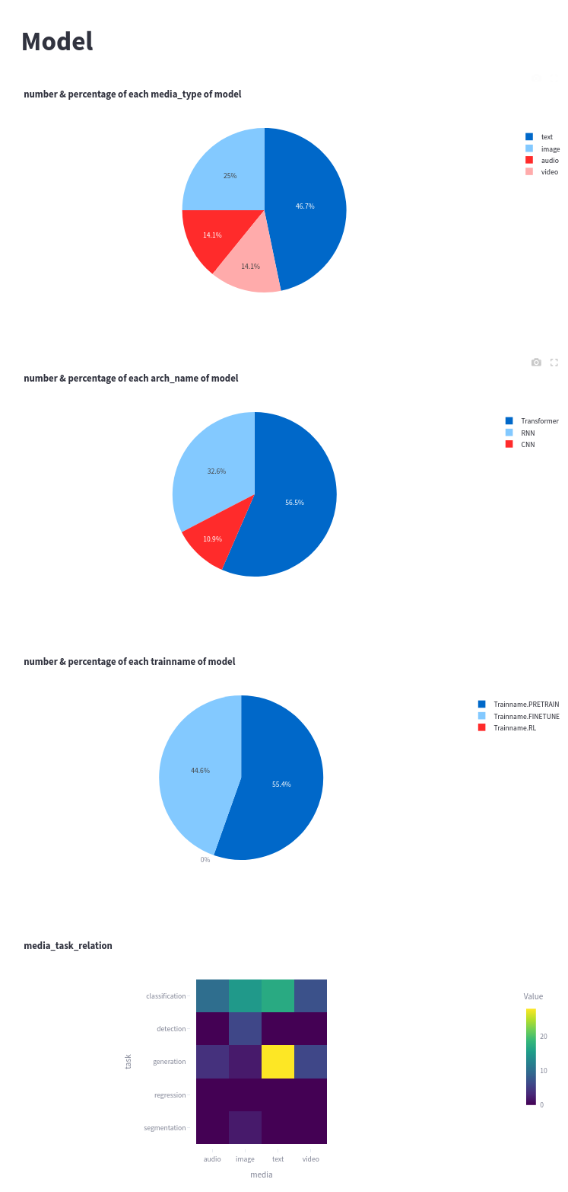
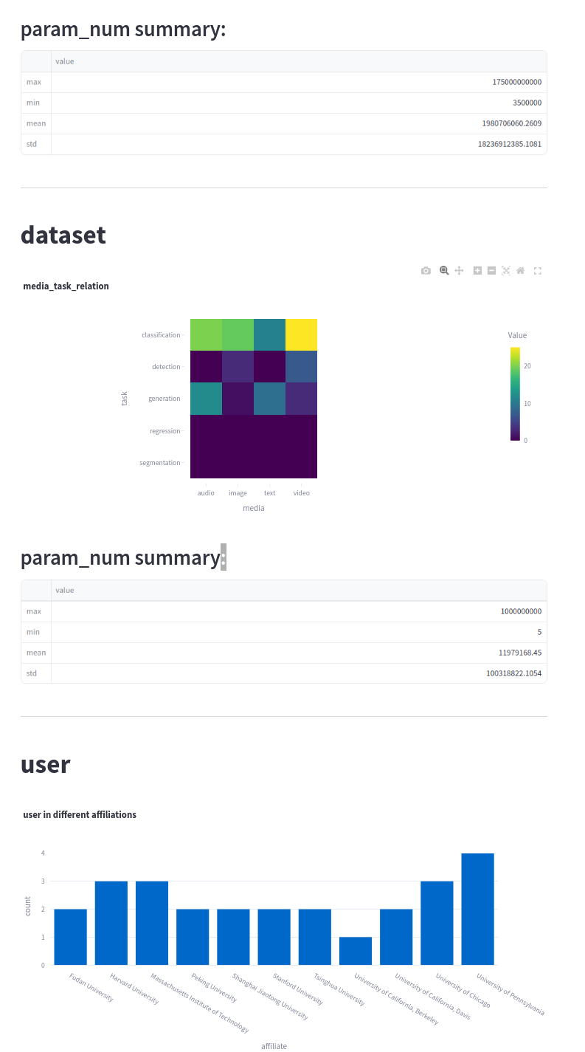
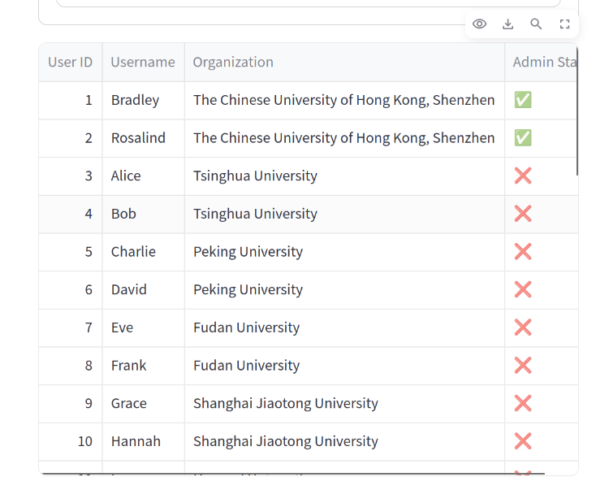
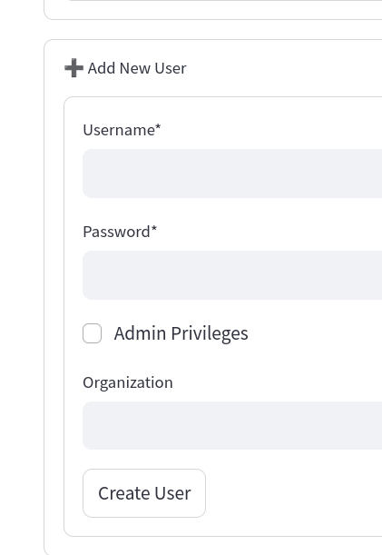
GUI demonstration:
Admin privileges
Data analysis
User management
Create user
& grant admin privilege or not

Slide 15
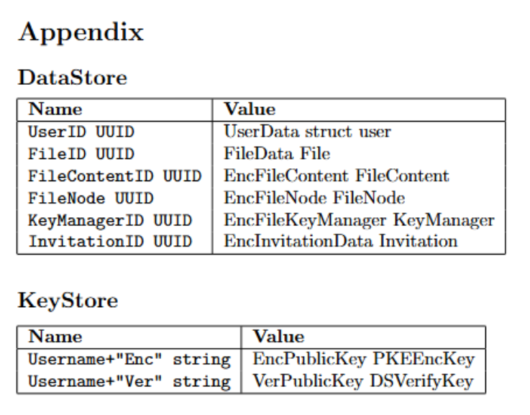
Security Module
Security Schema
Purpose: Securely store symmetric keys for critical files, including dataset contents and model weights.
Cryptographic Algorithms:
Symmetric: CBC block cipher, HMAC
Asymmetric: RSA-Enc, RSA-Sign
Key Derivation: Argon2
Encapsulations:
User: InitUser, GetUser
Key: StoreKey, LoadKey
Access Control: CreateInvitation, AcceptInvitation, RevokeAccess
Confidentiality, Integrity, and Authenticity:
Secure against in-path attackers with full database & keystore knowledge
Portability: Easy integration by calling appropriate handlers for:
User creation and loading.
File creation and loading.
Access permission propagation.
Concurrent Transactions
Backend: use package “aiomysql” to support async functions and concurrent execution;
Frontend: use “streamlit” to launch the GUI. Streamlit supports concurrent execution.

Slide 16
Realistic Data
"dataset": [
{
"ds_name": "JovialValley/syllable_totaldataset",
"ds_size": 487,
"media": "audio",
"task": ["classification"],
"columns": [
{"col_name": "name",
"col_datatype": "string"},
{"col_name": "audio",
"col_datatype": "Audio"},
{"col_name": "label",
"col_datatype": "string"},
{"col_name": "emotion",
"col_datatype": "string"},
{"col_name": "emotion_str",
"col_datatype": "string"}
]
},
……
]
dataset
Records are stored in json files. Can be exported from / imported to database.
Basic information about models and datasets (name, media_type) are copied from real models & datasets on huggingface.
Records number:
92 models
100 datasets
28 users
12 affiliations
dataset
model
"model":[
{
"model_name": "ResNet-50",
"param_num": 23500000,
"media_type": "image",
"arch_name": "CNN",
"trainname": "pretrain",
"task": ["classification", "detection"],
"module_num": 5,
"modules": [
{"conv_size": 64, "pool_type": "max"},
{"conv_size": 128, "pool_type": "avg"},
{"conv_size": 256, "pool_type": "max"},
],
"param": 15
},
…
]

Slide 17
Reference
Rivest, R. L., Shamir, A., & Adleman, L. (1978). A method for obtaining digital signatures and public-key cryptosystems. Communications of the ACM, 21(2), 120-126.
Feistel, H. (1973). Cryptography and computer privacy. Scientific American, 228(5), 15-23.
Hugging Face Inc. (n.d.). Hugging Face – The AI community building the future. https://huggingface.co/

Slide 18
THANK YOU.
LIN, Yufeng 123090342, TENG, Yimeng 123090540,
LIN, Wentao 123090337, GAN, Linyong 123090120,
LIU, Yuxuan 123090377, ZHANG, Shuhan 123090823,
ZHENG, Zirun 123090891

