Slide 1
Crime patterns in Baltimore IS 733 HomeWork 01
By
Ganesh Yalavarthi

Slide 2


Slide 3
Agenda
Baltimore Crime Dataset Statistics
Results from Data Analysis
Year-wise, month-wise and day-wise analysis
Criminal activity in several Baltimore neighbourhoods
Temporal variations in crime type distributions
Crime type distributions
Crime Dashboard
Recommendations for Baltimore Police Department

Slide 4
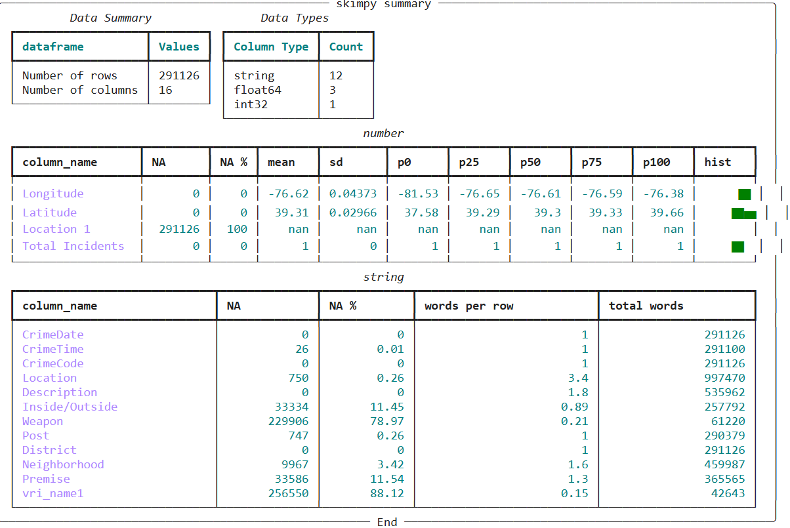
Baltimore Crime Dataset statistics
Total number of instances and features in dataset are 291126 and 16 respectively.
From the Baltimore crime data, there are 12 rows that are discrete and 4 row numeric.

Slide 5
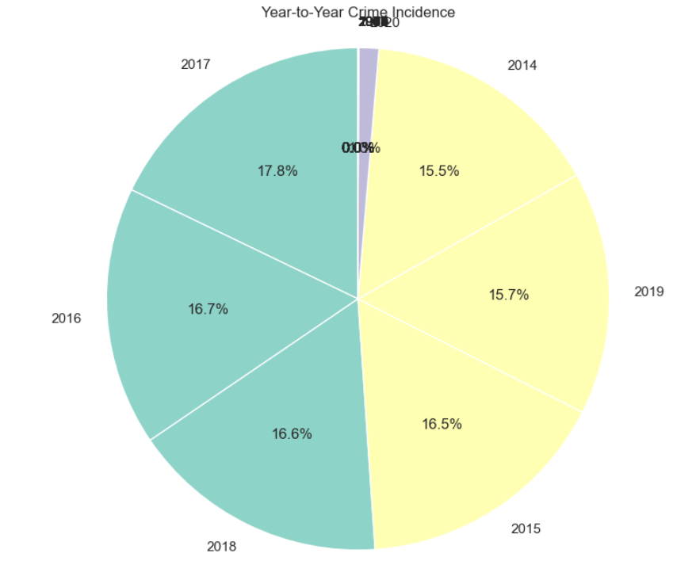
Year wise Analysis:
More than 5000 offenses annually, 2017 saw the most crimes ever.
The highest number of crimes are in 2017, 2016, and 2015.
The lowest crime rate was recorded in 2020 (due to COVID-19).
Crime data is for the period 2014 to 2020

Slide 6
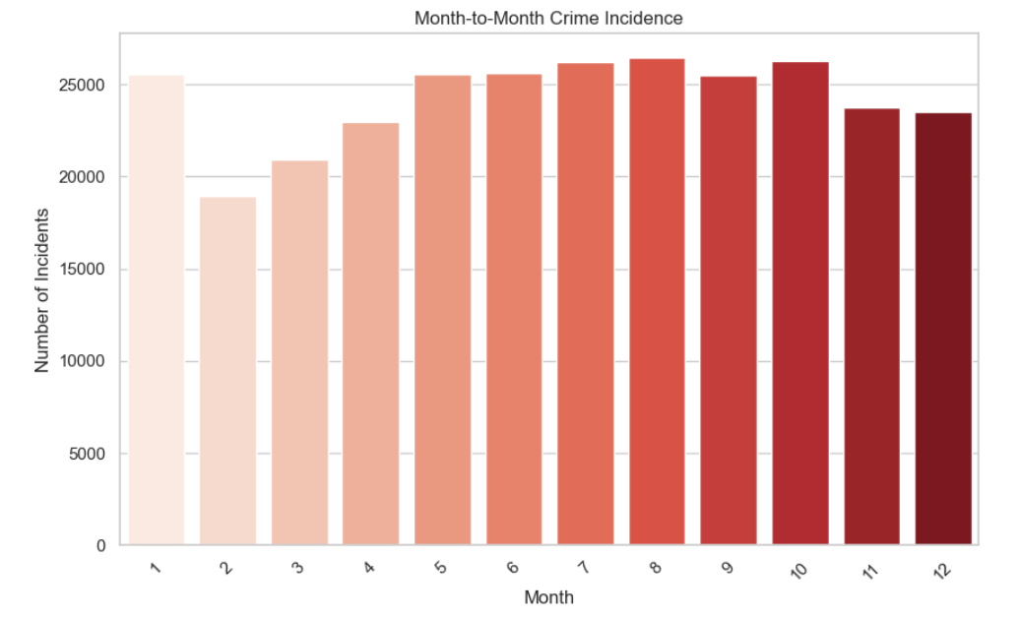
Month wise analysis :
A minimum of ~=17500 offenses are reported each month throughout the years.
January, July, August, and October saw the highest crime rates.
February, experienced the lowest crimes ever.

Slide 7
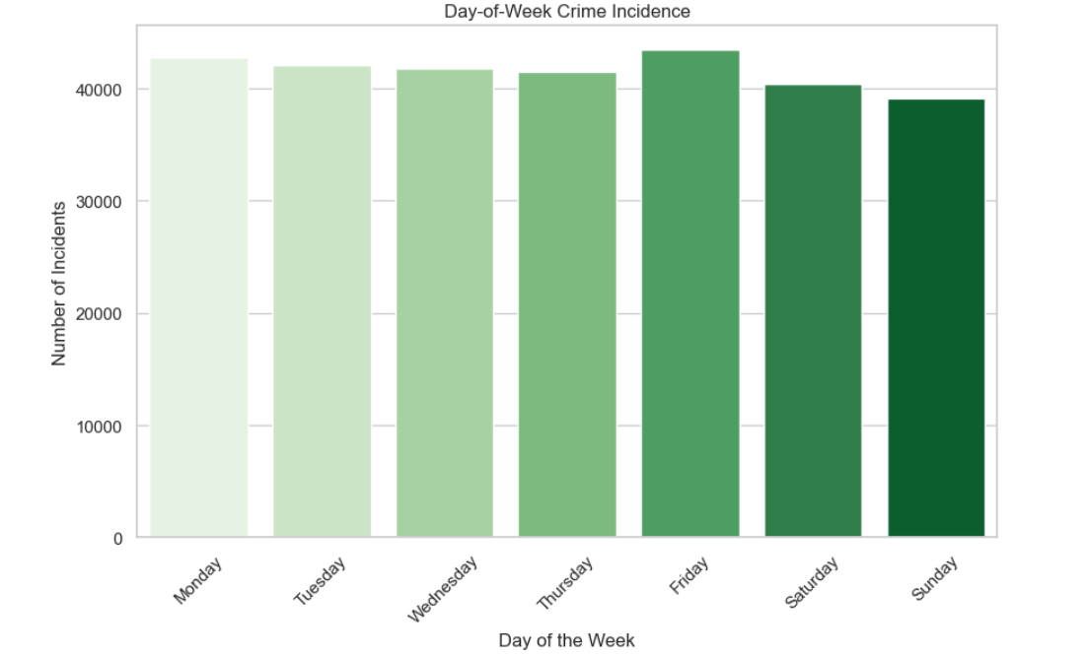
Day wise Crime
Many crimes committed on all seven days of the week, with Mondays and Fridays having the highest number.
It follows that Mondays, when the workday begins, and Fridays, when the weekend begins, have higher crime rates.

Slide 8
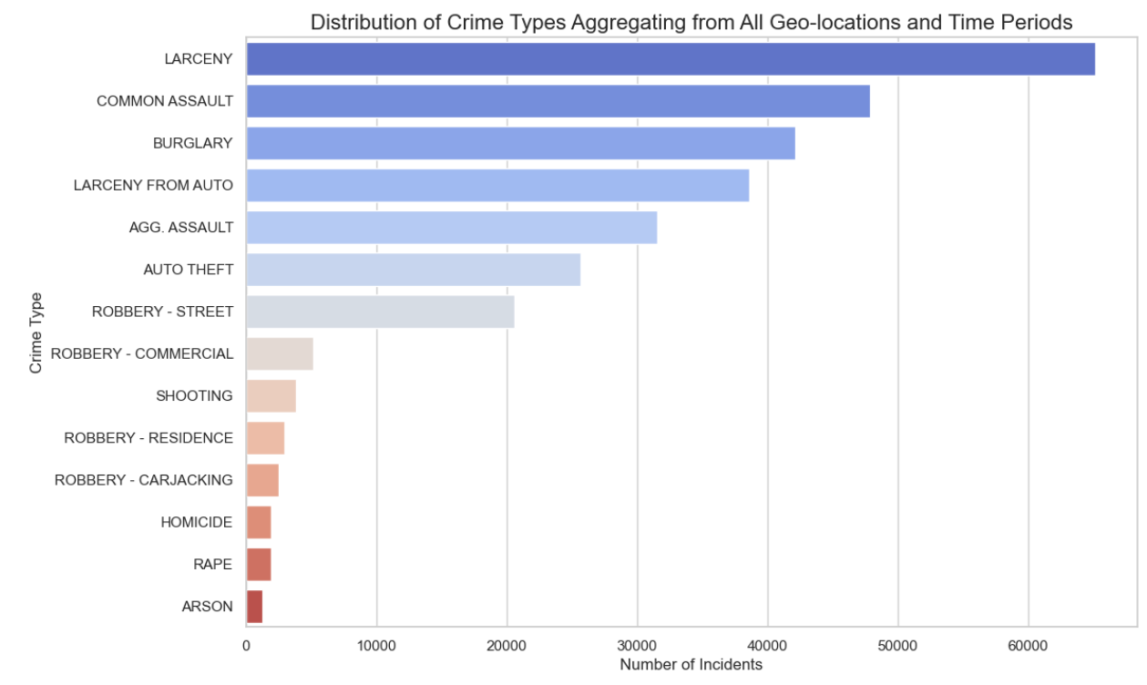
Temporal Variations in Crime type Distributions:
Larceny is the most frequent crime in Baltimore, with over 60,000 reported instances.
Common Assault ranks second with nearly 50,000 incidents, following larceny.
Other significant crimes include burglary, auto theft, aggravated assault, and theft.
Less frequent crimes are arson, rape, homicide, gunshot incidents, and robberies.

Slide 9
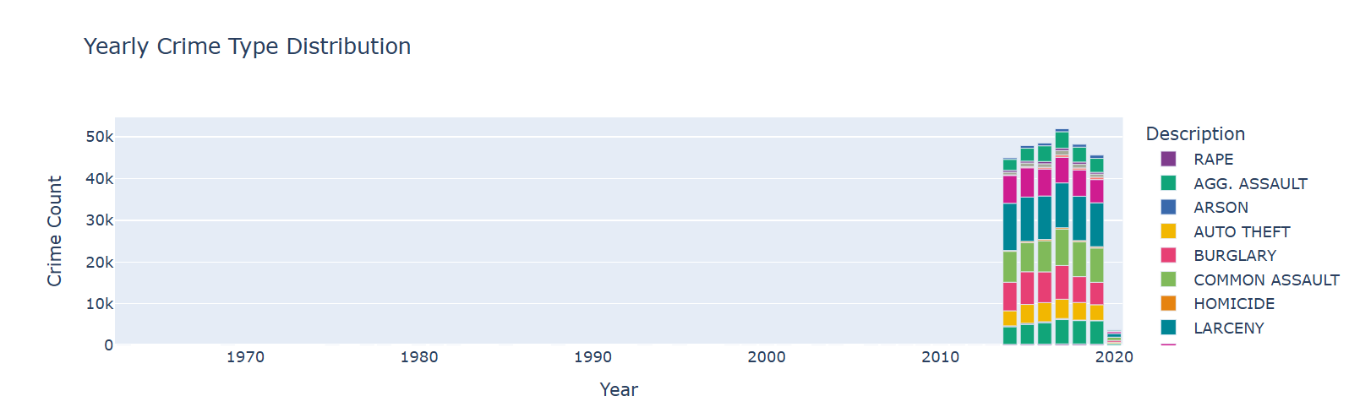
Distributions

Slide 10
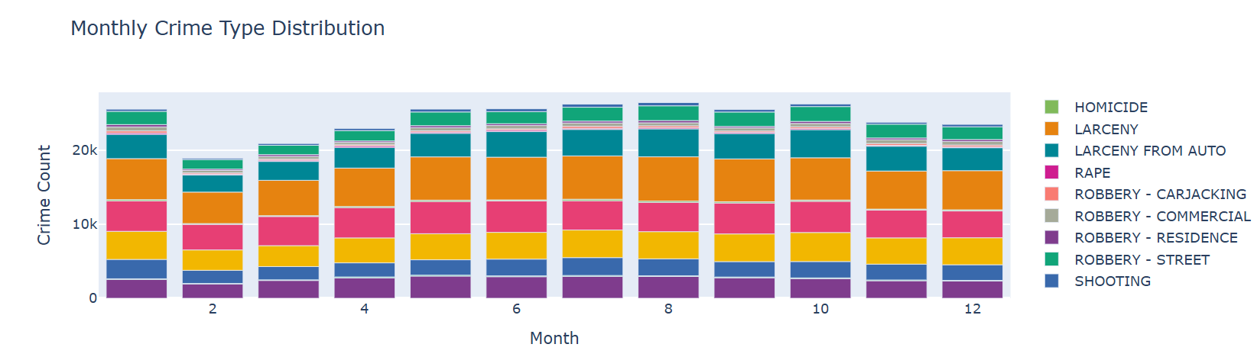
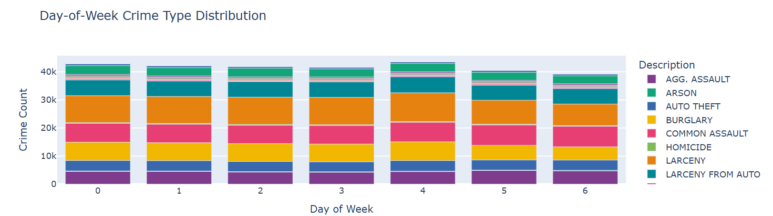

Slide 11
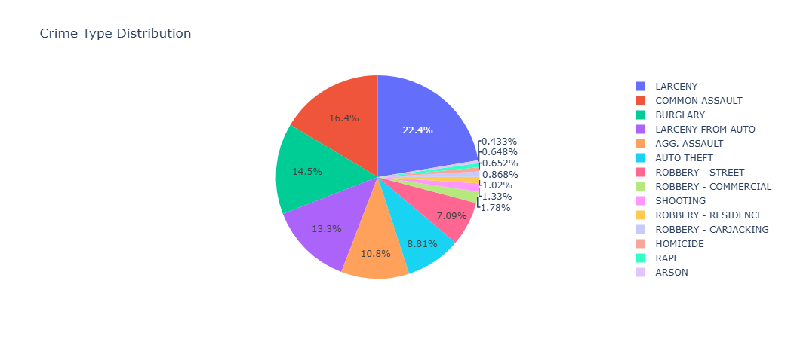
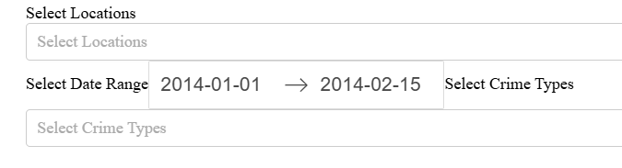
Gary’s Dashboard
This dashboard allows us to identify key trends in Baltimore's crime data, including yearly and monthly variations, as well as the most frequent crime types.

Slide 12
Recommendations for Baltimore Police Department :
Crimes peak in the summer months, additional police presence could help reduce crime rates.
Weekend patrols should be increased to address the spike in crimes on Fridays and Saturdays.
Efforts should be focused on reducing assault and theft incidents, as they make up the majority of crimes.
Based on the data, we recommend focusing resources on the most frequent crime types and adjusting patrol schedules to target high-crime times.

Slide 13
Thank you

