Slide 1
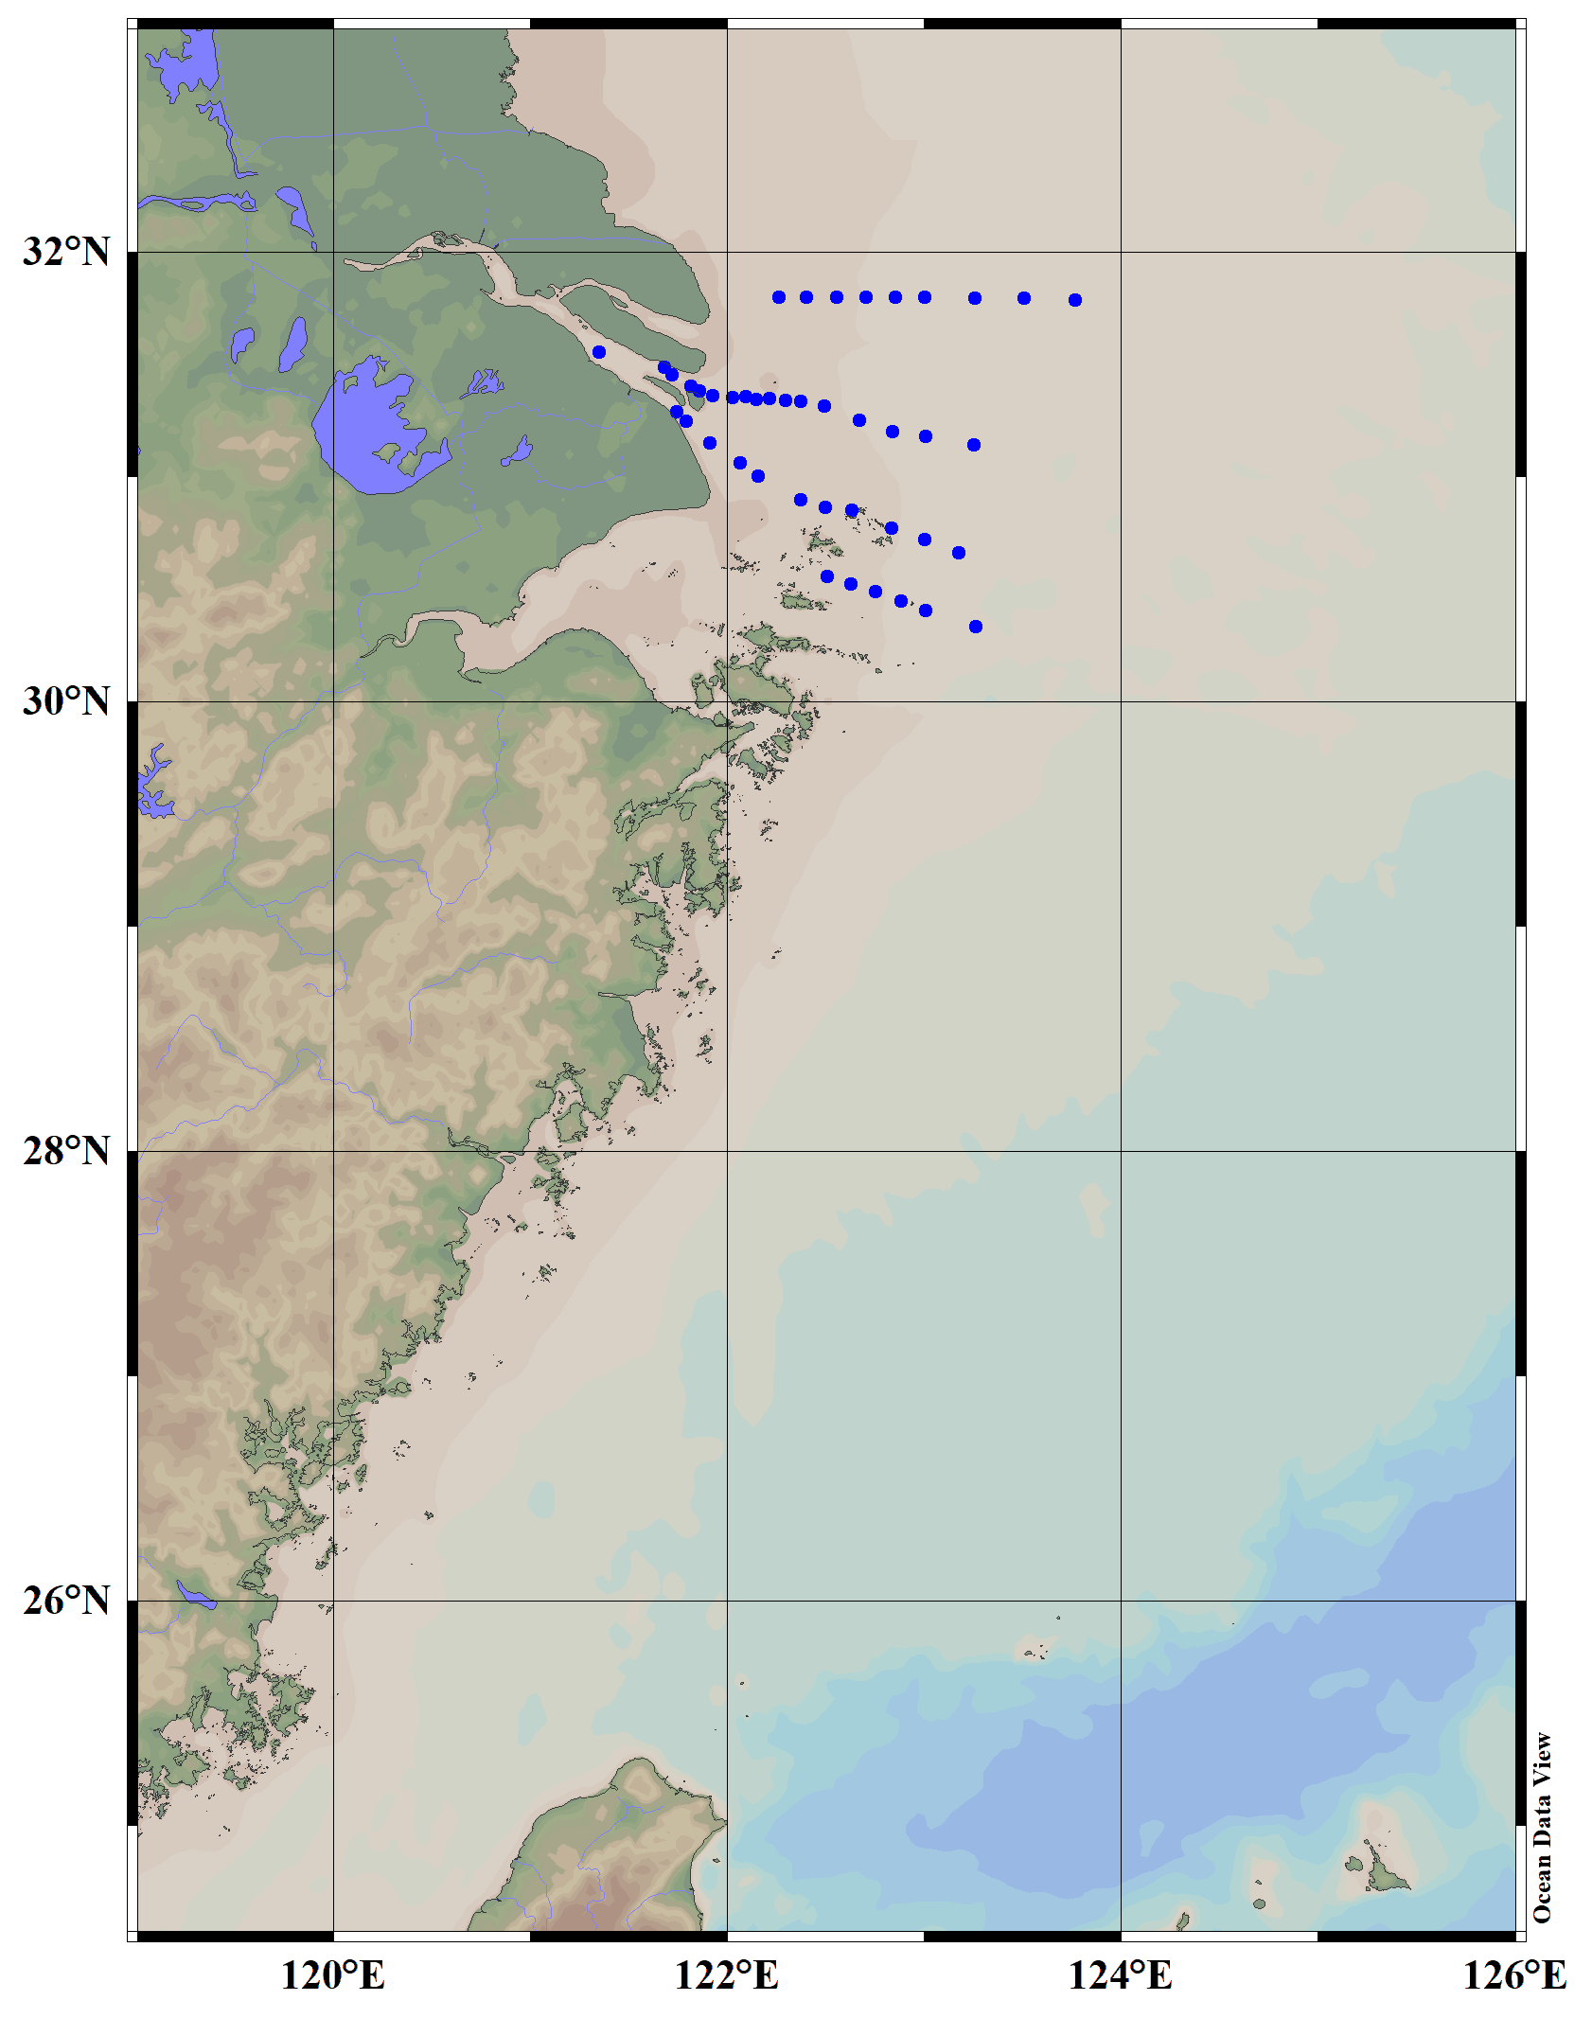
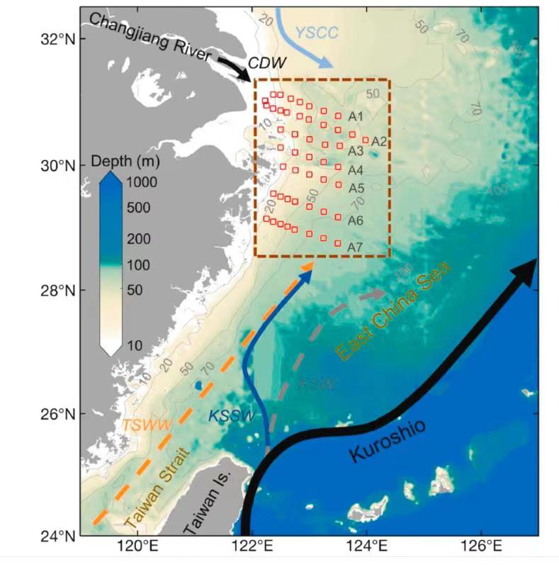

Slide 3
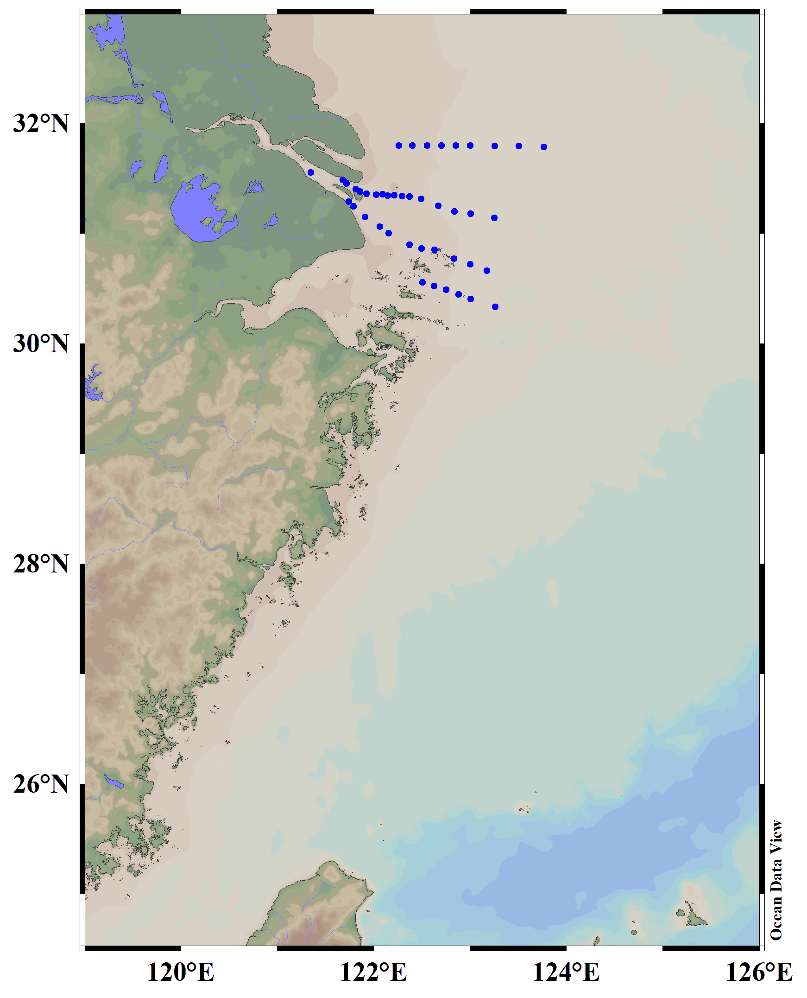
YSCC
Changjiang River
C4
CDW
C3
C2
C1
East China Sea
TSWW
KSSW
Kuroshio

Slide 4
YSCC
Changjiang River
C4
CDW
C3
C2
C1
East China Sea
TWC
KBC
Kuroshio

Slide 5
YSCC
Changjiang River
A1
CDW
A2
A3
A4
East China Sea
TWC
KBC
Kuroshio

Slide 6
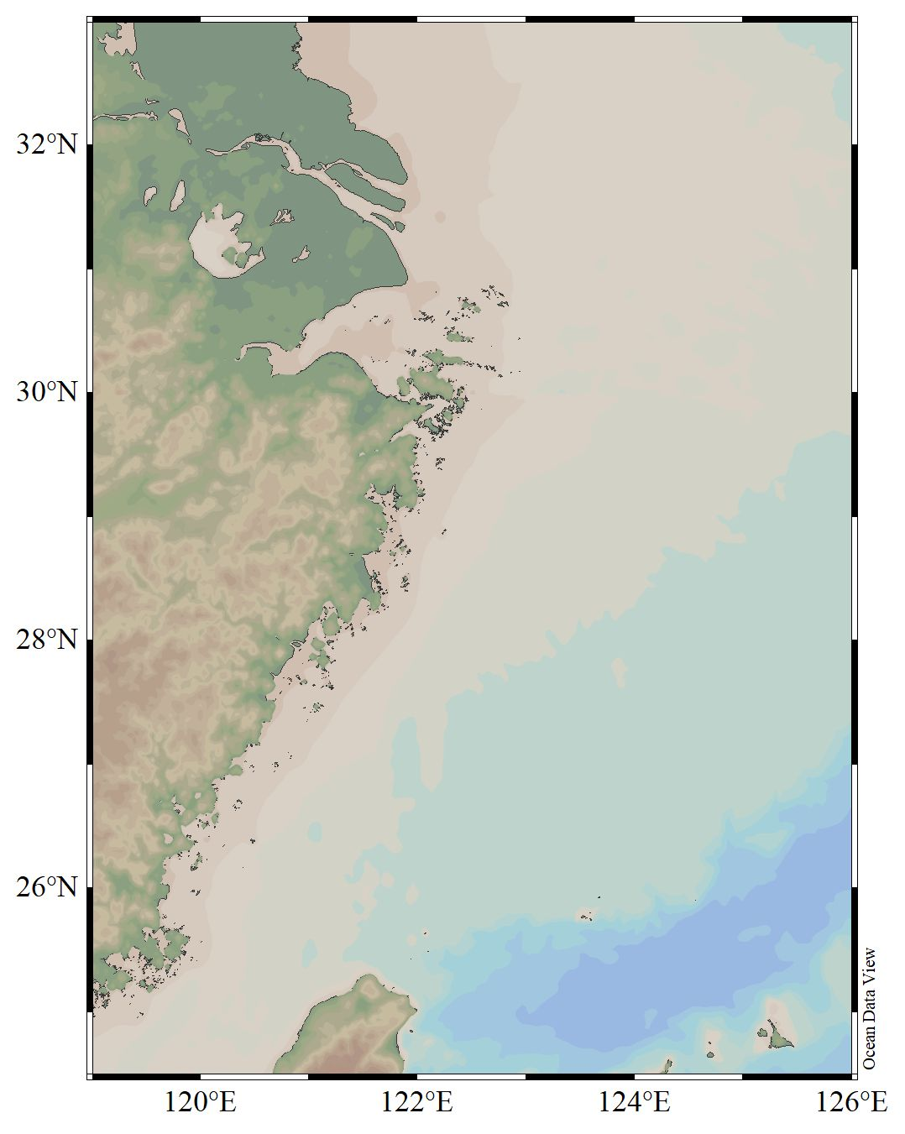
YSCC
Changjiang River
CDW
study area
East China Sea
TWC
KBC
Kuroshio

