Slide 1
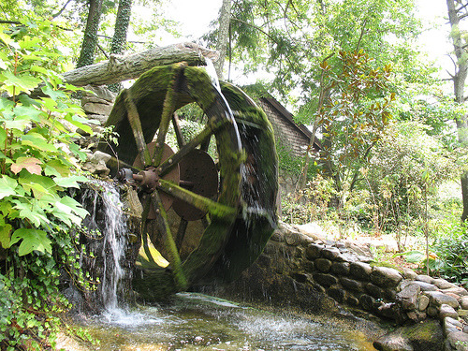
Sarasvati Workflow
© 2007 James Emery

Slide 2
Quick Facts
Masters Project
About a year old
Hosted on Google Code
  http://sarasvati.googlecode.com
Licensed under LPGL
Current release: 1.0.0-rc1

Slide 3
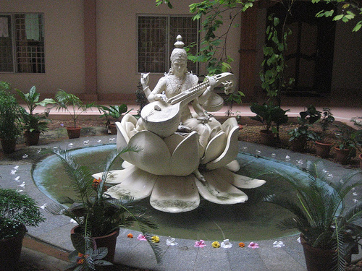
Why the name “Sarasvati”?
“associated with purity and creativity, especially in the context of communication, such as in literary and verbal skills”
“Her name literally means 'the one who flows'”
© 2007 Nick Gray

Slide 4

Design Goals
Simple
  To use and understand
© 2007 Darren Hester
Notes:
Easy to use.
Simple to understand.
Minimal translation to convert a business process into the engine model.

Slide 5

Design Goals
Simple
  To use and understand
Capable
© 2008 Brian Herzog

Slide 6

Design Goals
Simple
  To use and understand
Capable
Transparent
© 2008 Sergei Golyshev

Slide 7

Design Goals
Simple
  To use and understand
Capable
Transparent
Extensible
  And embeddable
© 2007 s.o.f.t.

Slide 8
Graphs for Workflow
Billing
Order Entry
Marketing
Fulfillment

Slide 9
Petri Nets
Place
Task
Place
Start
Task
Task
End
Place
Task
Place

Slide 10
Petri Nets
Place
Task
Place
Start
Task
Task
End
Place
Task
Place
Simple?

Slide 11
Petri Nets
Place
Task
Place
Start
Task
Task
End
Place
Task
Place
Simple?
Transparent?

Slide 12
jBPM
Task
Start
Task
Split
Join
Task
Task

Slide 13
Sarasvati
Task
Task
Task
Task

Slide 14
Sarasvati
Task
Task
Task
Task
Marked as Start node

Slide 15
Sarasvati
Task
Task
Task
Task
Marked as Start node
Marked as Join node

Slide 16

Building Blocks: Nodes
Node Properties
Name
Node type
Start?
Join?
Guard
  Accept
  Discard
  Skip
© 2004 Dave Morris

Slide 17
Flow Control: Discard
Task
Task
Task
Task
Start node
Not a Join node

Slide 18
Flow Control: Discard
Incomplete node token
Task
Task
Task
Task

Slide 19
Flow Control: Discard
Complete node token
Task
Task
Task
Task
Incomplete arc token

Slide 20
Flow Control: Discard
Task
Task
Task
X
Discarded node token
Task
Complete arc token

Slide 21
Flow Control: Discard
Task
Task
Task
X
Task

Slide 22
Flow Control: Discard
Task
Task
Task
X
Task

Slide 23
Flow Control: Discard
Task
Task
Task
X
Task

Slide 24
Flow Control: Skip
Task
Task
Task
Task
Start node
Join node

Slide 25
Flow Control: Skip
Task
Task
Task
Task

Slide 26
Flow Control: Skip
Task
Task
Task
S
Task
Skipped node token

Slide 27
Flow Control: Skip
Task
Task
Task
S
Task

Slide 28
Flow Control: Skip
Task
Task
Task
S
Task

Slide 29

Building Blocks: Arcs
Arc Properties
Name
© 2008 Rachel

Slide 30
Flow Control: Named Arcs
Task I
A
A
A
A
Task II
A
A
Choice
Join
B
Task III
B
B
B
Task IV

Slide 31
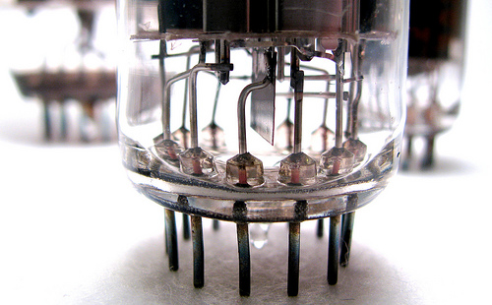
Components
Why?
© 2008 Kurt Faler

Slide 32
Components
Why?
Reuse
© 2008 Kurt Faler

Slide 33
Components
Why?
Reuse
Encapsulate
© 2008 Kurt Faler

