Slide 1
冒險故事

Slide 2
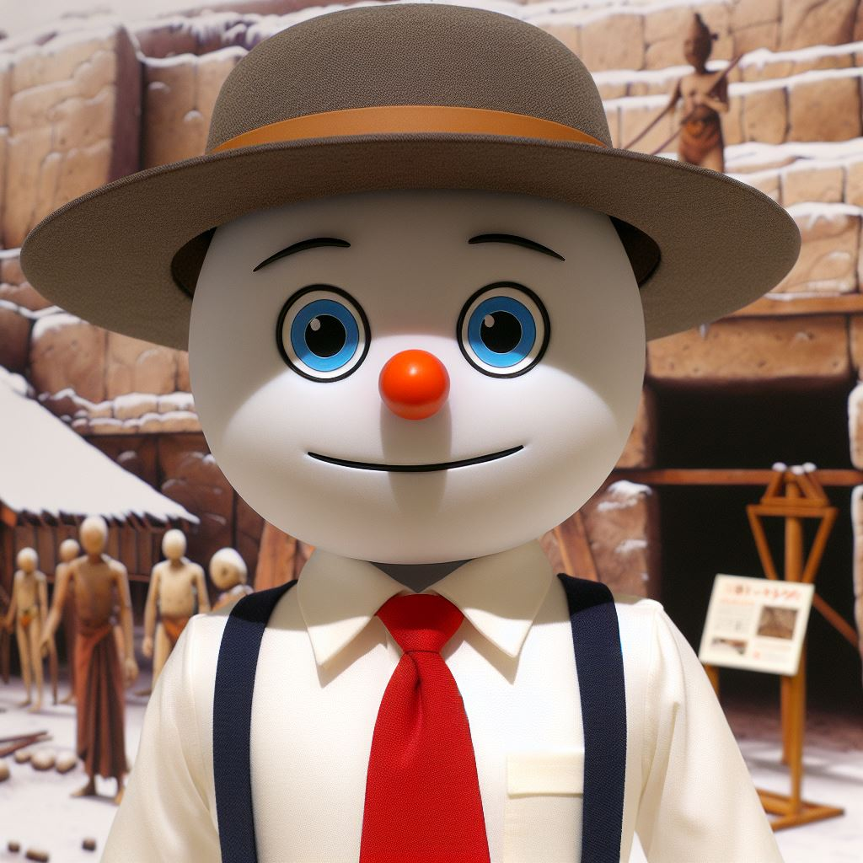
1.目標
Notes:
A Japanese 2D animation character, tall and thin, wearing a white shirt, red tie, dark blue suspenders, snowman face, small triangular brown hat on head, pure blue eyes, black triangular nose, red mouth, archaeologist
我是一名來自單親家庭的小孩，我的目標是找到我媽

Slide 3

2.阻礙
Notes:
A Japanese 2D animation character, tall and thin, wearing a white shirt, red tie, dark blue suspenders, snowman face, small triangular brown hat on head, pure blue eyes, black triangular nose, red mouth, archaeologist, looking like he is short of money, with some tattered coins and banknotes
面臨著巨大的阻礙：由於母親位於國外，需要資金出國，而金錢成了我最大的阻礙。

Slide 4
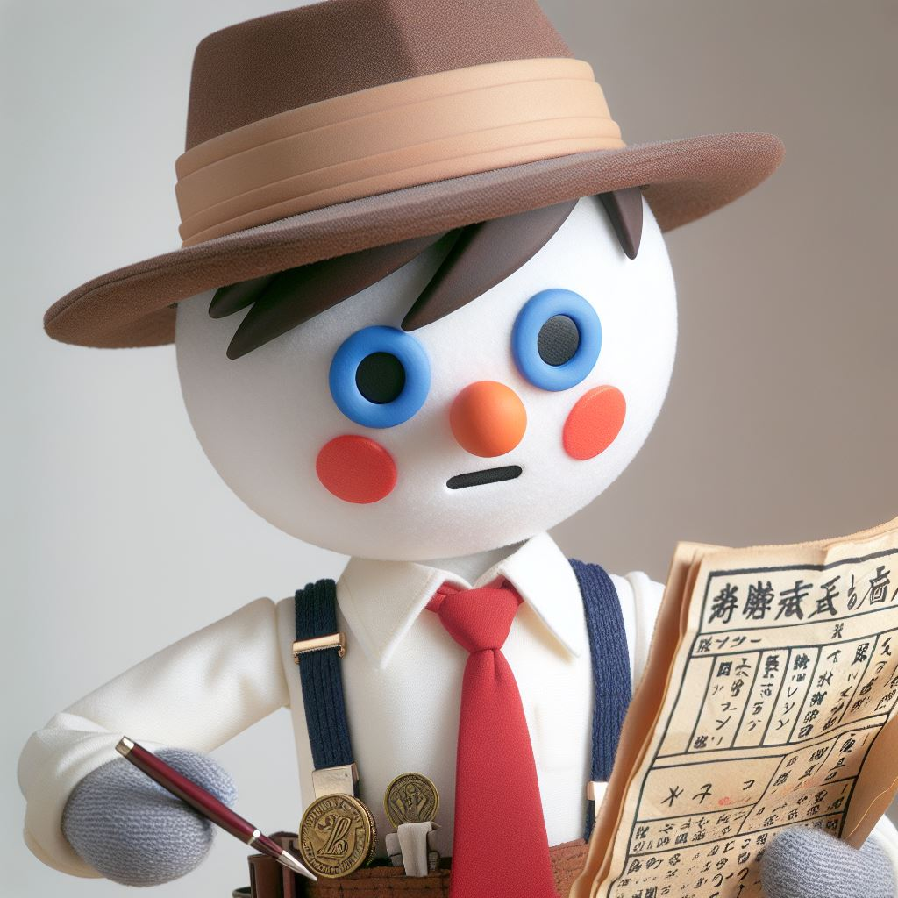
3.努力
Notes:
A Japanese 2D animation character, tall and thin, wearing a white shirt, red tie, dark blue suspenders, snowman face, small triangular brown hat on head, pure blue eyes, black triangular nose, red mouth, archaeologist, looking like he is short of money, with some tattered coins and banknotes, studying ancient documents diligently
我努力賺錢要買機票出國旅行尋親，最終我也存夠了錢可以購買所有的必需品。

Slide 5
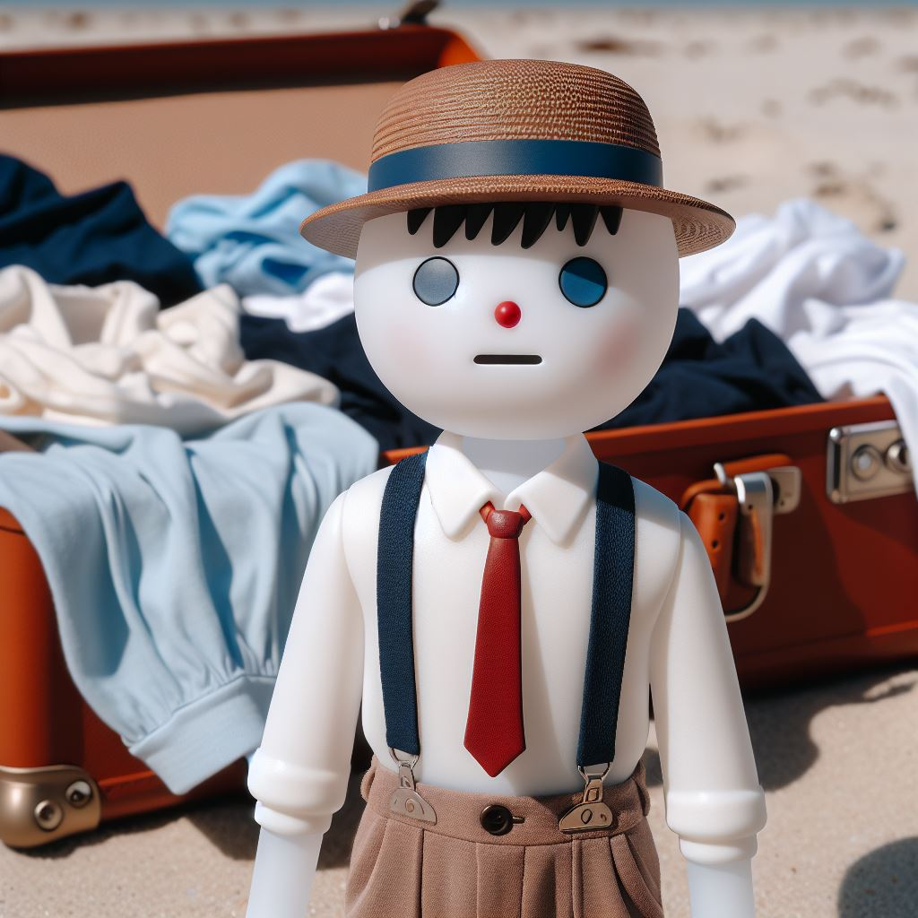
4.結果
Notes:
A Japanese 2D animation character, tall and thin, wearing a white shirt, red tie, dark blue suspenders, face is a snowman, small triangular brown hat on head, eyes are pure blue, black triangular nose, red mouth with expression :(. On a beach with scattered open luggage, body covered in injuries.
好景不常，在飛往馬來西亞的路途中，飛機意外失事了，醒來後我發現我漂到了無人島上。

Slide 6
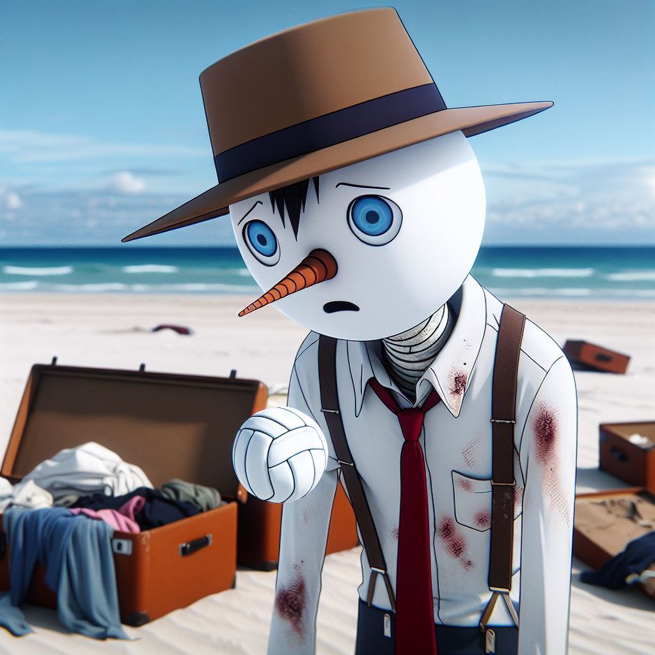
5.意外
Notes:
A Japanese 2D animation character, tall and thin, wearing a white shirt, red tie, dark blue suspenders, face is a snowman, small triangular brown hat on head, eyes are pure blue, black triangular nose, red mouth with expression :(. On a beach with scattered open luggage, body covered in injuries, finding a white volleyball in a bag.
我在與我一同漂流到無人島的行李中找到了一顆白色的排球，我決定給他一個叫做Wilson的名字，把它當成我的朋友跟它說話。

Slide 7
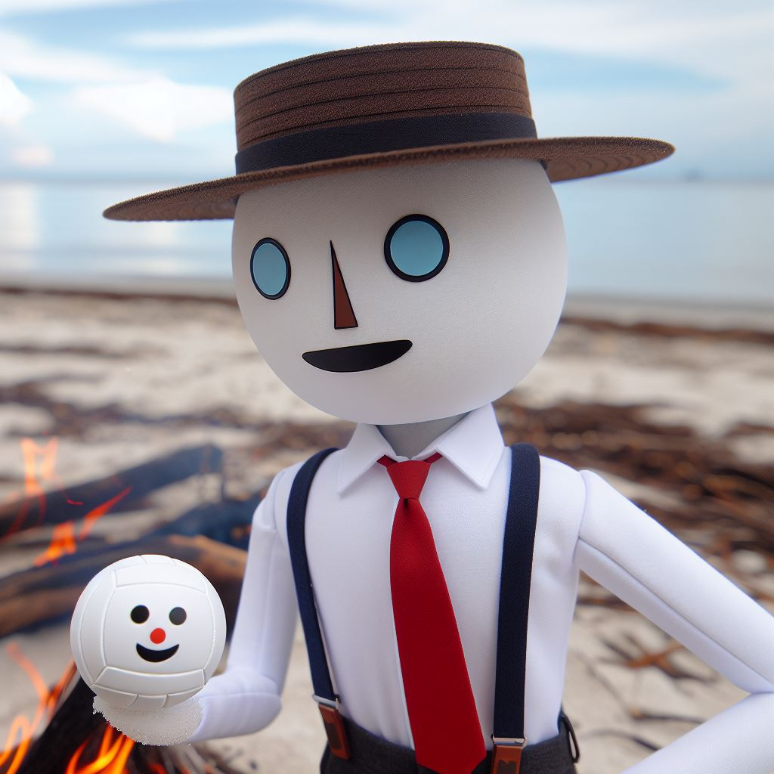
6.轉彎
Notes:
A Japanese 2D animation character, tall and thin, wearing a white shirt, red tie, dark blue suspenders, face is a snowman, small triangular brown hat on head, eyes are pure blue, black triangular nose, red mouth. On a beach, making a fire, with a white volleyball with a smiley face next to it.
幸虧有Wilson當我的朋友，我才可以在這個無人島排解心情，以較為健康的心情專心求生。

Slide 8
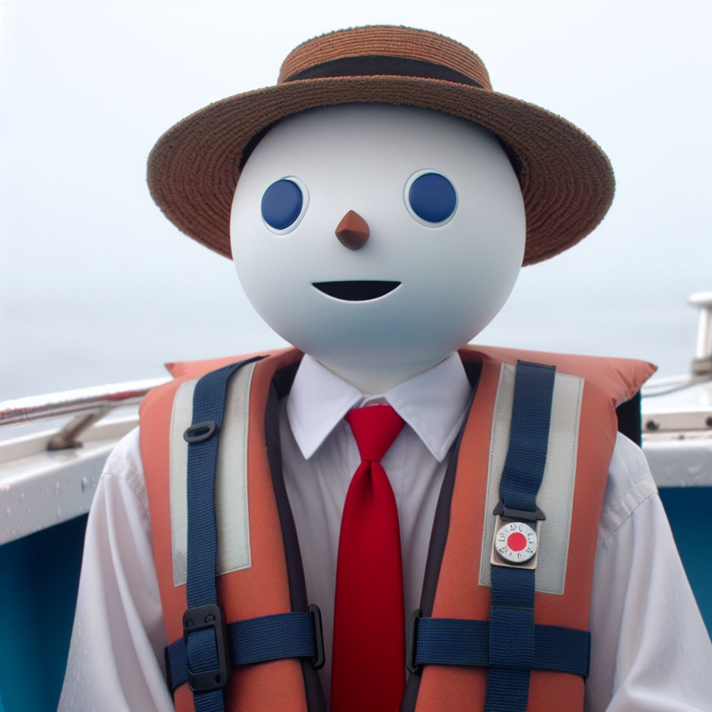
7.結局
Notes:
A Japanese 2D animation character, tall and thin, wearing a life jacket, red tie, dark blue suspenders, face is a snowman, small triangular brown hat on head, eyes are pure blue, black triangular nose, red mouth. Sitting at the bow of a boat.
最後在不知道過了多久，終於在海邊看到了一個路過的漁船，將我從無人島救出。

