Slide 1
Starbucks Beverage Contents Visualization
File created on: 10/15/23 8:37:53 PM EST

Slide 2
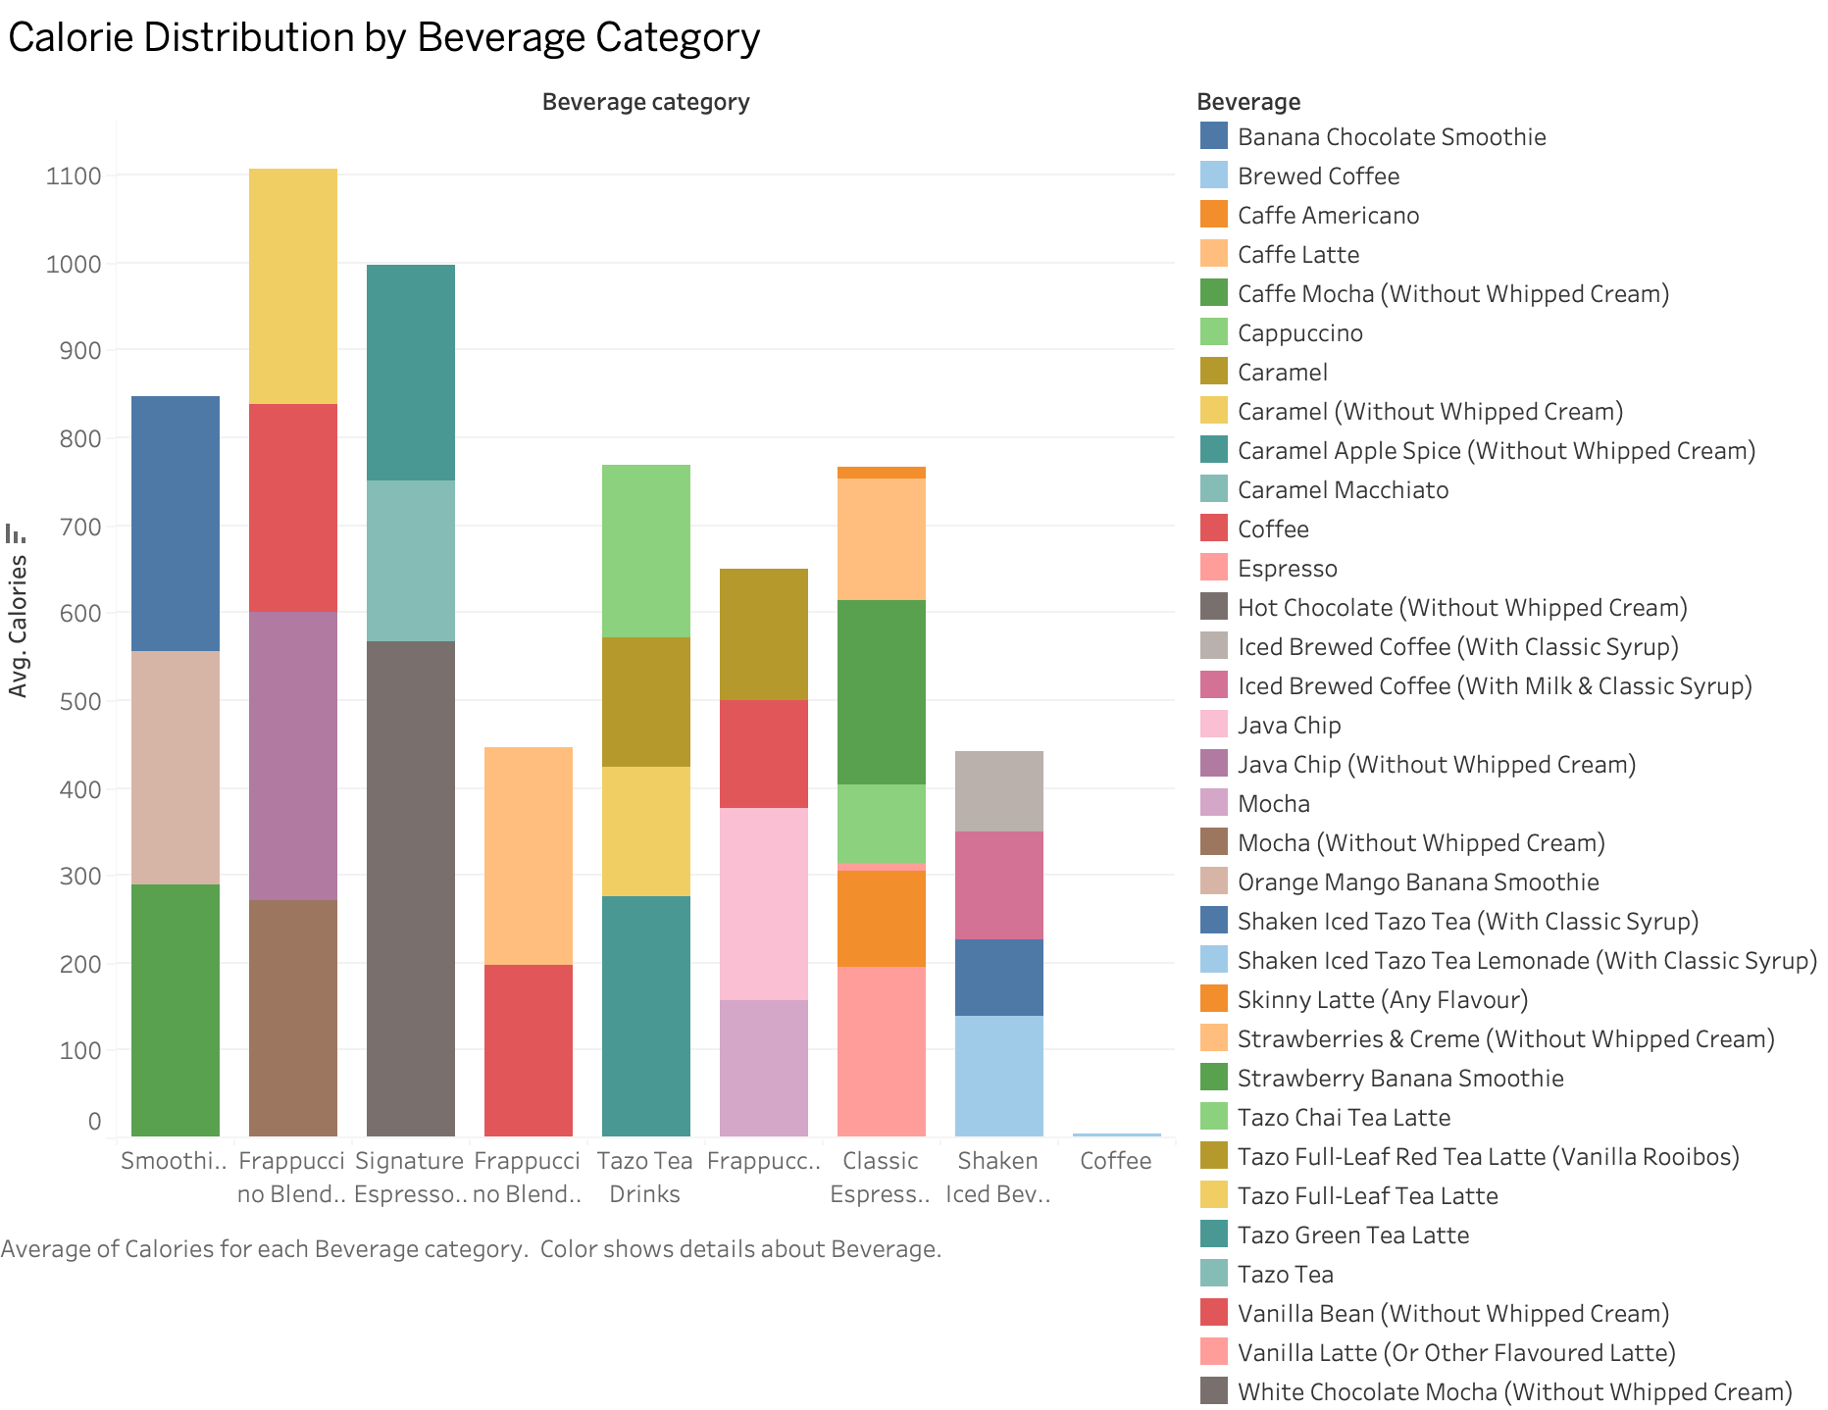

Slide 3
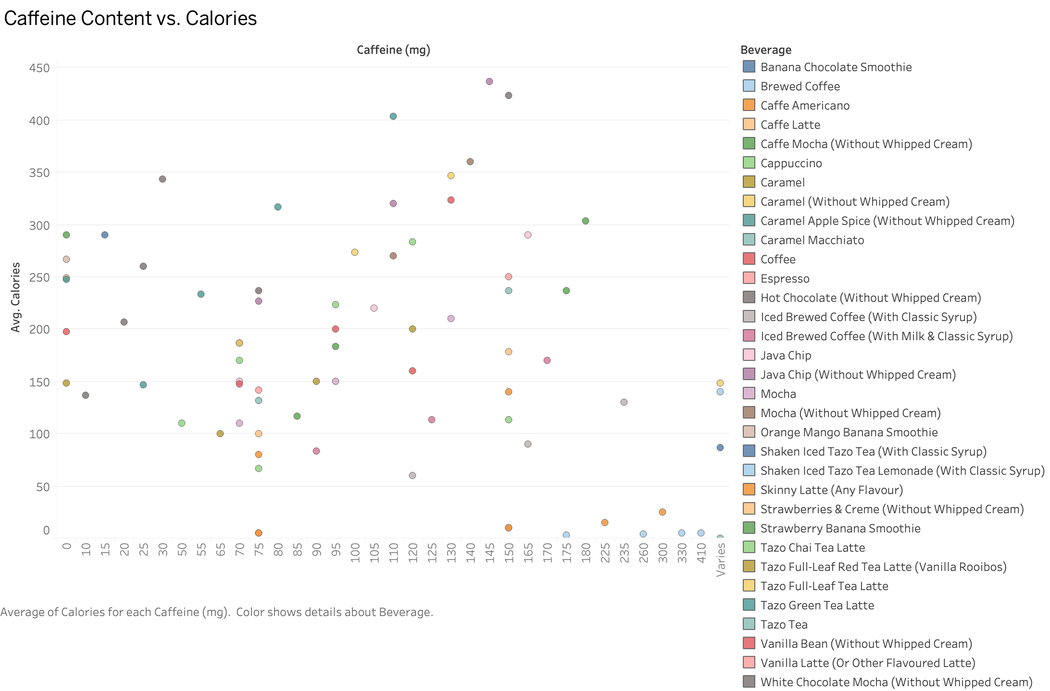

Slide 4
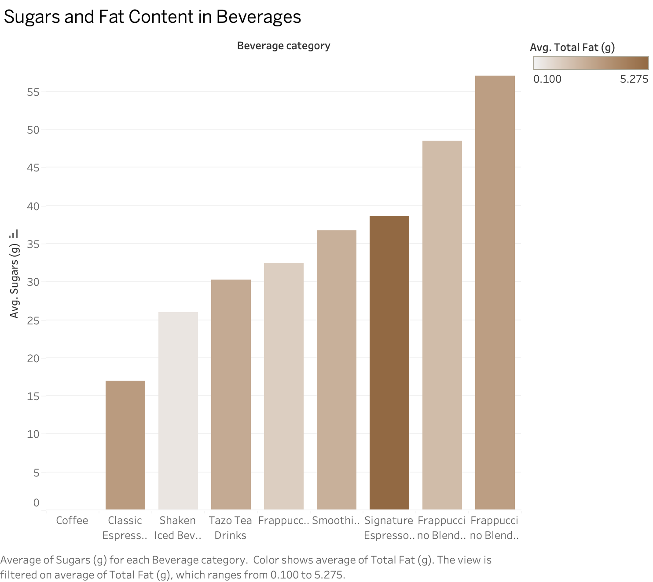

Slide 5
