Slide 1
ISP Overview
Architecture and tool
Marie-anne le menn
19 May 2017

Slide 2
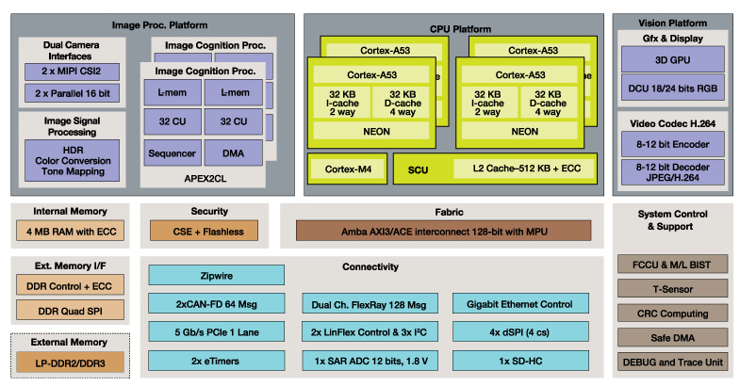
S32V234: Block Diagram

Slide 3
Image Sensor Processing
Black level correction
Exposure
White balancing
HDR
Vignetting
Debayering
RGB2YUV
Noise Filter
Format Conversion
Full processing for
up to 2x1Mpix @ 30fps!

Slide 4
AGENDA
ISP architecture
How to program it
Current software

Slide 5
AGENDA
Its architecture
Image processing and ISP kernels
ISP sub-system
ISP graph
Sequencer and processing pipeline
Memory management
IPU
How to program it
Current software

Slide 6
Image processing and ISP kernels

Slide 7



Principle
A matrix used for image convolution for image processing
1 x 0 +
2 x -1 +
3 x 0 +
13 x -1+
14 x 5 +
15 x -1+
25 x 0+
26 x -1+
27 x 0
0 x 0 +
1 x -1 +
2 x 0 +
Result
12 x -1+
13 x 5 +
14 x -1+
13
14
24 x 0+
25 x -1+
26 x 0
Kernel
Image
13
14

Slide 8
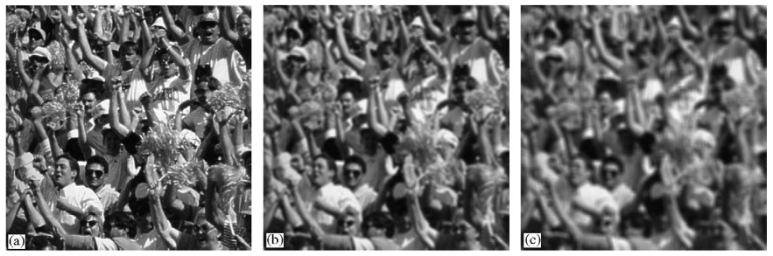
Examples: Mean
1 | 1 | 1 | 1 | 1 | 1 | 1
1 | 1 | 1 | 1 | 1 | 1 | 1
1 | 1 | 1 | 1 | 1 | 1 | 1
1 | 1 | 1 | 1 | 1 | 1 | 1
1 | 1 | 1 | 1 | 1 | 1 | 1
1 | 1 | 1 | 1 | 1 | 1 | 1
1 | 1 | 1 | 1 | 1 | 1 | 1
1/49 *
11
1 | 1 | . | . | 1 | 1
1 | 1 | . | . | 1 | 1
. | . | . | . | . | .
1 | 1 | . | . | 1 | 1
1/121 *
11

Slide 9
ISP Kernel
Can do image convolution
De-Bayering
White balancing
RGB to YUV conversion
…
But It can do much more like:
ISP kernel is a function

Slide 10
ISP kernel
Serialized with other ISP kernels
Kernel1
Kernel 2
Kernel 3

Slide 11
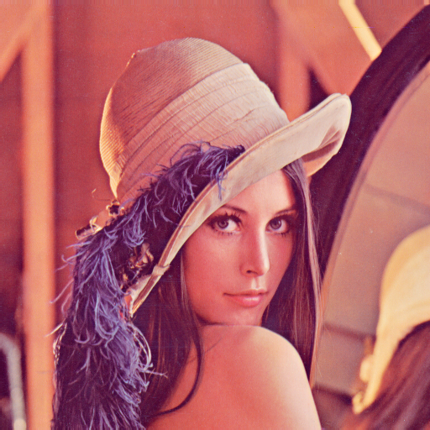

ISP Kernel examples
Kernel1
Kernel2

Slide 12
ISP subsystem

Slide 13
ISP Sub-system
IPU Modules
IPUS_0
IPUS
=
Scalar Image Processing Unit
(one result pixel at a time)
IPUS_1
…
IPUS_7

Slide 14
ISP Sub-system
IPU Modules
IPUS_0
IPUS_1
…
IPUS_7
IPUV_0
IPUV
=
Vector Image Processing Unit
(4 result pixels at a time)
…
IPUV_3

Slide 15
ISP Sub-system
IPU Modules
IPUS_0
Execute the Kernels
IPUS_1
…
IPUS_7
IPUV_0
…
IPUV_3

Slide 16
ISP Sub-system
SRAM
SRAM controller
IPU Modules
IPUS_0
IPUS_1
…
IPUS_7
Each input/output can fetch/output multiple data at the same time
IPUV_0
…
IPUV_3

Slide 17
ISP Sub-system
SRAM
SRAM controller
IPU Modules
IPUS_0
IPUS_1
…
The full SRAM is 4MB
=> 1MB is optimised for the ISP
IPUS_7
IPUV_0
…
IPUV_3

Slide 18
ISP Sub-system
SRAM
SRAM controller
IPU Modules
Sequencer
IPUS_0
IPUS_1
…
M0 Core
IPUS_7
IPUV_0
…
IPUV_3

Slide 19
ISP Sub-system
SRAM
SRAM controller
IPU Modules
Sequencer
IPUS_0
IPUS_1
…
M0 Core
IPUS_7
Data/ Instr. RAM
IPUV_0
…
IPUV_3

Slide 20
ISP Sub-system
SRAM
SRAM controller
IPU Modules
Sequencer
Crypto protected
IPUS_0
Kernel RAM
IPUS_1
…
M0 Core
IPUS_7
Data/ Instr. RAM
IPUV_0
…
IPUV_3

Slide 21
ISP Sub-system
SRAM
SRAM controller
IPU Modules
Sequencer
done
IPUS_0
start
Kernel RAM
IPUS_1
…
M0 Core
IPUS_7
Data/ Instr. RAM
IPUV_0
…
IPUV_3
Configuration and synchronization signals

Slide 22
ISP Sub-system
SRAM
SRAM controller
IPU Modules
Sequencer
done
IPUS_0
start
Kernel RAM
IPUS_1
…
M0 Core
IPUS_7
Data/ Instr. RAM
IPUV_0
…
IPUV_3
Fast DMA
DRAM

Slide 23
ISP Sub-system
SRAM
SRAM controller
IPU Modules
Sequencer
done
IPUS_0
start
Kernel RAM
IPUS_1
…
M0 Core
IPUS_7
Data/ Instr. RAM
IPUV_0
…
IPUV_3
done
Fast DMA
start
Configuration and synchronization signals
DRAM

Slide 24
ISP Sub-system
SRAM
SRAM controller
IPU Modules
Sequencer
done
IPUS_0
start
Kernel RAM
IPUS_1
…
M0 Core
IPUS_7
Data/ Instr. RAM
IPUV_0
…
IPUV_3
done
Fast DMA
Programmable Engines
start
DRAM

Slide 25

ISP Sub-system
SRAM
SRAM controller
MIPI-CSI
Camera
IPU Modules
Sequencer
done
IPUS_0
start
Kernel RAM
IPUS_1
…
M0 Core
IPUS_7
Data/ Instr. RAM
IPUV_0
…
IPUV_3
done
Fast DMA
start
DRAM

Slide 26
ISP graph

Slide 27
Graph
Camera Input
Buffer 1
Kernel1
Buffer 2
Kernel 2
…

Slide 28
Graph
Camera Input
Buffer 1
Kernel1
Final SRAM Buffer
DRAM Buffer
…
FAST DMA transfer

Slide 29
ISP Kernel examples
Kernel1
Kernel2

Slide 30
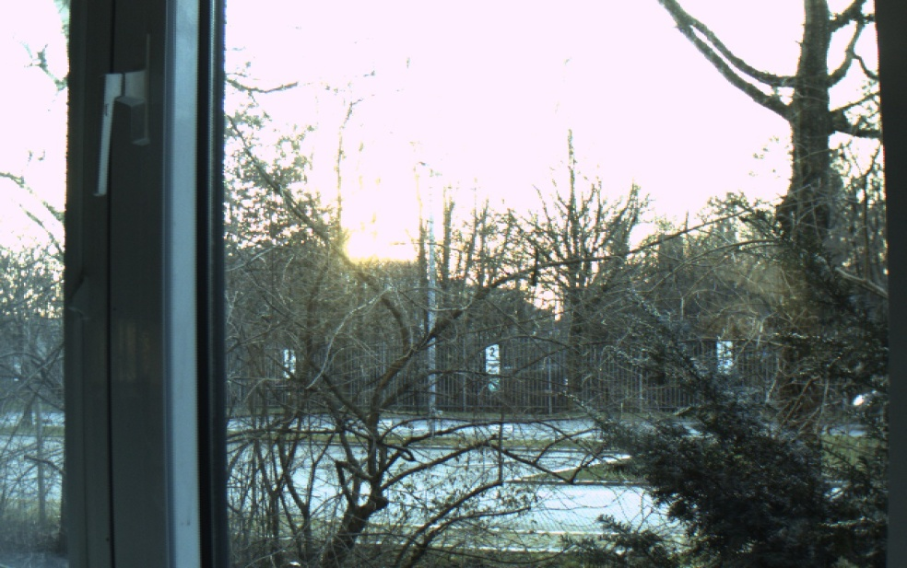
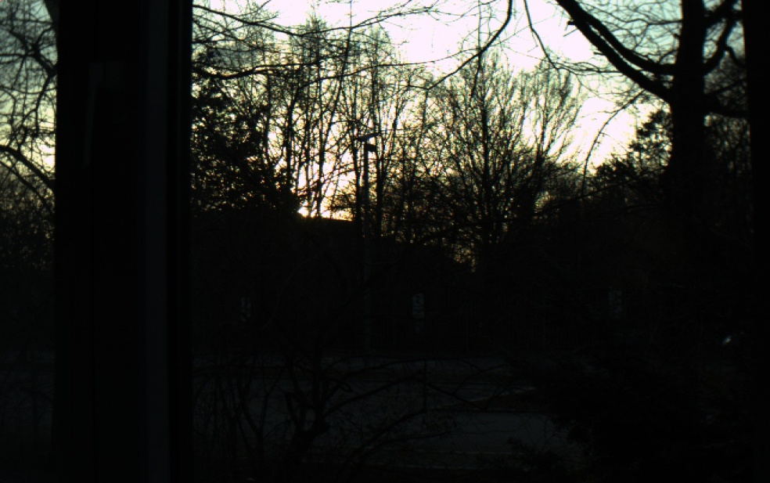
Graph
Buffer 1
Kernel1
Buffer 2

Slide 31
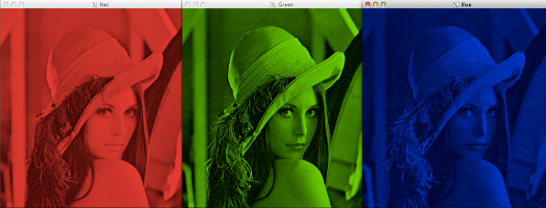
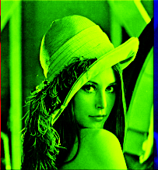
Graph
Buffer 1
Kernel 2
Buffer 2
Kernel1
Buffer 3
Kernel 3
…

Slide 32
Graph
Buffer 1
Kernel 3
…

Slide 33
Graph
Kernel 3
…
Buffer 1
Kernel 4
…

Slide 34
Sequencer and processing pipeline

Slide 35
ISP Sub-system
SRAM
SRAM controller
MIPI-CSI
Camera
IPU Modules
Sequencer
done
IPUS_0
start
Kernel RAM
IPUS_1
…
M0 Core
IPUS_7
Data/ Instr. RAM
IPUV_0
…
IPUV_3
done
Fast DMA
start
DRAM

Slide 36
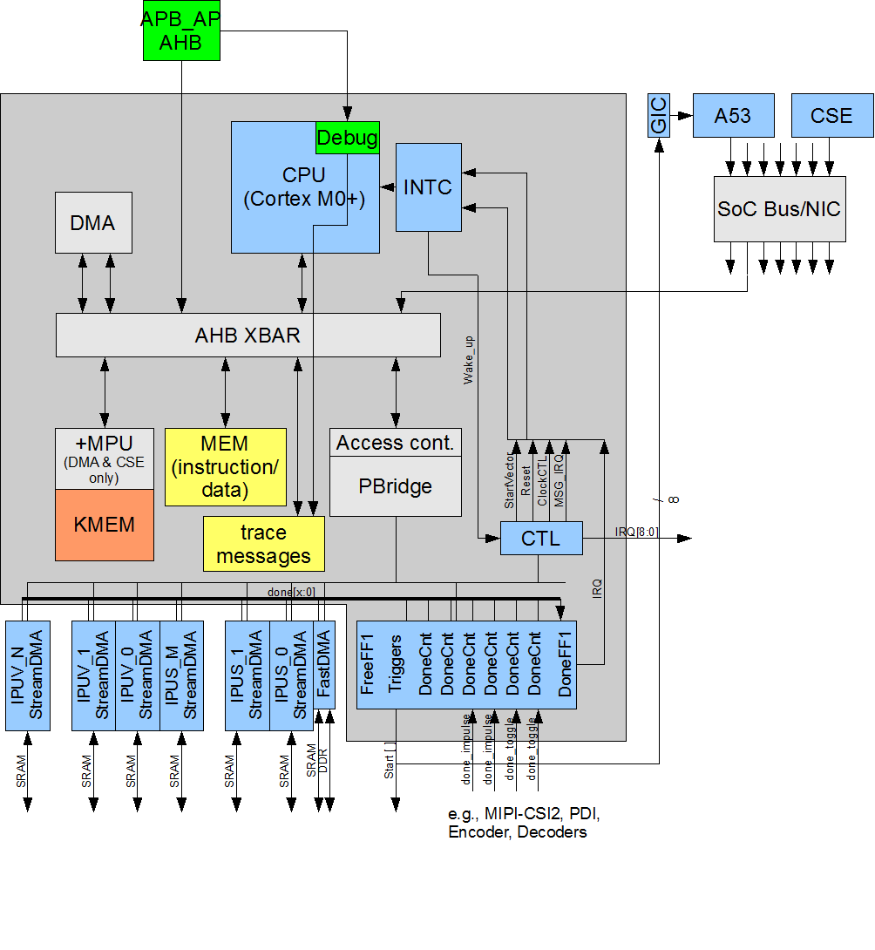
Sequencer: Block Diagram
Mapped into Host address space
Peripherals can also be controlled by Host CPU: IPUs and FastDMA
Servicing the Debug Unit for the IPUs
Sequencer code runs on the M0+ core
The sequencer executes/synchronises the ISP pipeline based on the graph description

Slide 37
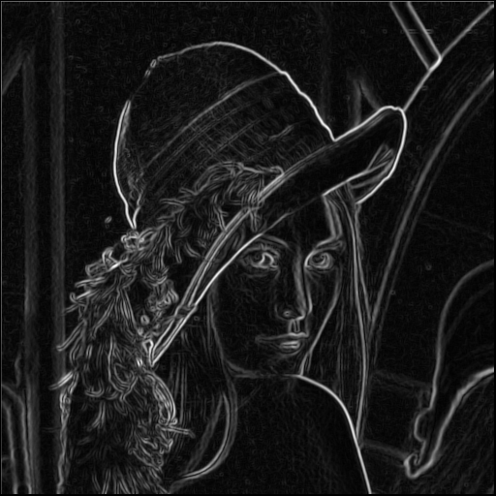
ISP Pipeline
Camera image buffer
Intermediate buffer
Final buffer
Kernel1
Kernel2

Slide 38
ISP Pipeline
Camera image buffer
Intermediate buffer
Final buffer
Kernel1
Kernel2

Slide 39
ISP Pipeline
Final SRAM buffer
Final DRAM buffer
FAST DMA transfer

Slide 40
IPU

Slide 41
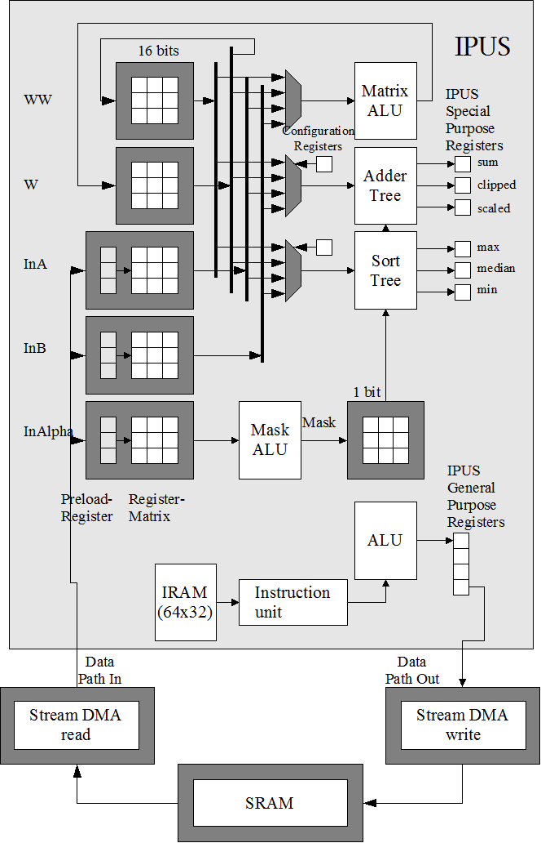
Scalar Engine (IPUS)

Slide 42
Scalar Engine (IPUS)
Input window: 3x3 or 9x1
Up to 3 Inputs:
Ex: R, G, B

Slide 43
Scalar Engine (IPUS)
No data memory (no load/store), only registers
Instruction memory
Decoding unit

Slide 44
Scalar Engine (IPUS)
Matrix ALU (3x3 -> 3x3)
Working matrix

Slide 45
Scalar Engine (IPUS)
3X3 Accelerators:
Sum, scaled, clipped
Max, median, min
Other accelerators:
Histogram
PRNG
Mask matrix: To select on which elements of the matrix the operation or accelerator should be applied to

Slide 46
Scalar Engine (IPUS)
Up to 2 output

Slide 47
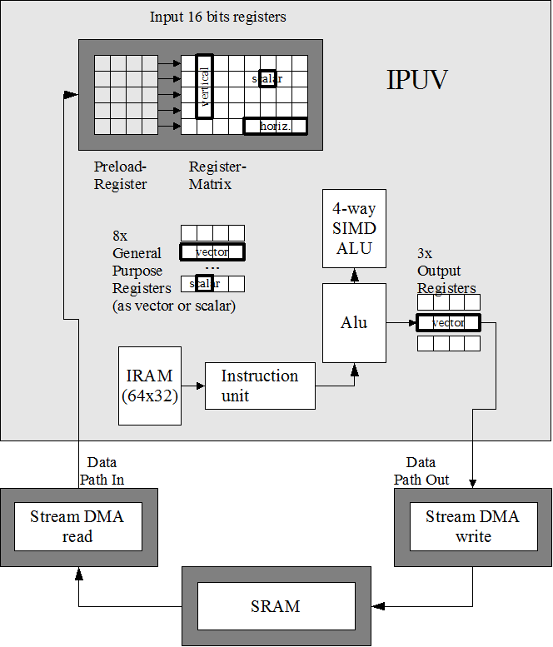
Vector Engine (IPUV)
5x5 input windows
Handles operation with:
Horizontal vectors
Vertical vectors
Scalars
4-way SIMD ALU

Slide 48
IPU Engines
8 x IPUS & 4 x IPUV
500MHz per Engine: 6000MHz total
Pixels are 16-bit fixed point data in signed or unsigned mode
Input and output managed by the StreamDMA engines

Slide 49
Input Matrix: IPUS
In2 | In1 | In0
In4 | In2 | In3
In7 | In6 | In5
3x3
In8 | In7 | In6 | In5 | In4 | In3 | In2 | In1 | In0
9x1

Slide 50
Input Matrix: IPUS
Pix 0 | Pix 1 | Pix 2 | Pix 3 | Pix 4 | Pix 5 | Pix 6 | Pix 7 | Pix 8
Pix 9 | Pix 10 | Pix 11 | Pix 12 | Pix 13 | Pix 14 | Pix 15 | Pix 16 | Pix 17
Pix 18 | Pix 19 | Pix 20 | Pix 21 | Pix 22 | Pix 23 | Pix 24 | Pix 25 | Pix 26
Pix 27 | Pix 28 | Pix 29 | Pix 30 | Pix 31 | Pix 32 | Pix 33 | Pix 34 | Pix 35
Pix 36 | Pix 37 | Pix 38 | Pix 39 | Pix 40 | Pix 41 | Pix 42 | Pix 43 | Pix 44
Pix 45 | Pix 46 | Pix 47 | Pix 48 | Pix 49 | Pix 50 | Pix 51 | Pix 52 | Pix 53
Input image
Input matrix

Slide 51
Input Matrix: IPUS
Pix 0 | Pix 1 | Pix 2 | Pix 3 | Pix 4 | Pix 5 | Pix 6 | Pix 7 | Pix 8
Pix 9 | Pix 10 | Pix 11 | Pix 12 | Pix 13 | Pix 14 | Pix 15 | Pix 16 | Pix 17
Pix 18 | Pix 19 | Pix 20 | Pix 21 | Pix 22 | Pix 23 | Pix 24 | Pix 25 | Pix 26
Pix 27 | Pix 28 | Pix 29 | Pix 30 | Pix 31 | Pix 32 | Pix 33 | Pix 34 | Pix 35
Pix 36 | Pix 37 | Pix 38 | Pix 39 | Pix 40 | Pix 41 | Pix 42 | Pix 43 | Pix 44
Pix 45 | Pix 46 | Pix 47 | Pix 48 | Pix 49 | Pix 50 | Pix 51 | Pix 52 | Pix 53
1st Input

Slide 52
Input Matrix: IPUS
Pix 0 | Pix 1 | Pix 2 | Pix 3 | Pix 4 | Pix 5 | Pix 6 | Pix 7 | Pix 8
Pix 9 | Pix 10 | Pix 11 | Pix 12 | Pix 13 | Pix 14 | Pix 15 | Pix 16 | Pix 17
Pix 18 | Pix 19 | Pix 20 | Pix 21 | Pix 22 | Pix 23 | Pix 24 | Pix 25 | Pix 26
Pix 27 | Pix 28 | Pix 29 | Pix 30 | Pix 31 | Pix 32 | Pix 33 | Pix 34 | Pix 35
Pix 36 | Pix 37 | Pix 38 | Pix 39 | Pix 40 | Pix 41 | Pix 42 | Pix 43 | Pix 44
Pix 45 | Pix 46 | Pix 47 | Pix 48 | Pix 49 | Pix 50 | Pix 51 | Pix 52 | Pix 53
2nd Input

Slide 53
Input Matrix: IPUS
Pix 0 | Pix 1 | Pix 2 | Pix 3 | Pix 4 | Pix 5 | Pix 6 | Pix 7 | Pix 8
Pix 9 | Pix 10 | Pix 11 | Pix 12 | Pix 13 | Pix 14 | Pix 15 | Pix 16 | Pix 17
Pix 18 | Pix 19 | Pix 20 | Pix 21 | Pix 22 | Pix 23 | Pix 24 | Pix 25 | Pix 26
Pix 27 | Pix 28 | Pix 29 | Pix 30 | Pix 31 | Pix 32 | Pix 33 | Pix 34 | Pix 35
Pix 36 | Pix 37 | Pix 38 | Pix 39 | Pix 40 | Pix 41 | Pix 42 | Pix 43 | Pix 44
Pix 45 | Pix 46 | Pix 47 | Pix 48 | Pix 49 | Pix 50 | Pix 51 | Pix 52 | Pix 53
… 5th input

Slide 54
Input Matrix: IPUS
Pix 0 | Pix 1 | Pix 2 | Pix 3 | Pix 4 | Pix 5 | Pix 6 | Pix 7 | Pix 8
Pix 9 | Pix 10 | Pix 11 | Pix 12 | Pix 13 | Pix 14 | Pix 15 | Pix 16 | Pix 17
Pix 18 | Pix 19 | Pix 20 | Pix 21 | Pix 22 | Pix 23 | Pix 24 | Pix 25 | Pix 26
Pix 27 | Pix 28 | Pix 29 | Pix 30 | Pix 31 | Pix 32 | Pix 33 | Pix 34 | Pix 35
Pix 36 | Pix 37 | Pix 38 | Pix 39 | Pix 40 | Pix 41 | Pix 42 | Pix 43 | Pix 44
Pix 45 | Pix 46 | Pix 47 | Pix 48 | Pix 49 | Pix 50 | Pix 51 | Pix 52 | Pix 53
1st Input of the 2nd line

Slide 55
Input Matrix: IPUS
Pix 0 | Pix 1 | Pix 2 | Pix 3 | Pix 4 | Pix 5
Pix 9 | Pix 10 | Pix 11 | Pix 12 | Pix 13 | Pix 14
Pix 18 | Pix 19 | Pix 20 | Pix 21 | Pix 22 | Pix 23
Pix 27 | Pix 28 | Pix 29 | Pix 30 | Pix 31 | Pix 32
Pix 36 | Pix 37 | Pix 38 | Pix 39 | Pix 40 | Pix 41
Pix 45 | Pix 46 | Pix 47 | Pix 48 | Pix 49 | Pix 50
9x1 mode 3rd Input

Slide 56
Memory management

Slide 57
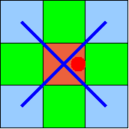
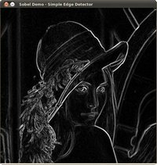
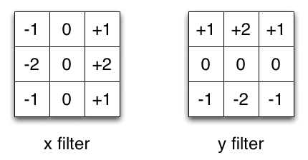
ISP Kernel
A lot of image processing steps (kernels) require multiple lines:
De-bayering
Sobel filtering
IPUs can fetch pixels from different lines

Slide 58
Image processing kernel
0 x 0 +
1 x -1 +
2 x 0 +
Result
12 x -1+
13 x 5 +
14 x -1+
13
24 x 0+
25 x -1+
26 x 0
Kernel
Image
13

Slide 59


Image processing kernel
Result
Kernel
Image

Slide 60
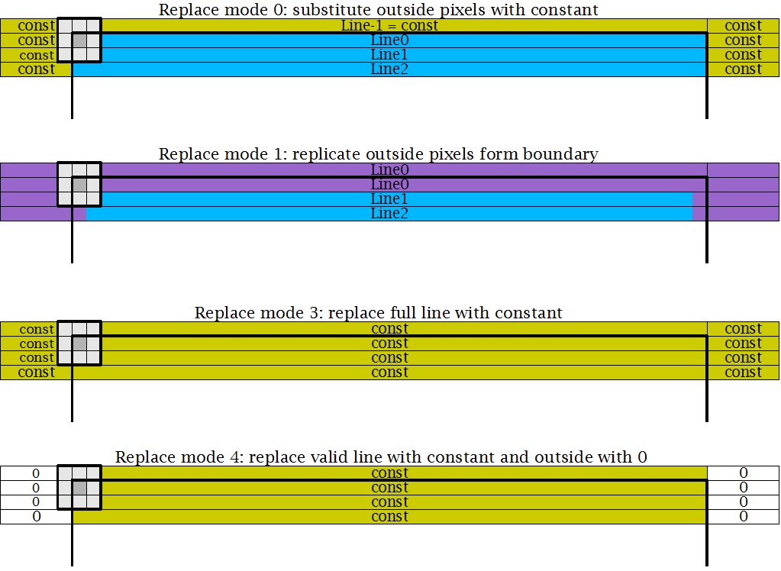
Hardware Replacement Modes
StreamDMA has a lot of additional features:
Scaling
Multiple data format support

Slide 61
AGENDA
Its architecture
How to program it
Current software

Slide 62
AGENDA
Its architecture
How to program it
Graph tool
Kernel example
Software Components
Build Process
Project structure
Optimisations
Current software

Slide 63
Graph tool (DEMO)

Slide 64
Kernel example

Slide 65
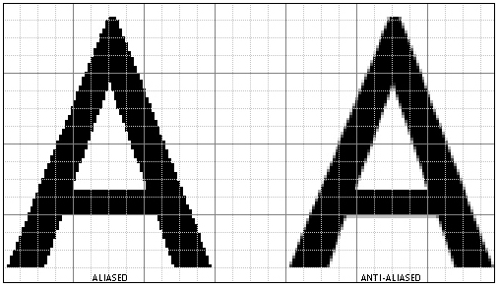
Example of 2:1 Scaling and Gaussian filter
1 | 2 | 1
2 | 4 | 2
1 | 2 | 1
x 1/16
3x3 Gaussian filter
Low pass filter

Slide 66
Example of 2:1 Scaling and Gaussian filter
1 | 2 | 1
2 | 4 | 2
1 | 2 | 1
1/16 | 1/8 | 1/16
1/8 | 1/4 | 1/8
1/16 | 1/8 | 1/16
1/16 equivalent to a right shift of 4
1/8 equivalent to a right shift of 3
1/4 equivalent to a right shift of 2
x 1/16
4 | 3 | 4
3 | 2 | 3
4 | 3 | 4
Shift Matrix:

Slide 67
Example of 2:1 Scaling and Gaussian filter
Code: IPU configuration
start_scale:
mov confalu, (0 /*unsigned*/ |
(1<<1) /*saturate*/)
mov confaddt,(0 /*w*/ |
(0<<3) /*unsigned*/ |
(5<<5) /*shift*/ |
(0x40 << 9) /* scale*/)
Confalu and Confaddt are core registers of the IPU

Slide 68
Example of 2:1 Scaling and Gaussian filter
 |  | Pix 1,1
 |  | Pix 2,1
 |  | Pix 3,1
Code: Input initialisation
Input matrix
InA
done d0,i
d0:
done d1,i
d1:
done d2,i
 | Pix 1,1 | Pix 1,2
 | Pix 2,1 | Pix 2,2
 | Pix 3,1 | Pix 3,2
Pix 1,1 | Pix 1,2 | Pix 1,3
Pix 2,1 | Pix 2,2 | Pix 2,3
Pix 3,1 | Pix 3,2 | Pix 3,3

Slide 69
Example of 2:1 Scaling and Gaussian filter
1 | 0 | 1
0 | 0 | 0
1 | 0 | 1
Code: Shifting matrix initialisation
Mask Matrix
d2:
mov maskv,0b101000101
mov w,4 // to w
mset 0b010101010
mov w,3 // to w
mov w4,2

Slide 70
Example of 2:1 Scaling and Gaussian filter
Mask matrix

Slide 71
Example of 2:1 Scaling and Gaussian filter
1 | 0 | 1
0 | 0 | 0
1 | 0 | 1
Code: Shifting matrix initialisation
Mask matrix
d2:
mov maskv,0b101000101
mov w,4
mset 0b010101010
mov w,3
mov w4,2
Matrix instruction
4 | 0 | 4
0 | 0 | 0
4 | 0 | 4
Working matrix W

Slide 72
Example of 2:1 Scaling and Gaussian filter
Working matrix W

Slide 73
Example of 2:1 Scaling and Gaussian filter
0 | 1 | 0
1 | 0 | 1
0 | 1 | 0
Code: Shifting matrix initialisation
Mask matrix
d2:
mov maskv,0b101000101
mov w,4
mset 0b010101010
mov w,3
mov w4,2
4 | 3 | 4
3 | 0 | 3
4 | 3 | 4
Working matrix W

Slide 74
Example of 2:1 Scaling and Gaussian filter
Code: Shifting matrix initialisation
d2:
mov maskv,0b101000101
mov w,4
mset 0b010101010
mov w,3
mov w4,2
4 | 3 | 4
3 | 2 | 3
4 | 3 | 4
Working matrix W
Scalar instruction
(Mask matrix does not apply)

Slide 75
Example of 2:1 Scaling and Gaussian filter
4 | 3 | 4
3 | 2 | 3
4 | 3 | 4
Code: Shifting matrix initialisation
Shift matrix saved in Working matrix WW
swp // w -> ww
mov maskv, 0b111111111
(important for future instruction)
1 | 1 | 1
1 | 1 | 1
1 | 1 | 1
Mask matrix

Slide 76
Example of 2:1 Scaling and Gaussian filter

Slide 77
Example of 2:1 Scaling and Gaussian filter
Code: Main Loop
loop:
lsr w,ina,ww
dout sum,odd,ixo
odd:
done loop,ix
end_scale:
Arithmetic-shift-right InA elements according to the coefficient in WW => result saved in W
“sum” register has the sum of all elements of the W matrix. Move that value to out0, and progress to next pixel (input, xpos, output)
Fetch new entry without creating any output: scaling of 2:1
Continue the loop
The kernel will restart from the beginning for each new line

Slide 78
Software Components

Slide 79
ISP Application
ARM Application for Linux or Standalone
ISP libraries
ISP
GDT Compiler
ISP Graph
ARM Code
main()
Compiler (AARCH64 – Linux, SA)
Compiler (AARCH64 – Linux, SA)
IPU Compiler
IPU Kernels
Support libraries
Device drivers
Final APP
3rd party libraries

Slide 80
ISP Application
ARM Application for Linux or Standalone
ISP libraries
ISP
GDT Compiler
ISP Graph
ARM Code
main()
Compiler (AARCH64 – Linux, SA)
Compiler (AARCH64 – Linux, SA)
IPU Compiler
IPU Kernels
Support libraries
Modified by the user
Device drivers
Final APP
3rd party libraries

Slide 81
Build Process

Slide 82
ISP Application
ARM Application for Linux or Standalone
ISP libraries
ISP
GDT Compiler
ISP Graph
ARM Code
main()
Compiler (AARCH64 – Linux, SA)
Compiler (AARCH64 – Linux, SA)
IPU Compiler
IPU Kernels
Support libraries
Device drivers
Final APP
3rd party libraries

Slide 83
Build sequence
Graph defined via graph design tool
ARM Application for Linux or Standalone
ISP libraries
ISP
GDT Compiler
ISP Graph
ARM Code
main()
Compiler (AARCH64 – Linux, SA)
Compiler (AARCH64 – Linux, SA)
IPU Compiler
IPU Kernels
Support libraries
Device drivers
Final APP
3rd party libraries

Slide 84
Build sequence
Graph compiled via GDT compiler -> .h and .c output
ARM Application for Linux or Standalone
ISP libraries
ISP
GDT Compiler
ISP Graph
ARM Code
main()
Compiler (AARCH64 – Linux, SA)
Compiler (AARCH64 – Linux, SA)
IPU Compiler
IPU Kernels
Support libraries
Device drivers
Final APP
3rd party libraries

Slide 85
Build sequence
ARM Application for Linux or Standalone
ISP libraries
ISP
GDT Compiler
ISP Graph
ARM Code
main()
Compiler (AARCH64 – Linux, SA)
Compiler (AARCH64 – Linux, SA)
IPU Compiler
IPU Kernels
Support libraries
Device drivers
IPU Kernels defined in assembly (.s file)
Final APP
3rd party libraries

Slide 86
Build sequence
ARM Application for Linux or Standalone
ISP libraries
ISP
GDT Compiler
ISP Graph
ARM Code
main()
Compiler (AARCH64 – Linux, SA)
Compiler (AARCH64 – Linux, SA)
IPU Compiler
IPU Kernels
Support libraries
Device drivers
IPU Kernels compiled - .c and .h file output
Final APP
3rd party libraries

Slide 87
Build sequence
ARM Application for Linux or Standalone
ISP libraries
ISP
GDT Compiler
ISP Graph
ARM Code
main()
Compiler (AARCH64 – Linux, SA)
Compiler (AARCH64 – Linux, SA)
IPU Compiler
IPU Kernels
Support libraries
Device drivers
Graph compiled and wrapped to C++ - .h and .a file output
Final APP
3rd party libraries

Slide 88
Build sequence
ARM Application for Linux or Standalone
ISP libraries
ISP
GDT Compiler
ISP Graph
ARM Code
main()
Compiler (AARCH64 – Linux, SA)
Compiler (AARCH64 – Linux, SA)
IPU Compiler
IPU Kernels
Support libraries
Device drivers
ISP header is included to ARM application code.
Final APP
3rd party libraries

Slide 89
Build sequence
ARM Application for Linux or Standalone
ISP libraries
ISP
GDT Compiler
ISP Graph
ARM Code
main()
Compiler (AARCH64 – Linux, SA)
Compiler (AARCH64 – Linux, SA)
IPU Compiler
IPU Kernels
Support libraries
Device drivers
Arm application is built and linked together with all the drivers, libs etc.
Final APP
3rd party libraries

Slide 90
Build sequence
ARM Application for Linux or Standalone
ISP libraries
ISP
GDT Compiler
ISP Graph
ARM Code
main()
Compiler (AARCH64 – Linux, SA)
Compiler (AARCH64 – Linux, SA)
IPU Compiler
IPU Kernels
Support libraries
Device drivers
Final application .elfs output
Final APP
3rd party libraries

Slide 91
Project structure

Slide 92
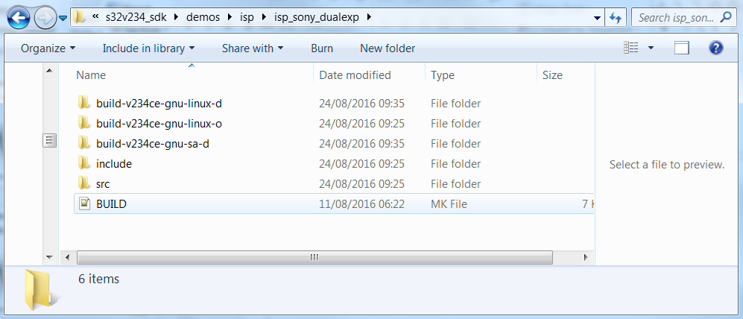
ISP demo
ISP demo can be found in: /s32v234_sdk/demos/isp folder
Demo can be built for stand-alone and Linux environment

Slide 93

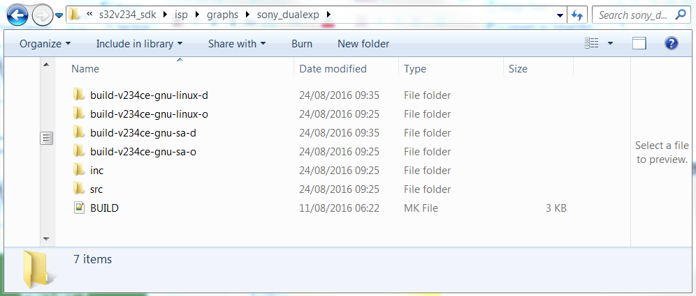
ISP demo
The ISP graph used by the demo is defined in the BUILD.mk file in the project folder
Then the graph can be found in the folder /s32v234_sdk/isp/graphs

Slide 94
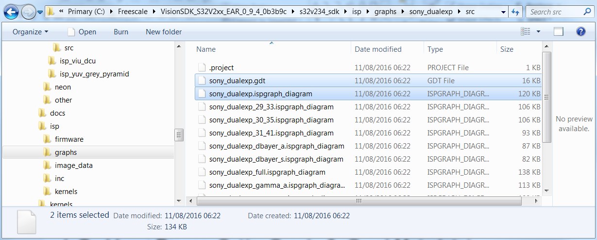
ISP graph
In the graph sources you can find the:
.ispgraph_diagram:
Graph created with the graph tool
As Many as you want
.gdt: descripton file generated by the tool and used by the gdt compiler
Generated based on the “ispgraph_diagram” with the same name as the graph folder

Slide 95
ISP graph
Graph compiled via GDT compiler -> .h and .c output
ARM Application for Linux or Standalone
ISP libraries
ISP
GDT Compiler
ISP Graph
ARM Code
main()
Compiler (AARCH64 – Linux, SA)
Compiler (AARCH64 – Linux, SA)
IPU Compiler
IPU Kernels
Support libraries
Device drivers
Final APP
3rd party libraries

Slide 96
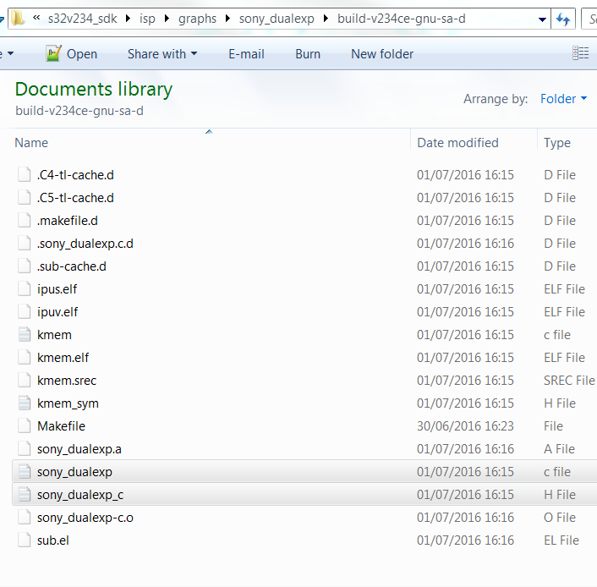
ISP Graph

Slide 97
ISP API
Allocation DRAM buffers for FastDMA transfer
Initialise camera
Start ISP sequencer
Get the output frames of the ISP (for APEX processing, display,…)
Stop ISP sequencer
Read/Write ISP registers

Slide 98
ISP API: Initialisation (main.cpp)
// *** Initialize SDI ***
lRes = sdi::Initialize(0);
// *** create grabber ***
sdi_grabber *lpGrabber = new(sdi_grabber);
lpGrabber->ProcessSet(gpGraph, &gGraphMetadata);
// *** prepare IOs ***
sdi_FdmaIO *lpFdma = (sdi_FdmaIO*)lpGrabber->IoGet(SEQ_OTHRIX_FDMA);
// *** allocate all the DDR buffers for the fast DMA transfers***
if (lpFdma->DdrBuffersAlloc(DDR_OUT_BUFFER_CNT) != LIB_SUCCESS) {
printf("Failed to allocate FastDMA buffers\n");
return 1;
}

Slide 99
ISP API: Initialisation (main.cpp)
// *** prestart grabber ***
lpGrabber->PreStart();
// *** configure camera parameters ***
CamConfig();

Slide 100
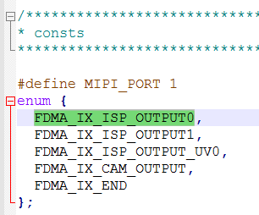
ISP API: Run time (main.cpp)
To access the latest frame
gFrameIsp = lpGrabber->FramePop(FDMA_IX_ISP_OUTPUT0);
if(gFrameIsp.mImage.mData == NULL)
{
break;
} // if pop failed
When the processing of the frame is over, the buffer needs to be released:
if(lpGrabber->FramePush(gFrameIsp) != LIB_SUCCESS)
{
break;
} // if push failed
From the file graph_name_c.h

Slide 101
ISP API: Run time (main.cpp)
Write into IPU registers:
// black level correction
seq_setReg(CHGAIN_ENGINE, 0, 0x70, 0xa18); // GPR0 (IPUS): R
seq_setReg(CHGAIN_ENGINE, 0, 0x71, 0xa18); // GPR1 (IPUS): GR
seq_setReg(CHGAIN_ENGINE, 0, 0x72, 0xa18); // GPR2 (IPUS): GB
seq_setReg(CHGAIN_ENGINE, 0, 0x73, 0xa18); // GPR3 (IPUS): B

Slide 102
Optimisations
Kernel assembly code
Multiple kernel ran on one IPU
Static sequencing

Slide 103
AGENDA
Its architecture
How to program it
Current software

Slide 104
AGENDA
Its architecture
How to program it
Current software
ISP kernels
AEC/AWB

Slide 105
ISP Kernels
Functions
Black level measurement
Black level correction
Dead pixel processing
Channel Gain
L/S decompression
Input decompression
Exposure measurement
HDR
De-Bayer
Color Correction Matrix
RGB2Y
Compression
YRB to YUV
Denoise Y
Subsample UV and denoise
Edge Enhancement
Functions
Channel gain
3x3 filters
Vignetting
Global tone mapping
Histogram computation
…

Slide 106
AEC/AWB
Only basic functions to provide example
Implemented de-flickering

Slide 107
Questions

