Slide 1
Priority queue
Data items are Comparable
Smaller elements (determined by compareTo()) have higher priority
remove() return the element with the highest priority = least in the compareTo() ordering
break ties arbitrarily

Slide 2
Examples of Priority Queues
Scheduling jobs to run on a computer default priority = arrival time
priority can be changed by operator
Scheduling events to be processed by an event handler priority = time of occurrence
Airline check-in
first class, business class, coach FIFO within each class
Tasks that you have to carry out. You determine priority

Slide 3


Example: Airline check-in
Fixed number of priority levels 0,...,p – 1
FIFO within each level
Example: airline check-in
•add()– insert in appropriate queue – O(1)
•poll()– must find a nonempty queue – O(p)
first class many miles paying frequent flier

Slide 4
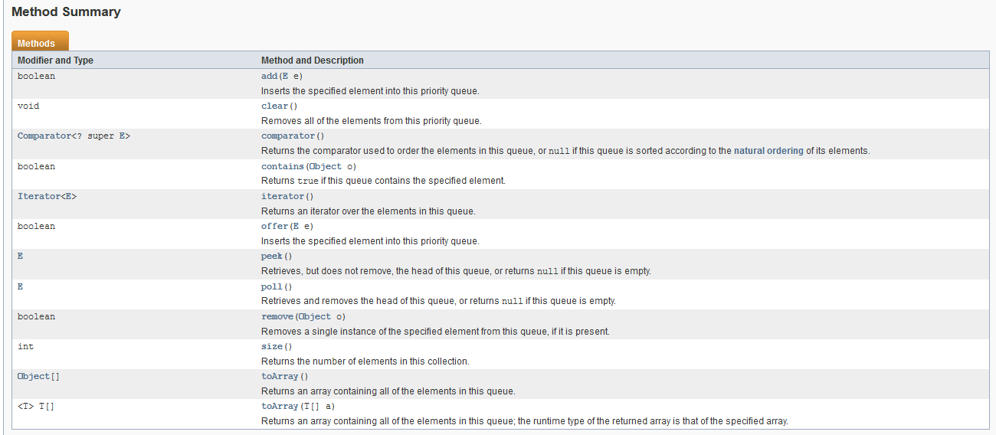
Priority Queue Methods

Slide 5
Priority queues as lists
9
Maintain as unordered list
add()
poll()
peek()
put new element at front – O(1) must search the list – O(n) must search the list – O(n)
Maintain as ordered list
add()
poll()
peek()
must search the list – O(n) must search the list – O(n) O(1)
Can we do better?

Slide 6
Heap
A heap is a specialized tree-based data structure that can be used to implement priority queues
Gives better complexity than either ordered or unordered list implementation:
add(): O(log n)
poll(): O(log n)
O(n log n) to process n elements
Do not confuse with heap memory, where the Java virtual machine allocates space for objects – different usage of the word heap

Slide 7
Heap
Binary tree with data at each node
Satisfies the Heap Order Invariant:
1. The least (highest priority) element of any subtree is at the root of that subtree.
Binary tree is complete (no holes)
2. Every level (except last) completely filled. Nodes on bottom level are as far left as possible.

Slide 8
Heap
Smallest element in any subtree
is always found at the root of that subtree
4
6
14
21
8
19
35
22
38
55
10
20
Note: 19, 20 < 35: Smaller elements can be deeper in the tree!

Slide 9
Not a heap —has two holes
Should be complete:
Every level (except last) completely filled.
Nodes on bottom level are as far
left as possible.
4
6
14
21
8
19
22
55
10
20
missing nodes

Slide 10
Heap: number nodes as shown
14
children of node k: at 2k + 1 and 2k + 2
0 4
1
6
2
14
parent of node k: at (k-1) / 2
3
21
4
8
5
19
6
35
7
22
8
38
9
55
Remember, tree has no holes

Slide 11



We illustrate using an array b (could also be ArrayList or Vector)
15
Heap nodes in b in order, going across each level from left to right, top to bottom
Children b[k] are b[2k + 1] and b[2k + 2]
Parent of b[k] b[(k – 1)/2]
to parent
0 1 2 3 4 5 6 7 8 9
to children
Tree structure is implicit. No need for explicit links!

Slide 12
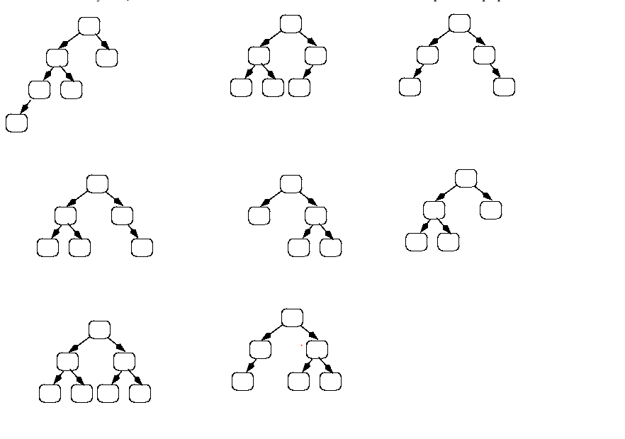
Heap Exercises

Slide 13
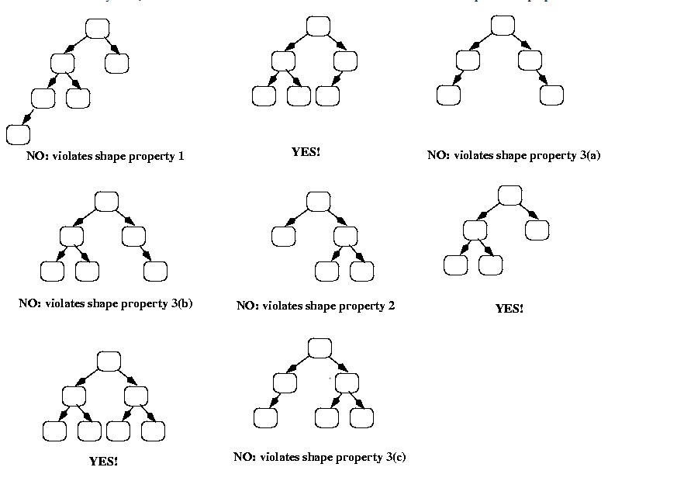
Solution

Slide 14
add(e)
16
Add e at the end of the array
If this violates heap order because it is smaller than its parent, swap it with its parent
Continue swapping it up until it finds its rightful place
The heap invariant is maintained!

Slide 15
add()
17
4
6
14
21
8
19
35
22
38
55
10
20

Slide 16
add()
18
4
6
14
21
8
19
35
22
38
55
10
20
5

Slide 17
add()
19
4
6
14
21
8
5
35
22
38
55
10
20
19

Slide 18
add()
20
4
6
5
21
8
14
35
22
38
55
10
20
19

Slide 19
add()
21
4
6
5
21
8
14
35
22
38
55
10
20
19

Slide 20
add()
22
4
6
5
21
8
14
35
22
38
55
10
20
19
2

Slide 21
add()
23
4
6
5
21
8
14
2
22
38
55
10
20
19
35

Slide 22
add()
24
4
6
2
21
8
14
5
22
38
55
10
20
19
35

Slide 23
add()
25
2
6
4
21
8
14
5
22
38
55
10
20
19
35

Slide 24
add()
26
2
6
4
21
8
14
5
22
38
55
10
20
19
35

Slide 25
add()
to a tree
of size n
27
Time is O(log n), since the tree is balanced
size of tree is exponential as a function of depth
depth of tree is logarithmic as a function of size

Slide 26
add()
--assuming
there
is space
28
/** An instance of a heap */ class Heap<E> {
E[] | b= | new | E[50]; | //heap is b[0..n-1]
int | n= | 0; |  | // heap invariant is | true
/** Add e to the heap */ public void add(E e) {
b[n]= e; n= n + 1;
bubbleUp(n - 1); // given on next slide
}
}

Slide 27
add().
Remember, heap is in b[0..n-1]
29
class Heap<E> {
/** Bubble element #k up to its position.
* Pre: heap inv holds except maybe for k */ private void bubbleUp(int k) {
int p= (k-1)/2; // p is the parent of k
// inv: p is parent of k and
// every other elt satisfies the heap inv while (k>0 && b[k].compareTo(b[p]) < 0) {
swap(b[k], b[p]); k= p;
p= (k-1)/2;
}
}

Slide 28
poll()
30
Remove the least element and return it – (at the root)
This leaves a hole at the root – fill it in with the last element of the array
If this violates heap order because the root element is too big, swap it down with the smaller of its children
Continue swapping it down until it finds its rightful place
The heap invariant is maintained!

Slide 29
poll()
31
4
6
5
21
8
14
35
22
38
55
10
20
19

Slide 30
poll()
32
4
6
5
21
8
14
35
22
38
55
10
20
19

Slide 31
poll()
33
4
6
5
21
8
14
35
22
38
55
10
20
19

Slide 32
poll()
34
4
19
6
5
21
8
14
35
22
38
55
10
20

Slide 33
poll()
35
4
5
6
19
21
8
14
35
22
38
55
10
20

Slide 34
poll()
36
4
5
6
14
21
8
19
35
22
38
55
10
20

Slide 35
poll()
37
4
5
6
14
21
8
19
35
22
38
55
10
20

Slide 36
poll()
38
4 5
6
14
21
8
19
35
22
38
55
10
20

Slide 37
poll()
39
4 5
6
14
21
8
19
35
22
38
55
10
20

Slide 38
poll()
40
4 5
20
6
14
21
8
19
35
22
38
55
10

Slide 39
poll()
41
4 5
6
20
14
21
8
19
35
22
38
55
10

Slide 40
poll()
42
4 5
6
8
14
21
20
19
35
22
38
55
10

Slide 41
poll()
43
4 5
6
8
14
21
10
19
35
22
38
55
20

Slide 42
poll()
44
4 5
6
8
14
21
10
19
35
22
38
55
20

Slide 43
poll()
45
Time is O(log n), since the tree is balanced

Slide 44
poll(). Remember, heap is in b[0..n-1]
46
/** Remove and return the smallest element
* (return null if list is empty) */ public E poll() {
if (n == 0) return null;
E v= b[0]; b[0]= b[n-1];
n= n - 1; bubbleDown(0); return v;
// smallest value at root
// move last elt to root
}

Slide 45
/** Bubble root down to its heap position.
Pre: b[0..n-1] is a heap except maybe b[0] */ private void bubbleDown() {
int k= 0;
// Set c to smaller of k’s children int c= 2*k + 2; // k’s right child
if (c >= n || b[c-1].compareTo(b[c]) < 0)
c= c-1;
// inv: b[0..n-1] is a heap except maybe b[k]
// Also, b[c] is b[k]’s smallest child while (c < n && b[k].compareTo(b[c]) > 0) {
swap(b[k], b[c]); k= c;
c= 2*k + 2; // k’s right child
if (c >= n || b[c-1].compareTo(b[c]) < 0) c= c-1;
}
47
}

Slide 46
Trouble changing heap behaviour a bit
48
Separate priority from value and do this:
add(e, p); //add element e with priority p (a double)
THIS IS EASY!
Be able to change priority
change(e, p); //change priority of e to p
THIS IS HARD!
Big question: How do we find e in the heap?
Searching heap takes time proportional to its size! No good! Once found, change priority and bubble up or down. OKAY

Slide 47
HeapSort(b, n)
—Sort b[0..n-1]
49
Whet your appetite –use heap to get exactly n log n in-place sorting algorithm. 2 steps, each is O(n log n)
1. Make b[0..n-1] into a max-heap (in place) 2. for (k= n-1; k > 0; k= k-1) {
b[k]= poll –i.e. take max element out of heap.
}
We’ll post this algorithm on course website
A max-heap has max value at root

Slide 48
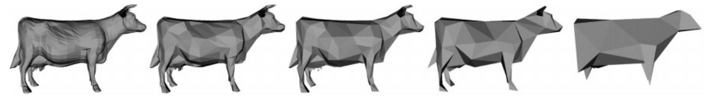
Many uses of priority queues & heaps
50
Surface simplification [Garland and Heckbert 1997]
Mesh compression: quadric error mesh simplification
Event-driven simulation: customers in a line
Collision detection: "next time of contact" for colliding bodies
Data compression: Huffman coding
Graph searching: Dijkstra's algorithm, Prim's algorithm
AI Path Planning: A* search
Statistics: maintain largest M values in a sequence
Operating systems: load balancing, interrupt handling
Discrete optimization: bin packing, scheduling
Spam filtering: Bayesian spam filter

