Slide 1
Design Pattern：An Introduction
Linzhang Wang
Department of Computer Science and Technology
Nanjing University

Slide 2
Outline
Background
What is a Design Pattern?
Why Design Pattern?
Description of Design Patterns.
Goals of Design Patterns
Classifications of Design Patterns.
Organization of Design Patterns
How Design Patterns Solve Design Problems.
Benefits of Design Patterns.
Liability of Design Patterns.

Slide 3
Background-Origins of Design Patterns
Building Architecture pattern
  Christopher Alexander, architect
  A Pattern Language---Towns, Buildings, Construction (1977)
  Timeless Way of Building (1979)
  “Each pattern describes a problem which occurs over and over again in our environment, and then describes the core of the solution to that problem, in such a way that you can use this solution a million times over, without ever doing it the same way twice.”
  ---Christopher Alexander, Sara Ishikawa, Murray Silverstein, Max Jacobson, Ingrid Fiksdahl-King, Shlomo Angel, “A Pattern Language: Towns/Buildings/ Construction”, Oxford University Press, New York, 1977
…
Notes:
CSc 335: Patterns I

Slide 4
Background
Other patterns:
  novels (tragic, romantic, crime),
  Poem
  movies,
  bureaucratic memos,
  political speeches
  。。。。

Slide 5
Background
In 1987, Kent Beck and Ward Cunningham began experimenting with the idea of applying patterns to programming and presented their results at the OOPSLA conference that year.
  ----Beck, Kent; Ward Cunningham (September 1987). "Using Pattern Languages for Object-Oriented Program". OOPSLA '87 workshop on Specification and Design for Object-Oriented Programming. OOPSLA '87. http://c2.com/doc/oopsla87.html

Slide 6
Background
In software engineering
  Search for recurring successful designs – emergent designs from practice (via trial and error)
  Supporting higher levels of reuse (i.e., reuse of designs) is quite challenging

Slide 7
What is a Design Pattern?
In software engineering, a design pattern is a general reusable solution to a commonly occurring problem in software design. A design pattern is not a finished design that can be transformed directly into code. It is a description or template for how to solve a problem that can be used in many different situations. Object-oriented design patterns typically show relationships and interactions between classes or objects, without specifying the final application classes or objects that are involved.
  ---http://en.wikipedia.org/wiki/Design_pattern_(computer_science)

Slide 8
What Is a Design Pattern?
A design pattern
  Is a common solution to a recurring problem in design
  Abstracts a recurring design structure
  Comprises class and/or object
    Dependencies
    Structures
    Interactions
    Conventions
  Names & specifies the design structure explicitly
  Distils design experience

Slide 9
Re-use Code VS. Design
Code re-use
  Don’t reinvent the wheel
  Requires clean, elegant, understandable, general, stable code
  leverage previous work
Design re-use
  Don’t reinvent the wheel
  Requires a precise understanding of common, recurring designs
  leverage previous work

Slide 10
Patterns vs “Design”
Patterns are design
  But: patterns transcend the “identify classes and associations” approach to design
  Instead: learn to recognize patterns in the problem space and translate to the solution
Patterns can capture OO design principles within a specific domain
Patterns provide structure to “design”

Slide 11
Design Patterns VS. Architecture Patterns
Design patterns reside in the domain of modules and interconnections.
At a higher level there are Architectural patterns that are larger in scope, usually describing an overall pattern followed by an entire system.

Slide 12
Design Patterns VS. Architecture Patterns
Design Patterns represent a lower level of system structure than “software architecture” (cf: seven levels of A)
Patterns can be applied to architecture:
  Mowbray and Malveau
  Buschmann et al
  Schmidt et al
Architectural patterns tend to be focussed on middleware. They are good at capturing:
  Concurrency
  Distribution
  Synchronization

Slide 13
Why design patterns in SA?
If you’re a software engineer, you should know about them anyway.
There are many architectural patterns published, and the Design Patterns is a prerequisite to understanding these:
  Mowbray and Malveau – CORBA Design Patterns
  Schmidt et al – Pattern-Oriented Software Architecture
Design Patterns help you break out of first-generation OO thought patterns

Slide 14
The seven layers of architecture*
OO architecture
Global architecture
ORB
Enterprise architecture
Subsystem
System architecture
Application architecture
Frameworks
Macro-architecture
Design patterns
Micro-architecture
Objects
OO programming

Slide 15
Design Patterns VS. Software Patterns
Not all software patterns are design patterns.
  For instance, algorithms solve computational problems rather than software design problems.
Design problem
Programming problem
Computational problem

Slide 16
What Makes it a Pattern?
A Pattern must:
  Solve a problem and be useful
  Have a context and can describe where the solution can be used
  Recur in relevant situations
  Provide sufficient understanding to tailor the solution
  Have a name and be referenced consistently

Slide 17
What Is a Design Pattern?
A design pattern has 4 basic parts:
  1. Name
  2. Problem
  3. Solution
  4. Consequences and trade-offs of application
Language- and implementation-independent
A “micro-architecture”
Adjunct to existing methodologies (Unified, OMT, etc.)
No mechanical application
  The solution needs to be translated into concrete terms in the application context by the developer

Slide 18
Description of a Design Pattern
Description of communicating objects and classes that are customized to solve a general design problem in a particular context.
Language- & implementation-independent
A “micro-architecture”
Adjunct to existing methodologies (RUP, Fusion, SCRUM, etc.)

Slide 19
Description of a Design Pattern
Graphical notation is generally not sufficient
In order to reuse design decisions the alternatives and trade-offs that led to the decisions are critical knowledge
Concrete examples are also important
The history of the why, when, and how set the stage for the context of usage

Slide 20
Description of a Design Pattern
Describe a recurring design structure
  Defines a common vocabulary
  Abstracts from concrete designs
  Identifies classes, collaborations, and responsibilities
  Describes applicability, trade-offs, and consequences
Formats of pattern writers vary, but a pattern description usually has at least these four things.
  pattern name
  problem
  solution
  Consequences

Slide 21
Pattern Name
A handle used to describe:
  a design problem
  its solutions
  its consequences
Increases design vocabulary
Makes it possible to design at a higher level of abstraction
Enhances communication
“The Hardest part of programming is coming up with good variable [function, and type] names.”

Slide 22
Problem
Describes when to apply the pattern
Explains the problem and its context
May describe specific design problems and/or object structures
May contain a list of preconditions that must be met before it makes sense to apply the pattern

Slide 23
Solution
Describes the elements that make up the
  design
  relationships
  responsibilities
  collaborations
Does not describe specific concrete implementation
Abstract description of design problems and how the pattern solves it

Slide 24
Consequences
Results and trade-offs of applying the pattern
Critical for:
  evaluating design alternatives
  understanding costs
  understanding benefits of applying the pattern
Includes the impacts of a pattern on a system’s:
  flexibility
  extensibility
  portability

Slide 25
Design Pattern Template
Pattern Name and Classification:
  A descriptive and unique name that helps in identifying and referring to the pattern.
Intent:
  A description of the goal behind the pattern and the reason for using it.
Also Known As:
  Other names for the pattern.
Motivation (Forces):
  A scenario consisting of a problem and a context in which this pattern can be used.
Applicability:
  Situations in which this pattern is usable; the context for the pattern.
Structure:
  A graphical representation of the pattern. Class diagrams and Interaction diagrams may be used for this purpose.
Participants:
  A listing of the classes and objects used in the pattern and their roles in the design.

Slide 26
Design Pattern Template
Collaboration:
  A description of how classes and objects used in the pattern interact with each other.
Consequences:
  A description of the results, side effects, and trade offs caused by using the pattern.
Implementation:
  A description of an implementation of the pattern; the solution part of the pattern.
Sample Code:
  An illustration of how the pattern can be used in a programming language.
Known Uses:
  Examples of real usages of the pattern.
Related Patterns:
  Other patterns that have some relationship with the pattern; discussion of the differences between the pattern and similar patterns.

Slide 27
Goals of Design Patterns
Codify good design
  Distil and disseminate experience
  Aid to novices and experts alike
  Abstract how to think about design
Give design structures explicit names
  Common vocabulary
  Reduced complexity
  Greater expressiveness
Capture and preserve design information
  Articulate design decisions succinctly
  Improve documentation
Facilitate restructuring/refactoring
  Patterns are interrelated
  Additional flexibility

Slide 28
Goals of Design Patterns
Design patterns can speed up the development process by providing tested, proven development paradigms.
Effective software design requires considering issues that may not become visible until later in the implementation.
Reusing design patterns helps to prevent subtle issues that can cause major problems, and it also improves code readability for coders and architects who are familiar with the patterns.

Slide 29
Why Design Patterns?
Designing OO software is hard
Designing reusable OO software – harder
Experienced OO designers make good design
New designers tend to fall back on non-OO techniques used before
Experienced designers know something – what is it?
Design Patterns
Notes:
Introduction to Software Engineering
Design Patterns

Slide 30
Why Design Patterns?
Expert designers know not to solve every problem from first principles.
They reuse solutions.
These patterns make OO designs more flexible, elegant, and ultimately reusable.
Notes:
Introduction to Software Engineering
Design Patterns

Slide 31
Two Major Principles of Object-Oriented Design
Program to an interface, not an implementation.
Favor object compositions over class inheritance.

Slide 32
OO Desgin
OOD methods emphasize design notations
  Fine for specification, documentation
But OOD is more than just drawing diagrams
  Good draftsmen  good designers
Good OO designers rely on lots of experience
  At least as important as syntax
Most powerful reuse is design reuse
  Match problem to design experience

Slide 33
Recurring OO Design Structures
OO systems exhibit recurring structures that promote
  abstraction
  flexibility
  modularity
  elegance
find pertinent objects and factor them into classes at the right granularity.
define class interfaces and inheritance hierarchies
Establish key relationship among classes.

Slide 34
OO Design is hard
The design should be specific to the problem at hand, but also general enough to address future problems and requirements.
Therein lies valuable design knowledge, the problem is
  Capturing,
  Communicating,
  applying this knowledge

Slide 35
Expert designers use patterns
When they find a good solution, they use it again and again.
The design patterns solve specific design problems and make OO designs more flexible, elegant, and ultimately reusable.
A designer who is familiar with patterns can apply them immediately to design problems.

Slide 36
A design pattern can …
Make it easier to reuse successful designs and architectures.
Help you choose good design: make system reusable.
Improve the documentation and maintenance.

Slide 37
Why Study Design Patterns?
Can reuse solutions.
  Gives us a head start
  Avoids the unanticipated things later
  No need to reinvent the wheel
Establish common terminology
  Design patterns provide a common point of reference
  Easier to say, “We need some Strategies here.”
Provide a higher level prospective.
  Frees us from dealing with the details too early.
Notes:
CSc 335: Patterns I

Slide 38
State of the Art
Notable Books：
  Gamma, Erich; Richard Helm, Ralph Johnson, and John Vlissides (1995). Design Patterns: Elements of Reusable Object-Oriented Software. Addison-Wesley. ISBN 0-201-63361-2.
  Schmidt, Douglas C.; Michael Stal, Hans Rohnert, Frank Buschmann (2000). Pattern-Oriented Software Architecture, Volume 2: Patterns for Concurrent and Networked Objects. John Wiley & Sons. ISBN 0-471-60695-2.
  Fowler, Martin (2002). Patterns of Enterprise Application Architecture. Addison-Wesley. ISBN 978-0321127426.
  Hohpe, Gregor; Bobby Woolf (2003). Enterprise Integration Patterns: Designing, Building, and Deploying Messaging Solutions. Addison-Wesley. ISBN 0-321-20068-3.

Slide 39
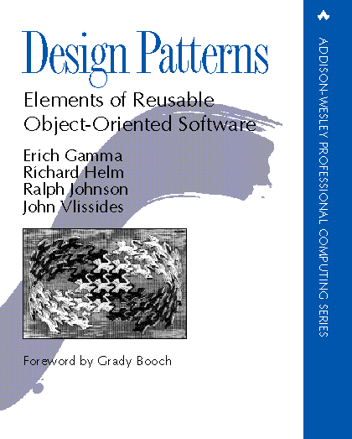
“Gang of Four” (GoF) Book
Design Patterns: Elements of Reusable Object-Oriented Software, Addison-Wesley Publishing Company, 1995
This book solidified thinking about patterns and became the seminal Design Patterns text

Slide 40
“Gang of Four” (GoF)
Dr. Erich Gamma, then Software Engineer, Taligent, Inc.; now at Object Technology International as the technical director of the Zurich lab in Switzerland.
Dr. Richard Helm, then Senior Technology Consultant, DMR Group; now at the Boston Consulting Group.
Dr. Ralph Johnson, then and now at University of Illinois, Computer Science Department; now a Research Associate Professor.
Dr. John Vlissides, then a researcher at IBM Thomas J. Watson Research Center.
Notes:
CSc 335: Patterns I

Slide 41
Patterns
This book defined 23 patterns, classified into three categories.
  Creational patterns, which deal with the process of object creation.
  Structural patterns, which deal primarily with the static composition and structure of classes and objects.
  Behavioral patterns, which deal primarily with dynamic interaction among classes and objects.
Many other patterns have been introduced by others.
  For example, the book Data Access Patterns by Clifton Nock introduces 4 decoupling patterns, 5 resource patterns, 5 I/O patterns, 7 cache patterns, and 4 concurrency patterns.
  Hundreds of patterns have been documented since; other examples include telecommunications patterns, pedagogical patterns, analysis patterns, and indexing patterns.
Notes:
CSc 335: Patterns I

Slide 42
What’s in this book
Designs that have been applied more than once in different systems.
Although the patterns are not new, they are arranged in a new and accessible way.
Three categories:
  Creational Patterns
  Structural Patterns
  Behavioral Patterns

Slide 43
GoF Patterns
Creational Patterns
  Abstract Factory
  Builder
  Factory Method
  Prototype
  Singleton
Structural Patterns
  Adapter
  Bridge
  Composite
  Decorator
  Façade
  Flyweight
  Proxy
Behavioral Patterns
  Chain of Responsibility
  Command
  Interpreter
  Iterator
  Mediator
  Memento
  Observer
  State
  Strategy
  Template Method
  Visitor
Notes:
CSc 335: Patterns I

Slide 44
What’s not in this book
About concurrency or distributed programming or real-time programming.
application domain-specific patterns.
patterns about user interfaces
device drivers
OO databases.
But an expert should know the above.

Slide 45
Types of Patterns
Creational patterns:
  Deal with initializing and configuring classes and objects
Structural patterns:
  Deal with decoupling interface and implementation of classes and objects
  Composition of classes or objects
Behavioral patterns:
  Deal with dynamic interactions among societies of classes and objects
  How they distribute responsibility

Slide 46
Classification of GoF Design Pattern
Creational | Structural | Behavioral
Factory Method Abstract Factory Builder Prototype Singleton | Adapter Bridge Composite Decorator Flyweight Facade Proxy | Interpreter Template Method Chain of Responsibility Command Iterator Mediator Memento Observer State Strategy Visitor

Slide 47
Alternative Classification (Reverse engineering)
Intent
language-provided patterns | structure-driven patterns | behavior-driven patterns | domain-specific patterns | generic concepts
Prototype Iterator | Bridge Composite Adapter Facade Proxy Template Method Visitor | Singleton Abstract Factory Factory Method Flyweight Chain of Responsibility Decorator Strategy State Observer Mediator | Command Interpreter | Memento Builder

Slide 48
Creational Patterns
Abstract Factory:
  Factory for building related objects
Builder:
  Factory for building complex objects incrementally
Factory Method:
  Method in a derived class creates associates
Prototype:
  Factory for cloning new instances from a prototype
Singleton:
  Factory for a singular (sole) instance

Slide 49
Structural Patterns
Adapter:
  Translator adapts a server interface for a client
Bridge:
  Abstraction for binding one of many implementations
Composite:
  Structure for building recursive aggregations
Decorator:
  Decorator extends an object transparently
Facade:
  Simplifies the interface for a subsystem
Flyweight:
  Many fine-grained objects shared efficiently.
Proxy:
  One object approximates another

Slide 50
Behavioral Patterns
Chain of Responsibility:
  Request delegated to the responsible service provider
Command:
  Request is first-class object
Iterator:
  Aggregate elements are accessed sequentially
Interpreter:
  Language interpreter for a small grammar
Mediator:
  Coordinates interactions between its associates
Memento:
  Snapshot captures and restores object states privately

Slide 51
Behavioral Patterns (cont.)
Observer:
  Dependents update automatically when subject changes
State:
  Object whose behavior depends on its state
Strategy:
  Abstraction for selecting one of many algorithms
Template Method:
  Algorithm with some steps supplied by a derived class
Visitor:
  Operations applied to elements of a heterogeneous object structure

Slide 52
Organization of Design Patterns
Two criterion are used to classify patterns:
  Purpose
    creational,
    structural,
    behavioral
  Scope
    Class
    Object

Slide 53
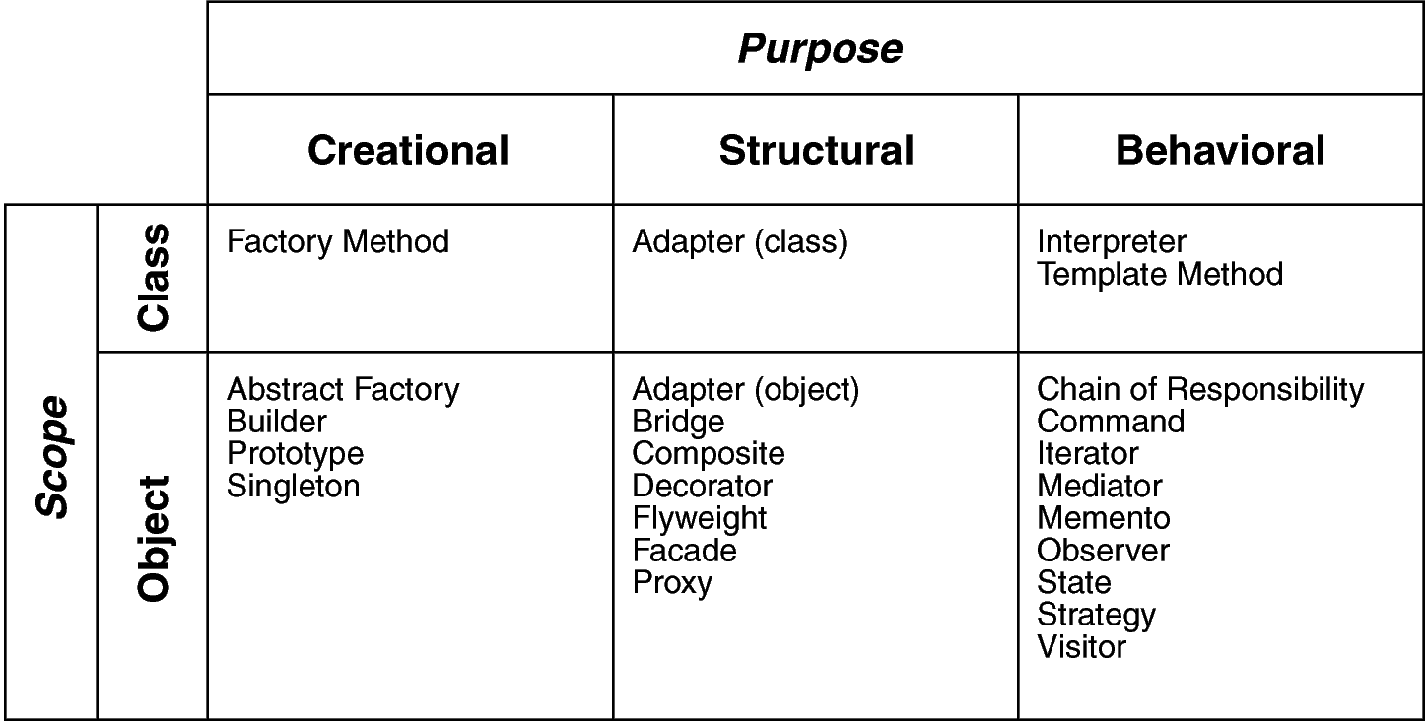
Design Space for GoF Patterns
Scope: domain over which a pattern applies
Purpose: reflects what a pattern does

Slide 54
Categorization Terms
Scope is the domain over which a pattern applies
  Class Scope: relationships between base classes and their subclasses (static semantics)
  Object Scope: relationships between peer objects
Some patterns apply to both scopes.

Slide 55
Class::Creational
Abstracts how objects are instantiated
Hides specifics of the creation process
May want to delay specifying a class name explicitly when instantiating an object
Just want a specific protocol

Slide 56
Example
Use Factory Method to instantiate members in base classes with objects created by subclasses
Abstract Application class: create application-specific documents conforming to a particular Document type
Application instantiates these Document objects by calling the factory method DoMakeDocument
Method is overridden in classes derived from Application
Subclass DrawApplication overrides DoMakeDocument to return a DrawDocument object

Slide 57
Class:: Structural
Use inheritance to compose protocols or code
Example:
  Adapter Pattern: makes one interface (Adaptee’s) conform to another
  Gives a uniform abstraction of different interfaces
  Class Adapter inherits privately from an Adaptee class
  Adapter then expresses its interface in terms of the Adaptee’s.

Slide 58
Class:: Behavioral
Captures how classes cooperate with their subclasses to satisfy semantics.
Example:
Template Method: defines algorithms step by step.
Each step can invoke an abstract method (that must be defined by the subclass) or a base method.
Subclass must implement specific behavior to provide required services

Slide 59
Object Scope
Object Patterns all apply various forms of non-recursive object composition.
Object Composition: most powerful form of reuse
Reuse of a collection of objects is better achieved through variations of their composition, rather than through sub classing.

Slide 60
Object:: Creational
Abstracts how sets of objects are created
Example:
Abstract Factory: create “product” objects through generic interface
  Subclasses may manufacture specialized versions or compositions of objects as allowed by this generic interface
User Interface Toolkit: 2 types of scroll bars (Motif and Open Look)
  Don’t want to hard-code specific one; an environment variable decides
Class Kit:
  Encapsulates scroll bar creation (and other UI entities);
  An abstract factory that abstracts the specific type of scroll bar to instantiate
  Subclasses of Kit refine operations in the protocol to return specialized types of scroll bars.
  Subclasses MotifKit and OpenLookKit each have scroll bar operation.

Slide 61
Object:: Structural
Describe ways to assemble objects to realize new functionality
  Added flexibility inherent in object composition due to ability to change composition at run-time
  not possible with static class composition
Example:
  Proxy: acts as convenient surrogate or placeholder for another object.
    Remote Proxy: local representative for object in a different address space
    Virtual Proxy: represent large object that should be loaded on demand
    Protected Proxy: protect access to the original object

Slide 62
Object:: Behavioral
Describes how a group of peer objects cooperate to perform a task that can be carried out by itself.
Example:
Strategy Pattern: objectifies an algorithm
Text Composition Object: support different line breaking algorithms
  Don’t want to hard-code all algs into text composition class/subclasses
Objectify different algs and provide them as Compositor subclasses (contains criteria for line breaking strategies)
Interface for Compositors defined by Abstract Compositor Class
  Derived classes provide different layout strategies (simple line breaks, left/right justification, etc.)
Instances of Compositor subclasses couple with text composition at run-time to provide text layout
Whenever text composition has to find line breaks, forwards the responsibility to its current Compositor object.

Slide 63
How Design Patterns Solve Design Problems.
The problems
  Finding Appropriate Objects
  Determining Object Granularity
  Specifying Object Interfaces
  Specifying Object Implementations
  Putting Reuse Mechanisms to Work
  Relating Run-Time and Compile-Time Structures.
  Designing for Change

Slide 64
Finding Appropriate Objects
To decomposing a system, we must consider:
  encapsulation, granularity, dependency, flexibility, performance, evolution, reusability, …
Strict modeling of the real world may lead to inflexibility.
The abstractions that emerge during design are key to making a design flexible.
Design patterns help you identify less-obvious abstractions and the objects that can capture them.

Slide 65
Determining Object Granularity
Objects can vary tremendously in size and number.
Design patterns address this issue as well.
The patterns: Facade, Flyweight, AbstractFactory, Builder, Visitor, Command …

Slide 66
Specifying Object Interface
Interface are fundamental in OO system.
  signature, type, supertype, dynamic binding, polymorphism.
Design patterns help you define interfaces by identifying their key elements and the kind of data that get sent across an interface.
A pattern also tell you what not to put.
Memento, Decorator, Proxy, Visitor

Slide 67
Specifying Object Implementation
About the implementation:
  Object’s implementation is defined by class.
  Objects are created by instantiating a class.
  New classes can be defined by class inheritance. (subclass and parent class).
  abstract class and concrete classes.
  A class may override an operation in the parent class.
  Mixin class is a class that’s intended to provide an optional interface or functionality.

Slide 68
Specifying Object Implementation
The issues:
  Class versus Interface Inheritance.
  Programming to an Interface, not an implementation.

Slide 69
Class versus Interface Inheritance(1)
The difference between class and type：
  class defines the implementation.
  type refers to the interface.
  An object can have many types, and objects of different classes can have the same type.
In some languages like C++, Eiffel, classes specify both an object’s type and its implementation.

Slide 70
Class versus Interface Inheritance(2)
Class inheritance versus interface inheritance
  class inheritance defines an object’s implementation in terms of another object’s implementation. (code and representation sharing).
  interface inheritance define when an object can be used in place of another. (subtyping)

Slide 71
Class versus Interface Inheritance(3)
Though most programming language don’t support the distinction between interface and implementation inheritance, people should make the distinction in practice.
Related patterns: Chain of Responsibility, Composite, Command, Observer, State, Strategy.

Slide 72
Programming to an interface, not an Implementation
Implementation reuse is only half of the purpose of inheritance.
Two benefits manipulating objects solely in terms of interface:
  Clients remain unaware of the specific types of objects they use.
  Clients remain unaware of the classes implementing the objects.

Slide 73
Programming to an interface, not an Implementation(2)
Declare variables using an interface defined by an abstract class.
Instantiate concrete classes somewhere.
The creational patterns make the instantiation possible.
  Abstract Factory, Builder, Factory Method, Prototype, Singleton.

Slide 74
Putting Reuse Mechanisms to Work
Inheritance versus Composition
Delegation
Inheritance versus Parameterized Types

Slide 75
Inheritance versus Composition
Inheritance is referred to as white-box reuse.
Object composition: assembling or composing objects to get more complex objects. referred as black-box reuse.

Slide 76
Reuse by Inheritance
The advantages:
  Defined statically at compile-time and is straightforward to use.
  Easier to modify the implementation being reused.
  Reuse by overrides some but not all operations.
The disadvantages:
  Can not change the implementations at run-time.
  Parent classes define part of the sub-classes’ physical representation. (inheritance breaks encapsulation)

Slide 77
Reuse by Composition
Composition requires objects to respect each others’ interfaces. So we don’t break encapsulation.
Any object can be replaced at run-time by another as long as it has the same type.
Reduce the implementation dependencies.
The classes and class hierarchies will remain small.

Slide 78
Favor object composition over class inheritance
You should be able to get all the functionality you need by assembling existing components.
You may use inheritance to define new components if the existing components are not enough.
Designs are often made more reusable by depending more on object composition.

Slide 79
Delegation(1)
A way of making composition as powerful as inheritance.
A receiving object delegates operations to its delegate.
Window
Rectangle
Area()
Area()
width
height

Slide 80
Delegation(2)
The advantage:
  easy to compose behaviors at run-time
  easy to change the way they’re composed.
Disadvantage:
  Dynamic, highly parameterized software is harder to understand than static software.
  run-time inefficiencies.
A good choice when it simplifiers more than it complicates.

Slide 81
Delegation(3)
The design patterns using delegation:
  State, Strategy, Visitor
  Less heavily: Mediator, Chain of Responsibility, Bridge.

Slide 82
Inheritance versus Parameterized Types
generics (Ada, Eiffel) or templates(C++)
A third way to reuse: Lets you define a type without specifying all the other types (as parameters) it uses.

Slide 83
Compare the three reuse methods
Object composition lets you change the behavior being composed at run-time. It requires indirection and can be less efficient.
Inheritance lets you provide default implementation, and lets you override them.
Parameterized types let you change the types that a class can use.

Slide 84
Relating Run-Time and Compile-Time Structures(1)
An object oriented program’s run-time structure often bears little resemblance to its code structure.

Slide 85
Aggregation and Acquaintance
Aggregation: one object owns or is responsible for another object.
Acquaintance: an object merely knows of another object. (also called ‘association’ or ‘using’)
Aggregation and acquaintance are similar. They are determined more by intent than by language mechanisms.
They are significantly different at the run-time.

Slide 86
Relating Run-Time and Compile-Time Structures(2)
We can not reveal everything about how a system will work.
The system’s run-time structure must be imposed more by designer.
Many design patterns capture the distinction between compile-time and run-time structures:
  Composite, Decorator, Chain of Responsibility.

Slide 87
Designing for Change
A design that doesn’t take change into account risks major redesign in the future.
Design patterns help you avoid this by ensuring that a system can change in specific ways.

Slide 88
Common causes of redesign
Creating an object by specifying a class explicitly.
  Abstract Factory, Factory Method, Prototype.
Dependence on specific operations:
  Chain of Responsibility, Command.
Dependence on hardware and software platform
  Chain of Responsibility, Command

Slide 89
Common causes of redesign(2)
Dependence on object representations or implementations
  Abstract Factory, Bridge, Memento, Proxy.
Algorithm dependencies
  Builder, Iterator, Strategy, Template Method, Visitor.
Tight coupling
  Abstract Factory, Bridge, Chain of Responsibility, Command, Facade, Mediator, Observer.

Slide 90
Common causes of redesign(3)
Extending functionality by subclassing
  Bridge, Chain of Responsibility, Composite, Decorator, Observer, Strategy.
Inability to alter conveniently
  Adapter, Decorator, Visitor

Slide 91
The flexibility for different kind of software
Application Programs
Toolkits
Frameworks

Slide 92
Using design patterns for application programs
internal reuse, maintainability, and extension are high priorities.
Design patterns increase internal reuse by reduce the dependencies.
Design patterns make an application more maintainable when they’re used to limit platform dependencies and to layer a system.
Reduce coupling also enhances extensibility.

Slide 93
Using design patterns for toolkits
Toolkits is a set of related and reusable classes designed to provide useful, general-purpose functionality.
Toolkits emphasize code reuse.
The designer should avoid assumptions and dependencies that can limit the toolkit’s flexibility.

Slide 94
Using design patterns for frameworks
A framework is a set of cooperating classes that make up a reusable design design for a specific class of software.
A framework defines:
  over-all structure
  its partitioning into classes and objects.
  key responsibilities thereof,
  the way the objects collaborate, and the control.
A framework emphasize design reuse.

Slide 95
Using design patterns for frameworks(2)
When you use a framework, you reuse the main body, and write the code it calls.
The software have the similar structure. They are easier to maintain.
Designing a frameworks is the hardest one.

Slide 96
Using design patterns for frameworks(3)
The most critical issues for framewrok design:
  As flexible and extensible as possible.
  Loose coupling between the elements.
A framework using design patterns is far more likely to achieve high levels of design and code reuse than the one doesn’t.
Design patterns can enhance the documentation of the framework.

Slide 97
Patterns vs Frameworks
Design patterns are more abstract than frameworks.
Design patterns are smaller architectural elements.
Design patterns are less specialized than framework.

Slide 98
Patterns vs Frameworks
Patterns are lower-level than frameworks
Frameworks typically employ many patterns:
  Factory
  Strategy
  Composite
  Observer
Done well, patterns are the “plumbing” of a framework

Slide 99
How to select a design pattern
Approaches to finding the design patterns:
  Consider how design patterns solve design problems.
  Scan intent sections.
  Study how patterns interrelate.
  Study patterns of like purpose.
  Examine a cause of redesign.
  Consider what should be variable in your design.(see table 1.2)

Slide 100
Where They are Used
Object-Oriented programming languages [and paradigm] are more amenable to implementing design patterns
Procedural languages: need to define
  Inheritance
  Polymorphism
  Encapsulation

Slide 101
When to Use Patterns
Solutions to problems that recur with variations
  No need for reuse if problem only arises in one context
Solutions that require several steps:
  Not all problems need all steps
  Patterns can be overkill if solution is a simple linear set of instructions
Solutions where the solver is more interested in the existence of the solution than its complete derivation
  Patterns leave out too much to be useful to someone who really wants to understand
  They can be a temporary bridge

Slide 102
Suggestions for Effective Use
Do not recast everything as a pattern
  Instead, develop strategic domain patterns and reuse existing tactical patterns
Institutionalize rewards for developing patterns
Directly involve pattern authors with application developers and domain experts
Clearly document when patterns apply and do not apply
Manage expectations carefully.

Slide 103
How to use a design pattern
A step-by-step approach:
  Read the pattern once through for an overview.
  Go back and study the Structure, Participants, and Collaborations sections.
  Look at the sample Code section to see a concrete example of the pattern in Code.
  Choose names for pattern participants that are meaningful in the application context.

Slide 104
How to use a design pattern(2)
Define the classes.
Define application-specific names for operations in the pattern.
Implement the operations to carry out the responsibilities and collaborations in the pattern.

Slide 105
Benefits of Design Patterns
Design patterns enable large-scale reuse of software architectures and also help document systems
Patterns explicitly capture expert knowledge and design tradeoffs and make it more widely available
Patterns help improve developer communication
Pattern names form a common vocabulary
Patterns help ease the transition to OO technology

Slide 106
Benefits of Design Patterns
Enhance understanding, restructuring, & team communication
Basis for automation
Transcends language-centric biases/myopia
Abstracts away from many unimportant details

Slide 107
Drawbacks to Design Patterns
Patterns do not lead to direct code reuse
Patterns are deceptively simple
Teams may suffer from pattern overload
Patterns are validated by experience and discussion rather than by automated testing
Integrating patterns into a software development process is a human-intensive activity.

Slide 108
Drawbacks to Design Patterns
Require significant tedious & error-prone human effort to handcraft pattern implementations design reuse
May limit design options
Leaves some important details unresolved

Slide 109
Design Patterns are NOT
Designs that can be encoded in classes and reused as is (i.e., linked lists, hash tables)
Complex domain-specific designs (for an entire application or subsystem)
They are:
  “Descriptions of communicating objects and classes that are customized to solve a general design problem in a particular context.”

Slide 110
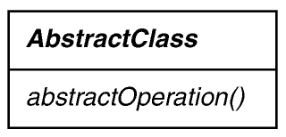
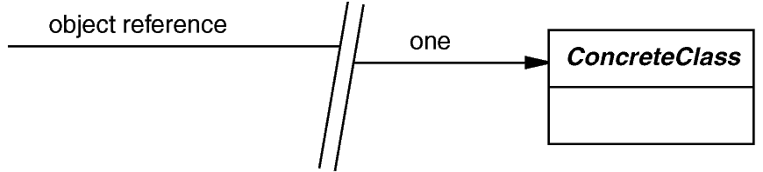



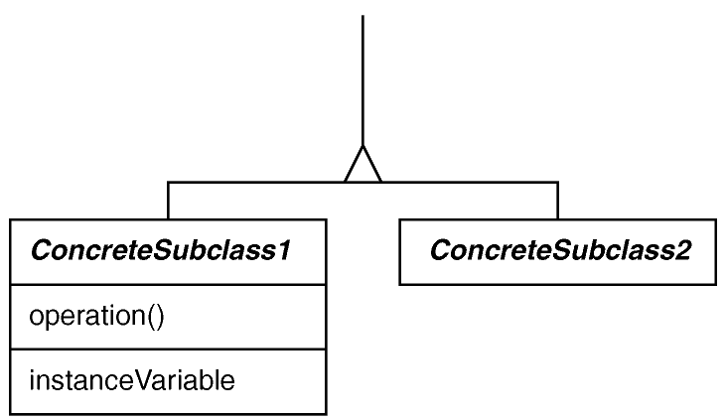
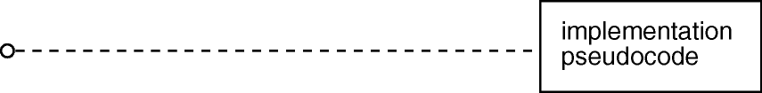
Modified UML/OMT Notation

Slide 111
Exapmle: Model-View-Controller Pattern
MVC consists of three kinds of objects:
  Model – the application object
  View – UI (screen presentation)
  Controller – defines the way the UI reacts to user inputs

Slide 112
MVC – What Is the Problem?
The same enterprise data needs to be accessed when presented in different views: e.g. HTML, JFC/swing, XML
The same enterprise data needs to be updated through different interactions
Supporting multiple types of views and interactions should not impact the components that provide the core functionality of the enterprise application

Slide 113
MVC – Solution
Separate core business model functionality from the presentation and control logic that uses this functionality
Allows multiple views to share the same enterprise data model
Makes supporting multiple clients easier to implement, test, and maintain

Slide 114
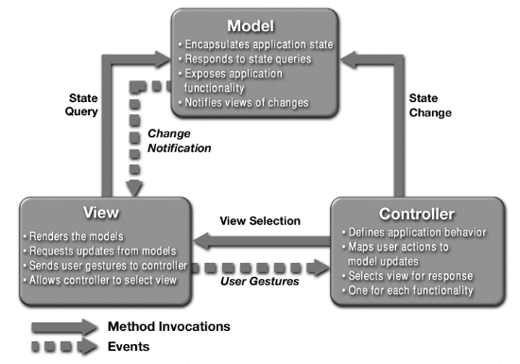
MVC Structure

Slide 115
MVC – Responsibilities
Model - the model represents enterprise data and the business rules that govern access to and updates of this data
View -the view renders the contents of a model. It accesses enterprise data through the model and specifies how that data should be presented
Controller - the controller translates interactions with the view into actions to be performed by the model

Slide 116
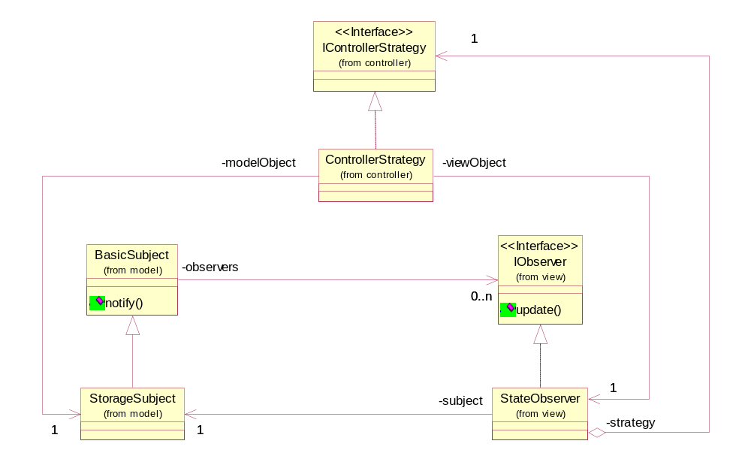
MVC – Class Diagram

Slide 117
MVC – Class Diagram
Strategy Pattern
Observer Pattern

Slide 118
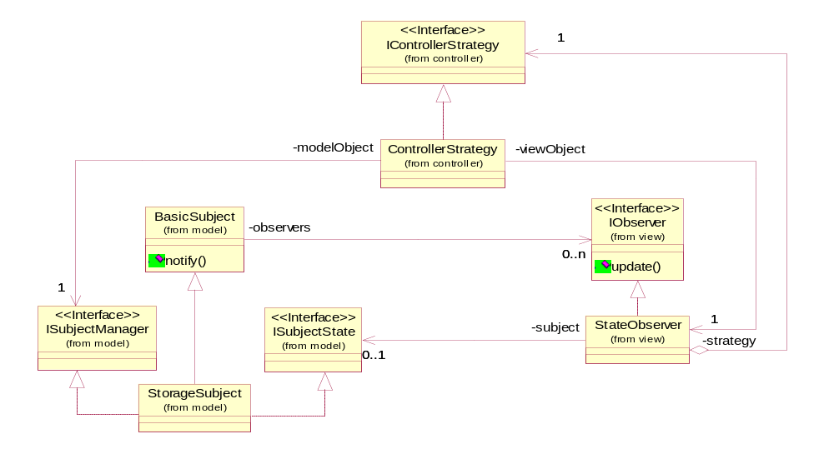
MVC – Class Diagram (including interfaces)

Slide 119
MVC – Class Diagram (including interfaces)
controller
view
model

Slide 120
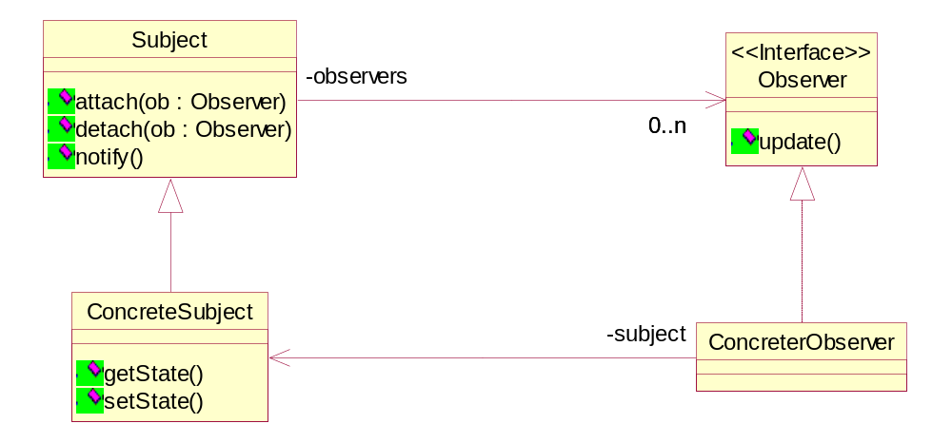
Observer Pattern
Class Diagram

Slide 121
Observer Pattern
Define a one-to-many dependency, all the dependents are notified and updated automatically
The interaction is known as publish-subscribe or subscribe-notify
Avoiding observer-specific update protocol: pull model vs. push model
Other consequences and open issues
Design Patterns

Slide 122
Composite Pattern
View can be nested
Described by the Composite design pattern seen in the lecture
Design Patterns

Slide 123
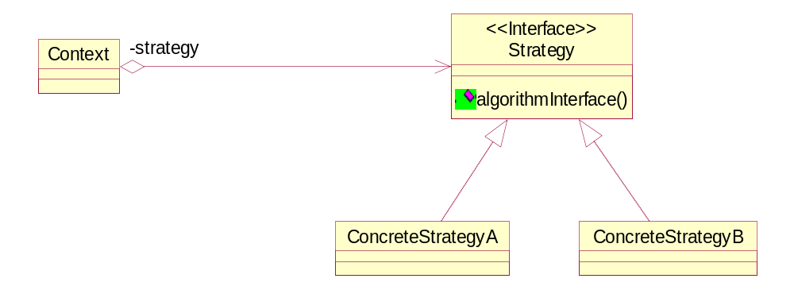
Strategy Pattern – Class Diagram
Design Patterns

Slide 124
Strategy Pattern
Define family of algorithms, encapsulates them and make them interchangeable
Eliminate conditional statements
Cons: communication overhead, increase number of objects
Design Patterns

Slide 125

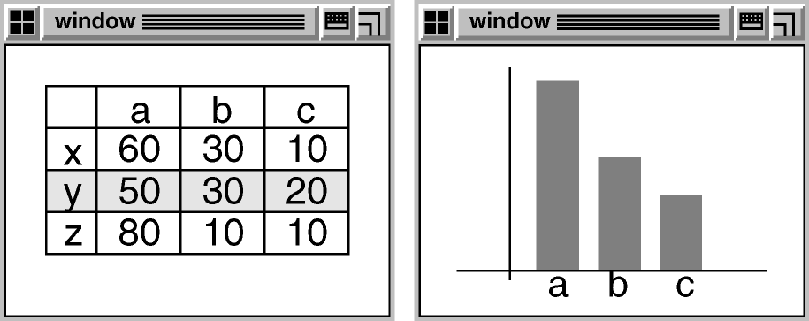
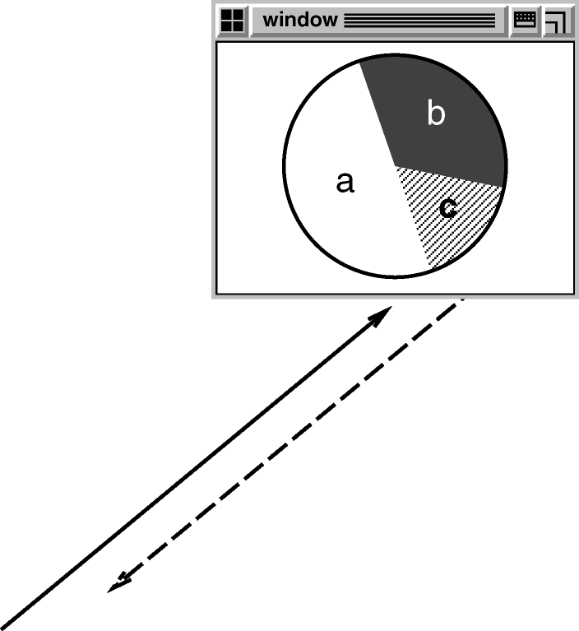
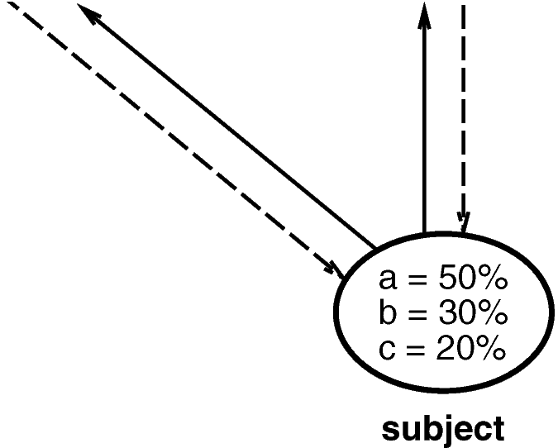
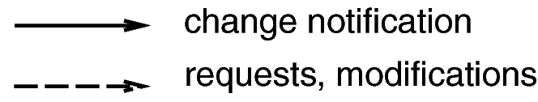
Example: OBSERVER

Slide 126
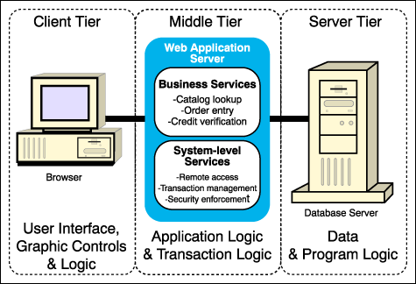
Three Tier Model

Slide 127
Example: Stock Quote Service
Real time
Market Data
Feed
Stock Quotes
Customer
Customer
Customer
Customer
Customer
Observers

Slide 128
Observer Pattern
Intent:
  Define a one-to-many dependency between objects so that when one object changes state, all its dependents are notified and updated automatically
Key forces:
  There may be many observers
  Each observer may react differently to the same notification
  The subject should be as decoupled as possible from the observers to allow observers to change independently of the subject

Slide 129
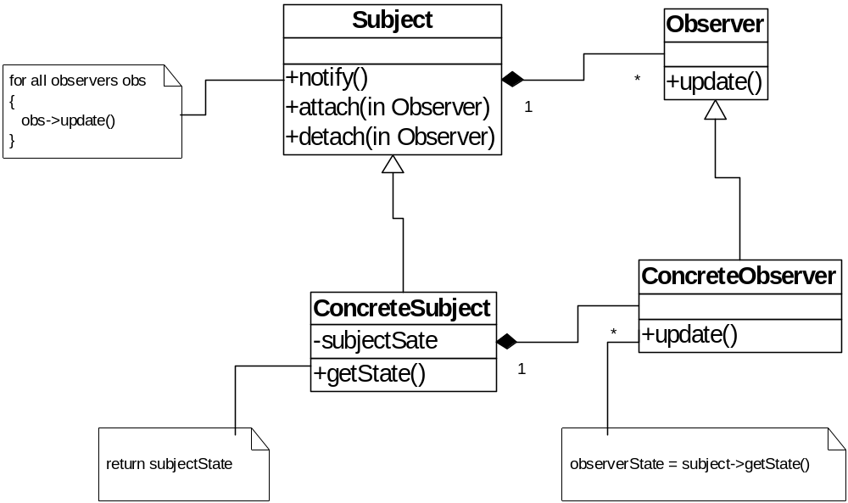
Structure of Observer Pattern

Slide 130
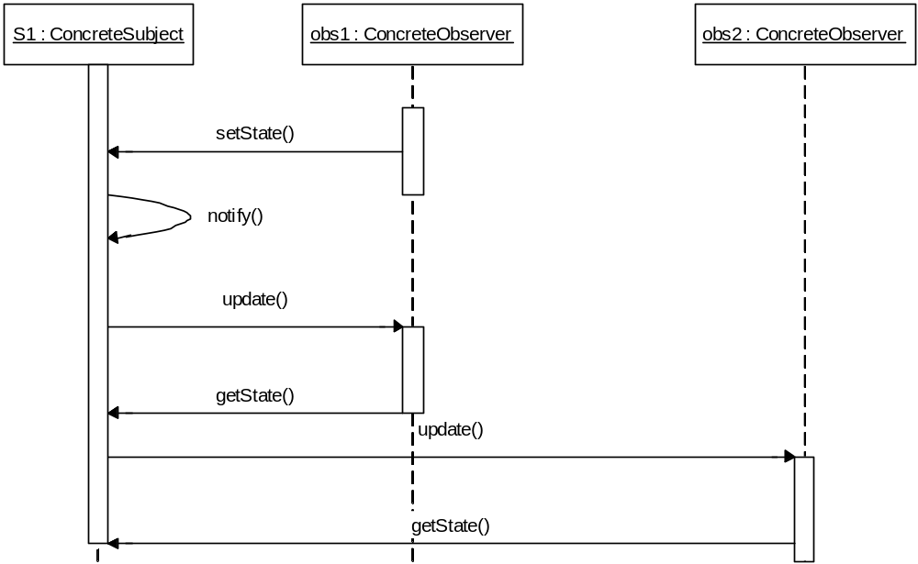
Collaborations in Observer Pattern

Slide 131
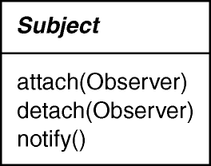
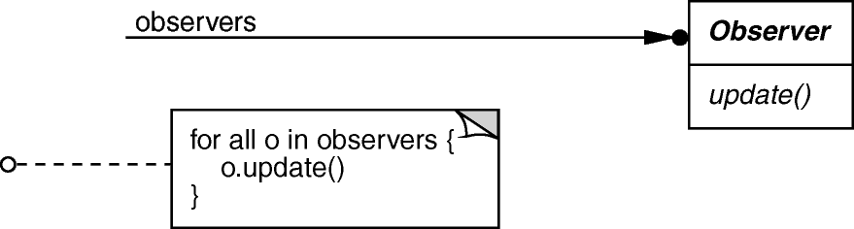
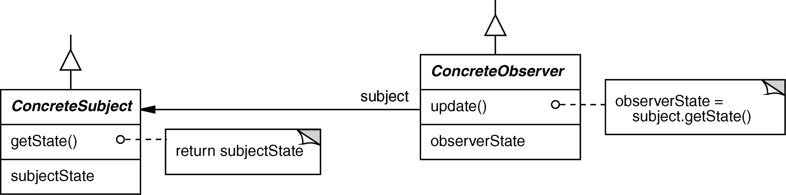
OBSERVER object behavioral
Intent
  define a one-to-many dependency between objects so that when one object changes state, all dependents are notified & updated
Applicability
  an abstraction has two aspects, one dependent on the other
  a change to one object requires changing untold others
  an object should notify unknown other objects
Structure

Slide 132
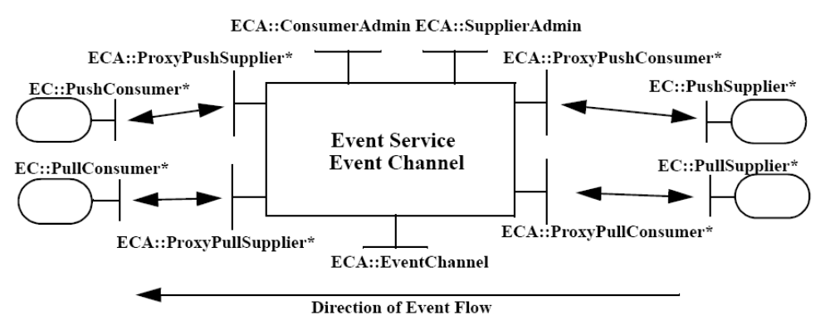
OBSERVER object behavioral
class ProxyPushConsumer : public // …
virtual void push (const CORBA::Any &event) {
for (std::vector<PushConsumer>::iterator i
(consumers.begin ()); i != consumers.end (); i++)
(*i).push (event);
}
class MyPushConsumer : public // ….
virtual void push
(const CORBA::Any &event) { /* consume the event. */ }
CORBA Notification Service example using C++ Standard Template Library (STL) iterators (which is an example of the Iterator pattern from GoF)

Slide 133
OBSERVER (cont’d) object behavioral
Consequences
  modularity: subject & observers may vary independently
  extensibility: can define & add any number of observers
  customizability: different observers offer different views of subject
  unexpected updates: observers don’t know about each other
  update overhead: might need hints or filtering
Implementation
  subject-observer mapping
  dangling references
  update protocols: the push & pull models
  registering modifications of interest explicitly
Known Uses
  Smalltalk Model-View-Controller (MVC)
  InterViews (Subjects & Views, Observer/Observable)
  Andrew (Data Objects & Views)
  Pub/sub middleware (e.g., CORBA Notification Service, Java Message Service)
  Mailing lists

Slide 134
Conclusions
Design Patterns provide a foundation for further understanding of:
  Object-Oriented design
  Software Architecture
Understanding patterns can take some time
  Re-reading them over time helps
  As does applying them in your own designs!

