Slide 1
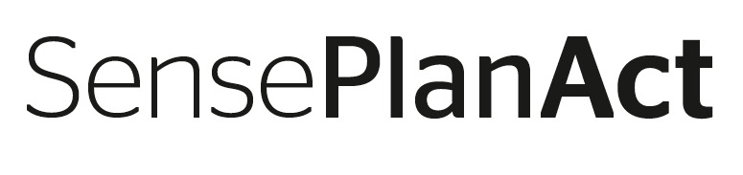
Problem Resolution Management
ADAS 2.6 Process.
Chassis & Safety

Slide 2
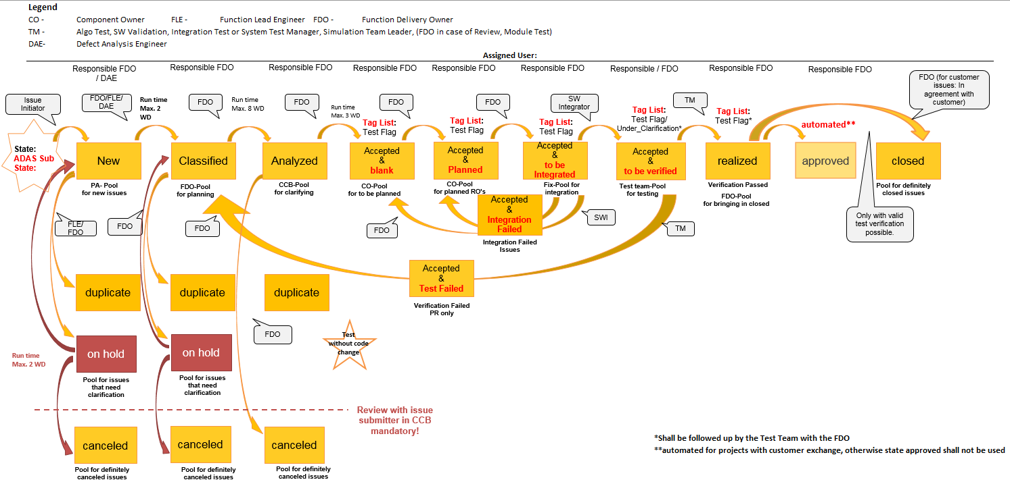
Problem Resolution Management Workflow Overview Issue Handling Problem Report
The queries need to be updated for all the roles with ADAS Sub State
ADAS Sub State replaces Requested By
Tag List shall be used to identify the Test Teams
27.06.2018
2

Slide 3
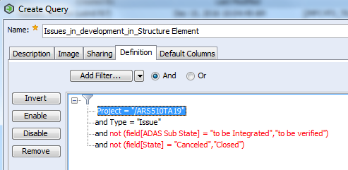
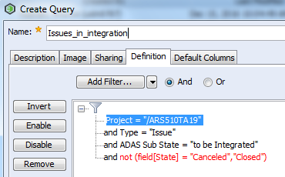
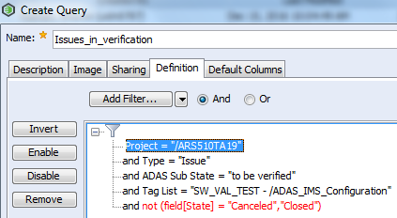
ADAS Sub State Query Examples
Open issues in structure element
Open issues in integration
Open issues in verification
Tag list for all test tags shall remain the same for all projects.
27.06.2018
3

Slide 4
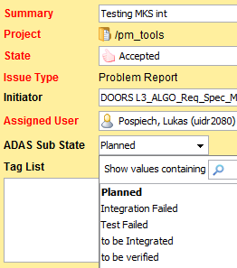
Problem Report Workflow
Issue Assigned User - FDO
New
Assigned user - CD
FDO – Funtion Delivery Owner,
CD – Component Delegate,
SE – Structure element
AT – Analysis Task
RO – Realization Order
Prj – Project
*Legacy project shall use their own project structure elements
CCB – Change Control Board
Classified
AT
Prj- Mainstream*
New
AT
Prj- Mainstream*
In Clarificaiton
AT
Prj- Mainstream*
Closed
Analyzed
CCB
RO
Prj- Mainstream*
New
Assigned user – CD
RO for code implementation
Accepted
&
blank
Accepted &
Planned
RO
Prj- Mainstream
Planned/In Work
RO
Prj- Mainstream
Realized
RO
Prj -Mainstream
Closed
Accepted &
to be Integrated
Accepted &
Integration Failed
RO for Verification
Assigned user – Test Engineer
Accepted &
to be verified
RO
SE – Test Area
New, Planned
RO
SE – Test Area
In Work/Realized
RO
SE – Test Area
Closed
Accepted &
Test Failed
Verification failed
Realized
Verification succesful
27.06.2018
4

Slide 5
Problem Report Workflow
Issue Assigned User - FDO
New
IMS Fields | Short Explanation
State: New ADAS Sub State: not editable Found in Release Detected by: | Issue Initiator creates an issue
State: Classified ADAS Sub State: not editable Analysis Due Date: Importance: Urgency: Analysis Summary: | FDO shall provide a due date for the analysis tasks
State: Analyzed ADAS Sub State: not editable | Issue Analyzed
State: Accepted ADAS Sub State: blank Planned Target Release: SW ‘Planning/Container’ Release Tag List: Test Area which shall verify the issue | FDO shall create the RO for implementation, test case creation* *in case of Feature Requests/Change Requests
State: Accepted ADAS Sub State: Planned Planned Target Release: SW CW Iteration/Cadence Release Tag List: Test Area which shall verify the issue | FDO shall set the issue to Planned when all the RO’s are planned
State: Accepted ADAS Sub State: To be integrated Planned Target Release: SW Cadence Release (update if needed) Tag List: Test Area which shall verify the issue | All the code implementation RO’s are closed & issue is ready to be integrated into a project release Integrator adds the fix integrated in checkpoint information
State: Accepted ADAS Sub State: Integration Failed Planned Target Release: SW Cadence Release | Integrator cannot integrate an issue FDO follows up and clarifies the issue
State: Accepted ADAS Sub State: To be Verified Planned Target Release: SW Cadence Release (update if needed) Tag List: Test Area which shall verify the issue | Test Manager uses the query to filter for issues to be verified in the project.
State: Accepted ADAS Sub State: Test Failed Planned Target Release: SW Cadence Release (update if needed) Tag List: Test Area which verified the issue | Test unsuccessful* Defined to be used only for Problem Reports
State: Realized ADAS Sub State: blank Planned Target Release: SW Cadence Release (update if needed) Tag List: Test Area which verified the issue | Test Successful
Assigned user - CD
FDO – Funtion Delivery Owner,
CD – Component Delegate,
SE – Structure element
AT – Analysis Task
RO – Realization Order
Prj – Project
*Legacy project shall use their own project structure elements
CCB – Change Control Board
Classified
AT
Prj- Mainstream*
New
AT
Prj- Mainstream
In Clarificaiton
AT
Prj- Mainstream
Closed
Analyzed
CCB
RO
Prj- Mainstream*
New
Assigned user – CD
RO for code implementation
Accepted
&
blank
Accepted &
Planned
RO
Prj- Mainstream
Planned/In Work
RO
Prj- Mainstream
Realized
RO
Prj -Mainstream
Closed
Accepted &
to be Integrated
Accepted &
Integration Failed
RO for Verification
Assigned user – Test Engineer
Accepted &
to be verified
RO
SE – Test Area
New, Planned
RO
SE – Test Area
In Work/Realized
RO
SE – Test Area
Closed
Accepted &
Test Failed
Verification failed
Realized
Verification succesful
27.06.2018
5

Slide 6


SensePlanAct

