Slide 1

VDY Component
Chassis & Safety | Advanced Driver Assistance Systems

Slide 2
Objective :
Estimate vehicle dynamic signals like Longitudinal velocity , Long Accel, Yaw rate and Lateral Accel by Offset compensation, Filtering and Plausibilization.
Vehicle path prediction by providing Curvature estimation & Motion State detection
Set the DEMs/Errors in case of
a. Invalid inputs
b. Estimated signal / Variance is crossing threshold
c. Input parameters out of range
d. Input signals out of range
e. NVM data out of range

Slide 3
VDY I/Os
DEMs & VDY Errors
Inputs
From
Sensors
VDY
Algorithm
Outputs
to other
modules
Parameters
Parameters
Inputs
Outputs
[ Wheel Base, 1]
[ Wheel Speed FL, 4]
[Wheel Ticks Cnt FL, ]
[ALN speed, ]
[Steer Ratio, ]
[ Long Vehicle Velocity, 3]
[Wheel Speed FR,5 ]
[Wheel Ticks Cnt FR, ]
[ALN Counter, ]
[Long Vehicle Accel, ]
[Axle Load Dist, ]
[Wheel Speed RF,6 ]
[Wheel Ticks Cnt RF, ]
[SWA, ]
[Wheel Load Dep, ]
[Yaw Rate, 1 ]
[Wheel Speed RR,7 ]
[Wheel Ticks Cnt RR, ]
[Track Width Frt, ]
[Motion State, ]
[Long Accel, ]
[Wheel Dir FL, ]
[Track Width Re, ]
[Lateral Accel, ]
[Yaw Rate Sensor,0 ]
[Wheel Dir FR, ]
[Selfsteer Grad, ]
[Curvature, ]
[Lateral Acceleration, 3 ]
[Wheel Dir RF, ]
[Front Axle Dist, ]
[Rear Axle Dist, ]
[Weight, ]
[Curve Error, ]
[Brake Actuation, ]
[Wheel Dir RR, ]
[Curve Conf, ]
[Gear Position, ]
[ABS Ctrl / Traction Ctr, ]

Slide 4
Error Handling in VDY:
If any of the inputs are invalid consecutively for 3 VDY cycles then set
VDY input state as INVALID for that particular signal.
Set the input state as “DECREASED” if peak error is detected
If Signal Error is detected set the input state as “SUBSTITUTE”
Simultaneously if states of Lateral Acceleration and Yaw Rate are INVALID /
DECREASED/SUBSTITUTE then set output yaw rate to INVALID
Simultaneously if all 4 input wheel speeds shows INVALID/SUBSTITUTE/DECREASD
make output velocity INVALID
If the Output velocity OR Output Acceleration goes out of bounds then make
output velocity INVALID
If any input is INVALID corresponding element in Z-Vector of Kalman Filter will be set
to zero and variance will be set to high value.
If output Yaw Rate OR output Lateral Acceleration or going out of bounds then
output Yaw Rate state will be set to INVALID
If any one of the PARAMETERS going out of Range “PARAMETER ERROR” will
be set
10. If gradient crosses Threshold in any of the signals then “PEAK ERROR” will be set
11. If Magnitude error occurs in any of the input signals then “SIGNAL ERROR” will be
set.
12. Based on the leant offset state curve error is computed.

Slide 5
Description of DEMs : (Error Handling in VDY)

Slide 6
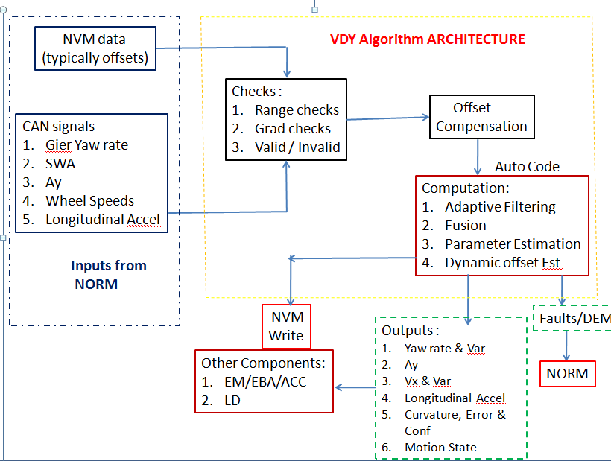
Algorithm Architecture
Co-ordinate system:
Autosar Compliant
Defined w.r.t. COG
Left Turn,
SWA +ve
Yaw Rate +ve
Lateral Acc +ve
X
Front Axle
Y
Rear Axle
4. Z +ve up

Slide 7
Inter Connection of Different VDY processing modules

Slide 8
Input Signal Checks
Magnitude Limiter
Wheel Speeds +/- 115 m/sec
Yaw Rate +/- 150 deg/sec
Long Accel +/- 10 m/sec2
Lateral Accel - +/10 m/sec2
SWA +/- 90 *SR
Input Signal
Rate Limiter
Wheel Speeds +/- 10 m/sec
Yaw Rate +/- 6 deg/sec
Long Accel +/- 2.5 m/sec2
Lateral Accel - +/2.5 m/sec2
SWA +/- 6 deg/sec
Input Signal
Validity checks
Wait for 3 VDY cycles
To check whether input is INVALID
Then set the state as INVALID
Input Signal

Slide 9
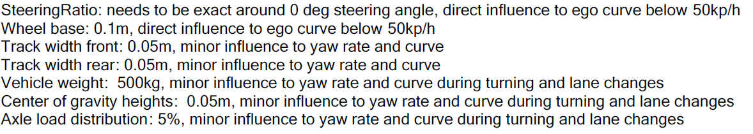
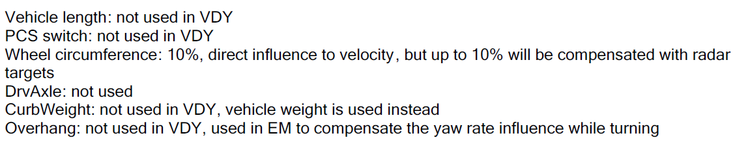
Influence of Different Parameters
Vehicle Width ------ Not used in VDY

Slide 10
SWA Offset
When the vehicle is moving at certain velocity
If driver provides SWA as an input
Steering column rotation
sensed by SWA sensor
Steer Ratio (Rack and Pinion)
Front Wheel Angle
Angular rotation about z-axis
is sensed by Gyro
Vehicle develops Yaw rate
Lateral Acceleration is experienced
by the vehicle
Lateral Accelerometer

Slide 11
Fast Steer Wheel Angle offset computation:
Learning Conditions :
a. NVM is cleared / New Sensor (Learnt State is zero)
b When the Wheel Speed Difference (FL – FR & RL – RR) is less than
0.6 m/sec and the vehicle velocity > 5 m/sec
c. SWA < 30 deg
d. Collect the samples till distance criteria (> 250 m) is met.
Compute the average of collected samples.
Method of computation :
1. Compute difference between Yaw rate estimated from SWA and
offset compensated Gyro Yaw rate. (Note : Estimated values are
o/ps of KFs)
2. SWA Offset = Difference * SR * (L + EG * V_{x}²)/V_{x}
3. Set the Learnt State to 1

Slide 12
Next Level SWA offset Learning
Learning conditions : (Straight drive)
Velocity > 10 m/sec, Wheel Speed Difference (FL – FR & RL – RR) is less than 0.3 m/sec
Build Histogram : Histogram is filled based on direct SWA measurements
W15
W5
W1
-14 deg
14 deg
Check enough number of samples are collected based on distance criteria.
Computed median, once enough number of samples are collected.

Slide 13
SWA offset
Learning distance Criteria :
Fast steer wheel angle --- 250 m
First Learning --- 20 Km
Second Learning --- 25 Km
Third Learning -- - 25 km
Fourth Learning ---- 25 Km
Fifth Learning ---- 25 km
Sixth Learning ----- 50 Km
(learned but not confirmed)
(learned and confirmed once)
(learned and confirmed twice)
Reset Criteria:
If there is a difference more than 0.5 deg between previously learnt value and the latest value then update that value with the latest value and set the state to 4.
Impact of SWA offset :
It will have impact on curvature computation
Errors associated with SWA offset :
Out of Range SWA offset error (Get actual names)
NVM error

Slide 14
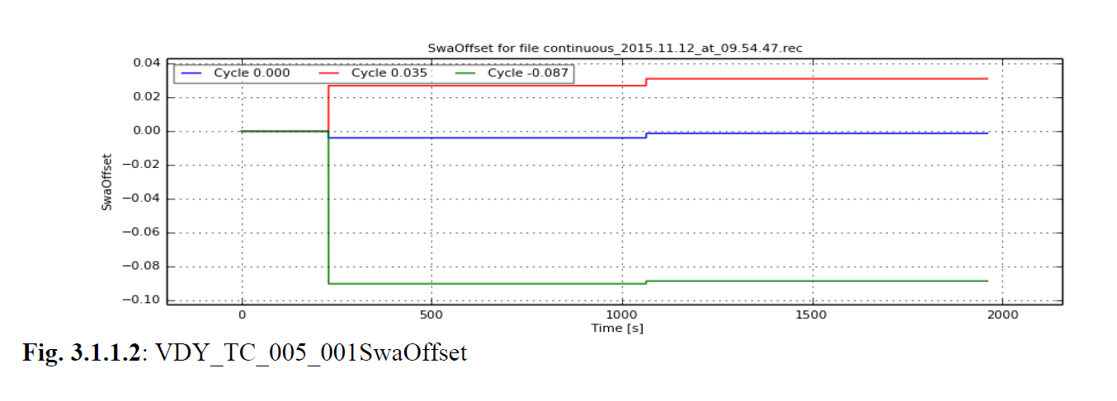
SWA offset : Plots from BBTtesting

Slide 15
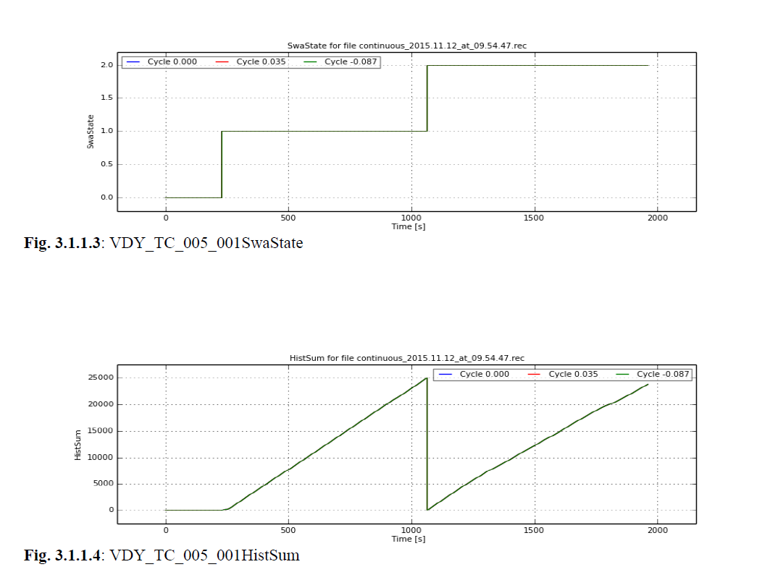
SWA offset : (Plots from BBT testing)

Slide 16
Yaw Rate Offset
When the vehicle is detected to be in stand still state, yaw rate stand still offset is estimated
as mean value of 30 cycles for the first time. Later on it is computed as a mean of 15 cycles.
Quality of yaw rate offset determines the last estimated yaw rate offset will be considered for
compensation or not.
The allowed learning is 4 deg/sec in a stand still cycle.
Turn Table Detection :
When the motion state detected is stand still and if the measured yaw rate is more than
7 deg/sec
Fast Stand Still : When the quality is less than 0.75 (approximately)
Dynamic Yaw rate offset : (High way driving)
a. Long Vel >=14 m/sec, Lateral Accel <=3.5 m/sec2, Long Accel <= 2.0 m/sec2, Yaw Rate Front and Rear Diffe <=0.02
b. Initial value of the dynamic yaw rate offset is Stand Still offset and its starts learning on top of that. The learning rate is not
allowed to go more than 0.002 in 1500 cycles.

Slide 17
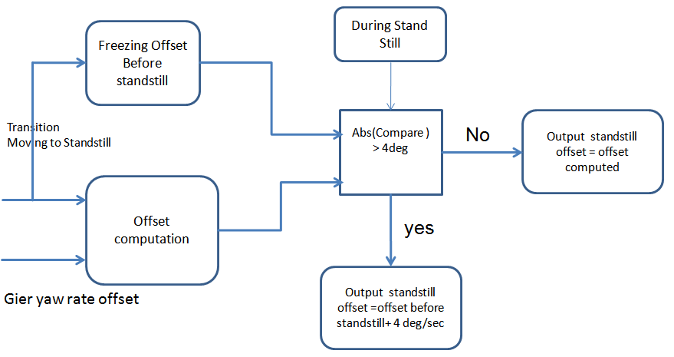
Liming standstill Yaw rate offset

Slide 18
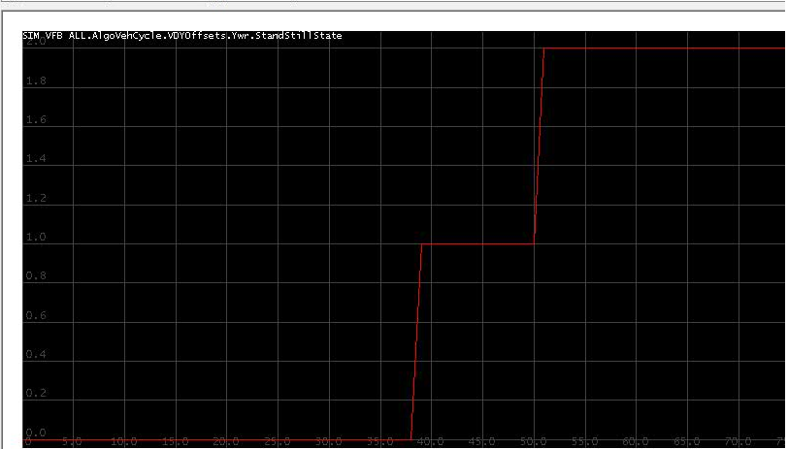
Yaw Rate Offset State (from BBT testing)
Impact of Yaw Rate offset :
It has direct impact on curvature. Based on the learning state curvature error is computed.
EBA / ACC will take curve error as one of the inputs to limit its range of operation.

Slide 19
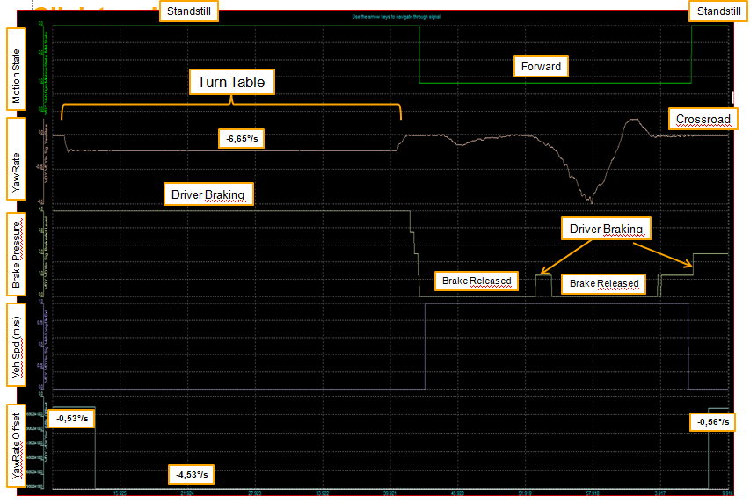
Sensitivity of Brake pressure on Standstill detection
When brake pressure was applied, motion state remained in "standstill" irrespective of gear position
When no brake pressure applied,
motionstate remained in "standstill" for gear P
motionstate transitioned to FWD or RWD, depending on whether gear was in D or R

Slide 20
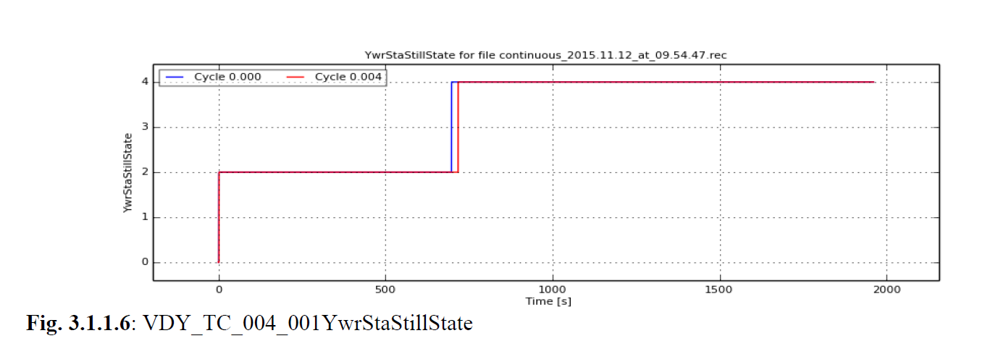
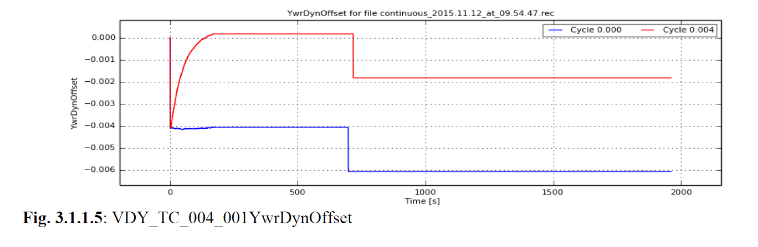
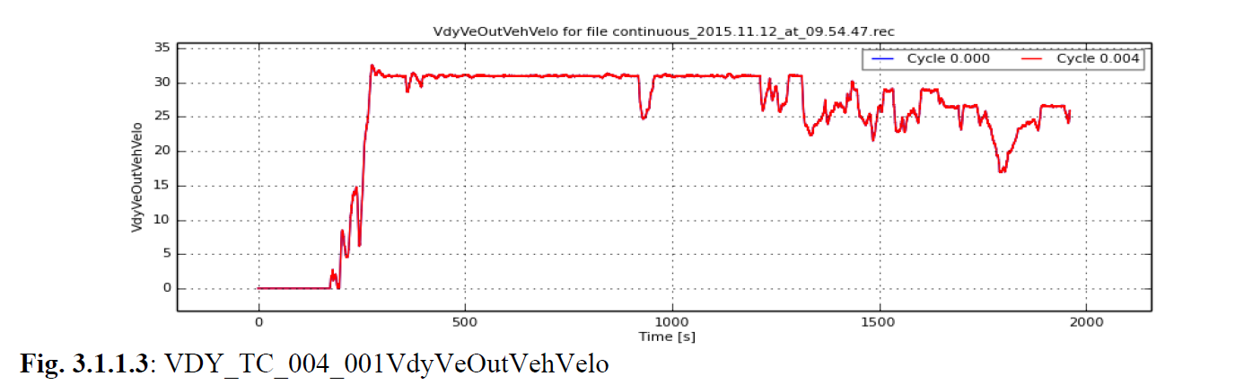
Dynamic Yaw Rate Offset Learning (from BBT Testing)

Slide 21
Lateral Accel Offset Learning (similar lines of SWA offset)
Learning conditions : (Straight drive)
Velocity > 10 m/sec, Wheel Speed Difference (FL – FR & RL – RR) is less than 0.3 m/sec
Build Histogram : Histogram is filled based on direct SWA measurements
W15
W5
W1
-2.5 m/sec2
2.5 m/sec2
Check enough number of samples are collected based on distance criteria.
Computed median, once enough number of samples are collected.

Slide 22
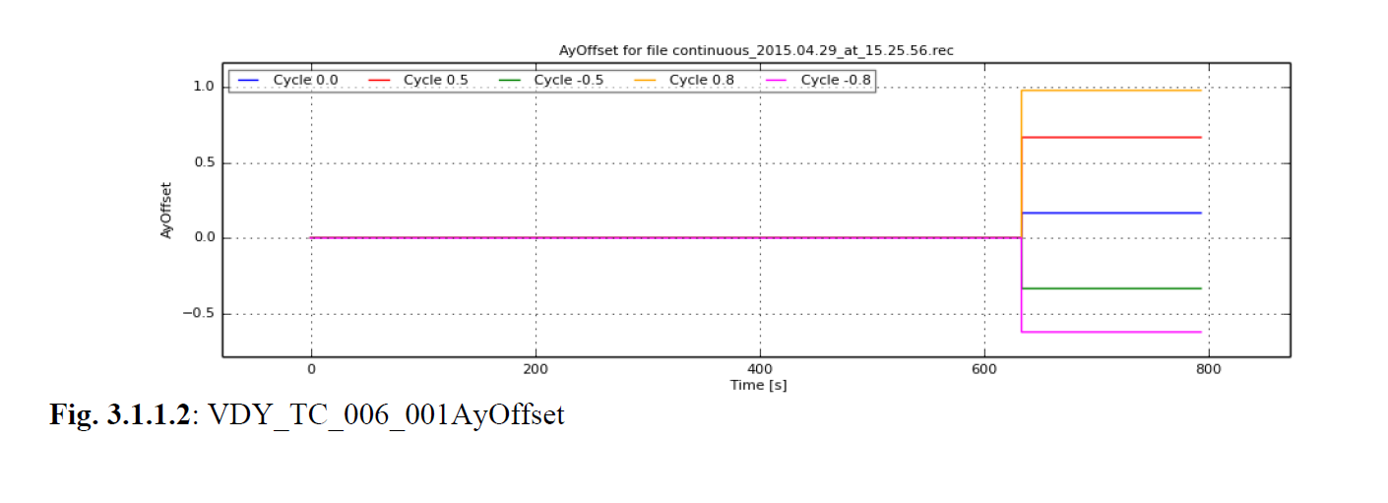
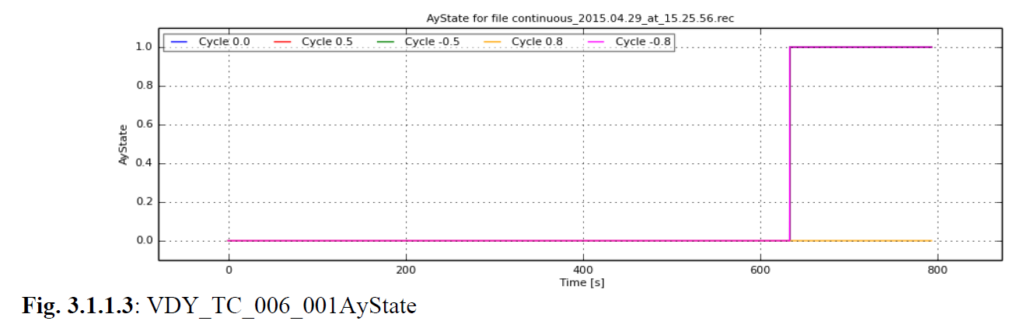
Lateral Accel Offset Learning (fromBBT testing)

Slide 23
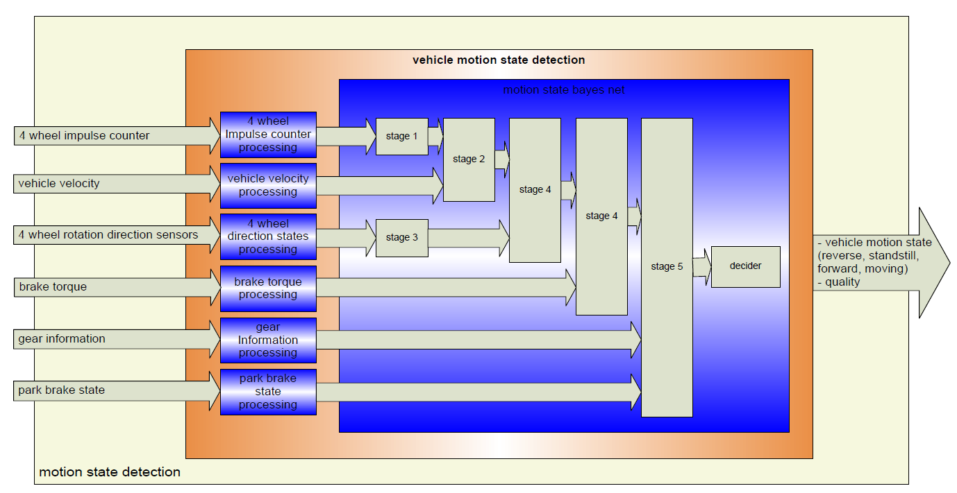
Mtn State Detection

Slide 24
Mtn State Determination

Slide 25
Mtn State Determination - Contd

Slide 26
Mtn State - Contd

Slide 27
Mtn State-contd (Isolating Wheel Pulse if INVALID)
function [fwd_percentage,ss_percentage,rws_percentage, cnt_ramp_out, cnt_delay_out] = fcn(diff_whl_puls, whl_puls_valid, whl_puls_percentage, cnt_ramp_in, fwd_p, ss_p, rws_p, cnt_delay_in, VDY_IO_STATE_VALID)
% calculate the wheel puls quality
if (whl_puls_valid == VDY_IO_STATE_VALID)
if (diff_whl_puls ~= uint8(0))
cnt_ramp_out = uint8(0);
cnt_delay_out = uint8(0);
fwd_percentage = whl_puls_percentage(1,1);
ss_percentage = whl_puls_percentage(1,2);
rws_percentage = whl_puls_percentage(1,3);
else
if (cnt_delay_in == whl_puls_percentage(4,1))
cnt_ramp_out = cnt_ramp_in + uint8(1);
cnt_delay_out = cnt_delay_in;
if cnt_ramp_out <= whl_puls_percentage(3,1)
fwd_percentage = fwd_p;
ss_percentage = ss_p;
rws_percentage = rws_p;
else
cnt_ramp_out = whl_puls_percentage(3,1) + uint8(1);
fwd_percentage = whl_puls_percentage(2,1);
ss_percentage = whl_puls_percentage(2,2);
rws_percentage = whl_puls_percentage(2,3);
end;
else
cnt_ramp_out = uint8(0);
cnt_delay_out = cnt_delay_in + uint8(1);
fwd_percentage = whl_puls_percentage(1,1);
ss_percentage = whl_puls_percentage(1,2);
rws_percentage = whl_puls_percentage(1,3);
end;
end;
else
cnt_ramp_out = uint8(0);
cnt_delay_out = uint8(0);
fwd_percentage = whl_puls_percentage(5,1);
ss_percentage = whl_puls_percentage(5,2);
rws_percentage = whl_puls_percentage(5,1);
end;

Slide 28
Mtn State - Cont
WHEEL PULSE
FL - FF | FR-FF | RL - FF | RR - FF | Prob-FF
F (51) | F (51) | F (51) | F (51) | v0(0)
T(49) | F (51) | F (51) | F (51) | v1(90)
F(51) | T (49) | F (51) | F (51) | v2(90)
T(49) | T (49) | F (51) | F (51) | v3(100)
F (51) | F (51) | T(49) | F (51) | v4(90)
T(49) | F (51) | T(49) | F (51) | v5(100)
F(51) | T (49) | T(49) | F (51) | v6(100)
T(49) | T (49) | T(49) | F (51) | v7(100)
F (51) | F (51) | F (51) | T(49) | v8(90)
T(49) | F (51) | F (51) | T(49) | v9(100)
F(51) | T (49) | F (51) | T(49) | v10(100)
T(49) | T (49) | F (51) | T(49) | v11(100)
F (51) | F (51) | T(49) | T(49) | v12(100)
T(49) | F (51) | T(49) | T(49) | v13(100)
F(51) | T (49) | T(49) | T(49) | v14(100)
T(49) | T (49) | T(49) | T(49) | v15(100)
FL
FF SS REV
49 2 49
2 98 2
FR
X
RL
Probability of being
Forward
RR
51*51*51*51*0 + 49 * 51 * 51 * 51 * 90 + 51 * 49 * 51 * 51 * 90 + 49 * 49 * 51 * 51 * 100
51 * 51 * 49 * 51 * 90 + 49 * 51 * 49 * 51 * 100 + 51 * 49 * 49 * 51 * 100 + 49 * 49 * 49 * 51 * 100
51 * 51 * 51 * 49 * 90 + 49 * 51 * 51 * 49 * 100 + 51 * 49 * 51 * 49 * 100 + 49 * 49 * 51 * 49 * 100
51 * 51 * 49 * 49 * 100 + 49 * 51 * 49 * 49 * 100 + 51 * 49 * 49 * 49 * 100 + 49 * 49 * 49 * 49 * 100

Slide 29
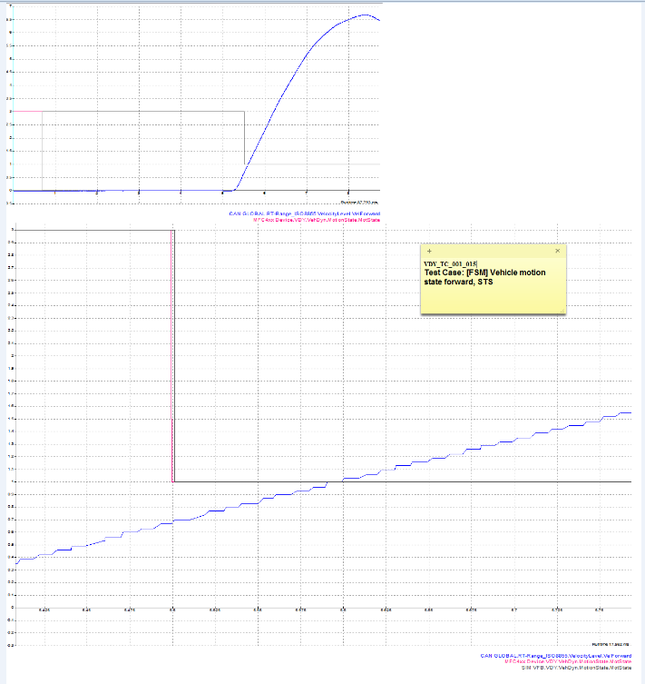
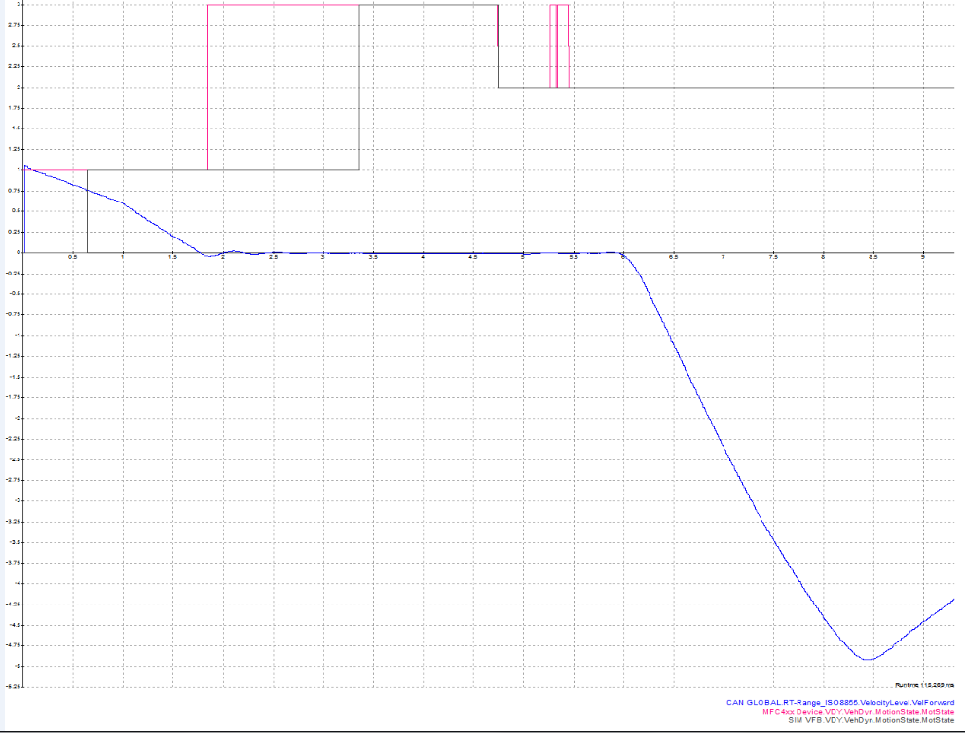
Motion State – BBT results
3
2
1
3
3 – Stand Still
1 - Forward
2 – Reverse
0 - Unknown
1

Slide 30
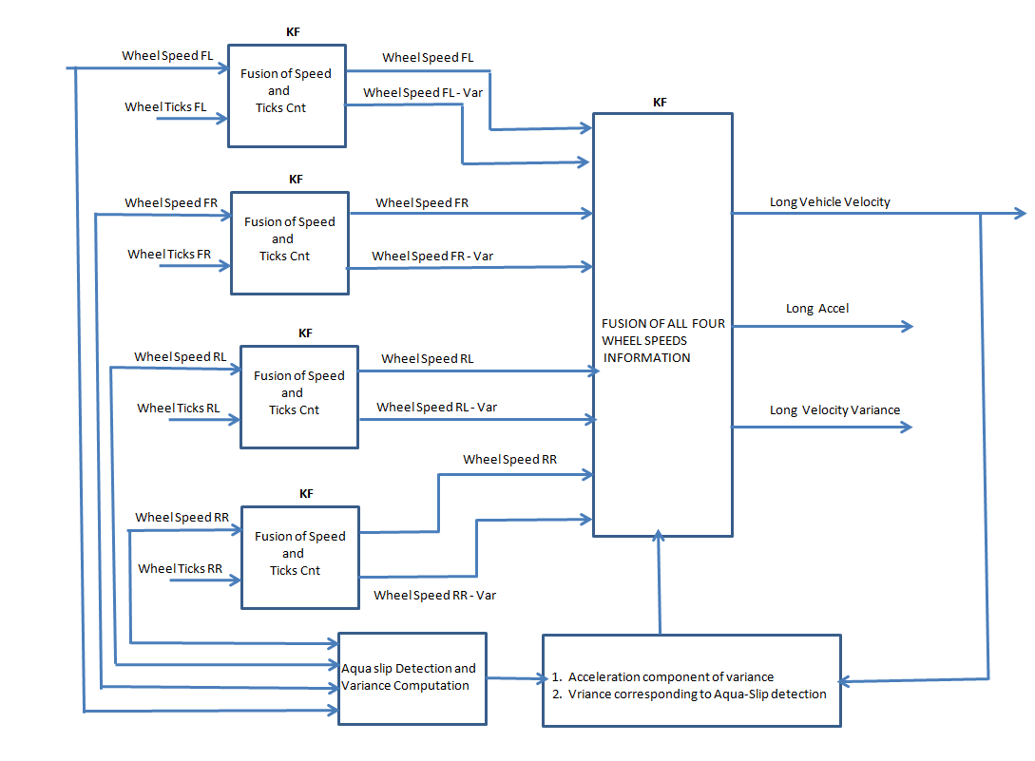
Wheel Speed Processing

Slide 31
Wheel Speed Computation ----- Pulse based

Slide 32
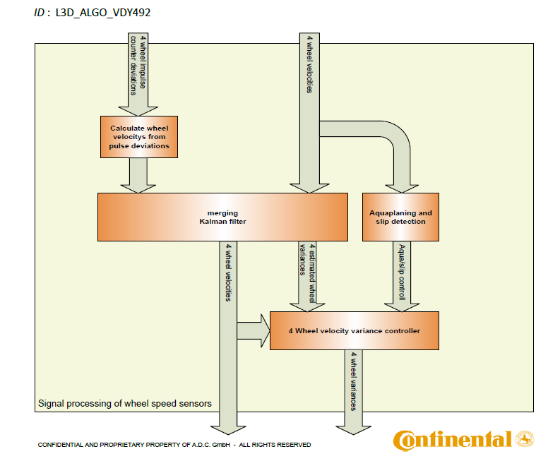
Merging Wheel Speed Information

Slide 33


Wheel Speed Processing ---- Kalman Filter
If Ticks are not available
Z
Q
KF
Wheel Speeds
R
A
H

Slide 34
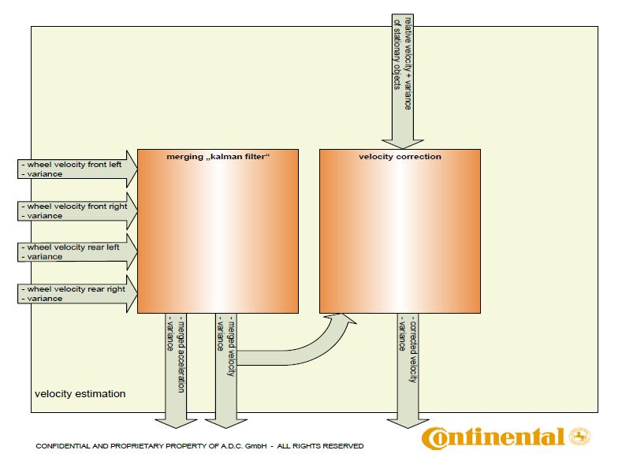
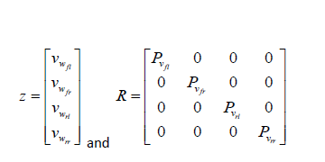
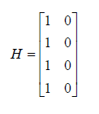
Vehicle Velocity Estimation ---- Fusion of 4 wheel speeds

Slide 35
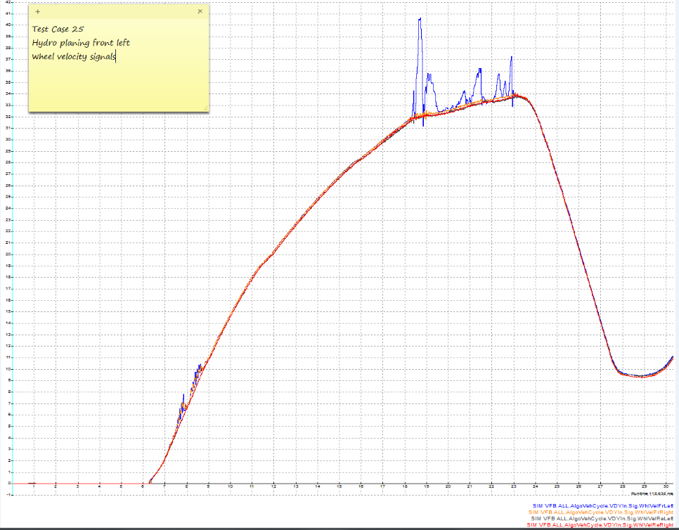
Velocity Estimation During Hydro Planing (BBT test results)

Slide 36
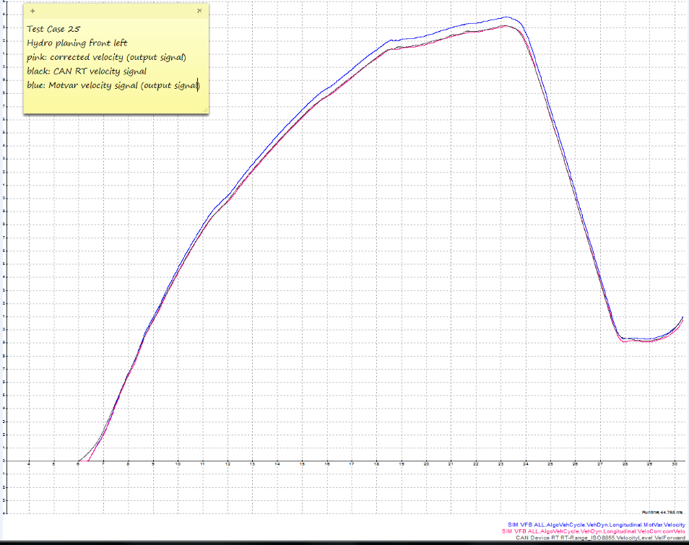
Effect of Tire radius change (Correction Factor) :

Slide 37
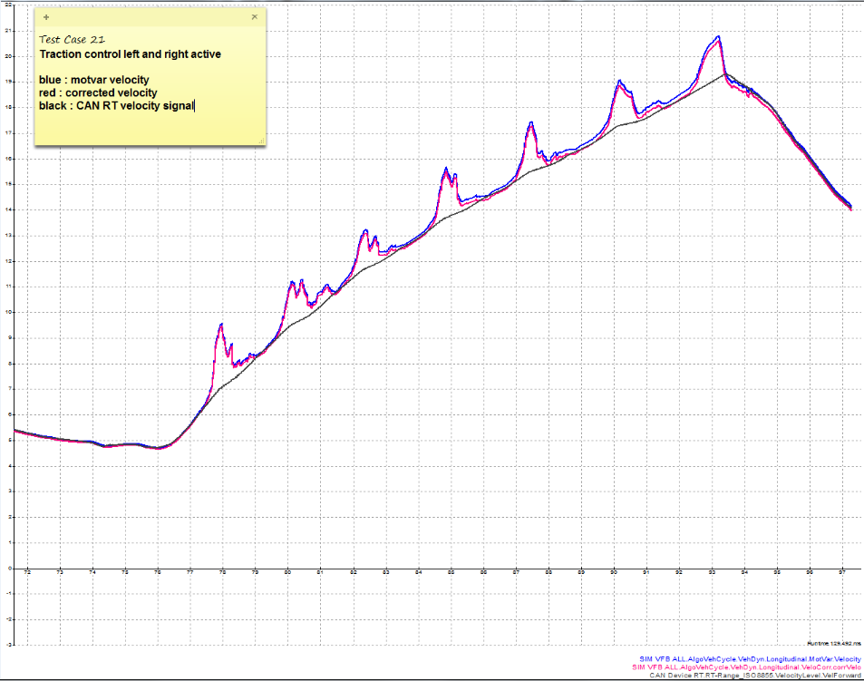
Velocity Estimation During Traction (All wheels slipping) Limitation of VDY

Slide 38
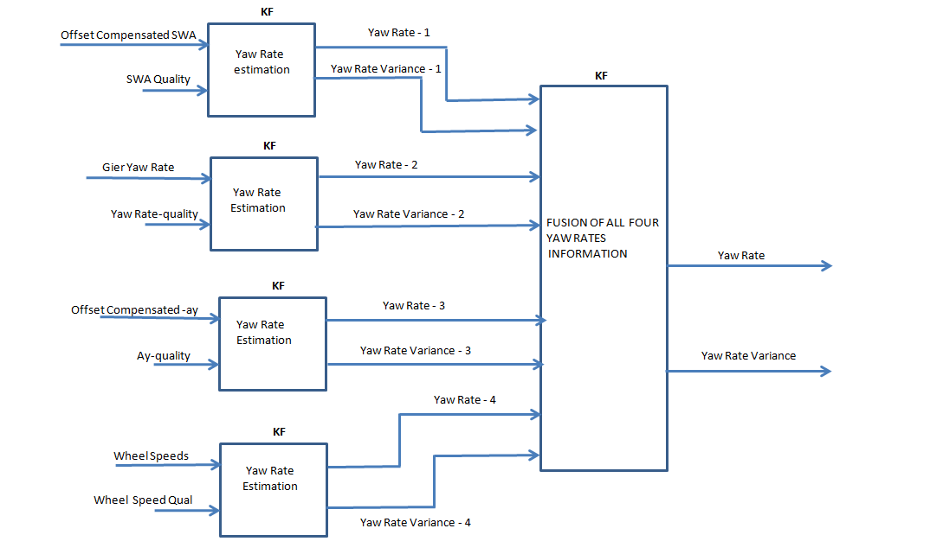
Yaw Rate Estimation

Slide 39
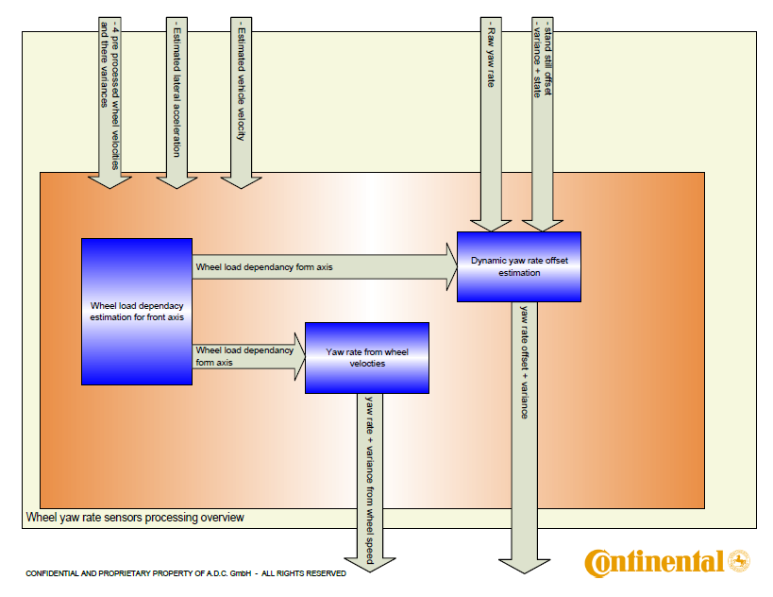
Yaw rate estimated from wheel speeds

Slide 40
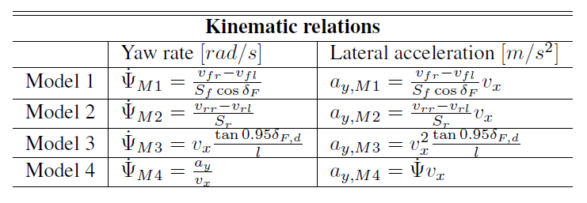

Yaw Rate Based On Rear Wheel speeds
Ref-1 : Yaw Rate and Lateral Acceleration Sensor Plausibilisation in an Active Front Steering Vehicle Master’s thesis performed in Vehicular Systems for ZF Lenksysteme [Chapter-4, Equations 4.1 – 4.6]
Modified equation of Model-1 is implemented in VDY as given below
When K → 1 and Vx = (Vfr + Vfl)/2
both the equations are same

Slide 41
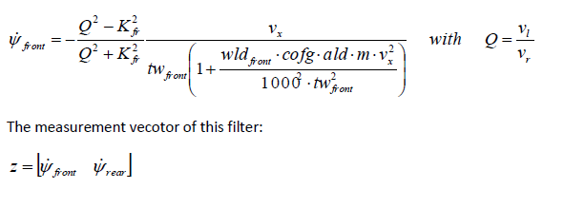
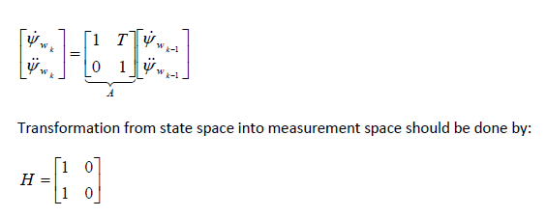
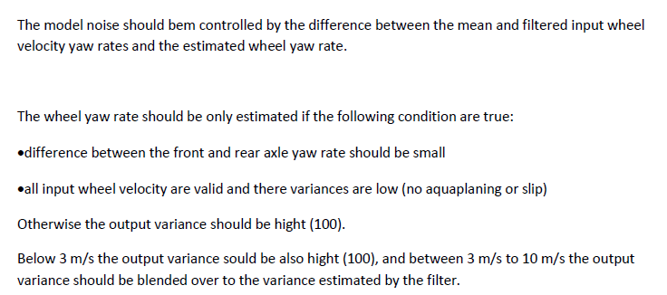
Yaw Rate Based On Front Wheel speeds

Slide 42
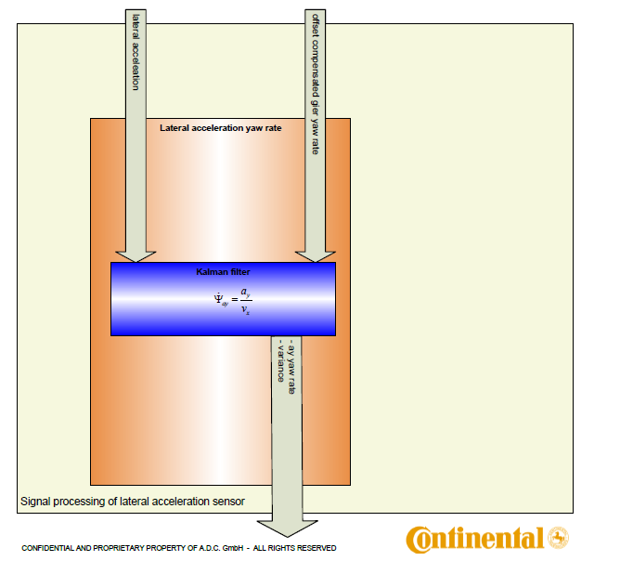
YawRatebased on lateral accel

Slide 43

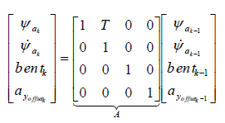


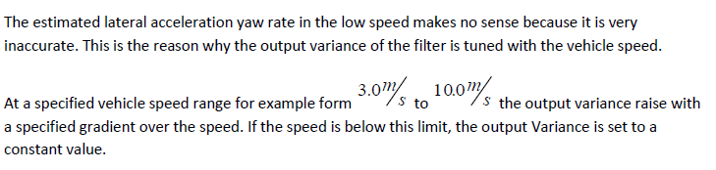

YawRatebased on lateral accel
Measurement Vector :
Model :
Measurement Equation (Hx) :

Slide 44
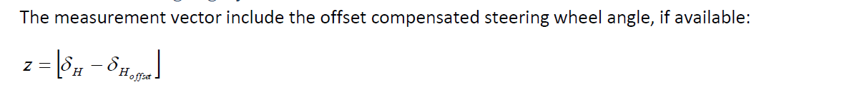
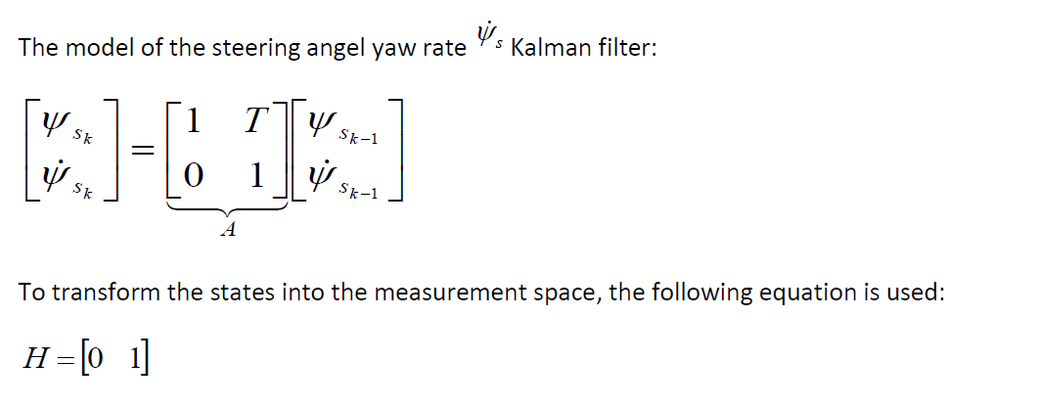


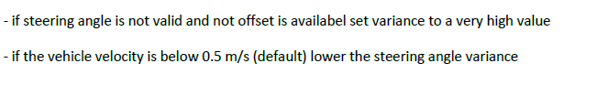
YawRatebased on SWA

Slide 45
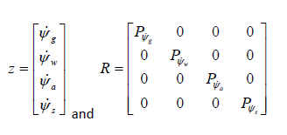
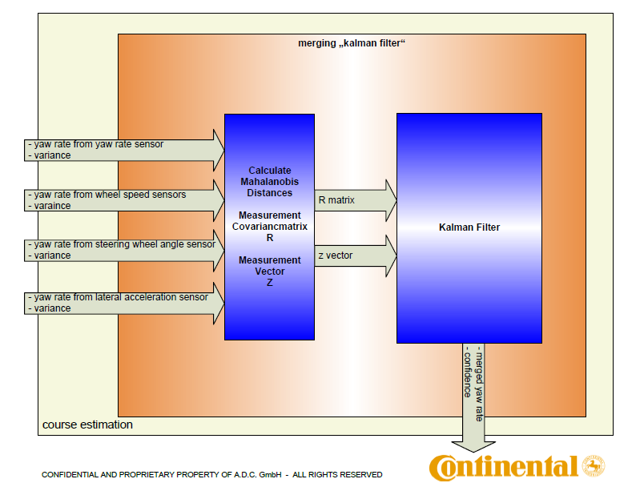

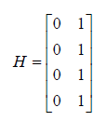
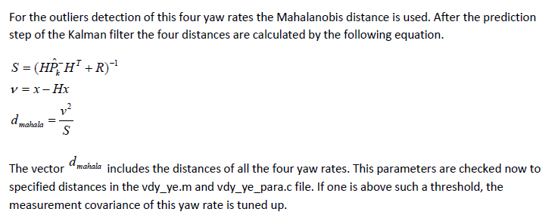
Fusion of Yaw Rate Yaw Rate

Slide 46
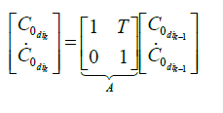

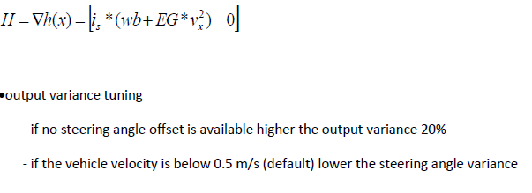
Curvature from SWA (Driver Intended Curvature)

Slide 47
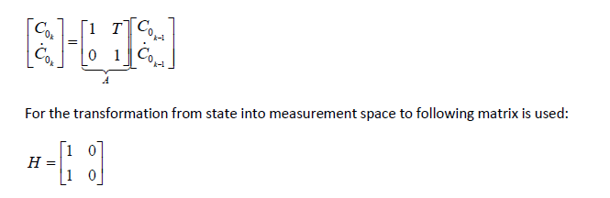

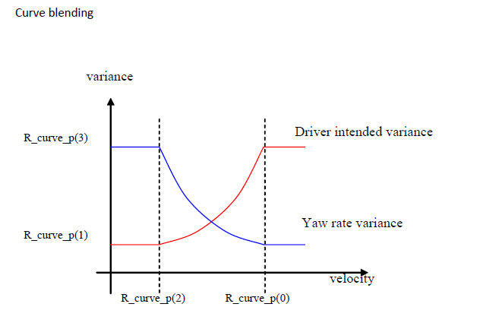
Final Curvature Estimation : (Curvature Blending)

Slide 48
Curve Error

Slide 49
Case Study : Endurance Analysis of ARS4D2
Yaw Rate Not Avaialble DEM is getting set in the Endurance test results at low speeds.
Possible Causes :
1. Output Yaw Rate > 150 deg/sec
2. Invalid / Peak Error / Signal Error can occur simultaneously in Lateral Acceleration and Gyro Yaw Rate
3. Yaw Rate Variance > Threshold
4. Lateral Acceleration > 15 m/sec²

Slide 50
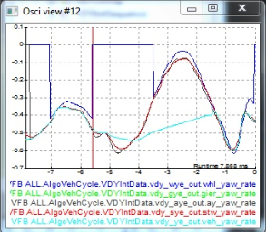
Analysis of 10.53.13 recording from Kalman filter’s perspective
The YWR_NOT_AVAILABLE DEM is getting set in10.53.13 recording as shown below behavior.
A deviation of final yaw rate w.r.t other 4 yaw rates is observed as a problematic area for this dem getting set.
The below screenshot shows the deviation.

Slide 51
ARS4D2 Endurance – Yaw Rate Not Available is set

Slide 52
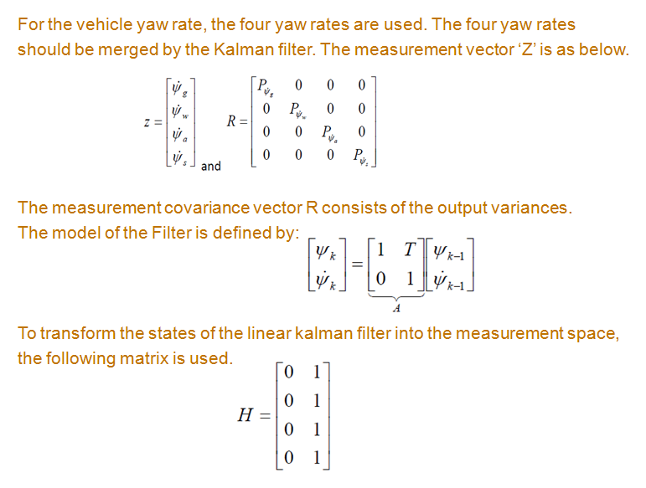
ARS4D2 Endurance – Yaw Rate Not Available is set
Please Refer Slide No : 43

Slide 53
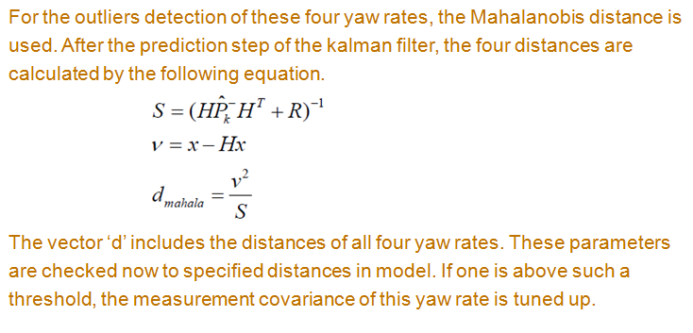
ARS4D2 Endurance – Yaw Rate Not Available is set
Please Refer Slide No : 43

Slide 54
ARS4D2 – Endurance Analysis (Calculation of R)

Slide 55
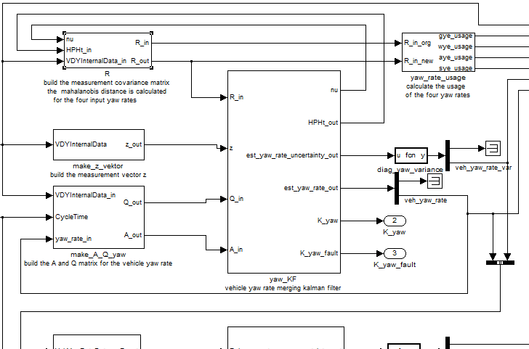
ARS4D2 – Endurance Analysis (R – Input to KF)

Slide 56
ARS4D2 Endurance – Yaw Rate Not Available is set
There are 3 parts in discussion:
1. Divergence of final yaw rate from other yaw rates
2. Convergence of final yaw rate with other yaw rates
3. Reason for Divergence (includes DEM not to set)
1. Divergence of final yaw rate from other yaw rates:
The input wheel speed for rear Right wheel is less than 3 m/s.
The minimum speed required to make the wheel yaw rate to zero is, one of the wheel speed should be less than 3 m/s. Hence, here, vdy will set the whl yaw rate to zero.
Though the whl yaw rate is zero, it is considered in calculating the sensor’s yaw rate mean value which in turn used for calculating the difference between sensor yaw rate mean value and estimated yaw rate mean value.
The Q(Q_gain) is modulated based on the difference between sensor yaw rate mean value and estimated yaw rate mean value. If the difference between the current diff value and the last diff value is more than 0.05, then Q will remain stuck to its previous value. Otherwise, Q gain-change is proportional to the difference.
Simultaneously, the distance (Z – Hx) or ‘nu’ or error factor increases, resulting in the increased value of R(Mahalanobis distance). Here, the place where the divergence of the final yaw rate starts.
As the R increases, the K gain decreases gradually.

Slide 57
ARS4D2 Endurance – Yaw Rate Not Available is set
As the K gain decreases, more weightage is given for the model prediction compared to measurement. Hence, the final yaw rate is following the model prediction.
Below gives pictorial presentation for above explanation.

Slide 58
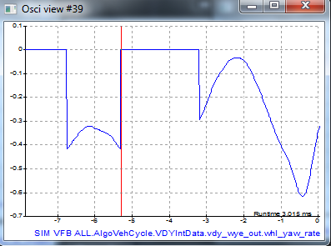
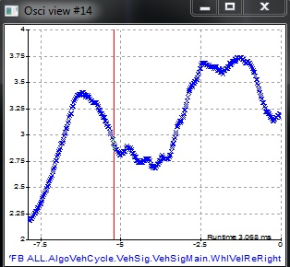
ARS4D2 Endurance – Yaw Rate Not Available is set
Rear Right wheel speed (< 3 m/s) resulting in vdy setting the wheel yaw rate to zero.
This results in difference in sensor yaw rate mean value
1

Slide 59



ARS4D2 Endurance – Yaw Rate Not Available is set
1
difference
Decision btw(curr_diff1, last_diff1)
to limit to 0.05
2

Slide 60




ARS4D2 Endurance – Yaw Rate Not Available is set
Q gain computation
2
Simultaneously, nu / error factor increases resulting in R increase.
1
3

Slide 61
ARS4D2 Endurance – Yaw Rate Not Available is set
Q gain computation
2
Simultaneously, nu / error factor increases resulting in R increase.
1
3

Slide 62



ARS4D2 Endurance – Yaw Rate Not Available is set
3
K decrease leads to dependency on model prediction for yaw rate calc
Final yaw rate (aqua color)

Slide 63
ARS4D2 Endurance – Yaw Rate Not Available is set
Conversion of final yaw rate with other yaw rates:
Eventually, when the difference decreases and crosses the value 0.05, the Q abruptly changes from last value (last stuck value) to a value close to 0.05 (observed value = 0.047).
Due to increase in Q, the covariance matrix (P) increases suddenly.
Parallely the measurement covariance matrix R decreases gradually, leading to gradual increase in k gain.
The two components of covariance matrix (Pk) are
I – KH [as K increases, Pk should decrease]
Pk(minus) [as Q increases, Pk should increase]
The Pk(minus) is more dependent on Q factor and K is more dependent on R factor.
As the shoot up in Pk(minus) is more compared to reduction in (I – KH), due to which the Pk is abruptly increased.
Pk(2,2) is (final variance of yaw rate) crossing threshold of 0.025 and the velocity > 1 m/s, results in setting the DEM.

Slide 64



ARS4D2 Endurance – Yaw Rate Not Available is set
Q changing due to decrease in Diff
Q changing

Slide 65

ARS4D2 Endurance – Yaw Rate Not Available is set

Slide 66

ARS4D2 Endurance – Yaw Rate Not Available is set
4
Yaw rate variance causing DEM set

Slide 67
ARS4D2 Endurance – Yaw Rate Not Available is set
Reason for Divergence (includes DEM not to set):
The root cause for the problem area is sudden increase in distance(nu factor) resulting in R increase.
The sudden increase in distance is due to the method of sensor yaw rate mean computation method.
The current implementation of the way the sensor yaw rate mean value calculated is – (summation of 4 yaw rates / 4) .
If one of the yaw rate is zero, still the division factor is 4 which reduces the output to less resulting in Q decrease. And hence, divergence point starts.

Slide 68



ARS4D2 Endurance – Yaw Rate Not Available is set
difference
4

Slide 69




ARS4D2 Endurance – Yaw Rate Not Available is set
4
decrease in Q gain
Eventually reducing the distance factor and keeping yaw rate variance under threshold, resulting in DEM not setting
DEM not set

Slide 70
ARS4D2 Endurance – Yaw Rate Not Available is set
Proposed solution - Implementation point of view:
Ideally, the yaw rate which is zero value should not be considered in division factor. That means, in this case, the whl yaw rate is zero. Hence, the division factor should be 3 i.e. (summation of 3 yaw rates / 3).
This avoids the sudden jump resulting in Q and R to be smoother.

Slide 71

Requirements and Validation (L2)
doors://RBGS854A:40000/?version=2&prodID=0&view=00000001&urn=urn:telelogic::1-503e822e5ec3651e-O-3152-00043322

Slide 72

Requirements and Validation (L3)
doors://RBGS854A:40000/?version=2&prodID=0&view=00000007&urn=urn:telelogic::1-503e822e5ec3651e-O-1533-000221c8

Slide 73

Requirements and Validation (Test Spec - BBT)
Test Spec : doors://rbgs854a:40000/?version=2&prodID=0&urn=urn:telelogic::1-503e822e5ec3651e-M-0002220d
L2 – Spec : doors://RBGS854A:40000/?version=2&prodID=0&view=00000035&urn=urn:telelogic::1-503e822e5ec3651e-O-1623-0002220d

Slide 74
VDY-MTS simulation (Interface)
MTS
ECU-CODE
S
I
M
A
D
A
P
T
E
R
NVM
interface
R T E
Simulation
Results
RECORDING
DEVICE
R
T
E
R
T
E
VISUAL
PLOTS
VDY-Algo
Input
interface
Output
interface
R T E
Parameter
interface

Slide 75
VDY-Structures in MTS
VDY offsets
VDY Errors
NVM
Read
NVM
Write
Veh
Sig
VDY
In
VDY-Algo
VehDyn
VehInt
Veh
Par

Slide 76






VDY-Structures in MTS

Slide 77


VDY-Structures in MTS

Slide 78
Thank You

