Slide 1

Controller Area Network

Slide 2
Contents
Need for CAN
Standardization
CAN communication
CAN frames
CAN bus access
CAN data protection
CAN extended frame format

Slide 3
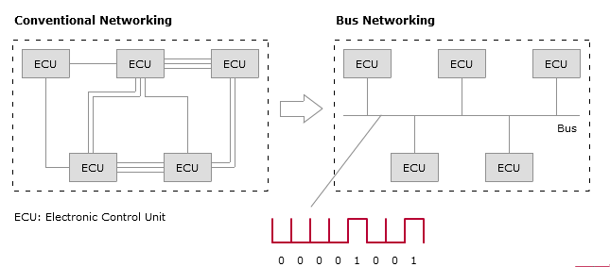

Need for CAN
Nowadays higher end automobiles have around 70 ECUs
There should be efficient communication between all these ECUs
Conventional method was to interconnect each ECU with another using wires
At the beginning of the 1980s, Bosch began to develop a serial communication system. It was given the name CAN (Controller Area Network).

Slide 4
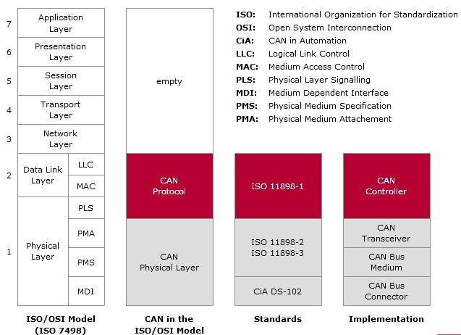
Standardization of CAN
CAN technology has been standardized since 1994 and is described by four ISO documents. ISO 11898-1 describes the CAN protocol.
CAN protocol just covers the Data Link Layer and the Physical Layer.

Slide 5
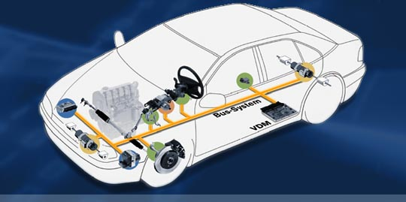
About CAN
The Controller Area Network (CAN) is a serial communications protocol which efficiently supports distributed real time control with a very high level of security.
Basically CAN is an event driven communication protocol, however we also have TT CAN which is time triggered.
The CAN network is usually based on a line topology with a linear bus to which a number of electronic control units are each connected via a CAN interface.
CAN has the following properties
• prioritization of messages
• multicast reception with time synchronization
• system wide data consistency
• multimaster
• error detection and signaling
autonomous switching off of defective nodes

Slide 6
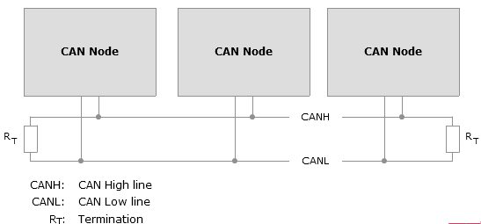
CAN NETWORK
A CAN network consists of a number of CAN nodes which are linked via a physical transmission medium (CAN bus).
An unshielded twisted two-wire line is the physical transmission medium used, over which symmetrical signal transmission occurs.
The data rate of High speed CAN is 1 Mbit/s.
The data rate of Low speed CAN is 125Kbit/s.
A maximum network extension of about
40 meters is allowed.
At the ends of the CAN network, bus
termination resistors contribute to
preventing transient phenomena (reflections).
ISO 11898 specifies the maximum number
of CAN nodes as 32.

Slide 7
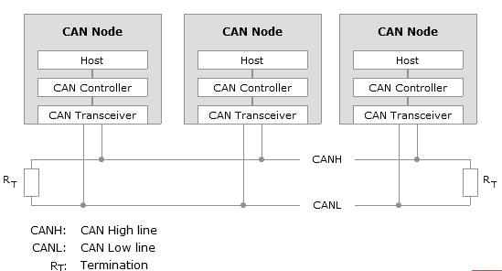
CAN Node
An ECU that performs its tasks in a CAN network is referred to as a CAN node.
Every node consists of a Host(Microcontroller) , CAN controller and a CAN transceiver.
The CAN controller fulfills communication
functions prescribed by the CAN protocol,
which relieves the host considerably.
The CAN transceiver connects the
CAN controller to the physical
transmission medium.

Slide 8
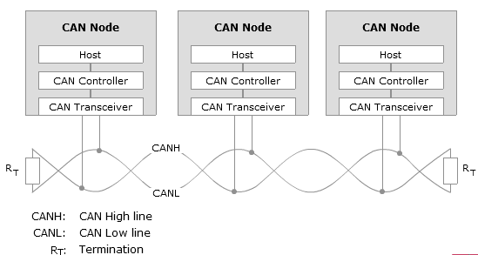
CAN Bus
Physical signal transmission in a CAN network is based on transmission of differential voltages (differential signal transmission).
This effectively eliminates the negative effects of interference voltages induced by motors, ignition systems and switch contacts.
Consequently, the transmission medium (CAN bus) consists of two lines: CAN high line (CANH) and CAN low line (CANL).
Twisting of the two lines reduces the magnetic field considerably.
Due to finite signal propagation speed, the effects of transient
phenomena (reflections) grow with increasing data rate
and bus extension.
Terminating the ends of the communication channel using
termination resistors prevents reflections in a high-speed
CAN network.

Slide 9
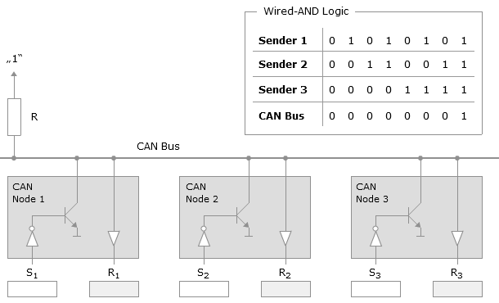
CAN BUS Logic
The dominant bus level corresponds to logical “0”.
The recessive bus level corresponds to logical “1”.
The dominant bus level overwrites the recessive bus level.
In terms of logic, such behavior is AND-logic

Slide 10

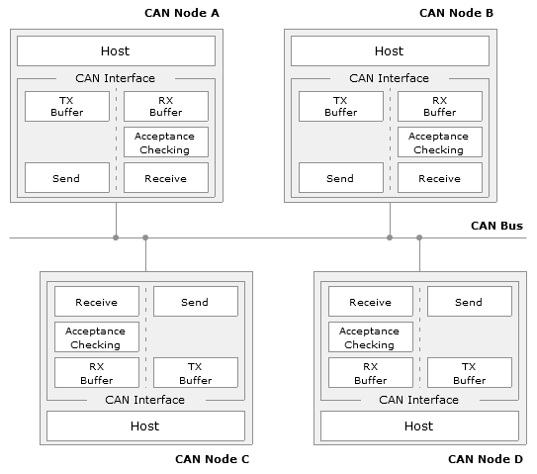
CAN Communication Principle

Slide 11
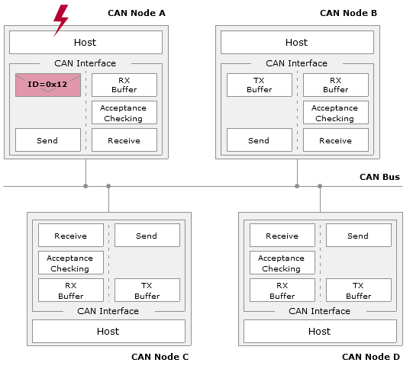
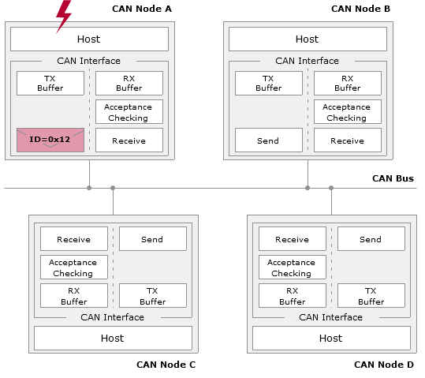
CAN Communication Principle

Slide 12
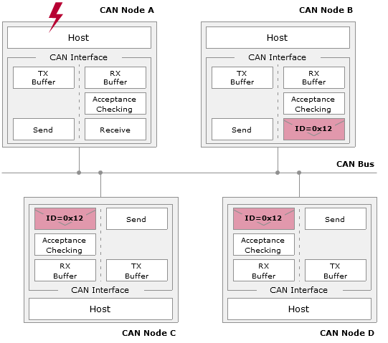
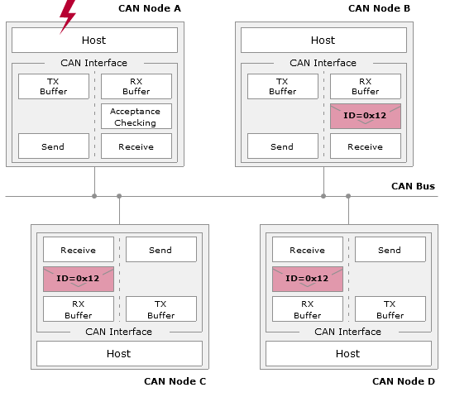
CAN Communication Principle

Slide 13
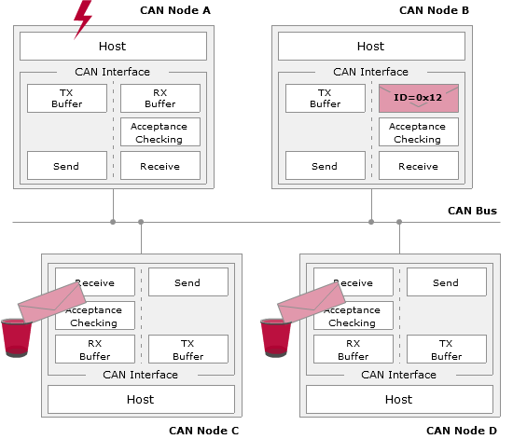
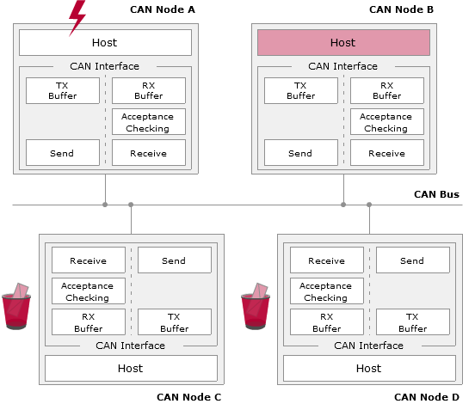
CAN Communication Principle

Slide 14
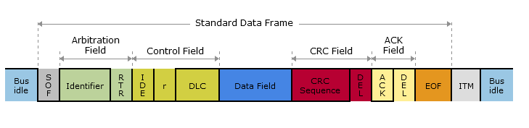
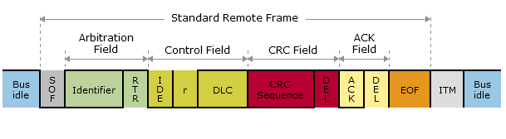
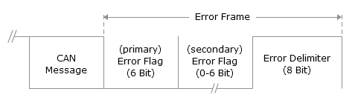
CAN Framing
Standard Data Frame:
Standard Remote Frame:
Error Frame:

Slide 15
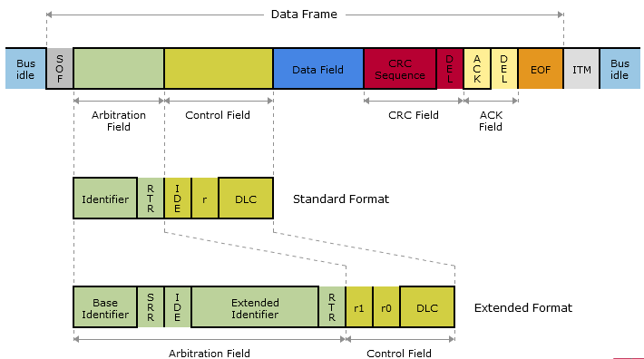
Data Frame
"Hello everyone, here's some data labeled X, hope you like it!"
Data frames serve to transmit the user data.
Data frame starts with the Start of Frame(SOF) followed by the Arbitration field.
Then comes the Control field and the Data field.
CRC field is used for error detection.
Acknowledgement field is used to check if the receiver received the data or not.
End of Frame(EOF) signifies the end of Data Frame.

Slide 16
Remote frame
"Hello everyone, can somebody please produce the data labeled X?"
Remote frame is a frame type used to request data, i.e. data frames, from any CAN node.
Difference between data and remote frame is
RTR bit in remote frame is set to 1 whereas in data frame, RTR bit is dominant.
Data field in a remote frame is absent.
Data frame has higher priority compared to remote frame.
A remote frame contains the message id of the data which it is requesting.

Slide 17
Different fields of a Data frame
Start of Frame(SOF):It is transmitted by the sender as a dominant level which produces a signal edge from the previous recessive (bus idle) level which is used to synchronize the entire network.
Arbitrarion Field: This field contains the identifier bits and the RTR bit
Identifier bits : The first 11 bits after SOF bit constitute the ID bits. These bits decide the priority of the message frame. Lower the ID value, higher the priority of the frame.
RTR bit : It is used by the sender to inform receivers of the frame type (data frame or remote frame). A dominant RTR bit indicates a data frame.
Control Field: This field contains an IDE( Identifier extension ) bit, a reserved bit and the data length code.
IDE bit : This bit differentiates between the Standard frame format and the extended frame format. A dominant value on IDE bit denotes a standard frame format.
Data Length Code : The DLC (Data Length Code) communicates the number of bytes in the data field to the receivers. DLC is of 4 bits and a combination of recessive and dominant bits.

Slide 18
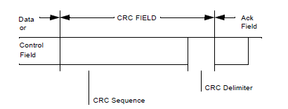
Different fields of a Data frame
CRC( Cyclic Redundancy Check) Field : This is a field of 16 bits consisting of a 15 bit CRC sequence and a CRC delimiter.
CRC sequence :
CRC sequence is computed based on the bits to be transmitted (from SOF up to and including the data field) and a generator polynomial G(x).
The overall polynomial is a multiple of the bits
to be transmitted.
The receiver of the overall polynomial can
then detect with very high reliability whether a
transmission error occurred.
CRC delimiter : It is a bit to denote the end of a CRC field. It is a recessive bit.

Slide 19
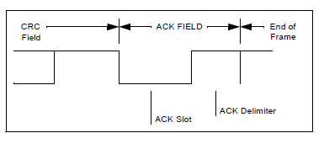
Different fields of a Data frame
ACK field : The Acknowledgement field has two bits. The ACK bit and the ACK delimiter.
ACK bit :
The sender sends this bit as a Recessive bit.
If the CRC check is successful, the receiver acknowledges the successful reception of the bits by pulling the recessive value down to a dominant bit.
The sender sees a mismatch in the value that it
had sent and the value it sees on the bus.
ACK delimiter : After the ACK bit is pulled down to
zero, the sender will send the ACK delimiter. It is a
recessive bit.
End of Frame(EOF) : The transmission of a data frame is terminated by seven recessive bits which marks the End of Frame.

Slide 20
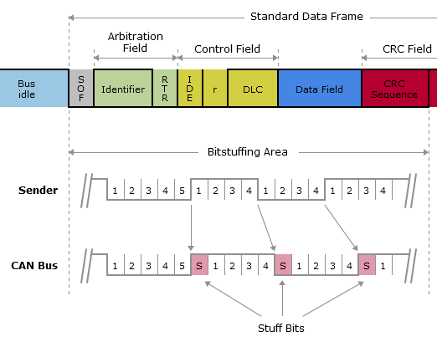
Bit stuffing
The resynchronization mechanism is based on evaluation of recessive-to-dominant signal edges.
Such signal edges are assured by the so-called bit stuffing mechanism.
ISO 11898-1 prescribes that senders must transmit a complementary bit at the latest after transmitting five homogeneous bits;
a stuff bit is added even if a complementary bit followed the five homogeneous bits anyway.

Slide 21
Types of Errors in CAN
There are 5 different error types
BIT ERROR:
A unit that is sending a bit on the bus also monitors the bus. A bit error has to be detected at that bit time, when the bit value that is monitored is different from the bit value that is sent. An exception is the sending of a ’recessive’ bit during the stuffed bit stream of the arbitration field or during the ack slot.
STUFF ERROR:
A stuff error has to be detected at the bit time of the 6th consecutive equal bit level in a message field that should be coded by the method of bit stuffing.
CRC ERROR:
The CRC sequence consists of the result of the CRC calculation by the transmitter. The receivers calculate the CRC in the same way as the transmitter. A CRC error has to be detected, if the calculated result is not the same as that received in the CRC sequence.
FORM ERROR:
A Form error has to be detected when a fixed-form bit field contains one or more illegal bits.
ACKNOWLEDGMENT ERROR:
An acknowledgment error has to be detected by a transmitter whenever it does not monitor a ’dominant’ bit during the ack slot.

Slide 22
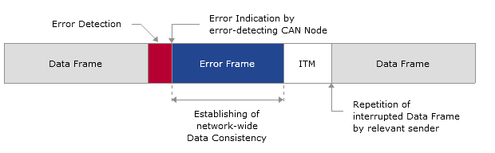
CAN Error Frame
The error frame consists of three parts. The primary error flag, secondary error flag and the error delimiters.

Slide 23
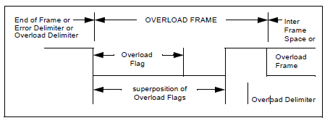
Overload frame
The Overload frame contains the two bit fields. The overload flag and overload delimiter.
Overload frame arises due to the internal conditions of a receiver, which requires a delay of the next data frame or remote frame.
There are two other kinds of overload conditions, which both lead to the transmission of an overload flag:
Detection of a ’dominant’ bit at the first and second bit of intermission.
If a can node samples a dominant bit at the eighth bit (the last bit) of an error delimiter or overload delimiter, it will start transmitting an overload frame (not an error frame). The error counters will not be incremented.
Overload flag = 6 dominant bits
Overload delimiter = 8 recessive bits

Slide 24
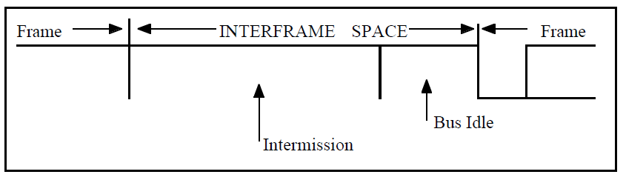
Interframe spacing
Data frames and remote frames are separated from preceding frames whatever type they are (data frame, remote frame, error frame, overload frame) by a bit field called interframe space.
Interframe space consists of three intermission bits.
During intermission the only action to be taken is signaling an overload condition and no station is allowed to actively start a transmission of a data frame or remote frame.
Note : Overload frames and error frames are not preceded by an interframe space and multiple overload frames are not separated by an interframe space.

Slide 25
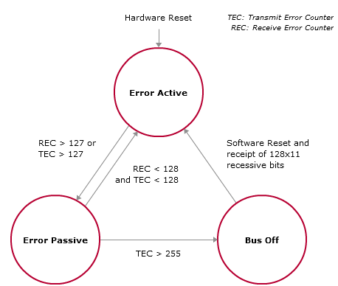
Fault confinement in CAN
Every node has two error counters. Transmit Error Counter and Receive Error Counter.
The counters are incremented or decremented based on the Errors or Successful communication respectively.
Based on the count value, they can be classified into
Active error state
Passive error state
Bus Off state

Slide 26
Difference between Standard frame and an Extended frame

Slide 27
Difference between Standard frame and an Extended frame
The number of bits in the identifier in an extended frame is 29, whereas in data frame it is 11.
The 29 identifier bits are split into two parts of 11 bits and 18 bits, both separated by two bits namely the SRR bit and the IDE bit.
Substitute Remote Request BIT
SRR is a dummy bit to let standard format RTR messages win arbitration
The SRR is a recessive bit. It is transmitted in Extended Frames at the position of the RTR bit in Standard Frames and so substitutes the RTR-Bit in the Standard Frame.
IDE bit
The IDE Bit belongs to the
ARBITRATION FIELD for the Extended Format
Control Field for the Standard Format.

Slide 28
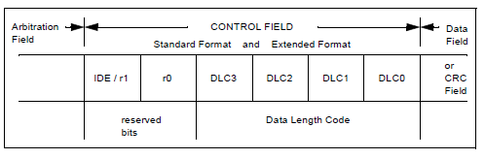
Difference between Standard frame and an Extended frame
The Control frame in Standard and Extended formats are almost the same except for the first bit.
In Standard frame format the first bit of Control field id the IDE bit
In Extended frame format the first bit of Control field id the R1(reserved) bit

Slide 29

Thank you for your attention!
Questions and Answers

