Slide 1


CAN & LIN
&
August 23, 2002, Friday Session
Oliver Bremicker, SV C CE SW B

Slide 2
Overview
&
CAN Introduction
LIN Introduction
CAN vs. LIN
Implementation / Integration

Slide 3
CAN History Timeline
Time
150.000.000 CAN controllers sold*
More than 80 different controllers available from 19 manufacturers
CAN in Automation (CiA) founded
International CAN manufacturers and users organization http://can-cia.de
First specification of the CAN Protocol
*Source: CAN in Automation (CiA) e.V.
1999
1992
1985
1993
1988
1983
ISO 11898 standardization
World-wide standardization leads to the widespread use of CAN in mass-market applications, e.g. automobiles
First CAN Controller on the market: Intel 82C526
BOSCH starts developing the CAN Protocol
Intended use: Power train applications

Slide 4

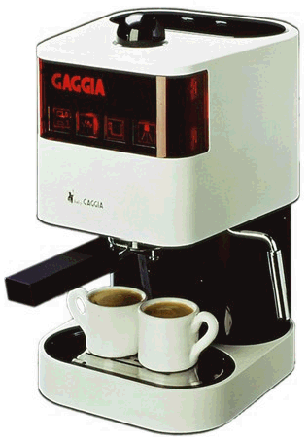
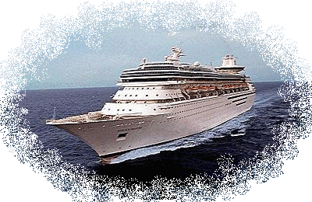
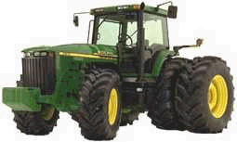

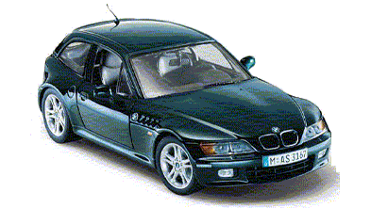

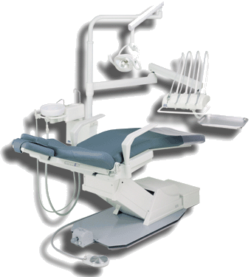

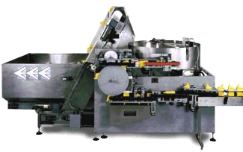
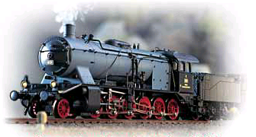
Application examples for the CAN Bus
Domestic Appliances
Construction Equipment
The many uses of
Ships & Boats
90 %
of all applications
Agricultural Machines
Automotive Sector
Medical Equipment
Building Automation
Trains
Industry Automation

Slide 5
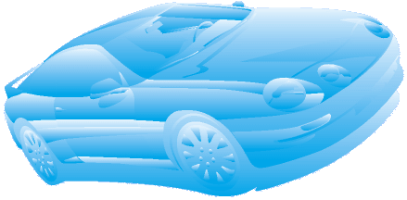
Typical examples for CAN in automobiles
Airbag
Dashboard
Air conditioning
Engine
Power windows
Gearbox
Mirrors
Central locking
Brakes
Lights
Car Body components
Typically low-speed CAN Bus
Power Train components
Typically high-speed CAN Bus

Slide 6
CAN: Bus characteristics
Serial data communications bus
Inexpensive and simple, but slower than parallel bus.
Linear bus structure
No star structure, no ring structure, no tree structure !
Sensor / actor bus
Example: rain sensor = sensor, windscreen wipers = actor,
both connected via the same bus.

Slide 7

CAN: Data rates
“Good” real-time capabilities
Small latency (“fast enough”)
➔ indispensable for automotive applications.
Data rate dependent on bus length
Data rate: 1 Mbit/sec ➔ Bus length: 40 meters,
Data rate: 125 kBit/sec ➔ Bus length: 500 meters,
Data rate: 50 kBit/sec ➔ Bus length: 1000 meters.
Typical definitions:
Low-speed: 25 kBit/sec up to 125 kBit/sec.
High-speed: 500 kBit/sec up to 1 Mbit/sec.

Slide 8
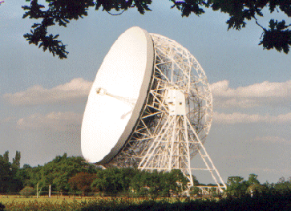
CAN: Transmission principles
Multicast / broadcast philosophy
CAN messages do not include references to
sender or receivers, but to information contents.
Bus access principle: CSMA/CA
Carrier Sense Multiple Access with Collision Avoidance
Carrier Sense: Every node monitors the bus level, all the time.
Multiple Access: Every node can start a transmission any time
when the bus is free.
Collision Avoidance: When several nodes start transmission at
the same time, all but one withdraw from sending.

Slide 9
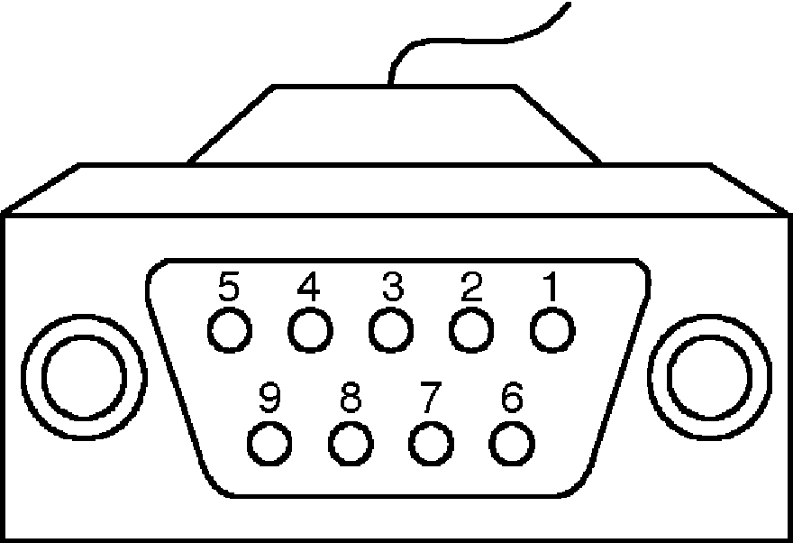
CAN: Hardware characteristics
Hardware message acceptance filtering
Only leaves messages through which are of interest for the node
➔ reduces CPU load.
Sophisticated hardware error management
Combination of different error prevention and detection methods,
automatic re-transmission of messages detected as erroneous
➔ very high transmission security among field bus systems.
Various transmission media
Twisted-pair (dual-wire) cable, single-wire cable or optical fiber.
Standardized connector
Recommended: 9-pin D-sub connectors (DIN 41652).

Slide 10
CAN: Signal coding
NRZ (non-return-to-zero) coding
Example: Voltage levels: 0V (dominant), 5V (recessive)
Characteristics of NRZ coding:
Voltage level stays the same for consecutive bits of same polarity.
Note:
Different voltage levels are defined for different purposes.
5V
recessive
0V
1
0
1
0
0
0
1
1
0
1
0
0
1
dominant

Slide 11
CAN: Bus stations (Nodes)
Typically 3 to 40 nodes per bus
No limit for node number defined in CAN specification.
Number of nodes depends on capabilities of CAN transceivers.
Bus load usually gets higher with more nodes.
Hot plug-in / plug-out
Connect / disconnect nodes while the bus is up and running.

Slide 12
Advantages of the CAN Bus
Advantages of
the
CAN Bus
conventional cabling
over
+
Less wires
+
Less space requirements
+
Less connections
+
Easier addition of new nodes
+
Less weight
+
Lower assembly costs
+
Less EMI problems
+
Increased transmission reliability

Slide 13


CAN: International Standards
“The great thing about standards is that there are so many to choose from.”
ISO
DIN
SAE
CiA
International CAN standards
ISO 11898 “Road vehicles: CAN for high-speed communication”
ISO 11519 “Road vehicles: Low-speed serial data communication -
Low-Speed CAN / VAN”
ISO 11992 “Road vehicles: Electrical connections between
towing and towed vehicles”
EIA RS-485 “Electrical Characteristics of Generators and
Receivers for Use in Balanced Digital Multipoint Systems”
(formerly used for CAN Physical Layer)

Slide 14
CAN Data Frame: Formats
Standard Format (CAN 2.0A): 11-bit Identifier
2¹¹ = 2048 (in reality only 2032) identifiers possible
Bus Idle
Arbitration Field
Control Field
Data Field
CRC Field
Ack Field
End of Frame Field
Inter- frame Space
Bus Idle
recessive
S
R
I
r
D
A
D
Bus Idle
O
11-bit Identifier
T
D
0
DLC
0..64 Bit Data
15-bit CRC
E
C
E
7-bit EOF
IFS
Bus Idle
dominant
F
R
E
L
K
L
Extended Format (CAN 2.0B): 29-bit Identifier
2²⁹ = 536.870.912 identifiers possible
Bus Idle
Arbitration field
Control Field
Data Field
CRC Field
Ack Field
End of Frame Field
Inter- frame Space
Bus Idle
recessive
S
S
I
R
r
r
D
A
D
Bus Idle
O
11-bit Base Id
R
D
18-bit Ext. Id
T
1
0
DLC
0..64 Bit Data
15-bit CRC
E
C
E
7-bit EOF
IFS
Bus Idle
dominant
F
R
E
R
L
K
L

Slide 15
Overview
&
CAN Introduction
LIN Introduction
CAN vs. LIN
Implementation / Integration

Slide 16
LIN: History and expectation
Time
200x
1999
Growth expectations:
3 … 10 LIN nodes per vehicle
1.2 billion LIN nodes per year world-wide
Current specification
LIN Specification Package V1.2
(Nov 17, 2000)
2000
1998
First specification
draft released
LIN Consortium initiated
(5 car manufacturers,
1 semiconductor supplier,
1 tool provider)
http://www.lin-subbus.org

Slide 17
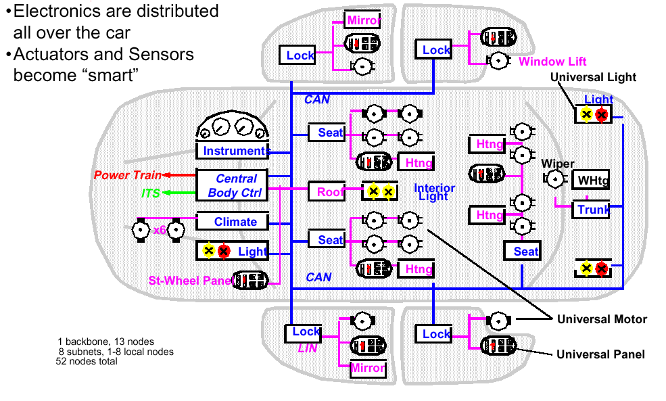
Typical example for LIN in automobiles (1)

Slide 18
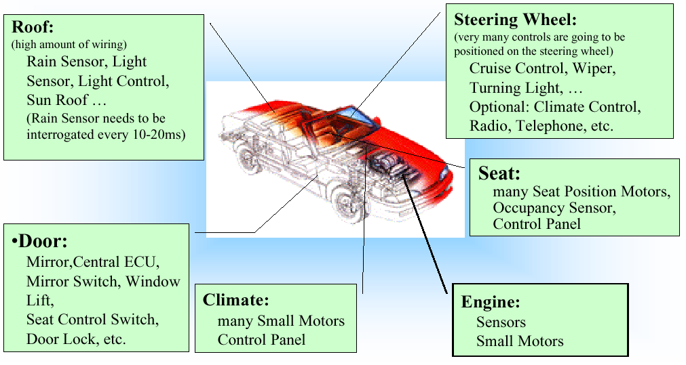
Typical example for LIN in automobiles (2)

Slide 19

LIN: Technical features (1)
Sub-bus as an extension to CAN to provide
connection to local network clusters
Low-cost single-wire implementation
(less expensive than CAN but not as reliable as CAN)
Low-cost silicon implementation based on
common UART/SCI interface hardware
(almost any microcontroller has necessary hardware on chip)
Single-master / Multiple-slave concept
(no arbitration is necessary)

Slide 20
LIN: Technical features (2)
Self-synchronization without quartz or
ceramics resonators in the slave node
(significant cost reduction of hardware platform)
Data rates of up to 20 kbit/sec
(limited by the EMI of single-wire transmission)
Recommended Bit Rates:
Slow : 2.400 bit/sec
Medium: 9.600 bit/sec
Fast : 19.200 bit/sec
Guaranteed latency times for signal
transmission
Hot plug-in / plug-out

Slide 21
LIN Frame
011100010101001111010101010101010101000111
Frame Format
Header
Response
Byte Field Format: transmission with LSB first
0
8 Data Bits
1
Start Bit
Stop Bit

Slide 22

LIN communication concept: Master task vs. Slave tasks
Master task vs. Slave tasks
master control unit
slave
control unit
slave
control unit
master task
slave task
slave task
slave task
LIN bus
only the master control unit contains a master task
slave tasks are contained in all control units

Slide 23
LIN communication concept: Frame timing
Synch Break
Identifier Field
1
3 b
it (min)
1 byte
Synch Field
next
1 byte
Synch Break
Master Task
Checksum Field
1 byte
t
In-frame Space
Data Field
2, 4 or 8 bytes
Inter-frame space / break
Slave Task
t

Slide 24
Overview
&
CAN Introduction
LIN Introduction
CAN vs. LIN
Implementation / Integration

Slide 25

Warning
LIN
“low-cost
CAN” !!!

Slide 26
CAN vs. LIN (1)
Data rate
max. 1 MBaud
max. 20 kBaud
Master/Slave
multi-master
master/slave
Data security
CRC code
simple checksum
Acknowledgement
yes
no
Node number
up to 100
up to 16

Slide 27
CAN vs. LIN (2)
Latency time
not guaranteed
deterministic
Frame scheduling
no
yes
Tx on event
yes
no
Error correction
retransmission
none
Error prevention
bus-off mechanism
none

Slide 28
CAN vs. LIN (3)
Upper SW layers
e.g. OSEK COM
LIN API
Protocol in HW
yes
no
Bus length
max. 1000m
max. 40m
Number of wires
2 (or 1)
1
ISO standard
ISO 11898 / 11519
no

Slide 29
Overview
&
CAN Introduction
LIN Introduction
CAN vs. LIN
Implementation / Integration

Slide 30
Embedded CAN Software Layers
Application Software
ISO/OSI Model
Diagnostic
Services
Application Layer
Presentation Layer
DP
Diagnostic
Protocol
IL
Interaction
Layer
NM
Network
Management
(e.g. OSEK)
μ Controller independent
Session Layer
CCP Driver
Can
Calibration
Protocol
Transport Layer
TP
Transport
Protocol
Network Layer
Software
CAN Driver
Data Link Layer
Hardware
CAN Controller / CAN Transceiver
Physical Layer

Slide 31
Embedded LIN Software Layers
Application Software
ISO/OSI Model
Application Layer
Presentation Layer
LIN Protocol Handler
μ Controller independent
Session Layer
Transport Layer
Network Layer
Software
UART/ASC Driver
Data Link Layer
Hardware
UART module / LIN Transceiver
Physical Layer

Slide 32
Integration of CAN/LIN software in projects (1)
Implementations of CAN/LIN software exist
for a large (and growing) number of controllers.
Existing implementations make use of
standard solutions.
Check customer requirements against
existing standards.
Check customer requirements for
configuration issues.

Slide 33
Integration of CAN/LIN software in projects (2)
Contact the SWFR for communication software
well ahead to check availability of CAN/LIN SW
for your project.
SWA group provides integration and support.
SWP group provides training for developers.

Slide 34

That’s all, folks!
Thank you for your attention

