Slide 1
Controller Area Network: Network Protocol Training
Agenda:
1. CAN: Detailed description of all CAN protocol features
2. Add-on CANalyzer: Getting started
<number> / O. Friedrichsohn / 16-Jan-2008 © Continental AG
Notes:
CAN: Controller Area Network, ISO standard, rights at BOSCH company
CCP: CAN Calibration Protocol

Slide 2
Section 1: CAN history and motivation
Brief history of CAN:
1991 First official release of CAN specification by BOSCH GmbH
First CAN-equipped car released by Daimler Benz
1993 ISO11519-2 (ISO11898) takes over CAN specification
1995 Release CAN 2.0B (Extended frame format)
Motivation:
Standard on a serial protocol for Inter-ECU communication
Application:
Inter-ECU data exchange (e.g. Senor-sharing)
Network-Management, Calibration & Diagnosis protocols
<number> / O. Friedrichsohn / 16-Jan-2008 © Continental AG
Notes:
Class A bus/communication: Low speed (up to 125 kbit/s) e.g. for car body applications.
Other examples: LIN, K-line
Class C bus/communication: high speed (up to 1 Mbit/s) e.g. for powertrain applications
Other examples: VAN (Vehicle Area Network), J1850-SCP

Slide 3
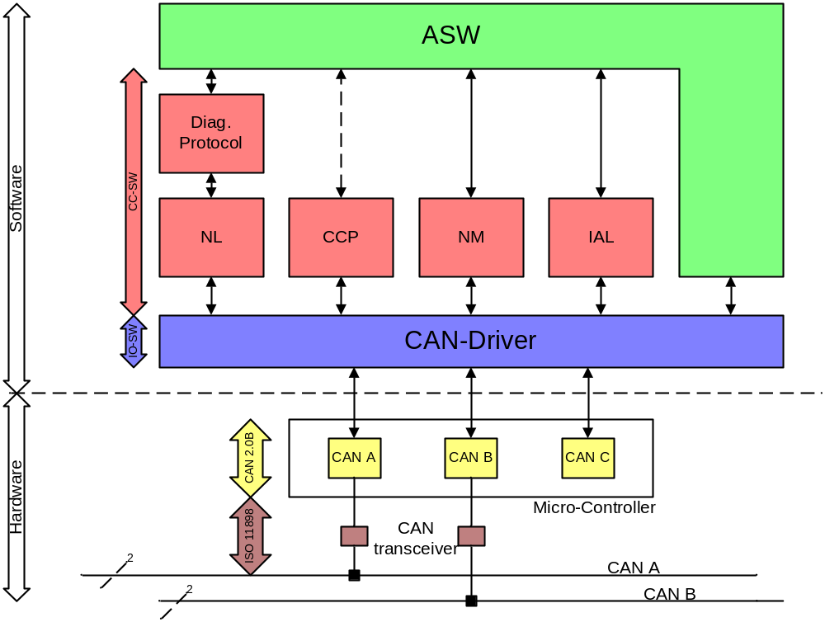
Section 1: CAN protocol stack
<number> / O. Friedrichsohn / 16-Jan-2008 © Continental AG
Notes:
Class A bus/communication: Low speed (up to 125 kbit/s) e.g. for car body applications.
Other examples: LIN, K-line
Class C bus/communication: high speed (up to 1 Mbit/s) e.g. for powertrain applications
Other examples: VAN (Vehicle Area Network), J1850-SCP

Slide 4
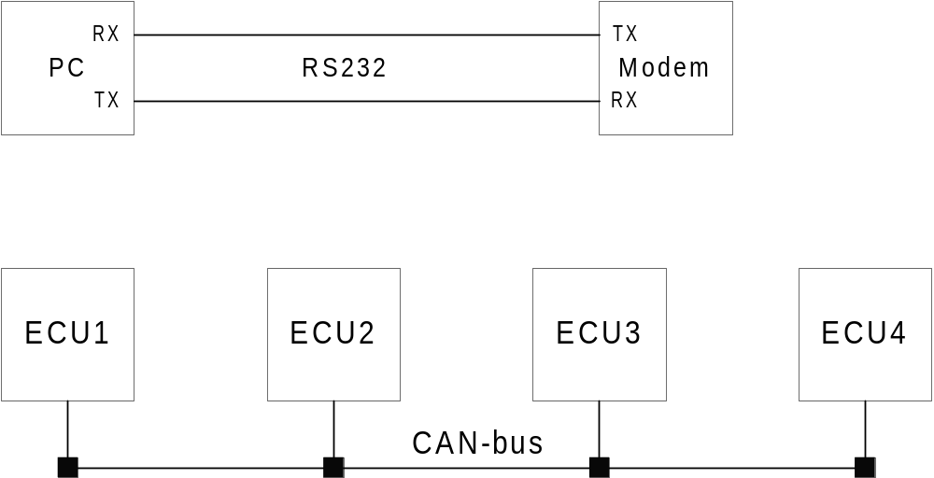
CAN: Serial Multi-Master Protocol
Comparison: RS232 versus CAN
Point-to-point connection:
1 Transmitter links to 1 Receiver
Full-duplex: 2 lines are required!
Multi-Master:
Each node can be a transmitter at a time while all others are receivers: Half-duplex.
Note: 2 lines are required only for EMI robustness!
<number> / O. Friedrichsohn / 16-Jan-2008 © Continental AG
Notes:
EMI: Electro-Magnetic-Interference

Slide 5
CAN: Dominant / Recessive Channel
V
d
d
V
d
d
Principle only: Not an ISO11898 channel
R
R
Channel
S
t
a
t
i
o
n
A
Receiver
S
t
a
t
i
o
n
B
Receiver
M
o
n
i
t
o
r
M
o
n
i
t
o
r
Sender
Sender
Asymmetric binary channel:
Logical assignment: dominate state = binary "0"
recessive state = binary "1"
The pull-up resistors yields in an endless transmission of a binary "1"s.
CAN uses NRZ bit-coding: A physical bit equals a logical bit
<number> / O. Friedrichsohn / 16-Jan-2008 © Continental AG
Notes:
Binary channel: A medium that is used to transmit two physical values that represent logical values.
Recessive: the state which in not actively driven by a transmitter
Dominant: the state that is actively driven by the transmitter
NRZ: Non-Return-Zero; a coding rule for binary values (the simplest one)
Additional example of an dominant/recessive-channel:
Optical fiber
“light on”: dominant
“light off”: recessive
⇨ “light on” overwrites “light off”

Slide 6
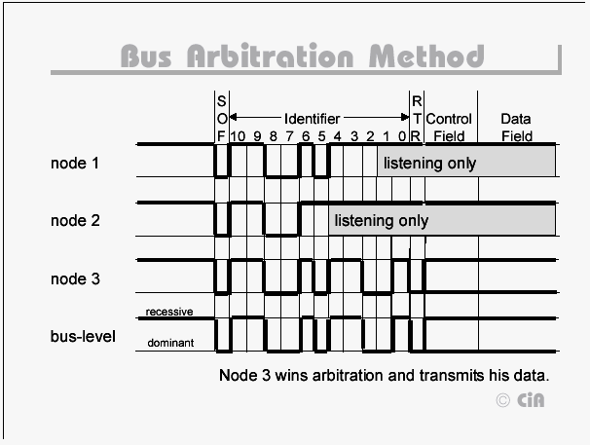
CAN: Media Access Method CSMA / CA
Every arbitration leads finally to the transmission of the message with the highest priority.
This feature is also called: Constructive Collision Handling and yields in a bus-load stability up to 100%.
SOF: Start of Frame Bit
RTR: Remote Transmission Request Bit
<number> / O. Friedrichsohn / 16-Jan-2008 © Continental AG
Notes:
Arbitration: a method to handle (negotiate) the access to a resource. "Which sender can send a message next?"
SOF: Start of Frame
RTR: Remote-Transmission-Request

Slide 7
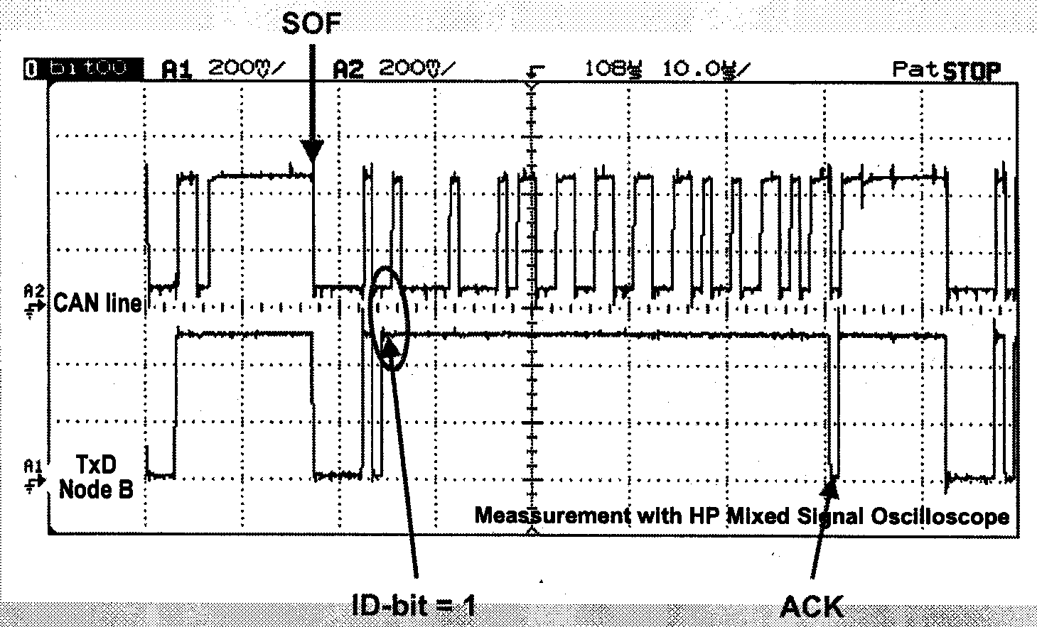
CAN: Arbitration example
Picture from MicroConsult CAN Training
<number> / O. Friedrichsohn / 16-Jan-2008 © Continental AG
Notes:
SOF: Start of Frame bit: First bit a of a CAN frame is by definition a dominant bit.
ACK: Acknowledge bit

Slide 8
CAN: Two Access Types
Asynchronous bus access
A CAN node starts a transmission after having detected a free bus: 11 consecutive recessive bits on the bus.
Synchronous bus access
Two or more stations have a pending transmit request and are waiting for the end of a running frame transmission. End of a transmission is detected after the EOF (end of frame) and inter-frame space: 10 consecutive recessive bits.
<number> / O. Friedrichsohn / 16-Jan-2008 © Continental AG
Notes:
EOF: End of Frame filed

Slide 9
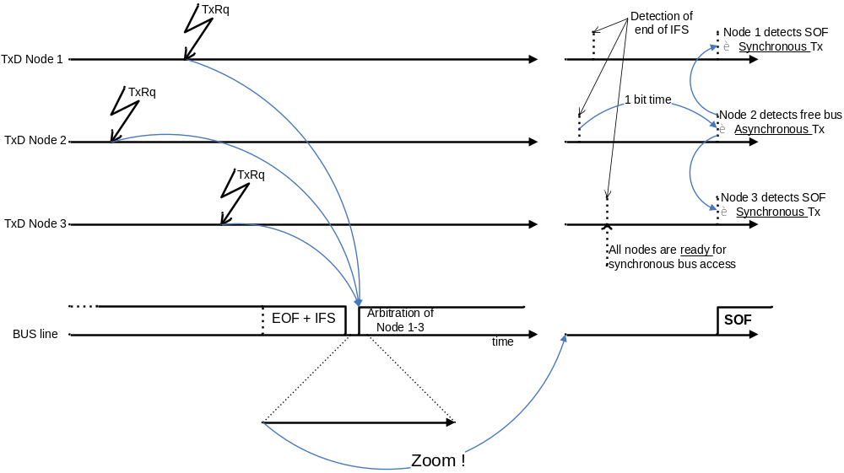
CAN: Example of synchronous and asynchronous access
<number> / O. Friedrichsohn / 16-Jan-2008 © Continental AG
Notes:
EOF: End of Frame filed

Slide 10
CAN: Message Addressing
CAN is a broadcast system using message addressing.
That means:
All message are received by ALL CAN controllers (no station addressing)
Message filtering is implemented based on mail-boxes
The content of a message is identifiable by its ID
As the message ID is the first variable part of the frame format, the message ID defines the message priority
There must not be more then one transmitter per frame ID
<number> / O. Friedrichsohn / 16-Jan-2008 © Continental AG

Slide 11
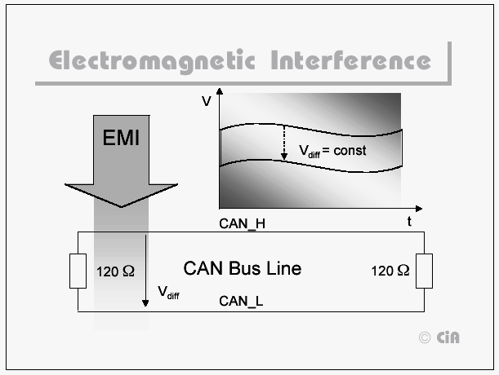
CAN: Differential Wire: CAN_High CAN_Low
The CAN high-speed transceivers according to ISO 11898-2 measure always the difference voltage between CAN_H and CAN_L.
Recessive State: 0 Volt
Dominant State: 2 Volt
Reason:
Robustness against EMI and ground offsets in a distributed environment
Additional measure:
Twisted pair and shielded cables
E.g. Mobil-phone, Ignition, power generator, etc.
!
<number> / O. Friedrichsohn / 16-Jan-2008 © Continental AG
Notes:
EMI: Electromagnetic Interference

Slide 12
CAN: Bus Topology according to ISO-11898
C
A
N
_
H
N
o
d
e
N
o
d
e
1
C
A
N
_
L
N
1
2
0
Ω
1
2
0
Ω
N
o
d
e
N
o
d
e
N
o
d
e
T
e
r
m
i
n
a
t
i
o
n
1
2
3
4
T
e
r
m
i
n
a
t
i
o
n
2
U
[
V
]
3
,
5
C
A
N
_
H
2
,
5
Level definitions
1
,
5
i
i
i
C
A
N
_
L
t
U
[
V
]
1
0
1
0
1
0
2
,
0
Differential signal U(CAN_H)-U(CAN_L)
evaluated by the receiver
t
<number> / O. Friedrichsohn / 16-Jan-2008 © Continental AG

Slide 13
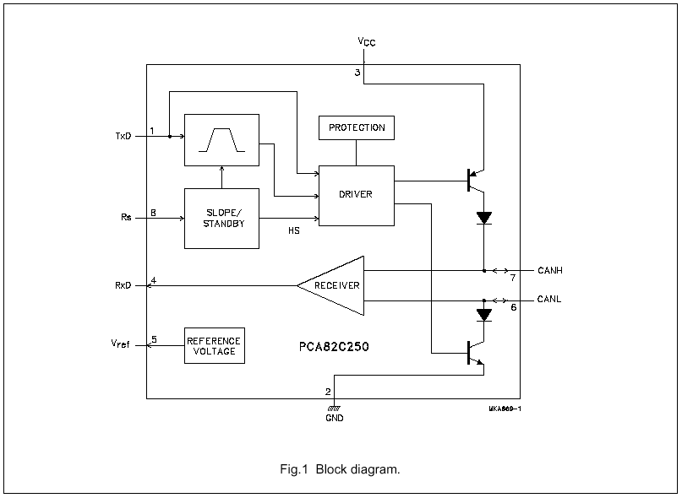
CAN: Transceiver circuit according to ISO11898
Beside the CAN-controller (internal e.g. C167C, MPC555 or external Intel 82527) there is always a transceiver circuit required.
Transceiver device implements physical adaptation layer (ISO/OSI layer 1a)
Signals TxD and RxD come from CAN controller
Rs: Slope control for EMV limitation
<number> / O. Friedrichsohn / 16-Jan-2008 © Continental AG

Slide 14
CAN: Bit-stuffing
After 5 successive bits of the same state a complementary stuff-bit is inserted in the bit-stream
The stuff-bits do also count!
unstuffed stream
stuffed stream
Stuff-Bit
Stuff-Bit
Bit-stuffing ensures re-synchronization as a minimum of falling or rising edges is guaranteed in the bit-stream!
Bit-stuffing area: From SOF (including) until CRC (excluding the CRC delimiter)
<number> / O. Friedrichsohn / 16-Jan-2008 © Continental AG

Slide 15
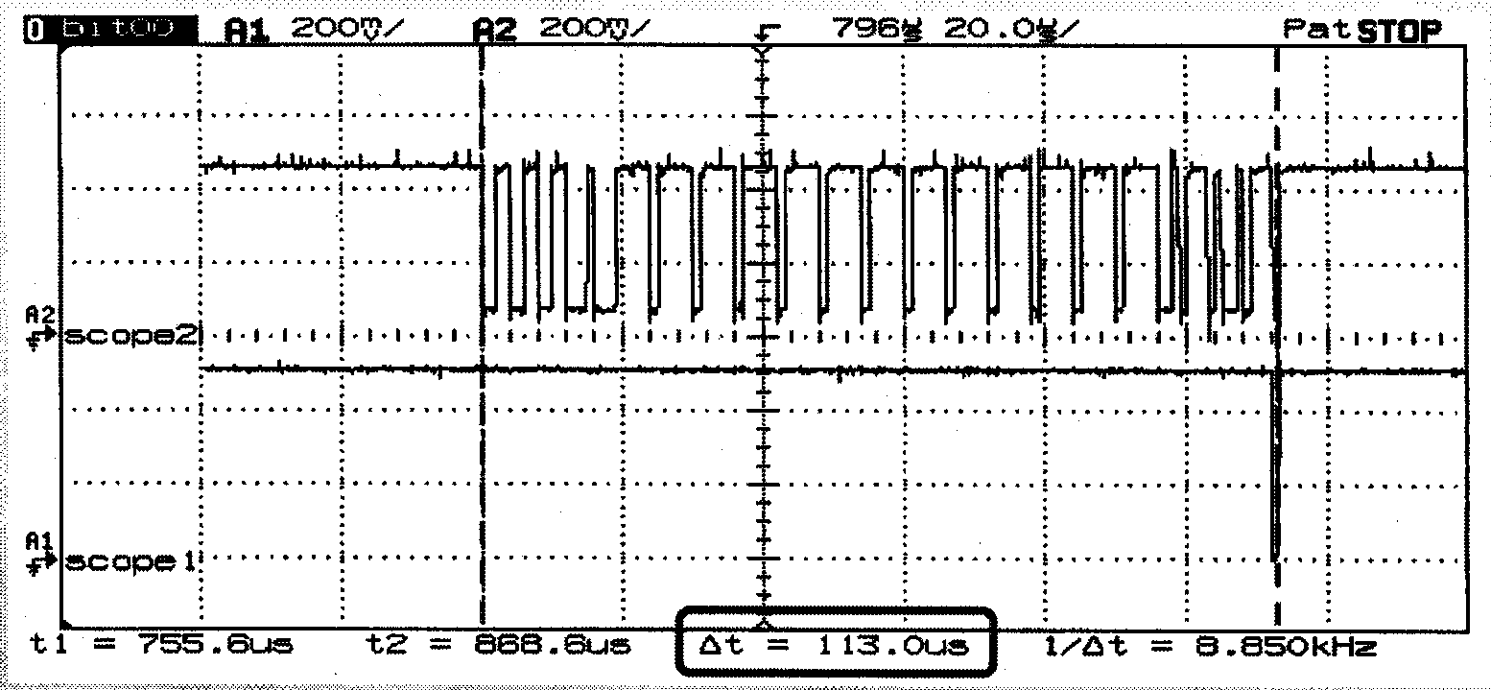
CAN: Bit-stuffing example
Calculated length SOF to ACK: 100 bits
Actual length: 113 bits ➔ 13 Stuff-bits
Picture taken from MicroConsult CAN Training
<number> / O. Friedrichsohn / 16-Jan-2008 © Continental AG

Slide 16
CAN: Data-Frame Format
Standard Format (CAN 2.0A): 11-bit Identifier
Bus Idle
Arbitration Field
Control Field
Data Field
CRC Field
Ack Field
End of Frame Field
Inter- frame Space
Bus Idle
recessive
Bus Idle
S
11-bit Identifier
R
I
r
DLC
0..64 Bit Data
15-bit CRC
D
A
D
7-bit EOF
IFS
Bus Idle
O
T
D
0
E
C
E
dominant
F
R
E
L
K
L
Extended Format (CAN 2.0B): 29-bit Identifier
Bus Idle
Arbitration field
Control Field
Data Field
CRC Field
Ack Field
End of Frame Field
Inter- frame Space
Bus Idle
recessive
Bus Idle
S
11-bit Base Id
S
I
18-bit Ext. Id
R
r
r
DLC
0..64 Bit Data
15-bit CRC
D
A
D
7-bit EOF
IFS
Bus Idle
O
R
D
T
1
0
E
C
E
dominant
F
R
E
R
L
K
L
<number> / O. Friedrichsohn / 16-Jan-2008 © Continental AG
Notes:
SOF: Start of Frame Bit
ID: Identifier
RTR: Remote Transmission Request
IDE: Identifier Extension field
res.: reserved
DLC: Data Length Code
CRC: Cyclic Redundancy Check
CRC Del.: CRC Delimiter
ACK: Acknowledge
ACK Del.: ACK Delimiter
EOF: End of Frame bits
SRR: Substitute Remote Request bit
IDE: Identifier Extension

Slide 17
CAN: Data-Frame Format
SOF: Start-of-Frame 1 dominant bit indicates the start of a new frame
ID: Identifier field 11-bit (standard) or 29-bit (extended)
RTR: 1-bit to indicate Data frame (0) or Remote-Transmission-Request (1)
IDE: Identifier extension filed indicated standard (0) or extended (1) frame
r0: Reserved dominant bit (most probably never used)
DLC: Data length code. 4-bit to indicate 0 to 8 byte data filed length
Data field: 0 to 8 byte of data (i.e. maximum of 64 data bits) according to DLC
CRC: 15-bit Cyclic redundancy check. Creating a hamming distance of 6 bits.
CRC-DEL: Delimiter bit (1)
ACK: 2 bits for in-frame acknowledgement of receivers. 1 bit must be (0), transmitted by the receivers, 2nd bit must be a delimiting (1)
EOF: 7 recessive bits (1) indicating the end of the frame
IFS: 3 recessive bits indicating the space between two subsequent transmissions
<number> / O. Friedrichsohn / 16-Jan-2008 © Continental AG
Notes:
SOF: Start of Frame Bit
ID: Identifier
RTR: Remote Transmission Request
IDE: Identifier Extension field
res.: reserved
DLC: Data Length Code
CRC: Cyclic Redundancy Check
CRC Del.: CRC Delimiter
ACK: Acknowledge
ACK Del.: ACK Delimiter
EOF: End of Frame bits
SRR: Substitute Remote Request bit
IDE: Identifier Extension

Slide 18
CAN: Protocol-Variants, Controller-Types
Protocol-Variants:
CAN 2.0A, Standard CAN:
Standard Frames with 11 Bit-ID
CAN 2.0B, Extended CAN:
Standard Frames and Extended Frames with 29 Bit-ID
CAN 2.0B passive:
Controller can only send and receive standard frames (11-bit ID) but tolerates extended frames (29-bit ID) on the bus.
Controller-Variants:
Basic-CAN (rarely distributed):
Only one buffer for send-channel and another single one for the receive channel.
CAN 2.0A or CAN 2.0B passive
Full-CAN (today’s standard):
Several send- and receive channels (Mailboxes). E.g. 15 at C167C. At least one of them is configurable as a Basic-CAN channel.
Protocol: CAN2.0A, CAN2.0B
<number> / O. Friedrichsohn / 16-Jan-2008 © Continental AG

Slide 19
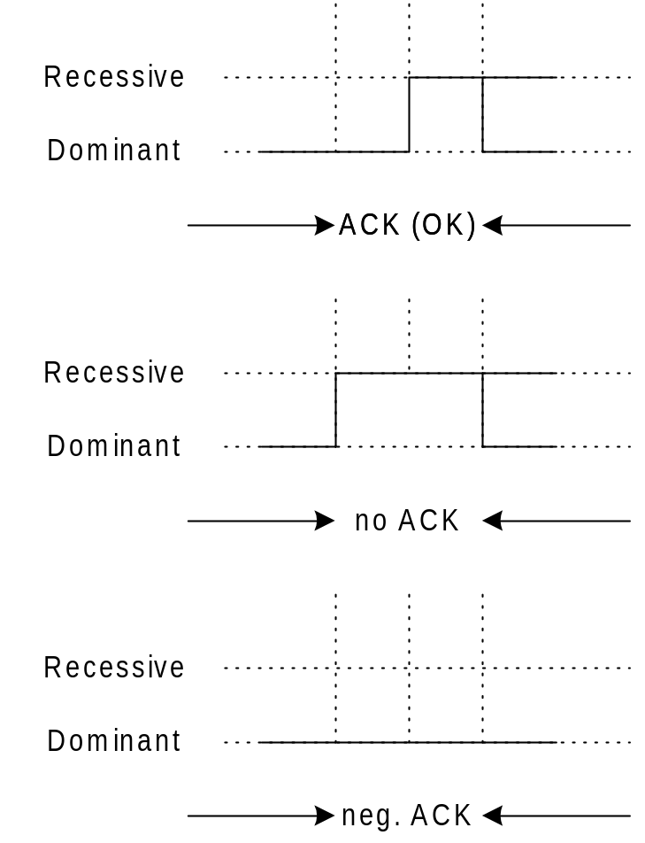
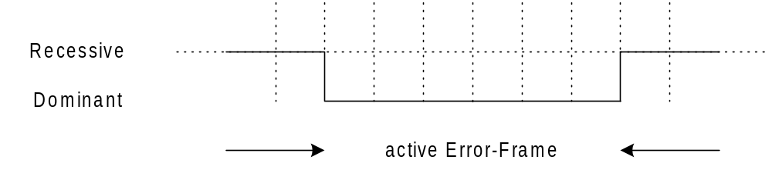
CAN: Error-Notification
CAN defines an active error notification mechanism:
An Error-Frame can be sent by every node at any time to communicate an error by actively destroying the affected frame
An active Error-Frame is a simply a sequence a 6 dominant bits. This causes a bit-stuffing error detection (or format error) at the other nodes
Each frame is acknowledged in-frame (ACK field) by all active receivers
Retransmission of a destroyed frames is initialized autonomously by the CAN-controllers (implemented in HW!)
6 dominant bits: Bit stuffing violation!
<number> / O. Friedrichsohn / 16-Jan-2008 © Continental AG

Slide 20
CAN: Error Frame Occurrence
Error frames should occur very, very seldom in a properly setup system!
Cases when error frames frequently occur are:
Booting bus nodes (switching on and off ECUs or tools connected to the bus)
Plugging to the bus during bus operation
Missing or wrong termination
Wrong bus timing configuration
More then one sender for on and the same message ID
"Slack joint" (loose contact)
Rule: In case of error-frame occurrence never proceed without solving this problem first
<number> / O. Friedrichsohn / 16-Jan-2008 © Continental AG

Slide 21
CAN: Error Confinement
Init
REC: Receive Error Counter
TEC: Transmit Error Counter
Error
Active
Bus off recovery sequence:
Reset and
occurrence of 128 times
11 recessive bits
REC > 127 or
TEC > 127
REC < 128 and
TEC < 128
Error
Passive
Bus
Off
TEC > 255
<number> / O. Friedrichsohn / 16-Jan-2008 © Continental AG
Notes:
REC: Receive Error Counter
TEC: Transmit Error Counter

Slide 22
CAN: Summary of the main Protocol Features
Bit-serial transmission of data packages up to 8 bytes length
NRZ-Coding plus bit-stuffing
Multiple master
Priority based Media Access Control: CSMA / CA
Message addressing
Broadcast: All CAN-controller receive all messages sent via the bus
Message filtering, message buffering
Error notification, error confinement, automatic retransmission
<number> / O. Friedrichsohn / 16-Jan-2008 © Continental AG
Notes:
NRZ: Non-Return-Zero bit encoding
CSMA / CA: Carrier sensed media access / collision avoidance

Slide 23
CAN: Resource characteristics of PT controllers
Controller | MPC555 | MPC56x | MPC5554 | MPC5553 | MPC5534 | MPC5566 | TC1796 | TC1766 | TC1762
Nickname | Black Oak | Green/Silver Oak | Copperhead | Moccasin | Coral | Viper | TriCore | TriCore | TriCore
Manufacturer | Freescale | Freescale | Freescale | Freescale | Freescale | Freescale | Infineon | Infineon | Infineon
Number of CAN nodes | 2 | 3 | 3 | 2 | 2 | 4 | 4 | 2 | 2
Number of Mailboxes | 2*16=32 | 3*16=48 | 3*64=192 | 2*64=128 | 2*64=128 | 4*64=256 | 128 | 64 | 64
Fix assignment of mailboxes to nodes | Yes | Yes | Yes | Yes | Yes | Yes | No | No | No
Transceiver shortcut option | No | Yes | No | No | No | No | No | No | No
Channels supporting RX-Multiplexing | 2 (#14-15) | 2 (#14-15) | 2 (#14-15) | 2 (#14-15) | 2 (#14-15) | all | all | all | all
<number> / O. Friedrichsohn / 16-Jan-2008 © Continental AG

Slide 24
CAN: Literature
[1] Trouble shooting CAN, CAN_trouble_shooting.doc, O. Friedrichsohn, 12-Apr-01
CAN-Termination, CAN-Ground, CANalyzer getting started
[2] CAN Protocol Description, CAN20B.pdf, CiA
Comprehensive manual on the protocol features of CAN
[3] CAN DLL Presentation slides, CANdll.pdf, CiA
Presentation slide-set on the upper layer of CAN (LLC and MAC)
[4] CAN Physical Layer, CANphy.pdf, CiA
Presentation slide-set on the lower layer of CAN (PLS, PMA, MDI)
Books:
CAN Controller Area Network, Wolfhard Lawrenz, Hüthig Verlag
Controller Area Network, Konrad Etschberger, IXXAT Inc.
Web-Links (Info-Page of CiA organization):
http://www.can-wiki.info/
http://www.can-cia.org/can/
<number> / O. Friedrichsohn / 16-Jan-2008 © Continental AG

Slide 25
Add-on session: CANalyzer Getting Started
2. Add-on: CANalyzer getting started:
Some tips and hints to start working with the CAN bus tool CANalyzer by Vector
<number> / O. Friedrichsohn / 16-Jan-2008 © Continental AG

Slide 26

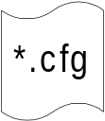



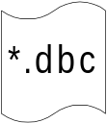

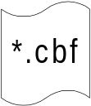
CANalyzer: Application Structure
CANalyzer
GUI for
CAN message analyzing
CAN message transmission
Connection to CAN HW via CAN driver
Arrow indicates:
embedded execution
Symbolic Database
for CAN Networks
stand-alone application
CAPL Browser
Editor for CAPL
stand-alone application
CAPL Compiler
DLL execution only
<number> / O. Friedrichsohn / 16-Jan-2008 © Continental AG
Notes:
CAPL: CAN Application Language

Slide 27


CANalyzer: The symbolic data base editor CANdb
With the current version of the CANaylzer there are two versions of the CANdb provided:
CANdb-Editor Traditional list-view oriented editor
"CANdb++"-Editor. Redesign of the editor with explorer-like tree- view
Editor defines the "Communication Matrix" based on the following abstractions:
Networks (only 1 network supported, >1 requires CANdb Admin version)
ECUs (limitation: ECU equals Network node!)
Network nodes (= CAN-Controller devices)
Messages (CAN- Frames)
Signals
<number> / O. Friedrichsohn / 16-Jan-2008 © Continental AG
Notes:
CANdb: CAN database; a tool by Vector to define the communication matrix of a complete can bus. Exchange format is a *.dbc-file.

Slide 28
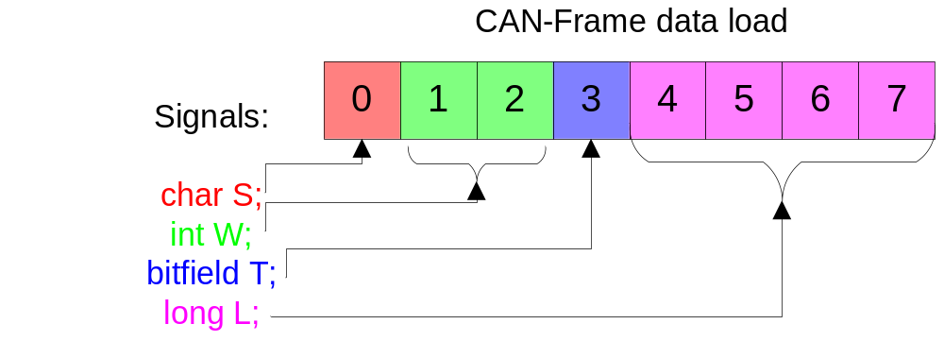
CANalyzer: Message, Data-field, Signal
A CAN-Message contains an Data-field of up to 8 bytes
Only a whole-numbered amount of bytes is possible (no single bits)
The Data-field is composed of data values also called Signals
Signals represent the smallest granularity of transmitted information and normally equal to C-variables
<number> / O. Friedrichsohn / 16-Jan-2008 © Continental AG

Slide 29
CANalyzer: First Steps & Core Functionality
Connecting a network
Measuring the bus termination (using a multi-meter)
Configuring the CAN Controllers (baud-rate, etc.)
Measurement setup, Message Flow Concept
Evaluation Windows: Trace, Data, Graphics, Bus Statistics, Statistics
CANdb association and usage
Send-branch: Message Generators, Interactive Generators
Filters (pass-through and block), Interruptions
Logging and Triggering
<number> / O. Friedrichsohn / 16-Jan-2008 © Continental AG

Slide 30
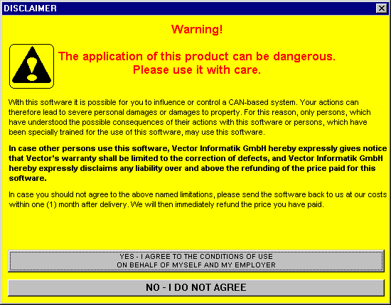
CANalyzer: Getting Started
Reason for the Disclaimer:
If you connect the CANalyzer to a CAN-bus you might shut down the whole bus communication due to invalid configuration of the CANalyzer in terms of:
Wrong bus timing: Bus will shut down bus immediately.
Invalid message configuration: E.g. Sending same CAN IDs as other bus nodes.
High bus load creation of high priority messages: Heavy impact on real-time behavior.
<number> / O. Friedrichsohn / 16-Jan-2008 © Continental AG

Slide 31
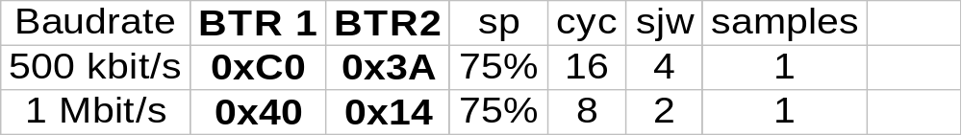
CANalyzer: Bit Timing Settings
All you need to know is the baud-rate of the target CAN-bus.
Caution: If you go online with a CANalyzer that has a wrong bus-timing configuration you will shut-down the complete communication of the connected CAN-bus!
Use the following table for setting the bus-timing registers (Example only):
Rule of thumb:
1) Set the baud rate (and press tab-key to update table)
2) Keep the selection as proposed by CANalyzer or:
3) Choose from the selection list a sampling point of 75% with the highest number of BTL cycles
4) Select the highest available SJW number
5) Select always 1 sampling point (not 3)
<number> / O. Friedrichsohn / 16-Jan-2008 © Continental AG
Notes:
BTR: Bit Timing Register
sp: sampling point
cyc: bit cycles
sjw: synchronization jump width
BTL: Bit Timing Logic; general term for the bit synchronization unit in an CAN controller

Slide 32

CANalyzer: Communication Matrix: Example DC KM20
Communication Matrix is part of the specification documents and provides a complete picture on the defined CAN communication messages
Real world example:
17 ECUs (Nodes) Delivery:
136 Messages
534 Signals
Example Message: MS_308h
Signal: Oil-Temperature
Name: T_OEL, ID: 0x308, Byte: 6, Bit: 0, Length: 8 Bit,
Value Range: Hex 0x0 to 0x200, Physical: -40°C to 160°C Resolution 1°C
<number> / O. Friedrichsohn / 16-Jan-2008 © Continental AG

Slide 33
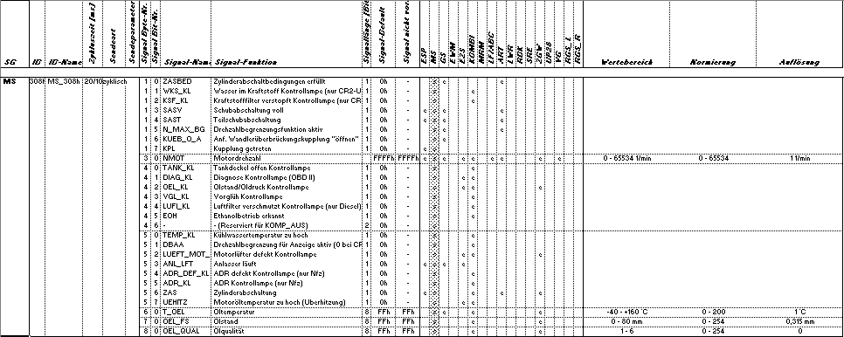
CANalyzer: Communication Matrix: Example DC KM20
Extract: Message MS_308h
<number> / O. Friedrichsohn / 16-Jan-2008 © Continental AG

Slide 34
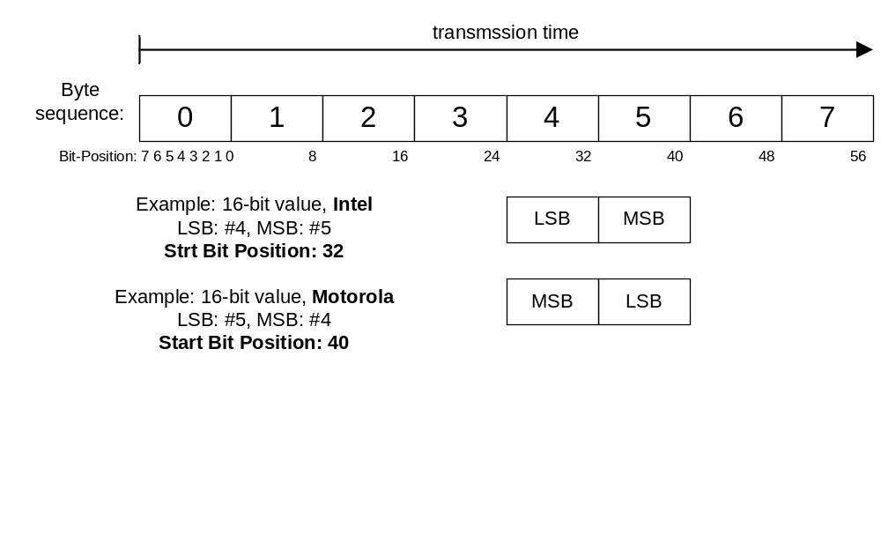
CANalyzer: CANdb
Start bit definition in CANdb depends on Intel/Motorola format!
Rule: In CANdb the start bit position of a CAN signal is defined by the position of the least significant bit of the least significant byte
<number> / O. Friedrichsohn / 16-Jan-2008 © Continental AG

