Slide 1
CAN Communication
Prathap Venugopal
SISL EIA APT AT CC

Slide 2
CAN – History, Motivation & Application
Brief history of CAN:
  1991 – First official release of CAN specification by BOSCH AG
  1992 – First CAN equipped car released by DC
  1993 – ISO11519 (ISO11898) takes over CAN specification
  1995 – Release CAN 2.0B (Extended frame format)
Motivation:
  Standard on a serial protocol for Inter-ECU communication
Application:
  Inter-ECU data exchange (e.g. Senor-sharing)
  Network-Management, Calibration & Diagnosis protocols

Slide 3
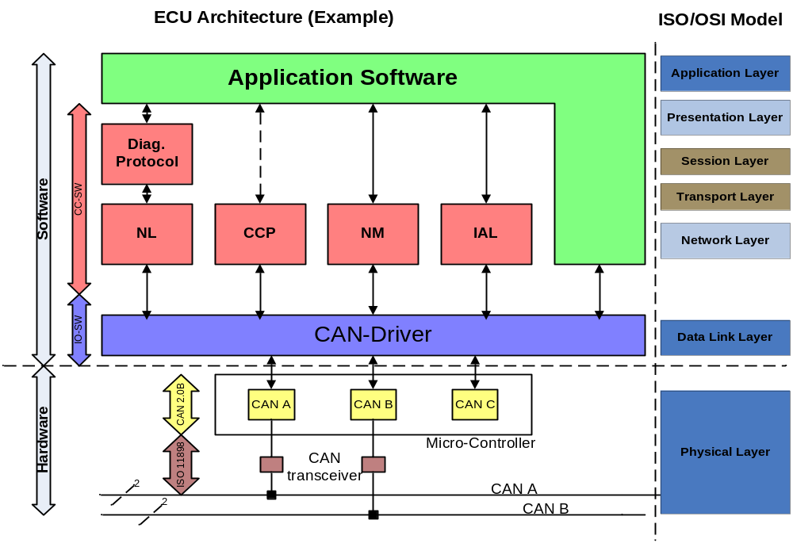
CAN Features – Layered Architecture

Slide 4
CAN Features
Information routing
  System Flexibility – hot plugging of nodes
  Message routing – Message identifier
  Multicast – message filtering
  Data Consistency
Bit-rate – Different for Networks; uniform within a network
Priorities – Identifier
Remote Data Request: Request for a Data frame
Multi-master
Arbitration – bit-wise arbitration
Notes:
Arbitration –
1. message ID
2. Method Guarantees that neither information nor time is lost
3. Data frame & Remote frame – data frame has the highest privilege
4. During TX, each node compares with their own level and stops transmitting if it detects any dominant bit instead of low.

Slide 5
CAN Features…
The total probability of undetected corrupted message is less than 4.7x 10 -11
Data Integrity
  Error detection by monitoring, Cyclic Redundancy Check (CRC), Bit-stuffing, Message frame check.
  Performance of error detection
    All global errors & local errors at transmitter are detected.
Error signaling & recovery time
  Corrupted messages
  Recovery time b/w error detection & next message is 29bit time.
Fault confinement
  Distinguish b/w short & permanent failures.

Slide 6
CAN features…
Connections
  No limit of Max no. of nodes
Single channel
  channel implementation is not fixed
Bus values
  Dominant – Logical Zero
  Recessive – Logical One
Acknowledgement
  ACK for consistent message
  Flag an inconsistent message

Slide 7
CAN – Message Transfer
CAN FRAMES
DATA
FRAME
REMOTE
FRAME
ERROR
FRAME
INTER-
FRAME
SPACE
OVERLOAD
FRAME

Slide 8
Data Frames
Standard Format (CAN 2.0A): 11-bit Identifier
2¹¹ identifiers possible
Bus Idle
Arbitration Field
Control Field
Data Field
CRC Field
Ack Field
End of Frame Field
Inter- frame Space
Bus Idle
recessive
S
R
I
r
D
A
D
Bus Idle
O
11-bit Identifier
T
D
0
DLC
0..64 Bit Data
15-bit CRC
E
C
E
7-bit EOF
IFS
Bus Idle
dominant
F
R
E
L
K
L
Extended Format (CAN 2.0B): 29-bit Identifier
2²⁹ identifiers possible
Bus Idle
Arbitration field
Control Field
Data Field
CRC Field
Ack Field
End of Frame Field
Inter- frame Space
Bus Idle
recessive
S
S
I
R
r
r
D
A
D
Bus Idle
O
11-bit Base Id
R
D
18-bit Ext. Id
T
1
0
DLC
0..64 Bit Data
15-bit CRC
E
C
E
7-bit EOF
IFS
Bus Idle
dominant
F
R
E
R
L
K
L

Slide 9
Remote Frame
Standard Data Frame
recessive
S
R
I
r
D
A
D
Bus Idle
O
11-bit Identifier
T
D
0
DLC
0..64 Bit Data
15-bit CRC
E
C
E
7-bit EOF
IFS
Bus Idle
dominant
F
R
E
L
K
L
Standard Request Frame
recessive
S
R
I
r
D
A
D
Bus Idle
O
11-bit Identifier
T
D
0
DLC
15-bit CRC
E
C
E
7-bit EOF
IFS
Bus Idle
dominant
F
R
E
L
K
L
Example:
How hot is oil ?
Remote Frame: ID→ oil_id
Node
A
Node
B
oil temp.
sensor
CAN
89ºC
89ºC
Data Frame: ID→ oil_id

Slide 10
Error Frame
Passive Error
Frame
Passive error frame
Active error frame
Bus Idle
Error Flag Field
6 bits
Error Delimiter
Field
8 bits
Inter frame or Overload
Frame
Active Error
Frame
Data or Error
Frame
Error Flag Field
6 ..12 bits
Error Delimiter
Field
8 bits
Inter frame or Overload
Frame

Slide 11
Inter frame Space (IFS)
Interframe Space
Intermission Field
3 bits
BUS Idle
0…
CAN Frame
CAN Frame
Consists of three consecutive recessive bits
separates two consecutive frames from each other
no transmission is allowed during the Inter frame Space (IFS)

Slide 12
Overload Frame
Overload Frame
Overload
Flag
Superposition of
Overload Flags
Overload
Delimiter
Inter frame
6 dominant bits
Inter frame
0..6 dominant bits
8 recessive bits
Unit sends Overload Frame when at present it cannot receive frames any more due to high workload
Other units react immediately by also transmitting Overload Frames

Slide 13
Error Detection
CRC
ERROR
FORM
ERROR
STUFF
ERROR
ACK
ERROR
BIT
ERROR

Slide 14
Error Detection..
Bit Error: transmitted and received bit are different (except in arbitration, acknowledgement and passive error)
Bit stuffing error : more than five bits of equal polarity inside of a frame are detected
CRC error: receive CRC code doesn’t match with the calculated code
ACK error: transmitting node receives no dominant acknowledgement bit (no receiver accepts the transmission message)
Form error: fixed-form bit field contains one ore more illegal bits (e. g. violation of end of frame EOF format, CRC- or ACK-delimiter)

Slide 15
Fault Confinement
Node states
  Error – active
  Error – passive
  Bus – off
Error counts
  Transmit Error Count (TEC)
  Receive Error Count (REC)
CAN
Initialization
Error
Active
REC > 127 or
TEC > 127
REC < 128 and
TEC < 128
Error
Passive
Bus
Off
TEC > 255

Slide 16
Summary
Bit-serial transmission of data packages up to 8 bytes length
NRZ-Coding plus bit-stuffing
Multiple master
Priority based Media Access Control: CSMA / CA
Message addressing
Broadcast: All CAN-controller receive all messages sent via the bus
Message filtering, message buffering
Error notification, error confinement, automatic retransmission

Slide 17
Resource characteristics of controllers with on-chip CAN modules
Controller | MPC555 | MPC56x | MPC5554 | MPC5553 | MPC5566 | TC1796 | TC1766 | TC1762 | S12x
Nickname | Black Oak | Green/Silver Oak | Copperhead | Moccasin | Viper | TriCore | TriCore | TriCore | 16-bit
Manufacturer | Freescale | Freescale | Freescale | Freescale | Freescale | Infineon | Infineon | Infineon | Freescale
Number of CAN nodes | 2 | 3 | 3 | 2 | 4 | 4 | 2 | 2 | up to 5
Number of Mailboxes | 2*16=32 | 3*16=64 | 3*64=192 | 2*64=128 | 4*64=256 | 128 | 64 | 64 | 3TX/5 RX
Fix assignment of mailboxes to nodes | Yes | Yes | Yes | Yes | Yes | No | No | No | Yes
Transceiver shortcut option | No | Yes | No | No | No | No | No | No | No
Channels supporting RX-Multiplexing | 2 (#14-15) | 2 (#14-15) | 2 (#14-15) | 2 (#14-15) | all | all | all | all | all

Slide 18
CAN – Knowledge Base
[1] Trouble shooting CAN, CAN_trouble_shooting.doc, O. Friedrichsohn, 12-Apr-01
CAN-Termination, CAN-Ground, CANalyzer getting started
[2] CAN Protocol Description, CAN20B.pdf, CiA
Comprehensive manual on the protocol features of CAN
[3] CAN DLL Presentation slides, CANdll.pdf, CiA
Presentation slide-set on the upper layer of CAN (LLC and MAC)
[4] CAN Physical Layer, CANphy.pdf, CiA
Presentation slide-set on the lower layer of CAN (PLS, PMA, MDI)
Books:
CAN Controller Area Network, Wolfhard Lawrenz, Hüthig Verlag
Controller Area Network, Konrad Etschberger, IXXAT Inc.
Web-Links (Info-Page of CiA organization):
http://www.can-wiki.info/
http://www.can-cia.org/can/

Slide 19
Questions
THANK YOU !

