Slide 1

Controller Area Network Training
CAN

Slide 2
BASIC CAN Training Agenda
1. CAN Application
~ 2 min
2. CAN History
~ 2 min
3. CAN- Overview
~ 15 min
9:00 - 10:30
4. CAN- Features
~ 2 min
5. Layer Structure
~ 10min
6. Frames
~ 1 hour
10:40 - 12:00
7. Error Detection
~ 1.5 hour
8. Synchronisation
~ 1 hour
13:00 - 14:30
9. Arbitration
~ 15 min
10. Controller
~ 10 min
11. Physical Layer
~ 20 min
14:45 - 15:45
12. TTCAN
~ 20 min
13. Questions
~ 30 min

Slide 3
CAN Application

Slide 4
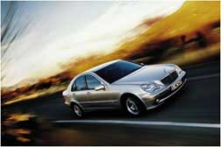
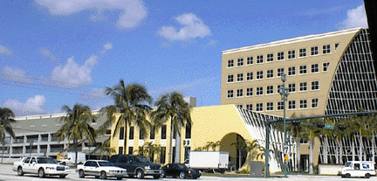
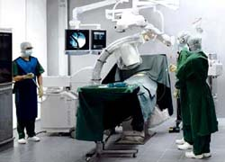
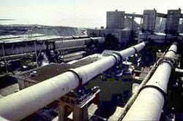
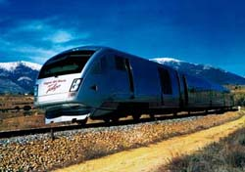
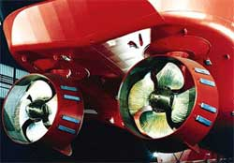


Application
CAN is used in a wide area of applications
Automotive
Building automation
    Medical
Factory automation
Railway
CAN
Maritime
Machine control

Slide 5

Application
Airbag
Dashboard
Air conditioning
Engine
Power windows
Gearbox
Mirrors
Central locking
Brakes
Lights
Car Body components
Typically low-speed CAN Bus
Power Train components
Typically high-speed CAN Bus

Slide 6
CAN History

Slide 7
History
1983
➲ Start of the Bosch internal project to develop an in-vehicle network
1986
➲ Official introduction of CAN protocol
1987
➲ First CAN controller chips from Intel and Philips Semiconductors
1991
➲ Bosch’s CAN specification 2.0 published
1991
➲ CAN Kingdom CAN-based higher-layer protocol introduced by Kvaser
1992
➲ CAN in Automation (CiA) international users and manufacturers group established
1992
➲ CAN Application Layer (CAL) protocol published by CiA
1992
➲ First cars from Mercedes-Benz used CAN network
1993
➲ ISO 11898 standard published
1994
➲ 1st international CAN Conference (iCC) organized by CiA
1994
➲ DeviceNet protocol introduction by Allen-Bradley
1995
➲ ISO 11898 amendment (extended frame format) published
1995
➲ CANopen protocol published by CiA
2000
➲ Development of the time-triggered communication protocol for CAN (TTCAN)

Slide 8
CAN
Overview

Slide 9
CAN Overview
In the beginning...
Anti-lock
Break
Control
Engine
Control
Air
Condition
Lighting
Dash-board
Power Seats
Transmission
Control
Active
Suspen-
sion
Airbag
➲ the different control systems (and their sensors) to exchange information.
➲ a cable network with a length of up to several miles and many connectors was required.
➲ growing problems concerning material cost, production time and reliability.

Slide 10
CAN Overview
Solution...
Anti-lock
Break
Control
Engine
Control
Air
Condition
Lighting
CAN
CAN
CAN
CAN
High Speed
Dash-board
low Speed
CAN
CAN
CAN
CAN
CAN
CAN
Power Seats
Transmission
Control
Active
Suspen-
sion
Airbag
➲ point-to-point wiring is replaced by one serial bus connecting all control systems.
➔ CAN

Slide 11
CAN Overview
CAN basic concept
Node A
message: rpm
Node B
message: oil temp.
Node C
messages: display-speed
.
Node N
message: display-oil-temp.
120 Ω
120 Ω
➲ In the CAN protocol, the bus nodes do not have a specific address. Instead, the address information is contained in the identifiers of the transmitted messages, indicating the message content and the priority of the message.
➲ The number of nodes may be changed dynamically without disturbing the communication of the other nodes.
➲ Multicasting and Broadcasting is supported by CAN.

Slide 12
CAN Overview
CAN basic concept...
Stand alone
CAN-Controller
Low end controller with integrated
CAN-Controller
High end controller with integrated
CAN-Controller
Application
Display
Sensors
Engine
Host-Controller
C502
TC1775
on chip CAN
C167CR
on chip CAN
CAN-Controller
SAE 81C90
CAN-Transceiver
PCA 82C250T
PCA 82C250T
PCA 82C250T
CAN-Bus
120 Ω
120 Ω

Slide 13
CAN basic concept...
Stand alone
CAN-Controller
Low end controller with integrated
CAN-Controller
Sophisticated
Error
Detection /Handling
Application
Display
Sensors
Host-Controller
C502
TC1775
on chip CAN
 NRZ Code
+Bit Stuffing
for
Synchronization
CAN-Controller
SAE 81C90
CAN-Transceiver
PCA 82C250T
PCA 82C250T
CAN_H
Bus access via
CSMA/CD
CAN-Bus
120 Ω
U_{dif}
120 Ω
CAN_L
EMI
40m-1Mbps

Slide 14
CAN Overview
CAN basic concept...
Bus access is handled by:
CSMA/CA : Carrier Sense Multiple Access with Collision Avoidance
➲ Carrier Sense: All the time, every node monitors the bus level.
➲ Multiple Access: When the bus is free, every node can start a transmission any time.
➲ Collision Avoidance: When several nodes start transmission at the same time, all but one withdraw from sending.
CAN protocol use:
NRZ bit coding: Non-Return-to-Zero
For synchronization:
Bit Stuffing is used.

Slide 15
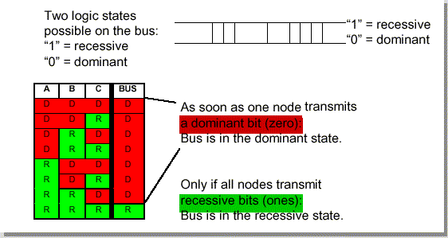
CAN Overview
CAN basic concept...
➲ There are two bus states, called "dominant" and "recessive".
➲ The bus logic uses a "Wired-AND" mechanism, that is, "dominant bits"
(equivalent to the logic level "Zero") overwrite the "recessive" bits
(equivalent to the logic level "One" ).

Slide 16
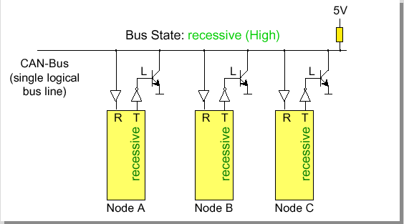
CAN Overview
CAN basic concept...
➲ Only if all nodes transmit recessive bits (ones), the Bus is in the
recessive state.

Slide 17
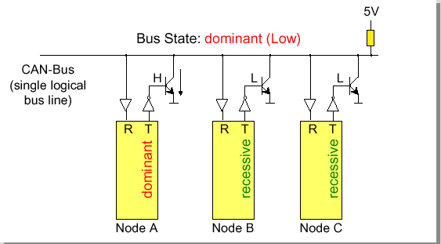
CAN Overview
CAN basic concept...
➲ As soon as one node transmits a dominant bit (zero), the bus is in the dominant state.

Slide 18
CAN
Features

Slide 19
Features
Bus-access by message priority
⬥ Carrier Sense Multiple Access / Collision Resolution
Bus access conflicts resolved by arbitration
⬥ Bit-wise
⬥ Non-destructive
⬥ Allows for guaranteed latency time
Message identifier
⬥ CAN has no node addresses

Slide 20
Features
Extensive ERROR checking
⬥ Five different checks
⬥ Every connected node participate
Data consistency secured
⬥ A message is accepted by all nodes or none
Different Bus Management Methods
⬥ Bit-wise arbitration
⬥ Master/Slave
⬥ Daisy Chain
⬥ TDMA

Slide 21
Features
A Higher Layer Protocol is always required
⬥ CAN is only a low level specification
The capability of CAN is restricted by the Higher Layer Protocol chosen
⬥ Market segment
⬥ Real-time requirements
⬥ Product Administration requirements
⬥ etc

Slide 22
CAN
ISO / OSI
Layer Structure
ISO/OSI: International Standardization Organization/Open Systems Interconnect

Slide 23
Layer Structure
Higher Layer Protocol
7: Application Layer
All
People
6: Presentation Layer
5: Session Layer
Seem
4: Transport Layer
To
3: Network Layer
Need
2: Data Link Layer
Data
1: Physical Layer
Processing

Slide 24
Layer Structure
Higher Layer Protocol...
7: Application Layer
Interface between the data
communication environment and the application
6: Presentation Layer
Provides code conversation and data reformatting
5: Session Layer
Task synchronization, buffers, connection setup
and monitoring, access rights control
4: Transport Layer
Address conversion, routing,
segmentation
3: Network Layer
Switching and Routing of
data information
2: Data Link Layer
Transfer unit, data protocol,synchronization, arbitration,error management
1: Physical Layer
Electrical / mechanical characteristics:
Transmission medium, wiring, connectors, encoding, signals

Slide 25
Layer Structure
Higher Layer Protocol...
7: Application Layer
Interface between the data communication environment and the application
6: Presentation Layer
5: Session Layer
4: Transport Layer
Not explicitly specified in CAN
3: Network Layer
Logical Link Control (LLC)
Acceptance filtering, overload notification and recovery management
Medium Access Control (MAC)
Data encapsulation (de-capsulation), frame coding(stuffing/de-stuffing), medium access management, error detection, error signaling, acknowledgement, and serialization (de-serialization).
2: Data Link Layer
Physical Signalling
Bit Encoding / Decoding, Bit Timing, Frame / Bit Synchronisation
Physical Medium Attachment
Driver / Receiver Characteristics
Transmission Medium
Cable, Connectors
1: Physical Layer

Slide 26
Layer Structure
Embedded Software Architecture (example)
Application Software
ISO/OSI Model
Diagnostic
Application Layer
NM
Network
Management
(e.g. OSEK)
Presentation Layer
IL
Interaction
Layer
Diagnostic
(e.g. KWP2000)
μ Controller independent
Session Layer
TP
Transport
Protocol
CCP Driver
Can
Calibration
Protocol
Transport Layer
Network Layer
Software
CAN Driver
Data Link Layer
CAN Controller / Transceiver
Physical Layer
Hardware

Slide 27
CAN
Frames

Slide 28
Frames
Type of Frames
DATA
FRAME
REMOTE
FRAME
ERROR
FRAME
INTER-
FRAME
SPACE
OVERLOAD
FRAME

Slide 29
Frames
Data Frame
Standard Format (CAN 2.0A): 11-bit Identifier
2¹¹ identifiers possible
Bus Idle
Arbitration Field
Control Field
Data Field
CRC Field
Ack Field
End of Frame Field
Inter- frame Space
Bus Idle
recessive
S
R
I
r
D
A
D
Bus Idle
O
11-bit Identifier
T
D
0
DLC
0..64 Bit Data
15-bit CRC
E
C
E
7-bit EOF
IFS
Bus Idle
dominant
F
R
E
L
K
L
Extended Format (CAN 2.0B): 29-bit Identifier
2²⁹ identifiers possible
Bus Idle
Arbitration field
Control Field
Data Field
CRC Field
Ack Field
End of Frame Field
Inter- frame Space
Bus Idle
recessive
S
S
I
R
r
r
D
A
D
Bus Idle
O
11-bit Base Id
R
D
18-bit Ext. Id
T
1
0
DLC
0..64 Bit Data
15-bit CRC
E
C
E
7-bit EOF
IFS
Bus Idle
dominant
F
R
E
R
L
K
L

Slide 30
Frames
Data Frame
SOF
Arbitration
Field
Control
Field
Data
Field
CRC
Field
ACK
Field
EOF
SOF
Start of Frame
Bus Idle
0
Arbitration Field
➲ marks the start of any CAN frame
➲ it is always a dominant bit
➲ provides a falling edge for hard synchronization of transmitter and receivers

Slide 31
Frames
Data Frame
SOF
Arbitration
Field
Control
Field
Data
Field
CRC
Field
ACK
Field
EOF
Arbitration
Field
Standard Frame
Bus Idle
SOF
11-bit Identifier
RTR
Control Field
➲ contains the Identifier (11 bit for CAN 2.0A) which is used for arbitration
➲ Identifier determines frame priority: low identifier = high priority
➲ the highest seven bits of the identifier must not be all recessive
➲ Remote Transmission Request (RTR) bit is always dominant in a Data Frame

Slide 32
Frames
Data Frame
SOF
Arbitration
Field
Control
Field
Data
Field
CRC
Field
ACK
Field
EOF
Arbitration
Field
Extended Frame
Bus Idle
SOF
11-bit Identifier
SRR
IDE
18-bit Identifier
RTR
Control Field
➲ contains the Identifier (29 bit for CAN 2.0A) which is used for arbitration
➲ Identifier determines frame priority: low identifier = high priority
➲ the highest seven bits of the identifier must not be all recessive
➲ Remote Transmission Request (RTR) bit is always dominant in a Data Frame
➲ Substitute Remote Request (SRR) bit is always recessive in a Data Frame

Slide 33
Frames
Data Frame
SOF
Arbitration
Field
Control
Field
Data
Field
CRC
Field
ACK
Field
EOF
Control Field
11-bit Identifier
RTR
IDE
DLC 0
DLC 1
DLC 2
DLC 3
Data Field
➲ Identifier Extension (IDE) bit is dominant for Standard Frames
and recessive for Extended Frames
➲ r0 bit is not used (“reserved for future extensions”)
➲ Data Length Code (DLC, 4 bits) indicates number of data bytes in Data Field;
may take values ranging from 0 to 8, other values are not allowed

Slide 34
Frames
Data Frame
SOF
Arbitration
Field
Control
Field
Data
Field
CRC
Field
ACK
Field
EOF
Data
Field
Control Field
Data Field
CRC Field
0 Data Bytes e.g. to indicate an event
1 Data Byte low net data rate on the CAN bus
8 Data Bytes high net data rate on the CAN bus
➲ contains the actual information which is transmitted
➲ number of data bytes may range from 0 to 8 in units of bytes
➲ number of data bytes is given in the Data Length Code (DLC)
➲ transmission starts with the first data byte (byte 0), MSB first

Slide 35
Frames
Data Frame
SOF
Arbitration
Field
Control
Field
Data
Field
CRC
Field
ACK
Field
EOF
CRC
Field
Data Field
CRC Field
DEL
Acknowledge Field
➲ contains the 15-bit Cyclic Redundancy Check (CRC) code
x¹⁵ + x¹⁴ + x¹⁰ + x⁸ + x⁷ + x⁴ + x³ + 1
➲ use polynomial generator:
➲ CRC is a complex, but fast and effective error detection method
➲ the CRC Field Delimiter (DEL) marks the end of the CRC field
➲ the CRC Field Delimiter is always recessive

Slide 36
Frames
Data Frame
SOF
Arbitration
Field
Control
Field
Data
Field
CRC
Field
ACK
Field
EOF
Acknowledge
Field
CRC Field
ACK
DEL
EOF Field
➲ contains the Acknowledgement (ACK Slot) bit
➲ the Acknowledgement bit can be dominant (RX) or recessive (TX)
➲ the ACK Field Delimiter (DEL) marks the end of the ACK field
➲ the ACK Field Delimiter is always recessive

Slide 37
Frames
Data Frame
SOF
Arbitration
Field
Control
Field
Data
Field
CRC
Field
ACK
Field
EOF
End Of Frame
(EOF) Field
1
1
1
1
1
1
1
1
1
ACK Field
Interframe
➲ consists of seven consecutive recessive bits
➲ marks the end of the Data Frame
➲ follows the Acknowledge (ACK) field
➲ is followed by the Interframe Space (IFS)

Slide 38
Frames
Acknowledgement procedure
Ack. Field
Recessive
● A frame must be
acknowledged by
at least one other node.
Otherwise ACK-Error
Node A
○ Idle
○ Receive
● Transmit
Dominant
Recessive
Node B
○ Idle
● Receive
○ Transmit
Dominant
Recessive
CAN Bus
○ Idle
● Active
Dominant
ACK. Delimiter
ACK. Slot

Slide 39
Frames
Remote Frame
Standard Data Frame
recessive
S
R
I
r
D
A
D
Bus Idle
O
11-bit Identifier
T
D
0
DLC
0..64 Bit Data
15-bit CRC
E
C
E
7-bit EOF
IFS
Bus Idle
dominant
F
R
E
L
K
L
Standard Request Frame
recessive
S
R
I
r
D
A
D
Bus Idle
O
11-bit Identifier
T
D
0
DLC
15-bit CRC
E
C
E
7-bit EOF
IFS
Bus Idle
dominant
F
R
E
L
K
L
➲ Used to request transmission of a specific Data Frame
➲ Similar to a Data Frame, but without Data Field
➲ Remote Transmission Request (RTR) bit is recessive
➲ Same identifier as the Data Frame which is requested
➲ Note: When Remote Frame is transmitted at the same time as corresponding
Data Frame, Data Frame wins arbitration because of dominant RTR bit

Slide 40
Frames
How is used Request Frame
How hot is oil ?
Remote Frame: ID→ oil_id
Node
A
Node
B
oil temp.
sensor
89ºC
Data Frame: ID→ oil_id
89ºC
➲ If a node wishes to request the data from the source, it sends a
Remote Frame with an identifier that matches the identifier of the
required Data Frame. The appropriate data source node will then send
a Data Frame as a response to this remote request.

Slide 41
Frames
Inter frame Space (IFS)
Interframe Space
Intermission Field
3 bits
BUS Idle
0…
CAN Frame
CAN Frame
➲ consists of three consecutive recessive bits
➲ separates two consecutive frames from each other
➲ no transmission is allowed during the Inter frame Space (IFS)
➲ is needed by controllers to copy received frames from their Rx buffers
➲ ACK Field Delimiter + EOF + IFS = 11 consecutive recessive bits
➲ might be followed by “Bus Idle” sequence of indefinite length

Slide 42
Frames
Overload Frame
Overload Frame
Overload
Flag
Superposition of
Overload Flags
Overload
Delimiter
Inter frame
6 dominant bits
Inter frame
0..6 dominant bits
8 recessive bits
➲ Unit sends Overload Frame when at present it cannot receive frames
any more due to high workload
➲ Transmission of an Overload Frame is started during the first two bits
of the Inter frame Space (IFS) of the preceding frame
➲ Other units react immediately by also transmitting Overload Frames
⇒ Overload Flags overlap, resulting in up to 12 consecutive dominant bits
➲ Implemented in very few (mostly older) controllers, though controllers
must still be able to interpret correctly Overload Frames they receive
➲ Overload Frames do not influence the error counters (TEC and REC)

Slide 43
Frames
Active Error Frame
Active Error
Frame
Data or Error
Frame
Error Flag Field
6 ..12 bits
Error Delimiter
Field
8 bits
Inter frame or Overload
Frame
➲ Sender and receivers reject erroneous frame completely
and do not process it any further
➲ Error flag actively violates the bit stuffing rule.
➲ After the Error Delimiter bus activity returns to normal and the interrupted node
attempts to re send the aborted message.

Slide 44
Frames
Passive Error Frame
Passive Error
Frame
Bus Idle
Error Flag Field
6 bits
Error Delimiter
Field
8 bits
Inter frame or Overload
Frame
➲ can still receive frames like a unit in error active state
➲ has to wait after transmission of a Data Frame for 8 recessive bit cycles
on the bus (Suspend Transmission Field) until it is permitted to transmit
another Data Frame
➲ can go back to error active state for TEC <= 127 AND REC <= 127

Slide 45
CAN
Error Detection

Slide 46
Error Detection
Overview
CRC
ERROR
FORM
ERROR
STUFF
ERROR
ACK
ERROR
BIT
ERROR

Slide 47
Error Detection
Following error types are detected:
➲ Bit error transmitted and received bit are different
(except in arbitration, acknowledgement and passive error)
➲ Bit stuffing error more than five bits of equal polarity inside of a frame are detected
➲ CRC error receive CRC code doesn’t match with the calculated code
➲ ACK error transmitting node receives no dominant acknowledgement bit
(no receiver accepts the transmission message)
➲ Form error fixed-form bit field contains one ore more illegal bits
e. g. violation of end of frame EOF format, CRC- or ACK-delimiter

Slide 48
Error Detection
Cyclic Redundancy Check
➲ This CRC sequence is transmitted in the CRC Field of the CAN frame.
➲ The receiving node also calculates the CRC sequence using the same
formula and performs a comparison to the received sequence.
Calculated
CRC Checksum
1234h
Calculated
CRC Checksum
1235h
Node A
Node B
Transmitted
CRC Checksum
1234h
Received
CRC Checksum
1234h
Error Frame
➲ If node B detects a mismatch between the calculated and the received
CRC sequence , then a CRC error has occurred.
➲ Node B discards the message and transmits an Error Frame to request
retransmission of the garbled frame.

Slide 49
Error Detection
Acknowledgement procedure
Ack. Field
Recessive
● A frame must be
acknowledged by
at least one other node.
Otherwise ACK-Error
Node A
○ Idle
○ Receive
● Transmit
Dominant
Recessive
Node B
○ Idle
● Receive
○ Transmit
Dominant
Recessive
CAN Bus
○ Idle
● Active
Dominant
ACK. Slot
ACK. Delimiter
➲ Acknowledge Error has occured and the message has to be repeated. No Error Frame is generated, though.

Slide 50
Error Detection
Frame Check.
Standard Data Frame
Inter Frame
1
11
1
1
1
4
0... 64
15
1
1
1
7
3
IDE Bit
RTR Bit
Reseved
CRC Delimiter
Bus Idle
Data length Code
Data Field
CRC Sequence
ACK Slot
intermission
End of Frame
ACK Delimiter
Identifier Field
End of Frame
Start fo Frame
Data Field
Arbitration
Field
Control
Field
CRC
Field
ACK
Field
If a transmitter detects a dominant bit in one of the four segments:
➲ CRC Delimiter,
➲ Acknowledge Delimiter
➲ End of Frame
➲ Interframe Space
then a Form Error has occurred and an Error Frame is generated. The message will then be repeated.

Slide 51
Error Detection
Bit Monitoring
Standard Data Frame
Inter Frame
1
11
1
1
1
4
0... 64
15
1
1
1
7
3
IDE Bit
RTR Bit
Reseved
CRC Delimiter
Bus Idle
End of Frame
Data length Code
Data Field
CRC Sequence
ACK Slot
intermission
Identifier Field
End of Frame
ACK Delimiter
Start fo Frame
Data Field
Arbitration
Field
Control
Field
CRC
Field
ACK
Field
Bit Error occurs if a transmitter
➲ Sends a dominant bit but detects a recessive bit on the bus line or,
➲ Sends a recessive bit but detects a dominant bit on the bus line.
➲ An Error Frame is generated and the message is repeated.
➲ When a dominant bit is detected instead of a recessive bit, no error
occurs during the Arbitration Field or the Acknowledge Slot because
these fields must be able to be overwritten by a dominant bit in order to
achieve arbitration and acknowledge functionality.

Slide 52
Error Detection
Bit Stuffing Check
Standard Data Frame
Inter Frame
1
11
1
1
1
4
0... 64
15
1
1
1
7
3
IDE Bit
RTR Bit
Reseved
CRC Delimiter
Bus Idle
End of Frame
Data length Code
Data Field
CRC Sequence
ACK Slot
intermission
Identifier Field
End of Frame
ACK Delimiter
Start fo Frame
Data Field
Arbitration
Field
Arbitration
Field
CRC
Field
ACK
Field
➲ If six consecutive bits with the same polarity are detected between
Start of Frame and the CRC Delimiter, the bit stuffing rule has been
violated.
➲ A stuff error occurs and an Error Frame is generated. The message is
then repeated.

Slide 53
Error Detection
Handling of the error management unit
➲ The error management unit is used to:
♦ cancel erroneous messages at all CAN nodes
♦ to disconnect nodes from the CAN bus, if they detect/generate to many errors
➲ The error management unit uses two error counters:
♦ a receive error counter REC
♦ a transmit error counter TEC
➲ The CAN controller may work in three different states:
♦ error active state for each detected error there is generated an active error flag
(queue of six consecutive dominant bits)
♦ error passive state for each detected error there is generated an passive error flag
(queue of six consecutive recessive bits)
♦ bus off state if to many errors are detected by one node, this node is
automatically disconnected from the bus

Slide 54
Error Detection
Status of a CAN Node
The CAN node status levels are switched depend on the values of TEC and REC:
➲ Error active Transmit Error Counter TEC and Receive Error Counter REC
are less than 128 (CAN node status after reset: TEC = REC = 0)
➲ Error passive TEC or REC is greater than 127 and TEC is less than 255
➲ Bus off TEC is greater than 255
Status of Node
Error Counter
Generated Error Flag
Error active
Error passive
Bus off
TEC and REC ≤ 127
TEC or REC > 127 and ≤ 255
TEC > 255
6 dominant bits
6 recessive bits

Slide 55
Error Detection
Operational States of a CAN Controller
CAN
Initialization
Error
Active
Bus off recovery sequence:
(Reset+Configuration or
Configuration) and
occurrence of 128 times
11 recessive bits
REC > 127 or
TEC > 127
REC < 128 and
TEC < 128
Error
Passive
Bus
Off
TEC > 255

Slide 56
Error Detection
Steps of CAN Error Handling
Each CAN node which detects an error - local or global error - sends an error
flag to inform all other stations about this error (globalization)
An error flag is a queue of six consecutive bits
Error active node :
Error passive node :
6 dominant bits
6 recessiv bits
Error condition
Error condition
In the case of one node detects a local error it will send an error flag. Other nodes
may detect an error because of this error flag. They send also an error flag.
After receiving/sending an error flag all nodes cancel the message.
Each node which detects an error increments his error counter(s).
The transmitter of a cancelled message retransmits automatically this message.

Slide 57
Error Detection
Error occur: Example
CRC error
Node A: Transmiter
Data Field
CRC Field
ACK
DEL
Node B: Receiver
Error Frame
0
0
0
0
0
0
1
1
1
1
1
1
1
1
Other Node
Stuff Error Error Frame
0
0
0
0
0
0
1
1
1
1
1
1
1
1
CAN Bus
Error Frame
0
0
0
0
0
0
0
0
0
0
0
1
1
0
1
1
1
1
1
1
1
12 bits
8 bits

Slide 58
Error Detection
The Error Counters
The ERROR MANAGEMENT UNIT serves two ERROR COUNTER
- 1
TEC
TX-COUNT
+ 8
- 1
REC
RX-COUNT
+ 8/+ 1
Successful
transmission
(incl. ACK)
Bit Error detected
(e.g. can’t write
dominant bit)
8th consecutive
dominant
bit following an
Error Flag
no Acknowledge bit
(only in Error Active mode)
error detected in EOF
Successful
reception
(incl. ACK)
node detects an error (+1)
error detected in first 6
bits of EOF (+1)
transmit node is sending
an Error Flag (+8)
Bit Error detected (+8)
8th consecutive dominant
bit following an Error Flag
(+8)

Slide 59
Error Detection
BUS OFF
A unit is in bus off state when
➲ its Transmit Error Counter (TEC) is greater than 255: TEC > 255
➲ Note: The value of the Receive Error Counter (REC) is of no importance
In bus off state a unit
➲ is practically disconnected from the bus
➲ cannot receive and transmit anything any more
➲ can only leave bus off mode via a hardware reset OR
a software reset and subsequent initialization carried through by the host
(BOSCH specification: TEC and REC are set to zero and the unit must
receive 128 times a field of 11 consecutive recessive bits)

Slide 60
Error Detection
Warning Level
The Warning Level for a unit is set when
➲ its Transmit Error Counter (TEC) is greater than 96: TEC > 96 AND / OR
➲ its Receive Error Counter (REC) is greater than 96: REC > 96
When a unit reaches the Warning Level
➲ it is indicated to the controller CPU that the unit is “heavily disturbed”
➲ an “Error Warning Flag” is set
➲ optionally, an interrupt might result from this
➲ the “Error Warning Flag” can be cleared for TEC <= 96 AND REC <= 96
Practical use of the Warning Level
➲ by constantly checking the “Error Warning Flag”, it can be determined
whether a unit gets near the threshold to the error passive state
➲ unfortunately, by checking this flag, one cannot determine whether a unit
is still in error active state or already in error passive state

Slide 61
Error Detection
TEC
Value
Bus Off
255
Error Passive
127
96
Warning Limit
Error Active
Time

Slide 62
Error Detection
Receive Error Counter REC
REC
Value
Bus Off
255
Error Passive
127
96
Warning Limit
Error Active
Time

Slide 63
Error Detection
The probability for not discovering an error is
4.7 ∗ 10⁻¹¹
Example 1*
A CAN bus is used 365 days / year
8 hours / day
with a transmission speed of 500 kBit / sec
and errors arise every 0.7 seconds
⇒ in 1.000 years, only one error remains undiscovered
Example 2**
A CAN bus in a car is runing at 500 kBit / sec
with an average bus load of 15 %
an average data frame size of 110 bits
for an average operating time of 4000 hours
⇒ only one error in 100.000 automobiles remains undetected
*Source: CiA
**Source: Kaiser, Schröder: “Maßnahmen zur Sicherung der Daten beim CAN-Bus”

Slide 64
CAN
SYNCRONIZATION

Slide 65
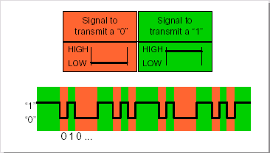
Synchronization
Non-Return-to-Zero NRZ
➲ The CAN protocol uses Non-Return-to-Zero or NRZ bit coding. This means that the signal is constant for one whole bit time and only onetime segment is needed to represent one bit.
➲ Usually, but not always, a "zero" corresponds to a dominant bit, placing
the bus in the dominant state, and a "one" corresponds to a recessive
bit, placing the bus in the recessive state.

Slide 66
Synchronization
Problems when using NRZ coding
recessive
1
0
1
0
0
0
1
1
0
1
0
0
1
dominant
➲ long sequences of bits of the same polarity
➲ no changes in voltage level for a longer time
➲ no falling edges for synchronization
➲ synchronization between sender and receiver may be lost

Slide 67
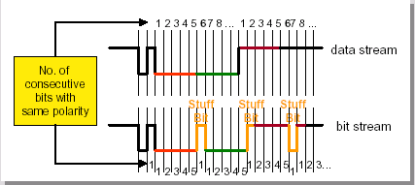
Synchronization
Bit stuffing
➲ Bit stuffing is used to ensure synchronization of all busnodes
➲ during the transmission of a message, a maximum of five consecutive bits
may have the same polarity.
➲ the transmitter will insert one additional bit of the opposite polarity
into the bit stream before transmitting further bits.
➲ The receiver also checks the number of bits with the same polarity and removes the stuff bits again from the bit stream. This is called "destuffing".

Slide 68
Synchronization
Bit stuffing ...
Standard Data Frame
Inter Frame
1
11
1
1
1
4
0... 64
15
1
1
1
7
3
IDE Bit
RTR Bit
Reseved
CRC Delimiter
Bus Idle
End of Frame
Data length Code
Data Field
CRC Sequence
ACK Slot
intermission
Identifier Field
End of Frame
ACK Delimiter
Start fo Frame
Data Field
Arbitration
Field
Arbitration
Field
CRC
Field
ACK
Field
➲ after five consecutive bits of same polarity, insert one bit of reverse polarity
➲ CRC code is calculated before bit stuffing is done
➲ bit stuffing is done by the sender directly before transmission
➲ de-stuffing is done by the receiver directly after reception
➲ CRC code check is done after de-stuffing the frame
➲ bit stuffing is applied to part of the frame from SOF to CRC field

Slide 69
Synchronization
Bit stuffing...examples
Example 1
original sequence
recessive
1
0
0
0
0
0
0
1
0
1
0
0
1
dominant
recessive
stuffed sequence
1
0
0
0
0
0
1
0
1
0
1
0
0
1
dominant
stuff bit
Example 2
original sequence
recessive
1
0
0
0
0
0
1
1
0
1
0
0
1
dominant
stuffed sequence
recessive
1
0
0
0
0
0
1
1
1
0
1
0
0
1
dominant
stuff bit
Example 3
original sequence
recessive
1
0
0
0
0
0
1
1
1
1
0
0
1
dominant
stuffed sequence
recessive
1
0
0
0
0
0
1
1
1
1
1
0
0
0
1
dominant
stuff bit
stuff bit

Slide 70
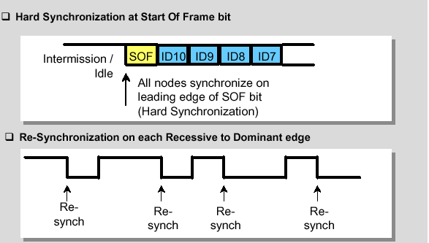
Synchronization
Bus Synchronization
➲ CAN handles message transfers synchronously.
➲ All nodes are synchronized at the beginning of each message with the first
falling edge of a frame which belongs to the Start Of Frame bit ➔ Hard Synchronization.
➲ To ensure correct sampling up to the last bit, the CAN nodes need to re-synchronize throughout the entire frame. This is done on each recessive to dominant edge.

Slide 71
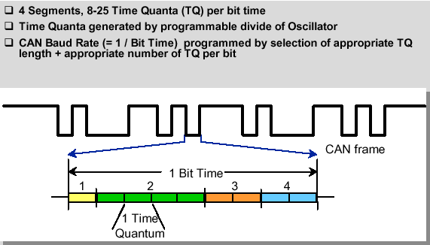
Synchronization
Bit Construction

Slide 72
Synchronization
Bit time
Bit time
1 Bit
The bit time t_{Bit} is the time it takes to transmit one bit.
Example: Data rate: f = 500 kBit / s
➔ Bit time: t_{Bit} = 2 μs

Slide 73
Synchronization
Time quantum
Bit time
1 Bit
t_{q}
The bit time is divided up into time quanta t_{q}.
Length of one time quantum: t_{q} = BRP / f_{Sys}
Allowed number of time quanta: 8 ≤ n_{q} ≤ 25
BRP: Baud Rate Prescaler, f_{Sys}: System clock

Slide 74
Synchronization
Bit time segments
Bit time
t_{q}
Sync_Seg
Synchronization Segment
Prop_Seg
Propagation Time Segment
Phase_Seg1
Phase Buffer Segment 1
Phase_Seg2
Phase Buffer Segment 2

Slide 75
Synchronization
Synchronization Segment
Bit time
t_{q}
Edges in CAN bus level are expected to occur here.
Synchronization Segment has fixed length: t_{Sync_Seg} = 1 t_{q}

Slide 76
Synchronization
Propagation Time Segment
Bit time
t_{q}
The Propagation Time Segment compensates for
physical delay times within the CAN network.
Length: 1 t_{q} ≤ t_{Prop_Seg} ≤ 8 t_{q}

Slide 77
Synchronization
Sample point
Bit time
t_{q}
Sample point
Phase_Seg1
Phase Buffer Segment 1
Phase_Seg2
Phase Buffer Segment 2
➲ Phase Buffer Segment 1 may be lengthened during resynchronization.
➲ Phase Buffer Segment 2 may be shortened during resynchronization.

Slide 78
Synchronization
Sample point
Bit time
t_{q}
Sample point
The Phase Buffer Segments surround the sample point.
Lengths: 1 t_{q} ≤ t_{Phase_Seg1} ≤ 8 t_{q}
2 t_{q} ≤ t_{Phase_Seg2} ≤ 8 t_{q}

Slide 79
Synchronization
Adjustable controller parameters
TSEG1
TSEG2
TSEG1
TSEG2
BRP
SJW
Time Segment 1
TSEG1 = Prop_Seg + Phase_Seg1
Time Segment 2
TSEG2 = Phase_Seg2
Baud Rate Prescaler
Synchronization Jump Width
SJW ≤ min ( Phase_Seg1, Phase_Seg2 ) AND SJW ≤ 4
SJW indicates the maximum number of time quanta t_{q}
by which TSEG1 may be lengthened or TSEG2 may be shortened.

Slide 80
Synchronization
Sample point
Bit time
t_{q}
Sample point
The Phase Buffer Segments surround the sample point.
Lengths: 1 t_{q} ≤ t_{Phase_Seg1} ≤ 8 t_{q}
2 t_{q} ≤ t_{Phase_Seg2} ≤ 8 t_{q}

Slide 81
Synchronization
Bit lengthening
tq
Needed Sample
Point
Next
sync.seg.
Transmitter-slower
Next edge for Re- synchronization delayed by 1tq
Next
sync.seg.
Receiver-faster
Needed Sample
Point
Needed Sample
Point
Next
sync.seg.
Transmitter-slower
Phase Buffer Segment 1 lengthened by 1tq
Next
sync.seg.
Receiver-faster
Needed Sample
Point
Sync_Seg
Synchronization Segment
Prop_Seg
Propagation Time Segment
Phase_Seg1
Phase Buffer Segment 1
Phase_Seg2
Phase Buffer Segment 2

Slide 82
Synchronization
Bit Shortening
Receiver-slower
Bit N
Bit N+1
Needed Sample
Point
Next
sync.seg.
Transmitter-faster
Next edge for Re- synchronization delayed by 1tq too early
Next
sync.seg.
Needed Sample
Point
Phase Buffer Segment 2 shortened by 1 tq
Next
sync.seg.
Needed Sample
Point
Receiver-slower
Transmitter-faster
Next
sync.seg.
Needed Sample
Point
Sync_Seg
Synchronization Segment
Prop_Seg
Propagation Time Segment
Phase_Seg1
Phase Buffer Segment 1
Phase_Seg2
Phase Buffer Segment 2

Slide 83
Synchronization
Sample point
Bit time
t_{q}
Sample point
The Phase Buffer Segments surround the sample point.
Lengths: 1 t_{q} ≤ t_{Phase_Seg1} ≤ 8 t_{q}
2 t_{q} ≤ t_{Phase_Seg2} ≤ 8 t_{q}

Slide 84
Synchronization
Parameter calculation (1)
1. Define bit rate f_{Bit}
or bit time t_{Bit} = 1 / f_{Bit}
2. Define number of time quanta n_{q}
per bit time t_{Bit} . Remember that:
8 ≤ n_{q} ≤ 25

Slide 85
Synchronization
Parameter calculation (2)
3. Calculate length of time quantum t_{q}
t_{q} = t_{Bit} / n_{q}
4. Calculate value of Baud Rate Prescaler (BRP)
BRP = t_{q} * f_{Sys}
➔ First Bit Timing parameter: BRP

Slide 86
Synchronization
Parameter calculation (3)
5. The length of the Synchronization Segment
Sync_Seg is fixed:
t_{Sync_Seg} = 1 t_{q}
6. To define the length of the Propagation Segment
Prop_Seg, measure the delay times in the system.
Rule of thumb: The longer the CAN Bus,
the longer the Propagation Segment.

Slide 87
Synchronization
Parameter calculation (4)
7. Define the length of the Propagation Segment
Prop_Seg. Remember that:
1 t_{q} ≤ t_{Prop_Seg} ≤ 14 t_{q}
Additionally, the following rule applies:
3 t_{q} ≤ t_{Bit} - t_{Sync_Seg} - t_{Prop_Seg} ≤ 16 t_{q}

Slide 88
Synchronization
Example of prop. seg. calculation
Node B transmit
Delay A_to_B
Delay B_to_A
Node A transmit
Sync_Seg
Synchronization Segment
Prop_Seg
Propagation Time Segment
Phase_Seg1
Phase Buffer Segment 1
Phase_Seg2
Phase Buffer Segment 2
➲ Prop_Seg >= Delay A_to_B + Delay B_to_A
➲ Prop_Seg >= 2 • [max(node output delay+ bus line delay + node input delay)]
➲ Delay A_to_B >= node output delay(A) + bus line delay(A→B) + node input delay(B)

Slide 89
Synchronization
Parameter calculation (5)
8. If the remaining number of time quanta
( t_{Bit} - t_{Sync_Seg} - t_{Prop_Seg} ) / t_{q}
is an odd number, choose:
t_{Phase_Seg2} = t_{Phase_Seg1} + 1 t_{q}
else choose: t_{Phase_Seg2} = t_{Phase_Seg1}

Slide 90
Synchronization
Parameter calculation (6)
9. Calculate values of TSEG1 and TSEG2:
TSEG1 = ( t_{Prop_Seg} + t_{Phase_Seg1} ) / t_{q}
TSEG2 = t_{Phase_Seg2} / t_{q}
➔ Second Bit Timing Parameter: TSEG1
Third Bit Timing Parameter: TSEG2

Slide 91
Synchronization
Parameter calculation (7)
10. Choose the Synchronization Jump Width (SJW).
Remember that:
SJW ≤ min ( Phase_Seg1, Phase_Seg2 )
SJW ≤ 4
Rule of thumb: The larger the oscillator tolerance,
the larger the Synchronization Jump Width.
➔ Fourth Bit Timing Parameter: SJW

Slide 92
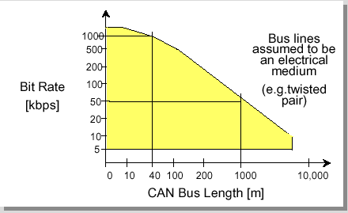
Synchronization
Relation between Baud Rate and Bus Length
1MB
40m
50KB
1000m

Slide 93
CAN
Arbitration

Slide 94
Arbitration
Physical Transmission
Transmission with Carrier Sense Multiple Access with Collision Avoidance CSMA/CA
dominante Bits (low) win against
recessive Bits (high) on the bus
V+
V+
1 (high)
recessive
dominant
recessive
0 (low)
Bus Line
Transmit
Transmit
Transmit
Node A
Node B
Node N
Receive
Receive
Receive

Slide 95
Arbitration
Arbitration: Example
Start
withdraws
Bus Idle
SOF
Unit 1
ID: 13Dh
recessive
1
0
0
0
1
0
0
1
1
1
1
0
1
loses arbitration
dominant
Start
Bus Idle
SOF
Unit 2
ID: 069h
recessive
1
0
0
0
0
0
1
1
0
1
0
0
1
wins arbitration
dominant
Start
withdraws
Bus Idle
SOF
Unit 3
ID: 079h
recessive
1
0
0
0
0
0
1
1
1
1
0
0
1
loses arbitration
dominant
Bus level
recessive
1
0
0
0
0
0
1
1
0
1
0
0
1
dominant

Slide 96
CAN Controller

Slide 97
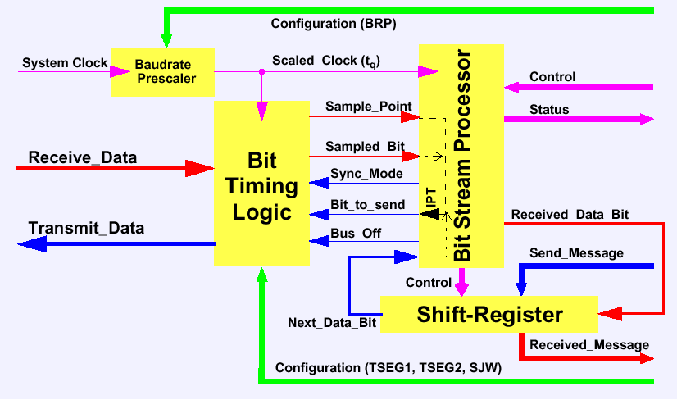
CAN Controller
Structure of the CAN Protocol Controller

Slide 98
CAN Controller
Bit Stream Processor
translates messages into frames and vice versa.
inserts and extracts stuff bits
calculates and checks the CRC code
evaluate at the Sample Point and processes the sampled bus input bit.
Bit Timing Logic
number of time quanta in the bit time..
synchronization but occasional
Bit Timing Logic (configured by TSEG1, TSEG2, and SJW) defines the
number of time quanta in the bit time.
The Shift Register
serializes the messages to be sent and parallelizes received messages
Its loading and shifting is controlled by the BSP.
Baud Rate Prescaler
defines the length of the time quantum,
the basic time unit of the bit time; the

Slide 99
CAN
Physical Layer

Slide 100
Physical Layer
Transceiver PCA 82C250
V_{ref}
Rs
μC
CAN_H
TxD
CAN_H
RxD
CAN_L
CAN_L
GND
V_{CC}
PCA82C250
V_{ref} reference voltage output
TxD transmit data input
RxD receive data output
GND ground
Rs slope resistor input
CAN_H HIGH level CAN voltage input / output
CAN_L LOW level CAN voltage input / output
V_{cc} supply voltage

Slide 101
Physical Layer
CAN - Physical aspects
Transmission rate up to 1 MBit/s needs bus driver circuits (transceiver)
according to ISO/DIS 11898
CAN High Speed Transmission (ISO/DIS 11898)
♦ Transmission rate 125 Kbit/s up to 1 MBit/s
♦ max. bus length depend on transmission rate (e.g. 1 MBit/s max. 40 m bus length)
♦ up to 30 nodes
Volts
CAN-H
3.5
2.5
CAN-L
1.5
Time
Recessive
Dominant
Recessive

Slide 102
Physical Layer
Transceiver TJA1053/1054
EN enable input signal
NSTB not standby input signal
NWAKE not wake input signal
TxD transmit data input
RxD receive data output
BAT battery voltage
V_{CC} supply voltage
EN
NSTB
NWAKE
VCC
μC
TxD
NERR
CAN_H
RxD
CAN_H
RTH
CAN_L
12V
V_{CC}
CAN_L
RTL
BAT
V_{CC}
INH
GND
NERR error output pin
CAN_H high voltage bus line
RTH termination resistor
CAN_L low voltage bus line
RTL termination resistor
INH inhibit output
GND ground
TJA1053

Slide 103
Physical Layer
CAN Low Speed Transmission (ISO / DIS 11519-2)
♦ Transmission rate 10 KBit/s up to 125 KBit/s
♦ max. bus length depend on the distributed capacity of the line
♦ up to 20 nodes
Volts
CAN-H
4.0
3.25
1.75
CAN-L
1.0
Time
Recessive
Dominant
Recessive

Slide 104
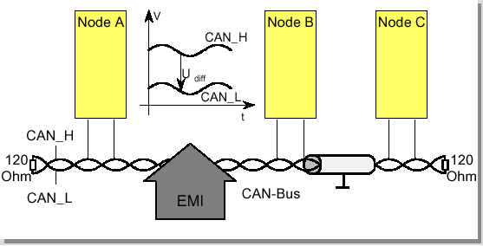
Physical Layer
CAN and EMI
➲ Due to the differential nature of transmission CAN is insensitive to electromagnetic interference,
because both bus lines are affected in the same way which leaves the differential signal unaffected.
➲ To reduce the sensitivity against electromagnetic interference even more, the bus lines can additionally be shielded. This also reduces the electromagnetic emission of the bus itself, especially at high baudrates.

Slide 105
Physical Layer
Double-Wire Bus Line Termination
Node 1
. . . . . .
Node n
~
~
CAN-H
124 Ω
124 Ω
~
~
CAN-L

Slide 106
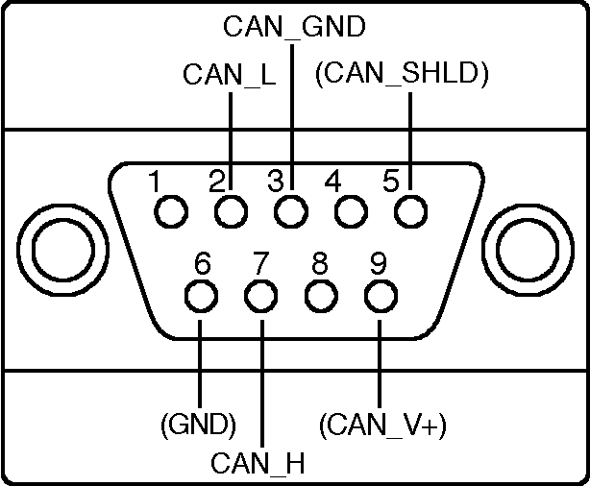
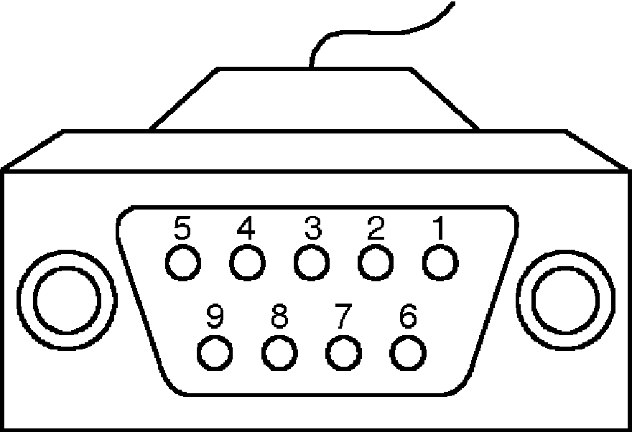
Physical Layer
Connectors for CAN
The CAN connector is defined according to the specifications ISO/DIS 11898 and CiA/DS 102-1 (defines pinning). The optional Pins 6 and 9 may be used to feed a NiPC (Networked industrial Process Control) unit.
male female
Pin Signal Description
1 - Reserved
2 CAN_L CAN_L bus line dominant low
3 CAN_GND CAN Ground
4 - Reserved
5 (CAN_SHLD) Optional CAN Shield
6 (GND) Optional Ground
7 CAN_H CAN_H bus line dominant high
8 - Reserved
9 (CAN_V+) Optional CAN external pos. supply

Slide 107
Physical Layer
CAN Cable Termination Resistor
➲ The CAN bus cable needs at the ends a termination resistor R_{T} to provide EMC characteristics without corrupting the DC characteristics:
➲ For basic termination at a serial cable use for termination resistor R_{T} = 124 Ω with linear CAN bus lines.
R_{T} = 124 Ω
CAN linear bus
R_{T} = 124 Ω
➲ For a split termination concept use for termination resistor R_{T}/2 = 62 Ω with a star architecture.
CAN_H
R_{T} /2 = 62 Ω
R_{T} /2 = 62 Ω
CAN linear bus
C_{g}
R_{T} /2 = 62 Ω
R_{T} /2 = 62 Ω
C_{g} = 10 .. 100nF
CAN_H

Slide 108
Physical Layer
CAN Cable Termination Resistor cont.
➲ The multiple termination concept is used when network architecture differs from linear structure e.g. the cable drop length of a few meters is needed. For such a topology a multiple termination concept with three branches needs about three times the total termination resistance R_{T} = 180 Ω .
R_{T} = 180 Ω
CAN star bus
R_{T} = 180 Ω
R_{T} = 180 Ω

Slide 109
Physical Layer
Daimler-Crysler Patented Star Topology
➲ Daimler-Crysler have patented a star topology with a common termination. This topology avoids resonance problems, undesired harmonies and intensive to incoming noise. All noise traveling towards the termination point will be absorbed there and never reflected.
T
r
a
n
s
c
e
i
v
e
r
CAN_H
T
r
a
n
s
c
e
i
v
e
r
30 Ω
CAN
node
10 Ω
CAN
node
CAN bus star
topology
30 Ω
CAN_L
2 mH
44 Ω
10 pF
ferrite bed:

Slide 110
Time-triggered
CAN

Slide 111
TT-CAN
Now in standard CAN
➲ All messages are transferred according to the priority of their identifiers and the message
with the highest priority will not be disturbed.
➲ Even at maximum bus load, the transmission of all safety related messages must
be guaranteed.
➲ It must be possible to determine the point of time when the message will be transmitted
with high precision.
➲ Networking even reaches such a state of complexity that a careful system design becomes
necessary.
➲ Unintended side-effects via the network on the microcontrollers and on the application
have to be avoided during runtime.

Slide 112
TT-CAN
Solution to complexity
➲ A deterministic behavior of the communication network must be provided, in particular when dealing with distributed functionality or redundant realization of certain nodes.
➲ The communication to be based on the periodic transmission of a reference message by a time master →Time-triggered CAN.
➲ A system wide global network time with high precision.
➲ Based on this time the different messages are assigned to time windows within a basic cycle.
➲ Transmit event triggered messages in certain "arbitrating" time windows as well.
➲ These time windows, where normal arbitration takes place, allow the transmission of
spontaneous messages.

Slide 113
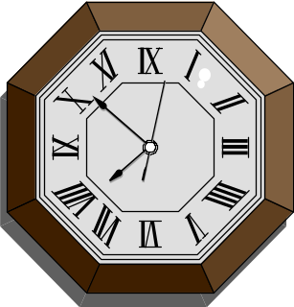
TT-CAN
How works TT CAN
3
Send Message A
5
Receive Message B
6
Send Message A
9
Send Message C
t
➲ Message A is sent if the system clock reaches 3 and 6 while message B is sent at 5

Slide 114
TT-CAN
Reference message
TTCAN is based on a time triggered and periodic communication which is clocked by a time master’s reference message.
The reference message starts the TTCAN basic cycle.
Reference
Message
Reference
Message
Time windows
for Messages
Global Time

Slide 115
TT-CAN
Time Windows
Three different types of time windows:
➲ exclusive time window: for periodic messages
➲ free time window : for further extension of the network
➲ arbitrating time window: for spontaneous messages.
In arbitrating time windows the bitwise arbitration decided which message of which node in the TT CAN in the network will succeeded
Reference
Message
Exclusive
window
Exclusive
window
Arbitrating
window
Free
window
Exclusive
window
Exclusive
window
Reference
Message
Exclusive
window
Time windows
for Messages
Global Time

Slide 116
TT-CAN
Local Information of a TT CAN
Node IV
Send MSG. C in 2, 6
Send MSG. F in 3
Receive MSG. A in 1
Reference
Message
Message A
Message C
Arbitrating
window
Free
window
Message D
Message C
Reference
Message
Message A
1
2
3
4
5
6
1
Global Time
The controller:
➲ sends message C in the exclusive time windows 2 and 6
➲ sends the spontaneous message F in the arbitrating time window 3.
➲ is only interested on the reception of message A in the exclusive time window 1.

Slide 117
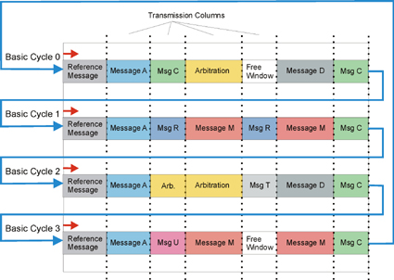
TT-CAN
The system Matrix
➲ Several basic cycles build the so called matrix cycle
➲ The system matrix is highly column oriented

Slide 118
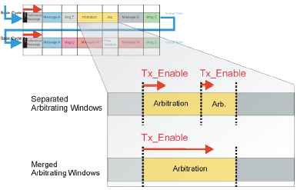
TT-CAN
The system Matrix...
➲ It may make sense to ignore the columns in the case of two or more arbitrating
time windows in series.
➲ constraint : the starting point of a spontaneous message within this merged arbitrating window is not allowed if it will not fit in the remaining time window. The start of the next periodic time window must be guaranteed.

Slide 119
TT-CAN
The Time Marks...
The necessary link between the cycle time and the system matrix are the so called time marks. Time mark = base mark + repeat count information;
base mark = number of first basic cycle after the beginning of the matrix cycle.
repeat count = number of basic cycle between two successive Tx/Rx
➲ They specify the beginning of the exclusive and arbitrating time windows.
➲ Time marks for sending periodic or spontaneous messages are called TxTriggers.
➲ RxTriggers have to be defined to check the reception of a periodic message.


Cycle Time
Cycle Time
5
15
20
33
52
5
15
Reference
Message
Reference
Message
5
15
20
33
52
5
15

