Slide 1
Spring Framework Programming
Study #02

Slide 2
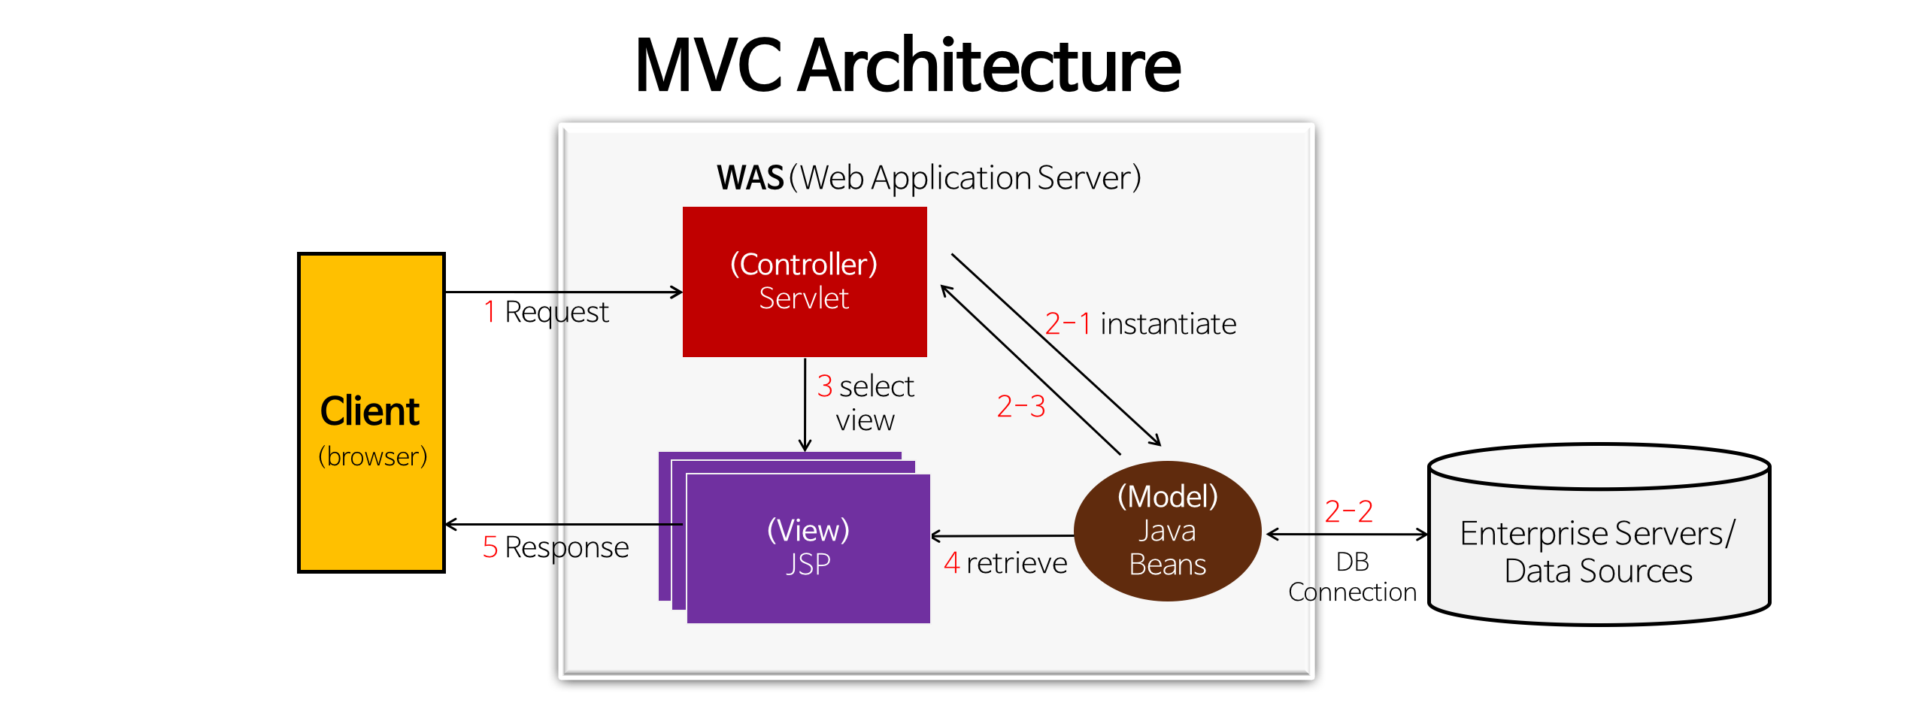
MVC 디자인 패턴 (1)
Business Logic 실행 모듈
Business Logic 실행 결과 데이터

Slide 3
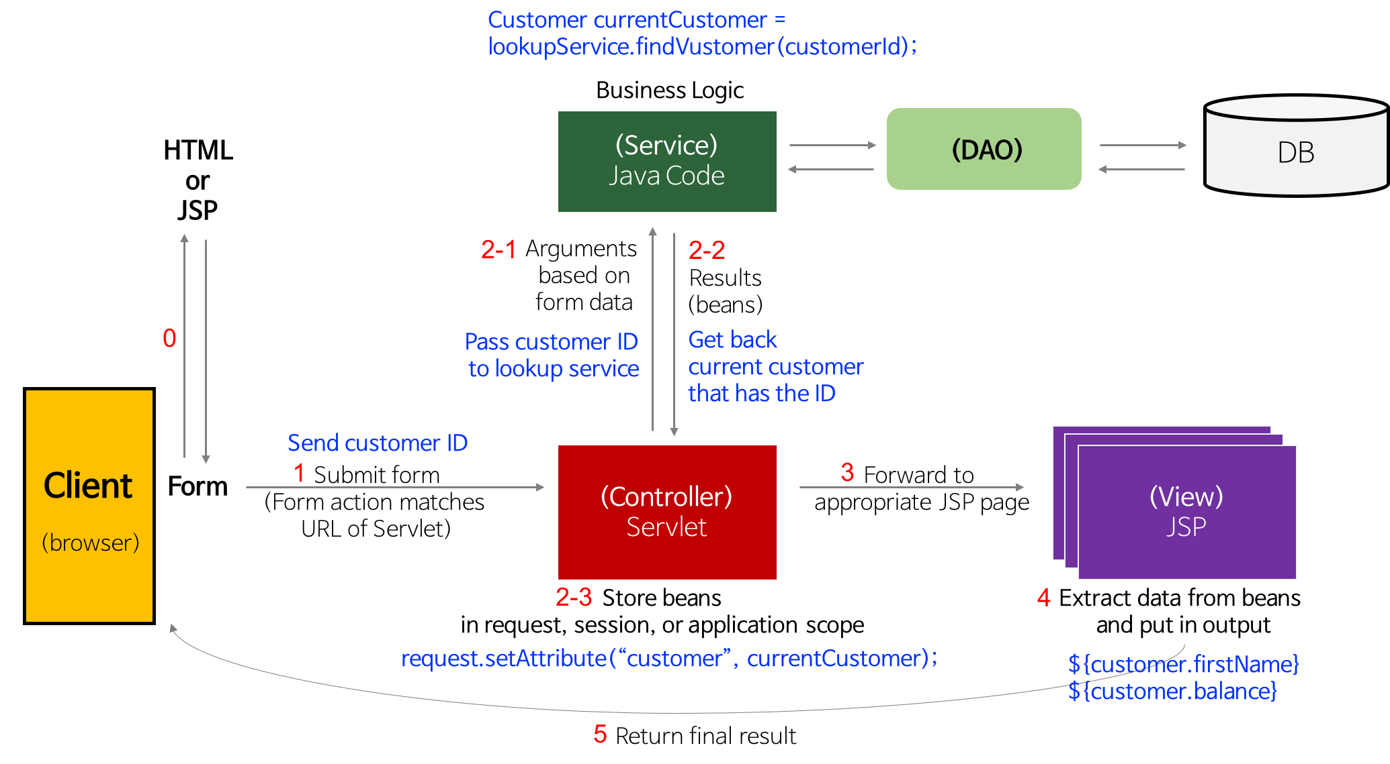
MVC 디자인 패턴 (2)

Slide 4
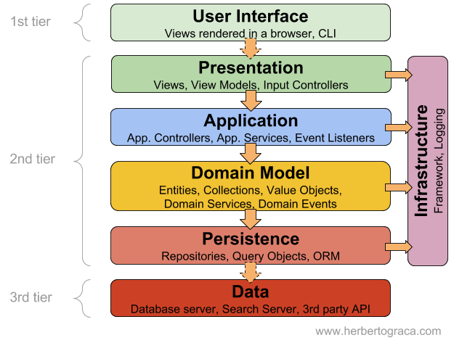
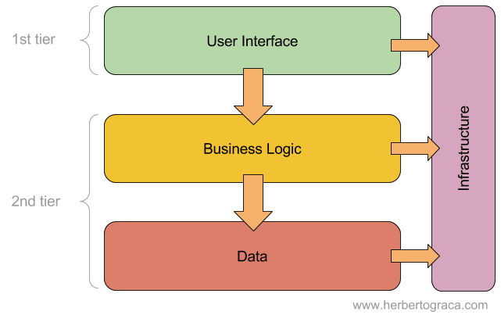
Layered Application Architecture (1)

Slide 5
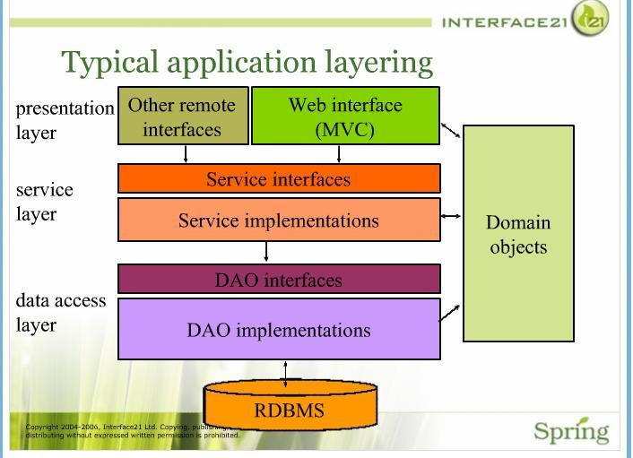
Layered Application Architecture (2)
DTO(Data Transfer Object)
DO(Data Object)
VO(Value Object)

Slide 6
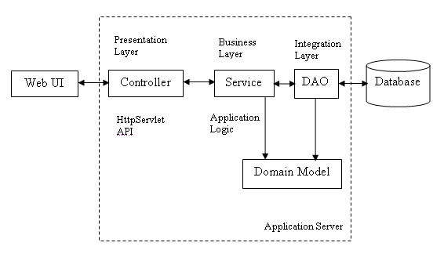
Layered Application Architecture (3)
Layered application architecture of a typical web application

Slide 7
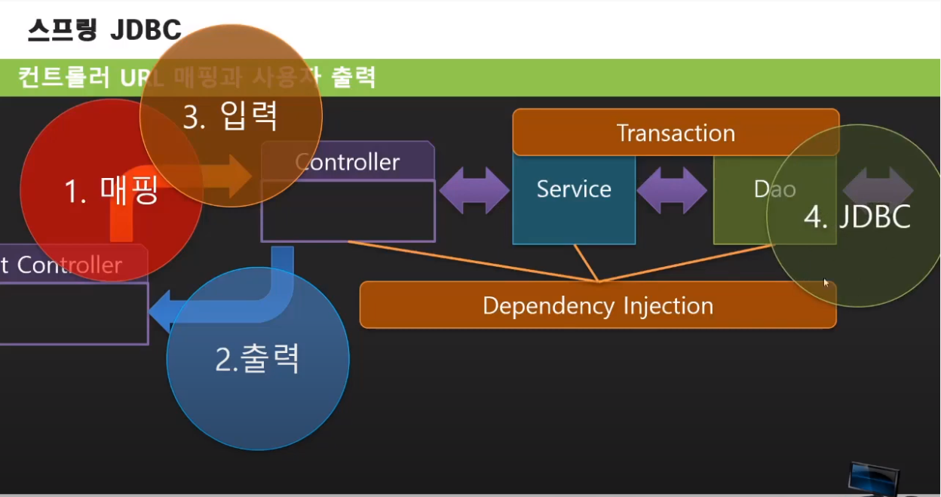
Service-DAO-DTO Architecture (1)

Slide 8
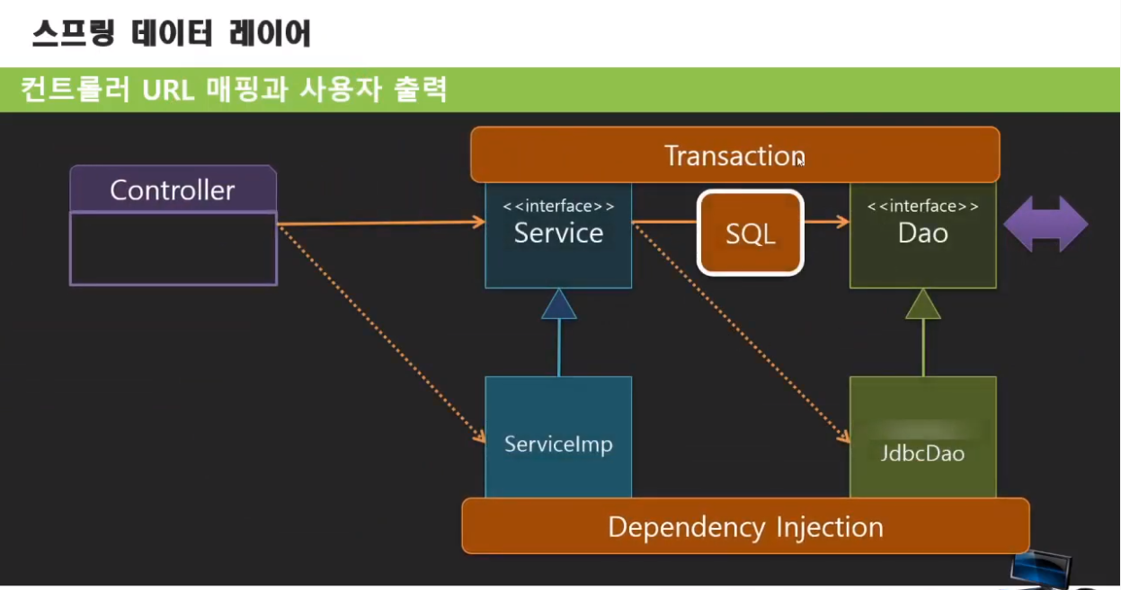
Service-DAO-DTO Architecture (2)

Slide 9
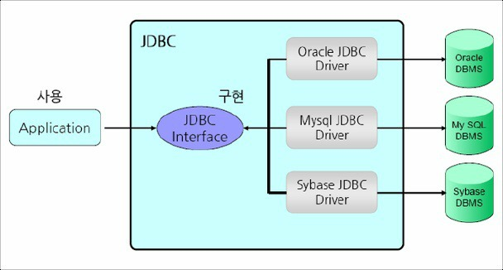
JDBC Programming (1)
Why?

Slide 10
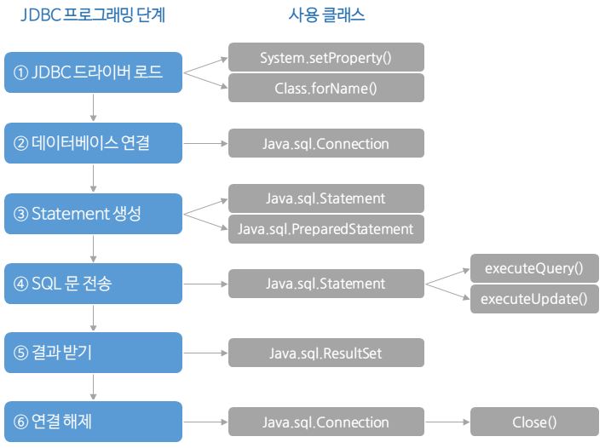
JDBC Programming (2)

Slide 11
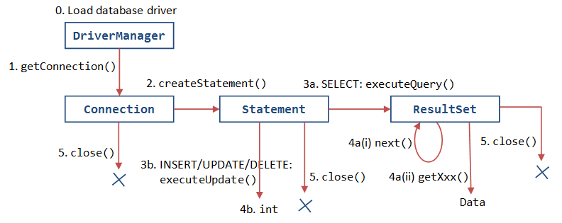
JDBC Programming (3)

Slide 12
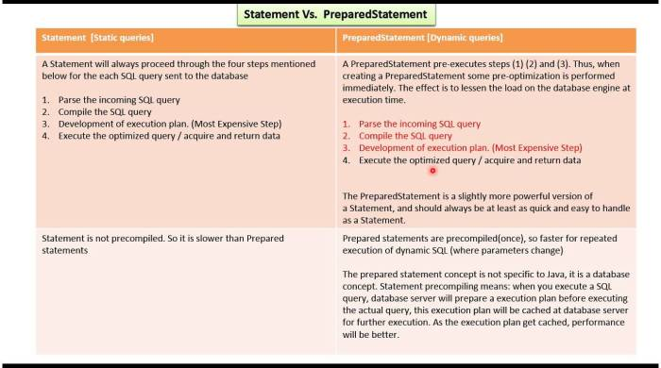
JDBC Programming (4) - Issues

Slide 13
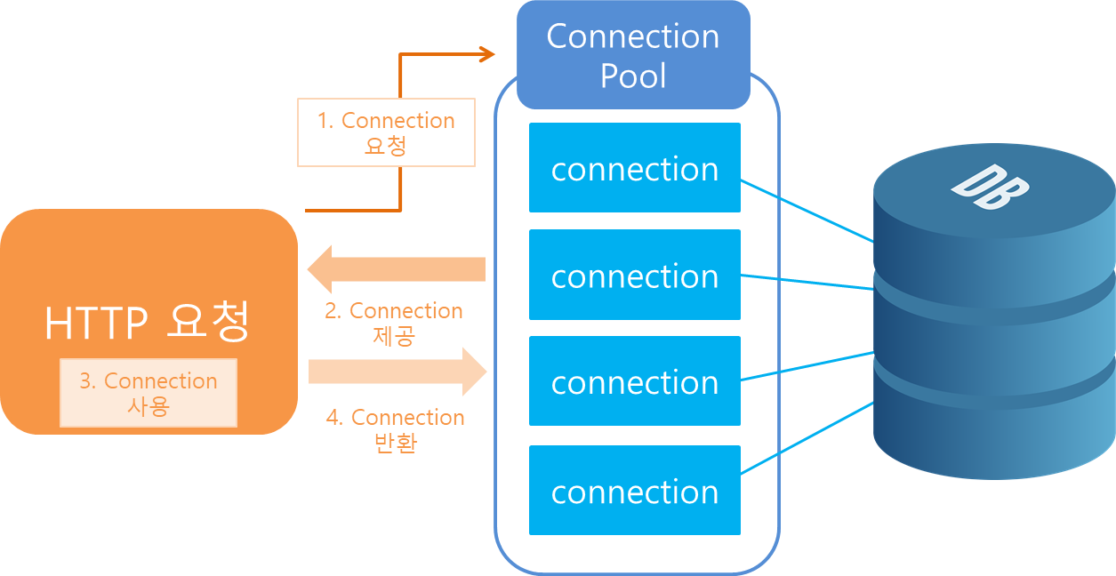
JDBC Programming (5) - Issues
DBCP(DataBase Connection Pool)

Slide 14
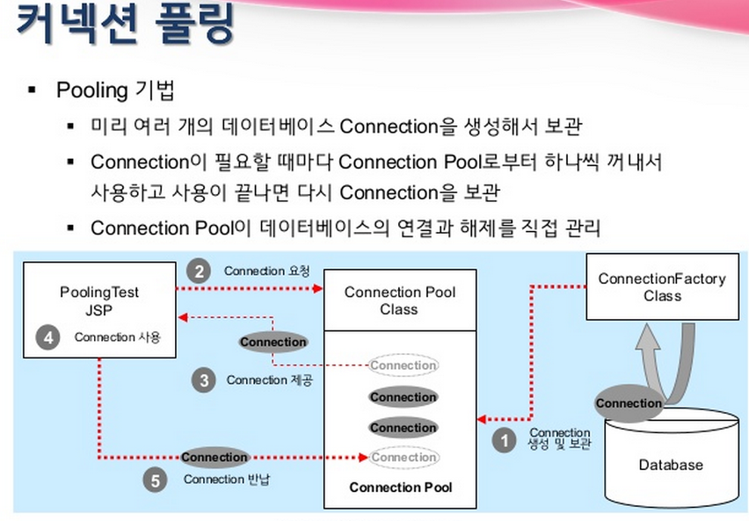

Slide 15
JDBC Programming (6) - Issues
Spring JDBC – JdbcTemplate
MyBatis – Persistency Framework
Hibernate – ORM Framework
JPA API – ORM 표준 API

Slide 16
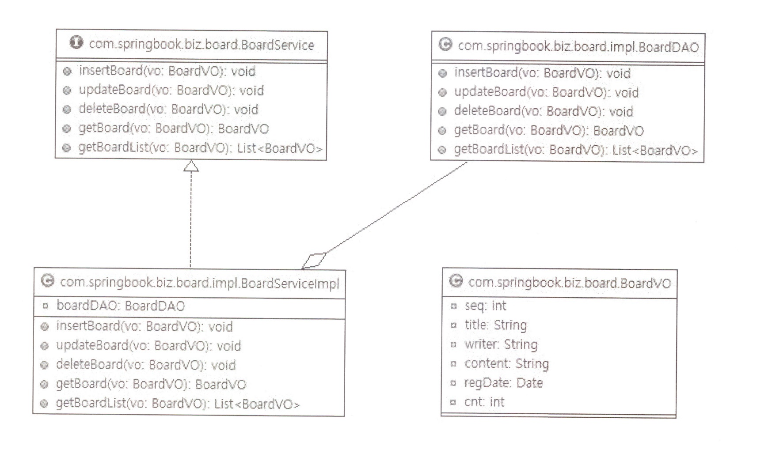
Board Application의 Model 설계 (1)
게시판 관리 비즈니스 논리
JdbcBoardDAO
com.springbook.biz.board.BoardDAO
insertBoard(vo: BoardVO): int
updateBoard(vo: BoardVO): int
deleteBoard(vo: BoardVO): int
getBoard(vo: BoardVO): BoardVO
getBoardList(void): List<BoardVO>

Slide 17
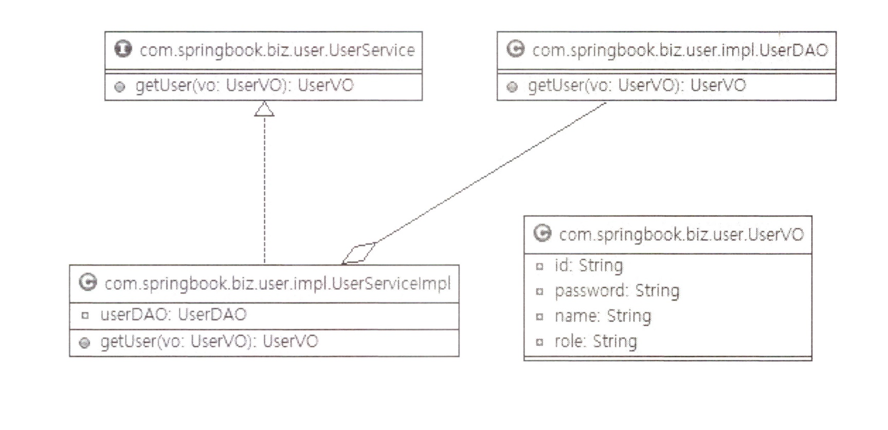
Board Application의 Model 설계 (2)
회원 관리 비즈니스 논리
com.springbook.biz.user.UserDAO
insertUser(vo: UserVO): int
updateUser(vo: UserVO): int
deleteUser(vo: UserVO): int
getUser(vo: UserVO): UserVO
getUserList(void): List<UserVO>
JdbcUserDAO

