Slide 1
IEEE’s
Hands on Practical Electronics (HOPE)
Final Project

Slide 2
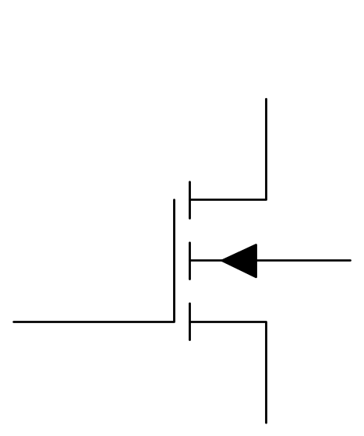
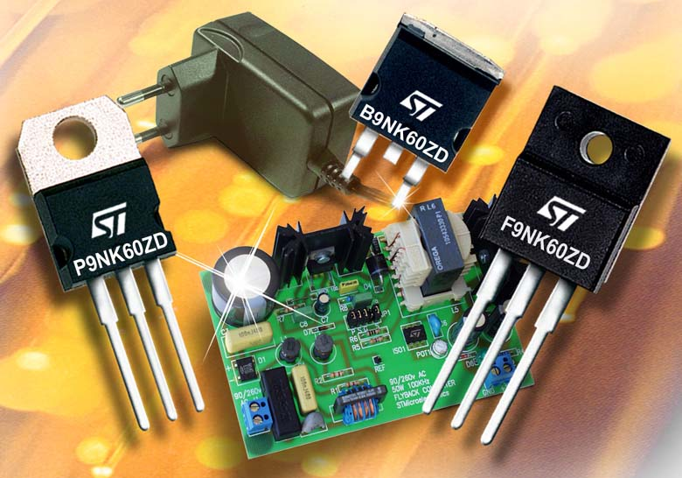
Question
D
B
G
S

Slide 3
This Week
Final Project
  Review of diodes
  Zener Diodes
  What can they be used for?

Slide 4

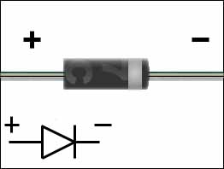
Review - PN Junctions
A PN Junction is also called a diode.

Slide 5
Review - Diode Usage
Diodes are used to
  prevent current from flowing in the wrong direction
  prevent too much current from flowing in a direction
  indicate if there is current flowing (LEDs)

Slide 6
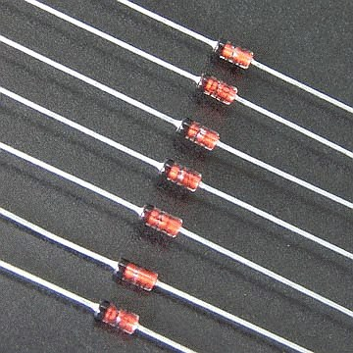

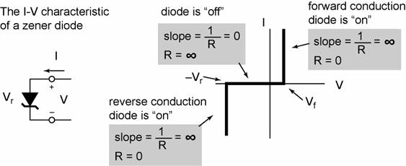
Zener Diode

Slide 7
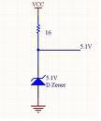
Zener Diode as Voltage Clamp
This will always stay at 5V if Vcc is large enough

Slide 8



The Problem
Many Devices Charge via USB
Computers are not always portable
We want to create a portable charger

Slide 9

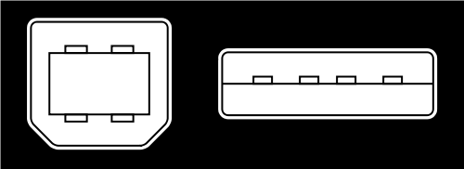
The Solution
Pin | Name | Cable colour | Description
1 | VCC | Red | +5V
2 | D− | White | Data −
3 | D+ | Green | Data +
4 | GND | Black | Ground
Male USB Port
1 2 3 4

Slide 10
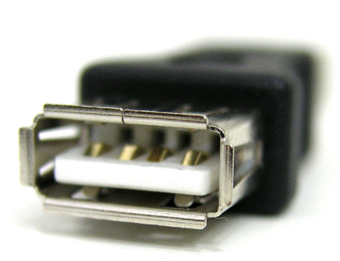
The Solution
Female USB Port
4 3 2 1
We need a circuit that will give us 5 Volts across pins 1 and 4

Slide 11
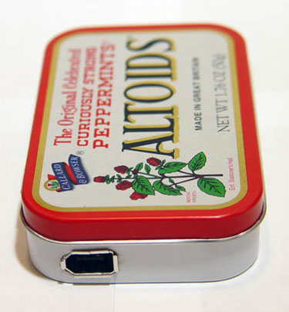
THE CONSTRAINTS
Your circuit must fit inside a portable enclosure
The charger must be able to switch “on” and “off”
You should be able to see if your charger is “on”
You have the following materials: resistors, LEDs, wire, USB port, 9V battery cell, switches
Feel free to expand form and functionality
Female
USB Port

Slide 12
HINTS AND SUGGESTIONS
Use the Voltage Clamp you learned about today to maintain 5V across pins 1 and 4 of the USB port
Too much current through the LED will burn it out. How do we limit the current flowing through the LED?
Every resistor and LED in the circuit will have a voltage drop across it. Make sure this does not compromise your circuit.
The Altoids enclosure is a conductor. What happens if your circuit touches the tin?

