Slide 1
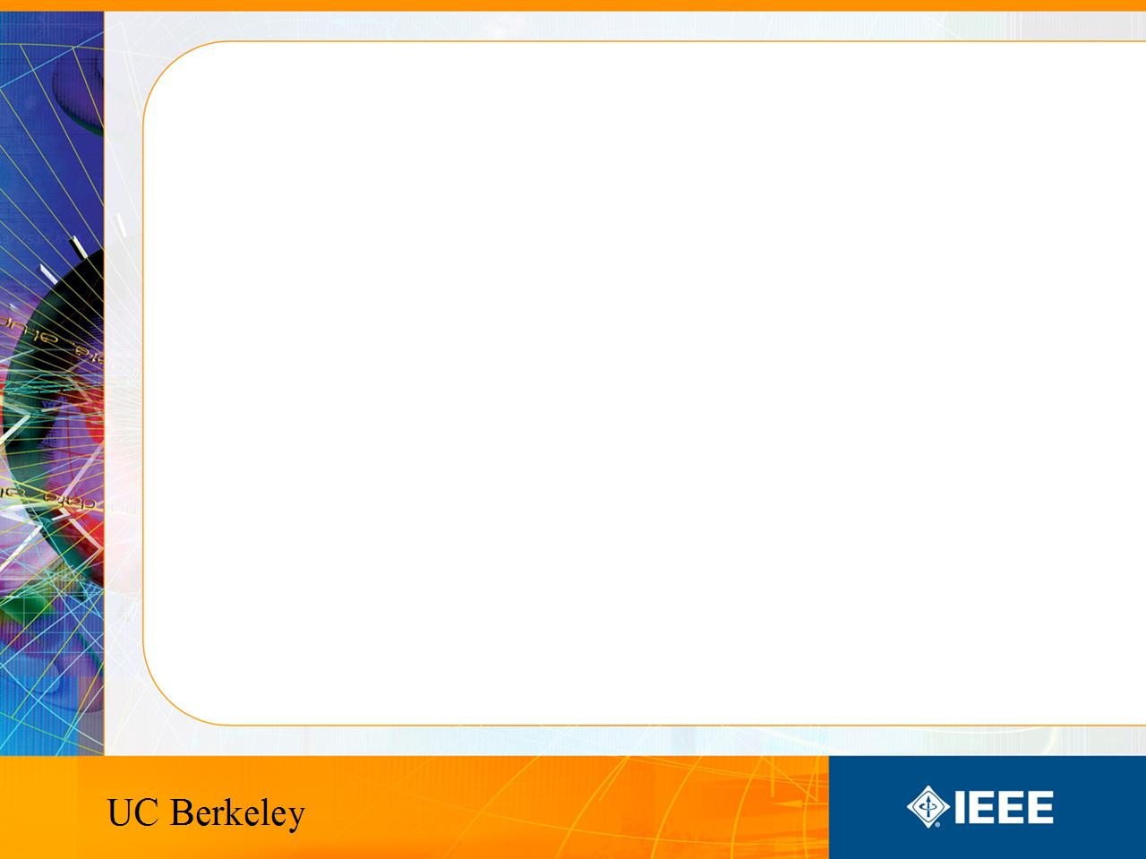
IEEE’s
Hands on Practical Electronics (HOPE)
Lesson #: Inductance

Slide 2
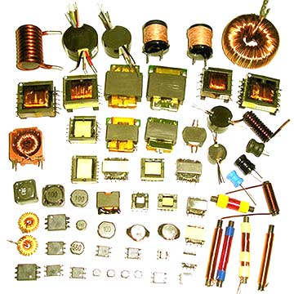
This Week
Inductors
Inductance
Right hand rule
Faraday’s Law
Simple circuits

Slide 3

Everyday Use
DC-DC Converter
  Boost converter
Electromagnets
  Motors
  Generators
Transformers

Slide 4
Other Uses
Filters
LNA
Matching networks
Impedance boosting (transmission lines)

Slide 5

Inductor
Variable: L
Units: Henries (H)
Symbol:
Stores energy in the magnetic field

Slide 6
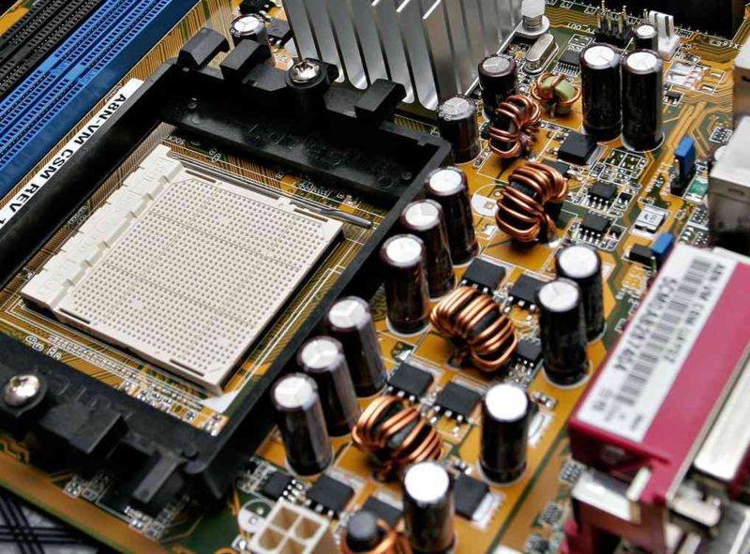
CPU
Filter
Multiphase power supply converters
AMD Socket 939 processor

Slide 7
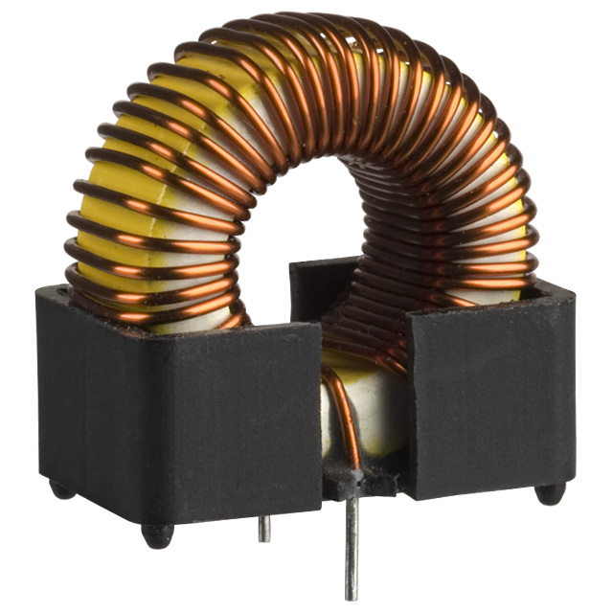
Inductance
How much something opposes a change in current
1 Henry = 1 Weber/Ampere
  Weber measures magnetic flux
  Ampere measures current

Slide 8
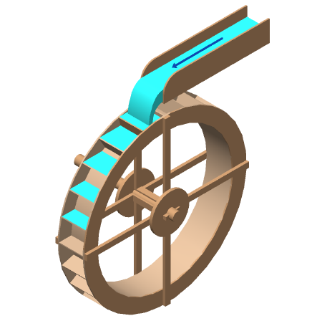
Analogy
Think of current as water.
It takes a while to get the wheel turning
But the wheel will continue to spin if the flow is stopped.

Slide 9
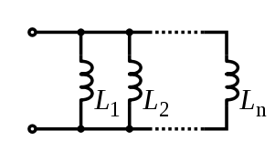

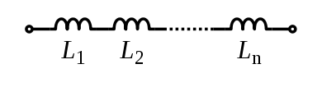
Total Inductance
Analogous to total resistance
Parallel
Series

Slide 10
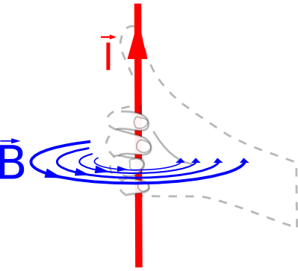
Right Hand Rule
Current in direction of thumb
Magnetic field in direction of fingers

Slide 11

Faraday’s Law of Induction
E is the electromotive force in volts
φb is the magnetic flux through the circuit in webers

Slide 12
Faraday’s Law
In other words:
  Change of magnetic field through a coil of wire induces a change in current

Slide 13
DC-DC conterter
You have 9V batteries
How do you get a circuit to produce 18 volts?
Put them in series?
What if you only have one battery?
Charge pumps (capacitors)
Use inductors!

Slide 14
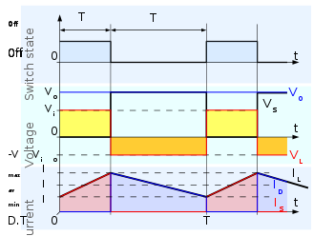
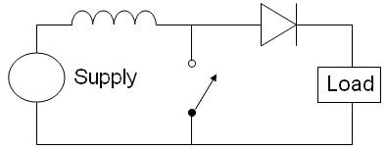
Boost Converter
Step up converter

Slide 15
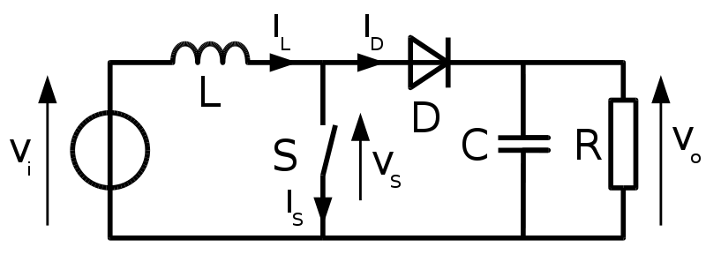
Boost Converter

Slide 16
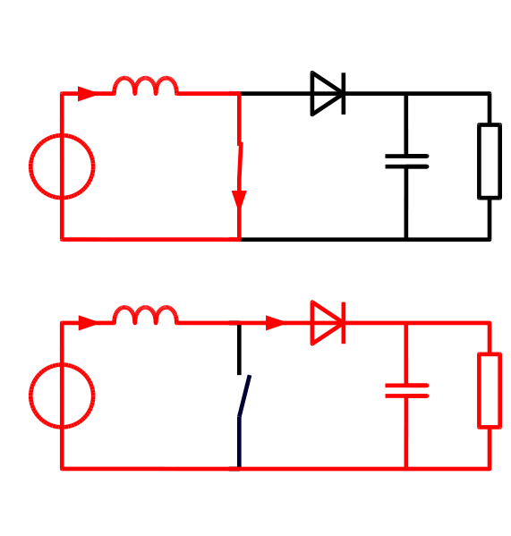
Operation
Phase I
  Charging
Phase II
  Discharging

Slide 17
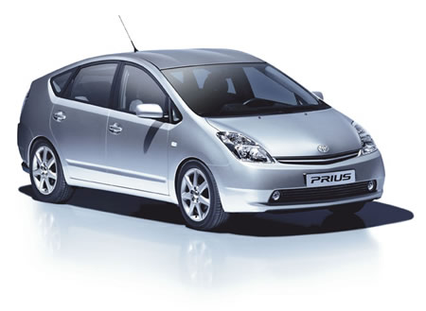
Prius
Uses 500V
Without boost converter
  417 cells to power the motor
With boost converter
  168 cells to power the motor
A Prius actually uses only 168 cells and boosts the battery voltage from 202 V to 500 V.

Slide 18
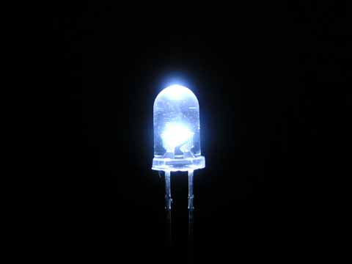
LEDs
AA batteries 1.5V
White LEDs need 3.3V
Use a boost converter

Slide 19
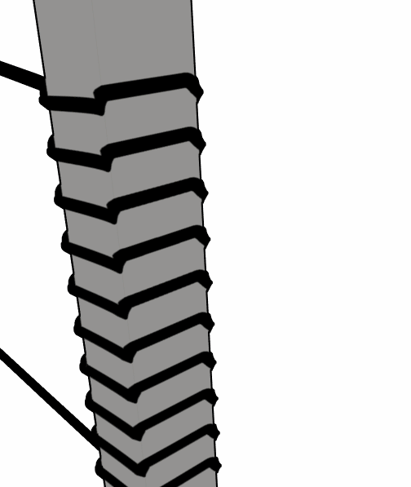
Electromagnets
Magnetic field generated from current
No magnetic field if on current
More controllable than permanent magnets

Slide 20
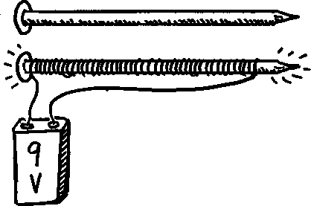
Electromagnets
Generate heat when in use
Strength limited by heat dissipation (before the magnet breaks)
Pulsing current can generate stronger fields

Slide 21
Uses
Motors/generators
Relays (telephone line switching)
Speakers/microphones (transducers)
Hard disks
Particle accelerators (SLAC, bevatron)
Industrial lifting magnets

Slide 22
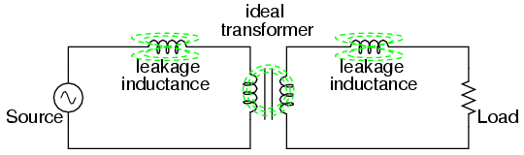
Transformer
Steps up voltage while reducing current
  Power lines
Relies on inductive coupling
NEEDS AC current!

Slide 23
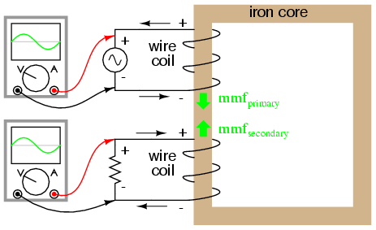
Lab

Slide 24
Today’s Lab
Make a simple transformer
Wind the wire into coils around the same rod
Measure the voltages to see voltage boosting
Is the transformation ideal?
  Calculate efficiency
Where is the power loss generated?

Slide 25
Other Uses
Analog circuitry
  Tuning old school radios

Slide 26
References
Wikipedia!!!
Google

