Slide 1


PANIMALAR ENGINEERING COLLEGE
An Autonomous Institution
DEPARTMENT OF ARTIFICIAL INTELLIGENCE AND DATA SCIENCE
PROJECT VIVA VOICE
21AD1811 PROJECT WORK
SMART VISON AID
BATCH NO: 1
TEAM MEMBERS:
GOKUL Y (211421243054) GOKUL BT (211421243053)
MATHANKUMAR K (211421243092)
PROJECT SUPERVISOR:
Dr. A. JOSHI, M.E., Ph.D.,
Professor
Department t of AI&DS

Slide 2
INTRODUCTION
The Smart Aid Vision is a wearable device that integrates ultrasonic sensors, a normal camera, and machine learning algorithms—such as YOLO (You Only Look Once) for object detection—to detect obstacles and provide real-time understandable feedback. It enhances mobility by guiding users through static and dynamic obstacles across indoor and outdoor environments. Designed to be lightweight, energy-efficient, and comfortable, the system ensures prolonged usage and user-friendliness. Rigorous testing confirms its high accuracy in obstacle detection and distance estimation, reducing collision risks and empowering visually impaired individuals with safe and independent mobility.

Slide 3
OBJECTIVE:
Develop a wearable device integrating ultrasonic sensors, computer vision, and machine learning algorithms to accurately detect obstacles and estimate distances.
Implement real-time audio feedback to guide visually impaired users, ensuring safe navigation through static and dynamic obstacles in diverse environments
Incorporate advanced algorithms such as YOLO for object detection and KNN for obstacle classification to enhance accuracy and reliability.
Design a lightweight and energy-efficient system for prolonged usage, ensuring user comfort and ease of use.
Conduct rigorous data preprocessing and testing to validate the system’s accuracy and reduce the risk of collisions during mobility.
Ensure adaptability of the device to work effectively in both indoor and outdoor environments, promoting independence for visually impaired individuals.

Slide 4
LITERATURE REVIEW:
AUTHORS | PAPER TITLE | YEAR | METHOD USED | ADVANTAGE | DISADVANTAGE
Pachodiwale, Zeeshan Ahmed | Smartphone Haptic Applications for Visually Impaired Users | 2023 | Development of five haptic applications utilizing HTML5 vibration API to create varied vibration patterns for interaction. User-centered design approach to optimize the applications for visually impaired individuals. | Enhances daily life participation for visually impaired users. Utilizes accessible technology like smartphones for practical application. Uses haptic feedback, which is intuitive for individuals with vision impairment | Limited to devices with vibration functionality, potentially restricting accessibility. Relies on the HTML5 vibration API, which may not be supported across all platforms. Haptic feedback may not convey complex information as effectively as visual cues.
Patil, Shreyash | Assistant Systems for the Visually Impaired | 2022 | - Sensor-based obstacle detection - Voice command interface - Real-time navigation assistance | * Clear problem identification and user focus * Potential for significant impact * Multimodal approach for comprehensive solution | * Lack of technical specificity * Limited scope of the proposed solution * Absence of evaluation plan

Slide 5
LITERATURE REVIEW:
AUTHORS | PAPER TITLE | YEAR | METHOD USED | ADVANTAGE | DISADVANTAGE
Kuriakose, Bineeth, Raju Shrestha, and Frode Eika Sandnes. | LiDAR-based obstacle detection and distance estimation in navigation assistance for visually impaired | 2023 | - LiDAR technology for obstacle detection - Distance estimation algorithms - Real-time data processing for navigation assistance | * Leverages advanced technology for potential solutions. * Demonstrates practical implementation. | * Limited scope and focus. * Neglects user-centric design. * Lacks detailed system information.
Hakobyan, Lilit | Mobile assistive technologies for the visually impaired | 2024 | - Accessibility features integration - Sensor-based environment mapping - User interface design for ease of use | *Increases independence and confidence in users *Offers various tools for accessing information *Facilitates navigation with real-time guidance | *Can be costly and limit access for some users *Performance may vary due to environmental factors *Users may experience a learning curve when adopting new technologies

Slide 6
LITERATURE REVIEW:
AUTHORS | PAPER TITLE | YEAR | METHOD USED | ADVANTAGE | DISADVANTAGE
Kumar, Bhavesh | Visual assistant for the visually impaired | 2022 | - Sensor-based obstacle detection - Real-time navigation assistance | *Enhances independence in navigation and daily tasks *Provides real-time information and feedback *Supports communication and social interaction | *Limited accessibility and affordability *Dependence on technology and potential reliability issues *May require a steep learning curve for some users
Gayitri, H. M | Al Based Advanced Navigation Assistant for the Visually Impaired | 2023 | - AI algorithms for obstacle recognition - Real-time route optimization | *Provides precise navigation assistance in real-time *Enhances safety by alerting users to obstacles *Utilizes AI for personalized user experiences | *Dependence on technology may lead to reliability issues *High development and maintenance costs *Potential privacy concerns with data collection and usage

Slide 7
LITERATURE REVIEW:
AUTHORS | PAPER TITLE | YEAR | METHOD USED | ADVANTAGE | DISADVANTAGE
Tapu, Ruxandra, Bogdan Mocanu, and Titus Zaharia | A smartphone assistant used to increase the mobility of visual impaired people | 2023 | * Image processing algorithms for obstacle detection and recognition. * Voice-assisted GPS navigation for real-time guidance. | * Enhances independence and mobility for visually impaired users. * Provides real-time feedback on obstacles and directions. | * Requires consistent internet or GPS connectivity for accurate navigation. * Battery life may limit prolonged outdoor usage.
Albogamy, Fahad | smart robot assistant for visually impaired persons. | 2022 | - Autonomous navigation systems - Voice interaction and command processing | *Enhances independence by assisting with daily tasks *Provides companionship and social interaction *Can navigate complex environments with advanced sensors | *High development and maintenance costs *Limited battery life may restrict usage time *Potential difficulty in user adaptation and interaction

Slide 8
PROPOSED METHODOLOGY :
Object Reading using Webcam: Utilize the laptop's built-in webcam to capture real-time video streams.
YOLOv8 for Object Detection: Implement YOLOv8 to detect and classify objects from the live webcam feed.
Dynamic Obstacle Identification: Distinguish between static and moving objects to provide more relevant feedback.
Object Distance Estimation: Use monocular depth estimation techniques (e.g., MiDaS) to estimate the distance of detected objects from the webcam feed.
Role of Ultrasonic Sensor: The ultrasonic sensor measures the exact distance of nearby objects, particularly when visual data is insufficient or obstructed, enhancing overall accuracy and reliability.
Real-Time Data Processing: Ensure efficient frame-by-frame detection and distance calculation for smooth operation on a laptop.
Text-to-Audio Conversion via Gemini 1.5: Convert object labels and distance information into speech using the Gemini 1.5 model.
Audio Feedback through Speakers/Earbuds: Provide real-time audio output through connected laptop speakers or wired/wireless earbuds.
Scalable to Future Phases: Design the system to be modular, allowing for future upgrades to wearable devices or mobile platforms.

Slide 9
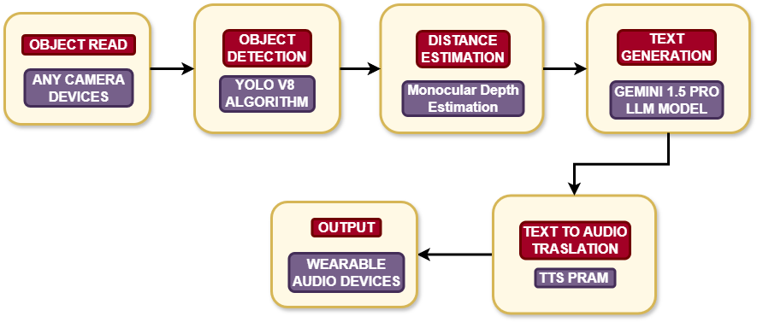
PROPOSED SYSTEM DESIGN :

Slide 10

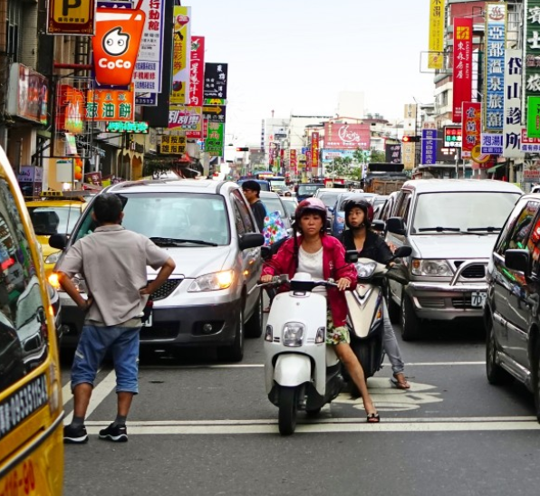
Camera Input Module
Function: Estimates how far the detected objects are from the user.
Input: Object positions from detection and camera frame data.
Accessibility Design: Provide input in simple video format

Slide 11
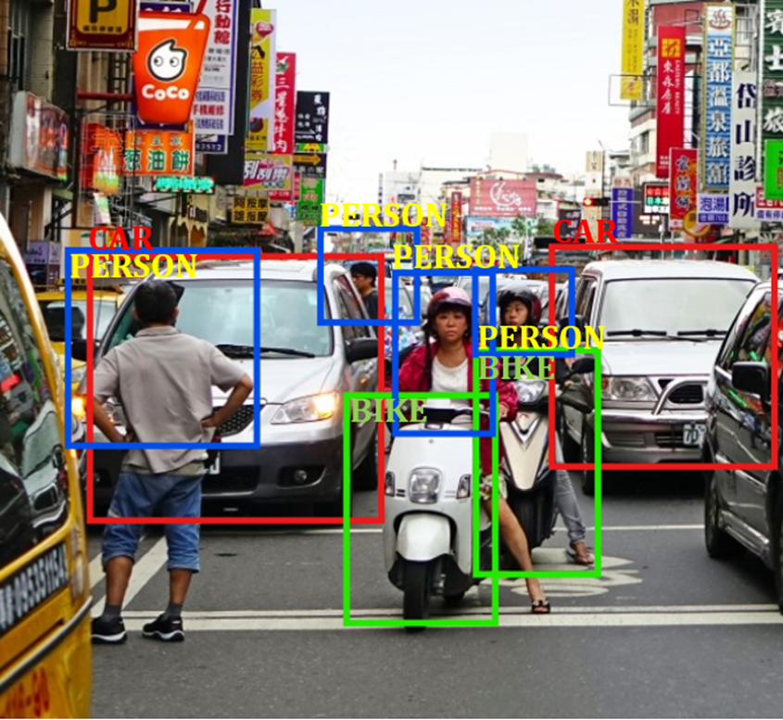
Object Detection
Function: Detects objects in the frame and identifies them with labels (e.g., “chair,” “person”).
Input: Frames from the camera module.
Output: List of objects with their labels and positions.
Accessibility Design: Detect only essential objects relevant to users, such as obstacles or furniture, to avoid information overload.

Slide 12

Object Distance Estimation
Function: Estimates how far the detected objects are from the user.
Input: Object positions from detection and camera frame data.
Output: Distance values for each detected object.
Accessibility Design: Provide distance in simple terms like "close," "far," or exact meters (e.g., "Table 2 meters ahead") to ensure clarity.
22 feet
23 feet
23 feet
22 feet
22 feet
22 feet
22 feet
22 feet

Slide 13
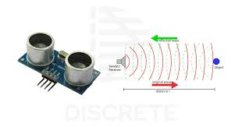
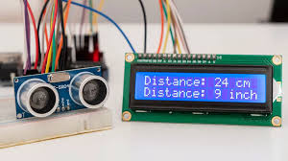
Ultrasonic Sensor
Function: Measures the distance between the user and detected objects using ultrasonic waves.
Input: Signal from the ultrasonic sensor.
Output: Distance values of objects in real-time.
Accessibility Design: Provide clear distance feedback in terms users can understand, such as "object 1 meter ahead," to ensure accurate and accessible distance measurement.

Slide 14
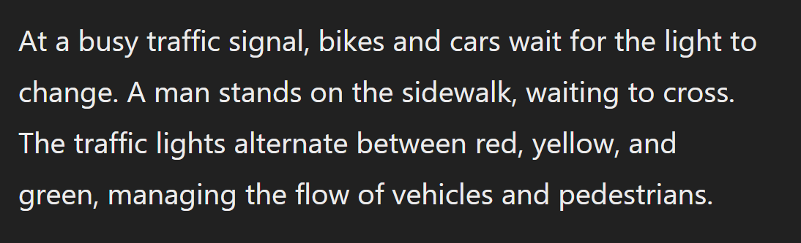
Text Generation
Function: Generates a passage from detected object .
Input: Object positions from detection and camera frame data.
Output: A descriptive passage containing all details
Accessibility Design: provides a easy understandable context to understand all the objects in the area
22 feet
23 feet
23 feet
22 feet
22 feet
22 feet
22 feet
22 feet

Slide 15

Audio Feedback Module
Function: Plays audio instructions to the user in real-time via connected audio devices (e.g., laptop speakers or earbuds).
Input: Text instruction from the text Generate module.
Output: Real-time verbal feedback.
Accessibility Design: Use headphones or earbuds to avoid environmental noise interference, ensuring the audio feedback is easy to hear.
22 feet
23 feet
23 feet
22 feet
22 feet
22 feet
22 feet
22 feet

