Slide 1
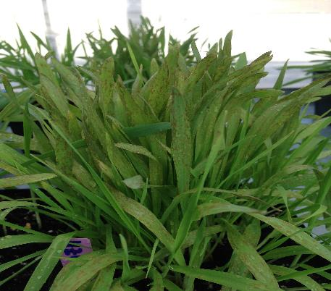
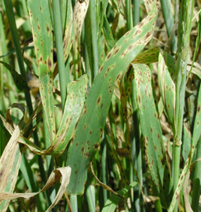
Spot blotch – caused by Bipolaris sorokiniana
Greenhouse screening.
Field conditions.
Courtesy NDSU

Slide 2
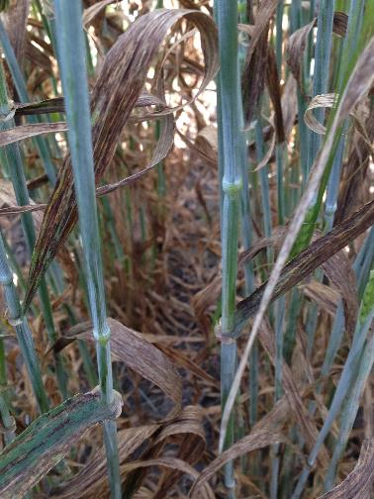
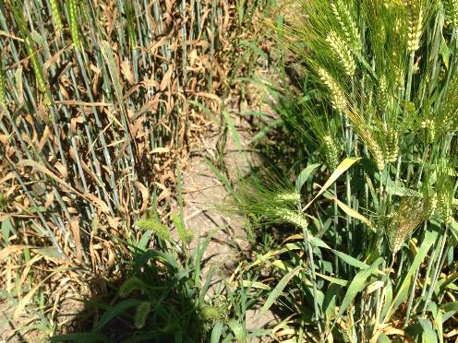
Net blotch – caused by Pyrenophora teres
On the left susceptible plants, on the right moderately resistant plants
Highly susceptible variety

Slide 3
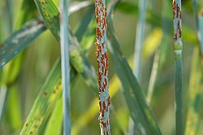
Stem rust symptoms – Puccinia graminis
Courtesy NDSU

Slide 4
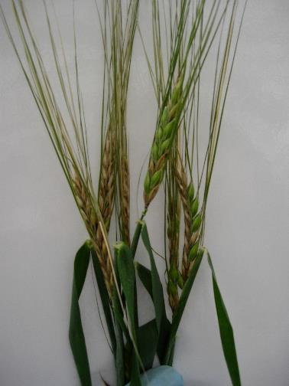
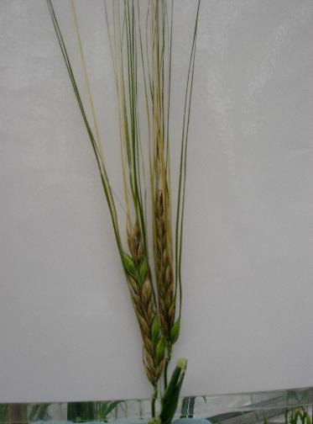
Fusarium head blight – FHB - caused by Fusarium graminearum

