Slide 2
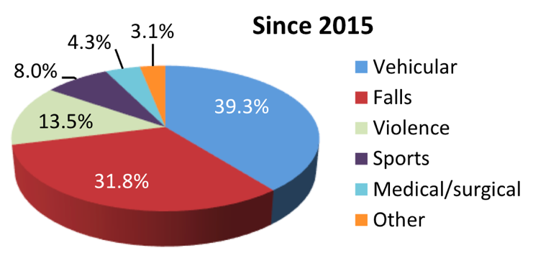
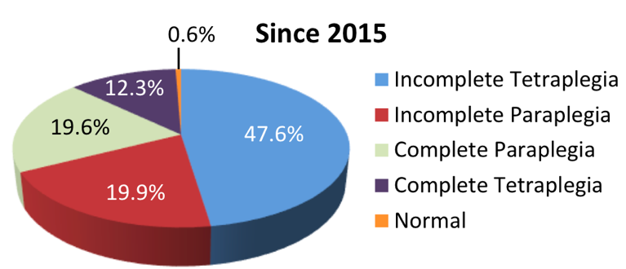
Spinal cord Injury (SCI) Overview
Incidence
Since 2015, in the U.S, about 18,000 new cases each year
Prevalence
Between 250,000 and 368,000 persons
Causes | Neurological Level and Extent of Lesion

Slide 3
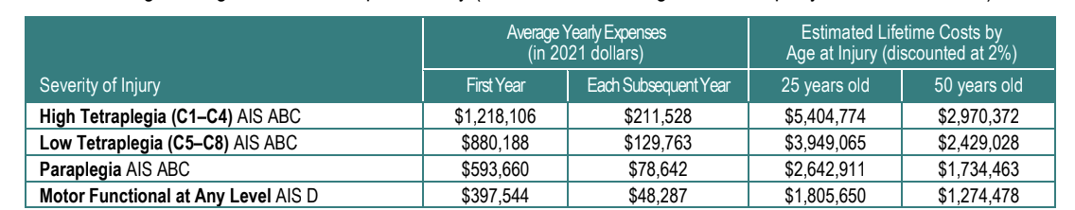
SCI Burden and Critical Needs
Cost*
$2,601 daily average cost for patients with AIS-A,-B, or –C
75% of patients are unemployed 10 years post injury
Lifetime cost: up to 5 Million
Re-Hospitalization*
Since 2015, about 30% of persons with SCI are re-hospitalized one or more times following injury
Leading causes: disease of the skin, respiratory, digestive, circulatory, and musculoskeletal diseases
*National SCI statistical Center, 2019 Data Sheet.

Slide 4
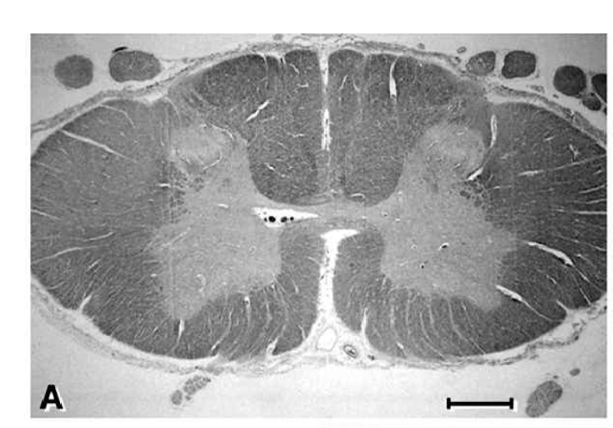
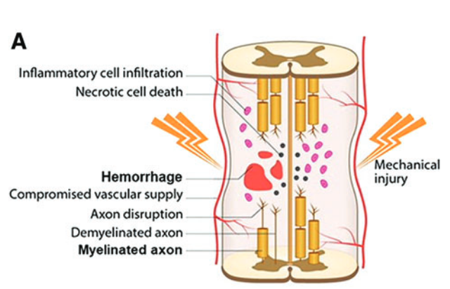
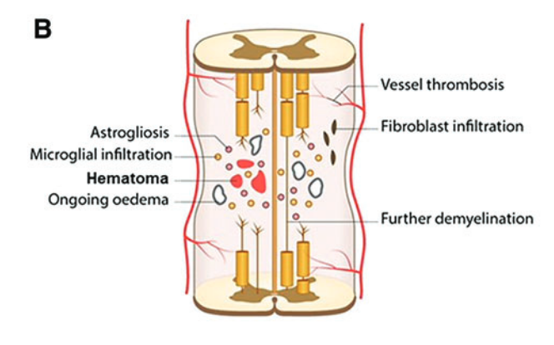
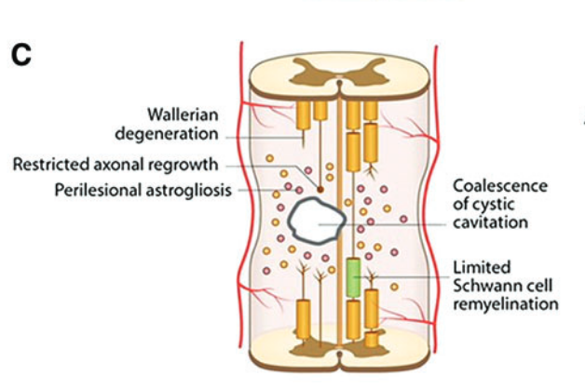
The Pathology of Human Spinal Cord Injury*
Normal Spinal Cord
Acute Stage
Intermediate Phase
Late Phase
Hours to 1 to 2 days
Days to weeks
Weeks to Months
*The pathology of Human SCI, Norenberg et al.

Slide 5
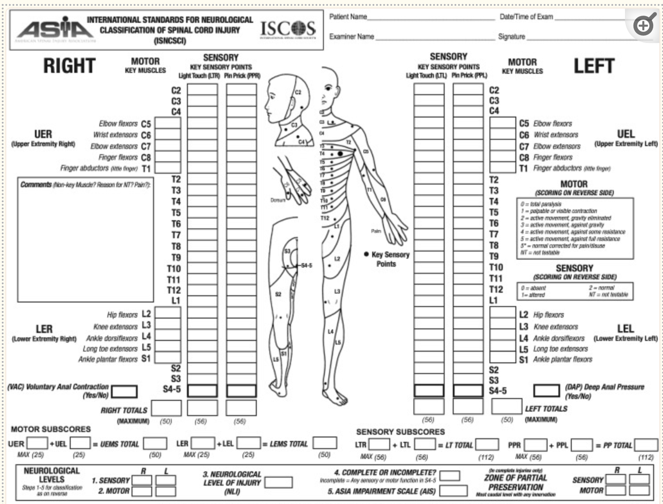
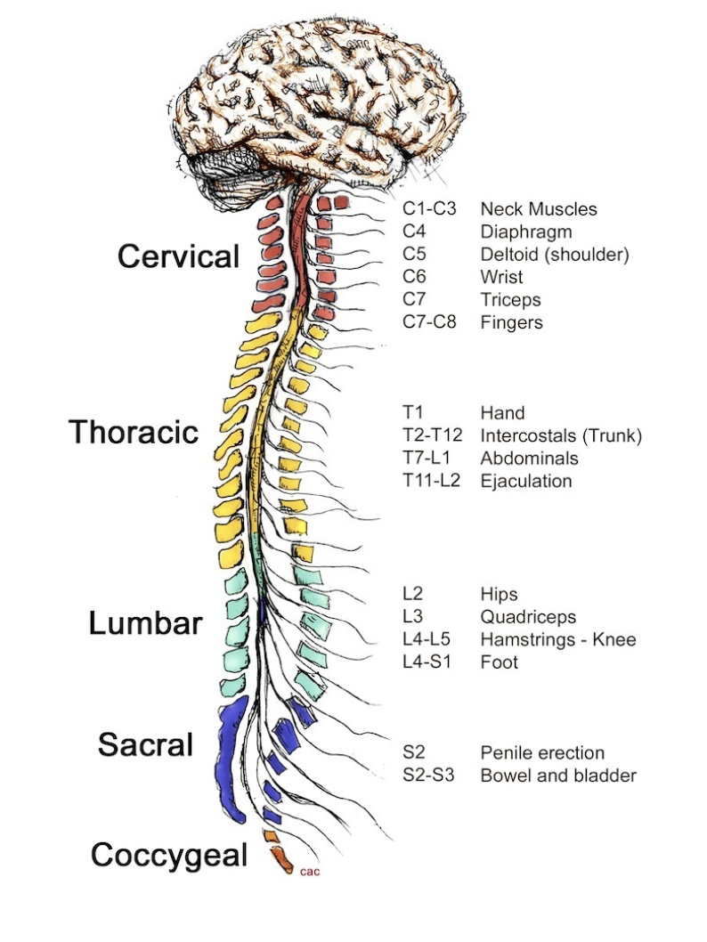
ASIA* Impairment Scale (AIS) Score
*American Spinal Injury Association International Standards for Neurological Classification of Spinal Cord Injury

