Slide 1
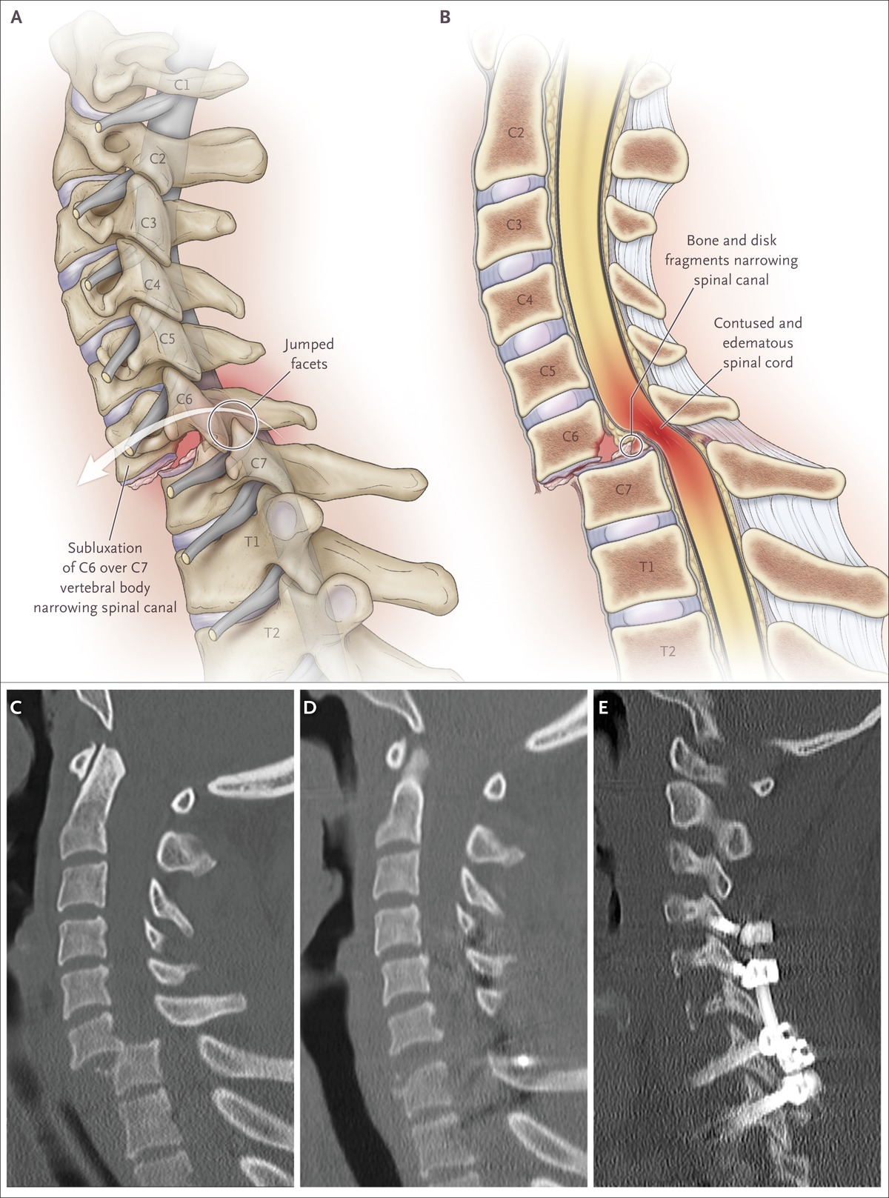

Acute Cord Compression Due to Trauma to the Cervical Spine.
Ropper AE, Ropper AH. N Engl J Med 2017;376:1358-1369.
Notes:
Figure 1. Acute Cord Compression Due to Trauma to the Cervical Spine. A lateral view of the cervical spine (Panel A) shows traumatic spondylolisthesis, in which the facets of the C6 vertebra have “jumped” over those of C7. Bone fragments from fracture of the vertebral bodies have been impelled into the spinal canal, and the C6–C7 disk has ruptured through the annulus. The misalignment and the material within the spinal canal cause acute compression of the spinal cord. A midsagittal view of the cervical spine (Panel B) shows spinal cord edema and hemorrhage extending caudally and rostrally from the level of spondylolisthesis. The anterior and posterior longitudinal ligaments and the ligamentum flavum are torn, allowing displacement of the vertebral bodies. Bone and disk material exacerbate the narrowing of the spinal canal. A midsagittal CT image from a patient who had been in a high-speed motor vehicle accident (Panel C) shows severe spondylolisthesis at C6–C7, with narrowing of the spinal canal and worsening cord compression. A postoperative midsagittal CT image (Panel D) shows reduction of the spondylolisthesis shown in Panel C, realignment of the spine, and decompression of the spinal canal. A parasagittal CT image (Panel E) shows spinal fixation, from C4 through T1, with the use of posterior screws and rods, supplemented with a bone graft to create arthrodesis. This spinal reconstruction can also be performed anteriorly.

