Slide 1
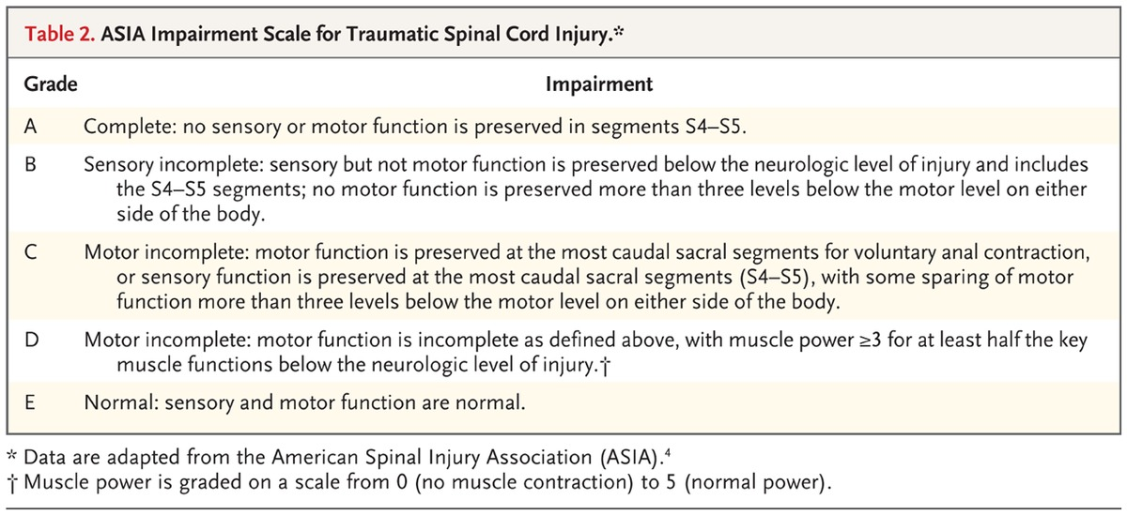

ASIA Impairment Scale for Traumatic Spinal Cord Injury.
Ropper AE, Ropper AH. N Engl J Med 2017;376:1358-1369.
Notes:
Table 2. ASIA Impairment Scale for Traumatic Spinal Cord Injury.

