Slide 1

Design Review Case Study: Zynteglo for the treatment of Beta-Thalassemia
Anup Rao

Slide 2
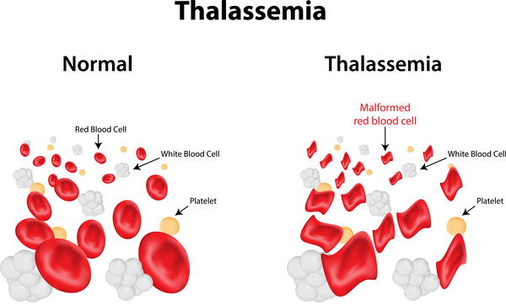
Beta Thalassemia is a genetically inherited blood disease
Genetic blood disorder that causes a shortage of human red blood cells
Clinical Symptoms:
Paleness
Diarrhea
Fever
In some cases, jaundice, poor musculature, skeletal changes
https://medlineplus.gov/genetics/condition/beta-thalassemia/

Slide 3
Thalassemia is prevalent worldwide and gene therapy market continues to expand
Prevalence of the disorder
Worldwide but most common in Middle East, Central Asia, India, Southern China, and countries along the north coast of Africa and South America (Galanello et. al 2010)
1.5% of the global population (80 to 90 million people worldwide) are impacted with 60,000 symptomatic patients born yearly (Galanello et. al 2010).
Most common short-term treatment are regular blood transfusions which can quickly become expensive and time consuming
Market for gene therapy solution expected to increase from $6 billion in 2020 to $46.5 billion in 2030

Slide 4
Existing Solution Landscape for Beta Thalassemia
Solutions
Blood Transfusion
Iron Chelation
Stem Cell Transplant
Folic Acid Supplement
Luspatercept

Slide 5
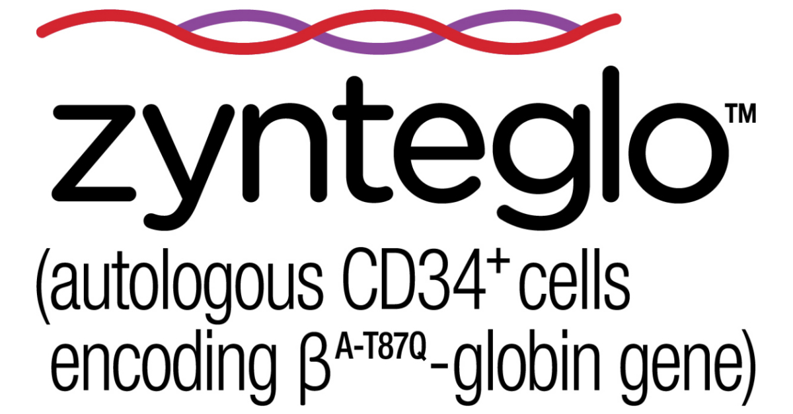
Zynteglo is a stem cell therapy solution with efficacy
One time gene-therapy treatment for beta thalassemia
9 out of 10 (89%) patients treated with ZYNTEGLO stopped transfusions and had a normal or near-normal median total hemoglobin of 11.5 g/dL.‡
https://www.businesswire.com/news/home/20190603005497/en/bluebird-bio-Announces-EU-Conditional-Marketing-Authorization-for-ZYNTEGLO%E2%84%A2-autologous-CD34-cells-encoding-%CE%B2A-T87Q-globin-gene-Gene-Therapy-for-Patients-12-Years-and-Older-with-Transfusion-Dependent-%CE%B2-Thalassemia-Who-Do-Not-Have-%CE%B20%CE%B20-Genotype

Slide 6
Zynteglo satisfies unmet needs for thalassemia patients
Need or criteria | Unit of measure | Ideal value
Cost | Dollars | 2.1 million
Restoration of hemoglobin values | Grams per deciliter | 11
Frequency of treatment | Number of physician visits | 1
Ease of use | Number of physicians needed for dose | <1

Slide 7
Zynteglo is Safe, Effective, Affordable, and Easy to Use
Verification:
Sterility, Endotoxin, and mycoplasma
Hemoglobin potency and strength
%LVV+ cells, colony forming cells, and βA-T87Q-globin Quantitative Protein Expression
Validation:
The product should:
Be affordable
Not require more than 1 treatment
Be easy to use

Slide 8
Conclusion
Zynteglo:
Is a stem cell therapy that is effective at treating Beta Thalassemia
Is easy to use and administer
Addresses disadvantages of existing solutions
Bridges a need those who do not prefer the frequency of blood transfusions

Slide 9
Sources
Mokhtar, Galila M et al. “Morbidities and mortality in transfusion-dependent Beta-thalassemia patients (single-center experience).” Pediatric hematology and oncology vol. 30,2 (2013): 93-103. doi:10.3109/08880018.2012.752054
https://www.fda.gov/vaccines-blood-biologics/zynteglo
Commissioner, O. of the. (n.d.). FDA approves first cell-based gene therapy to treat adult and pediatric patients with beta-thalassemia who require regular blood transfusions. U.S. Food and Drug Administration. Retrieved October 11, 2022, from https://www.fda.gov/news-events/press-announcements/fda-approves-first-cell-based-gene-therapy-treat-adult-and-pediatric-patients-beta-thalassemia-who
“Blood Transfusion.” Mayo Clinic, Mayo Foundation for Medical Education and Research, 27 Apr. 2022, https://www.mayoclinic.org/tests-procedures/blood-transfusion/about/pac-20385168.
“Beta Thalassemia.” Beta Thalassemia | Johns Hopkins Medicine, 2 July 2020, www.hopkinsmedicine.org/health/conditions-and-diseases/beta-thalassemia.
“Beta-Thalassemia - about the Disease.” Genetic and Rare Diseases Information Center, U.S. Department of Health and Human Services, rarediseases.info.nih.gov/diseases/871/beta-thalassemia.
Forbes, J M et al. “Blood transfusion costs: a multicenter study.” Transfusion vol. 31,4 (1991): 318-23. doi:10.1046/j.1537-2995.1991.31491213295.x
Galanello, Renzo, and Raffaella Origa. “Beta-thalassemia.” Orphanet journal of rare diseases vol. 5 11. 21 May. 2010, doi:10.1186/1750-1172-5-11
“Gene Therapy Market Statistics, Growth Factors: Forecast- 2030.” Allied Market Research, www.alliedmarketresearch.com/gene-therapy-market.
JB;, Porter. “A Risk-Benefit Assessment of Iron-Chelation Therapy.” Drug Safety, U.S. National Library of Medicine, https://pubmed.ncbi.nlm.nih.gov/9429839/#:~:text=These%20effects%20include%20arthritis%2C%20nausea,for%20patients%20taking%20this%20drug.
“Stem Cell Transplant for Beta Thalassemia.” WebMD, WebMD, https://www.webmd.com/a-to-z-guides/beta-thalassemia-stem-cells#:~:text=If%20you%20or%20your%20child,stem%20cells%20into%20your%20bloodstream.
“Luspatercept-AAMT Injection: Medlineplus Drug Information.” MedlinePlus, U.S. National Library of Medicine, https://medlineplus.gov/druginfo/meds/a620043.html.
Person, and Mrinalika Roy. “Bluebird's $2.8 Million Gene Therapy Becomes Most Expensive Drug after U.S. Approval.” Reuters, Thomson Reuters, 18 Aug. 2022, https://www.reuters.com/business/healthcare-pharmaceuticals/us-fda-approves-bluebird-bios-gene-therapy-rare-blood-disorder-2022-08-17/.
“Thalassemia: Complications and Treatment.” Centers for Disease Control and Prevention, Centers for Disease Control and Prevention, 29 Apr. 2022, www.cdc.gov/ncbddd/thalassemia/treatment.html.
“Thalassemia: Types, Traits, Symptoms &amp; Treatment.” Cleveland Clinic, https://my.clevelandclinic.org/health/diseases/14508-thalassemias#:~:text=Standard%20treatments%20for%20thalassemia%20major,red%20blood%20cells%20and%20hemoglobin.
Watson, Stephanie. “Folic Acid: Benefits, Foods, Deficiency, and More.” Healthline, Healthline Media, 5 Apr. 2022, https://www.healthline.com/nutrition/folic-acid#side-effects-precautions.
Pagliarulo, Ned. “With $2.8M Gene Therapy, Bluebird Sets New Bar for US Drug Pricing.” BioPharma Dive, 18 Aug. 2022, https://www.biopharmadive.com/news/bluebird-bio-gene-therapy-price-zynteglo-million/629967/.
“ICER Publishes Final Evidence Report and Policy Recommendations on Beti-Cel Gene Therapy for Beta Thalassemia.” ICER, 20 Sept. 2022, https://icer.org/news-insights/press-releases/icer-publishes-final-evidence-report-and-policy-recommendations-on-beti-cel-gene-therapy-for-beta-thalassemia/.
“Zynteglo® (Betibeglogene Autotemcel) for Healthcare Professionals.” ZYNTEGLO® (Betibeglogene Autotemcel) for Healthcare Professionals, https://www.zynteglohcp.com/.
Summary Basis for Regulatory Action Date: From: Jakob Reiser, Phd ... https://www.fda.gov/media/161472/download.

