Slide 2
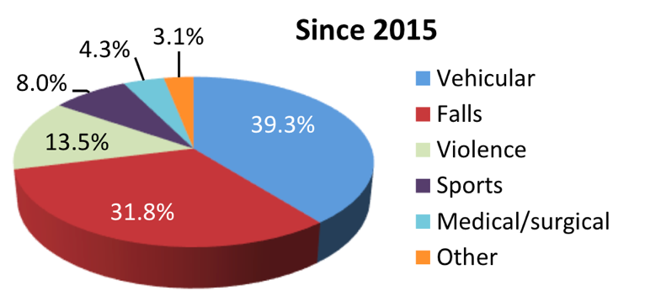
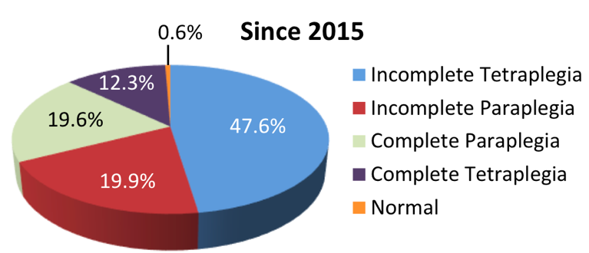
Spinal cord Injury (SCI) Overview
Incidence
Since 2015, in the U.S, about 18,000 new cases each year
Prevalence
Between 250,000 and 368,000 persons
Causes | Neurological Level and Extent of Lesion

