Slide 1
Brain tumor Auto-segmentation
10/29/2025

Slide 2
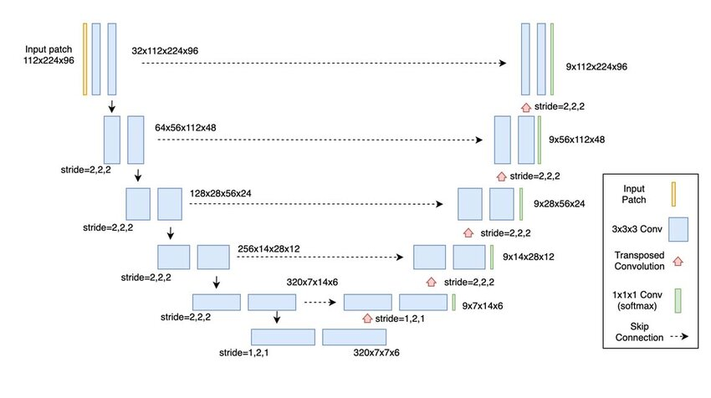
U-Net Network Architecture for Segmentation
Contracting Path, Encoder
At each level, the image’s spatial dimensions (height and width) are reduced (down sampling), while the number of feature channels increases.
At the bottom, the network develops a rich, compressed understanding of what is in the image.
Expanding Path, Decoder
The decoder upsamples the feature maps, gradually restoring spatial resolution while reducing the number of channels. This path reconstructs fine details and localizes features back to the image domain, aided by skip connections from the encoder.

Slide 3
CP Network Training and Validation Curves
Loss | Purpose
Dice + Cross-Entropy | General Segmentation
Dice + Top-K-Cross-Entropy | Focus on hard voxels
Dice + Focal Loss | Handle imbalance

