Slide 1
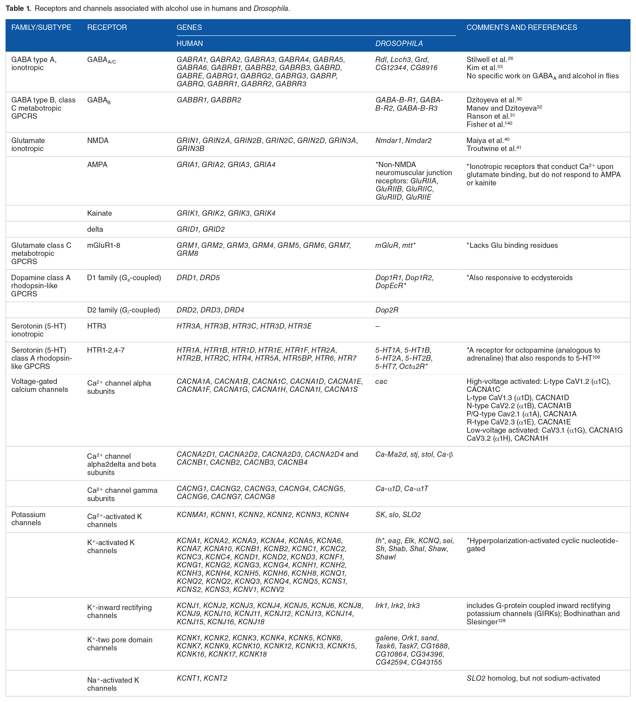
Table 1. Receptors and channels associated with alcohol use in humans and Drosophila.
Article Copyright © 2021 Authors, Source DOI: 10.1177/26331055211007441. See content reuse guidelines at: sagepub.com/journals-permissions

