Slide 1
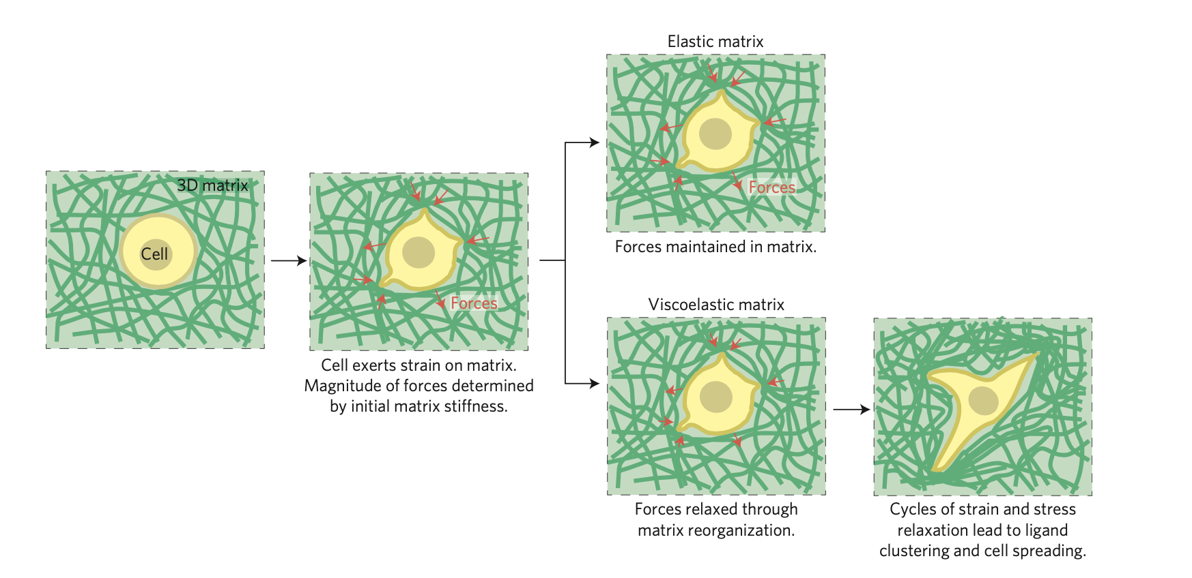
Cell/ECM Interaction Steps in Elastic and Viscoelastic Matrices
No local clustering of ligands
No spreading
No osteogenic differentiation
Local clustering of RGD ligands
Actomyosin contractility through binding to RGD ligands
Nuclear localization of YAP
String Integrin-mediated signaling
Osteogenic differentiation

