Slide 1
My Phenotyping Evaluation Hypertension
Yves Greatti

Slide 2
Requirements
In order to create this computational phenotyping algorithm and accomplish this task you will:
Test two or more individual data types
Apply two or more manipulations of individual data types
Create two or more combinations of data types
Provide 2x2 tables and evaluation metrics (sensitivity/specificity/PPV/NPV) for all algorithms tested.
Choose and justify the selection of a final computational phenotyping algorithm

Slide 3
Training data
Data is from table course3_data.hypertension_goldstandard

Slide 4
Data Types – Testing for hypertension Clinical criteria
Systolic BP >= 140 mmHg on more than two occasions
Any event from table mimic3_demo.CHARTEVENTS containing the word “systolic” for which VALUE >=140, and event count > 2
Diastolic BP>= 90 mmHg on more than two occasions
Any event from table mimic3_demo.CHARTEVENTS containing the word “diastolic” for which VALUE >=90, and event count > 2

Slide 5
Data Types – Testing for hypertension ICD-9 diagnosis codes
401.0 Malignant
401.1 Benign
401.9 Unspecified
ICD-9 codes from mimic3_demo.DIAGNOSES_ICD in (4010, or 4011, 4019)

Slide 6
Data Types – Testing for hypertension Medications
blood pressure lowering drugs available in
Table course3_data.D_ANTIHYPERTENSIVES.

Slide 7
Clinical criteria Alone
 |  | Manual Review Hypertension
 |  | + | -
BP EVENTS | + | 14 | 8
 | - | 49 | 28
Sensitivity: 22.2%
Specificity: 77.7%
PPV: 63.6%
NPV: 36.3%

Slide 8
ICD-9 Codes Alone (401.0, 401.1, 401.09)
 |  | Manual Review Hypertension
 |  | + | -
ICD-9 CODES | + | 35 | 3
 | - | 63 | 36
Sensitivity: 35.7%
Specificity: 92.3%
PPV: 92.1%
NPV: 36.3%

Slide 9
Medication Alone
 |  | Manual Review Hypertension
 |  | + | -
MEDICATIONS | + | 52 | 24
 | - | 11 | 12
Sensitivity: 82.5%
Specificity: 33.3%
PPV: 68.4%
NPV: 52.1%

Slide 10
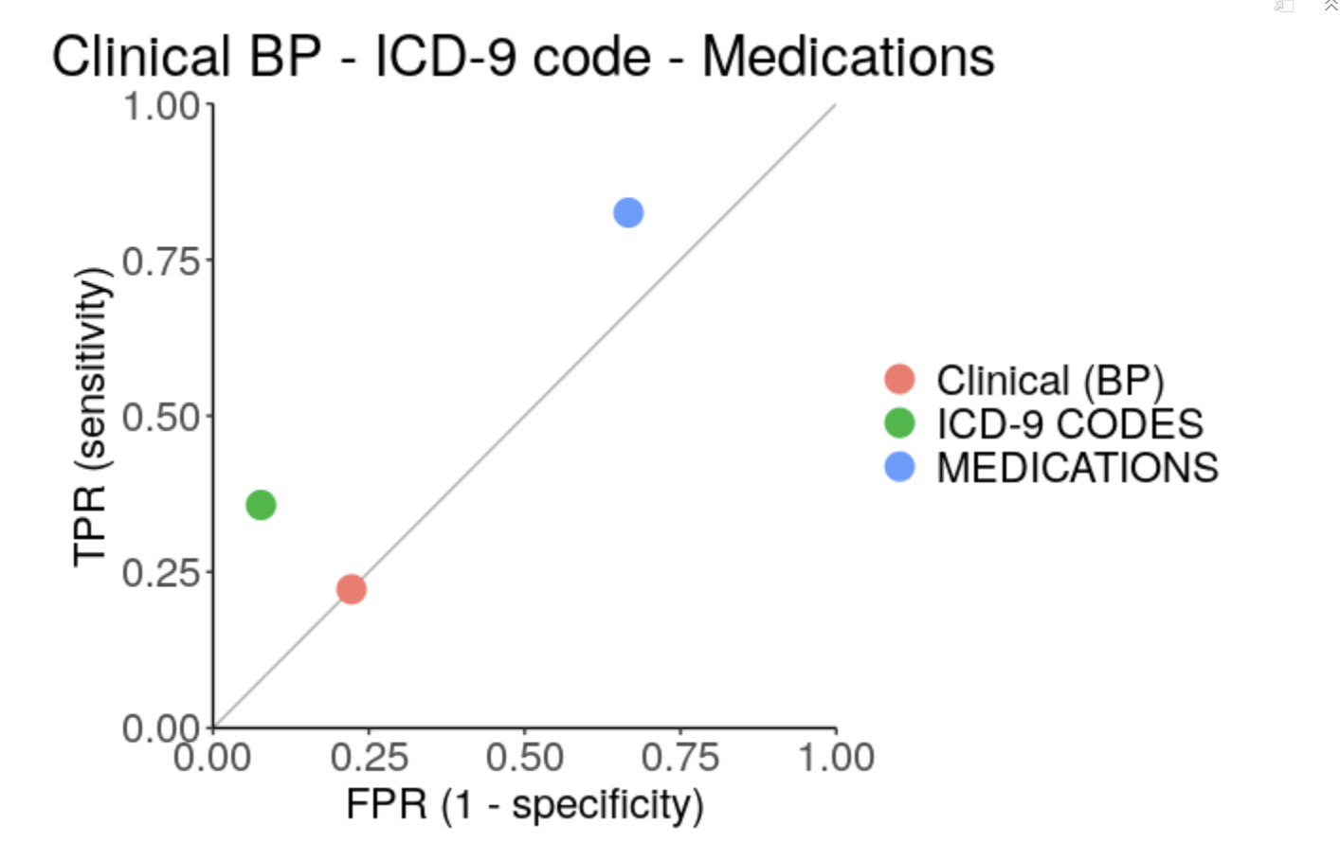
Algorithm Performances
High Specificity Algorithm: ICD-9 Codes
High Sensitivity Algorithm: Medications
Clinical BP is not better than a random algorithm

Slide 11
Clinical criteria OR ICD-9 codes
 |  | Manual Review Hypertension
 |  | + | -
COMBINATION | + | 39 | 9
 | - | 24 | 27
Sensitivity: 61.9%
Specificity: 75%
PPV: 81.2%
NPV: 52.9%

Slide 12
Clinical criteria OR MEDICATIONS
 |  | Manual Review Hypertension
 |  | + | -
COMBINATION | + | 54 | 24
 | - | 9 | 12
Sensitivity: 85.7%
Specificity: 33.33%
PPV: 69.2%
NPV: 57.1%

Slide 13
(Clinical criteria AND MEDICATIONS) OR ICD-9
 |  | Manual Review Hypertension
 |  | + | -
COMBINATION | + | 40 | 8
 | - | 23 | 28
Sensitivity: 63.4%
Specificity: 77.7%
PPV: 83.3%
NPV: 54.9%

Slide 14
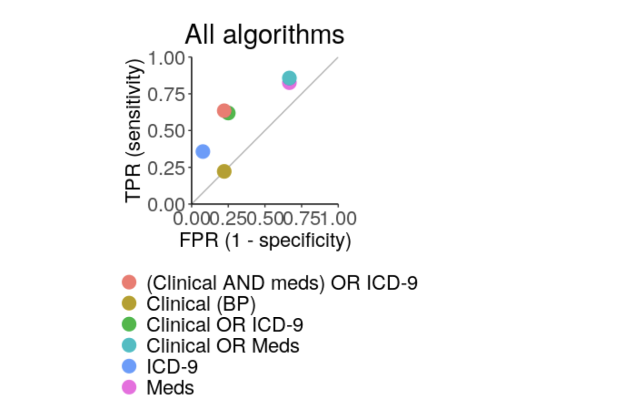
The best algorithm is
Clinical And Meds) or ICD-9
Because it has a good balance of sensitivity (63.4%) and specificity (77.7%0
However it is rather complex by mixing different data types
Portability is in question since there are different data types
so data availability and consistency might be an issue

