Slide 1
Outline
Background
Motivation / Challenges
Proposed Methodology / Solution
Experiment Results
Discussion and Limitations
Conclusion

Slide 2
Background
You may spend a little bit more time on background if the topic is quite new for you and/or us.
More figures / tables, less words please
Use multiple slides for this part if necessary

Slide 3
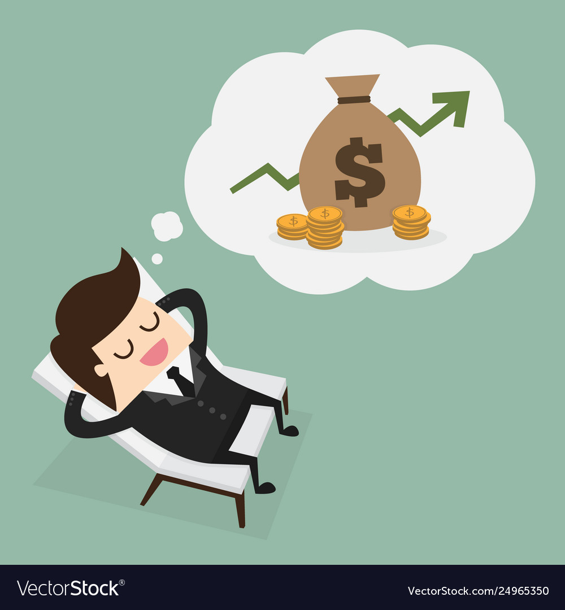
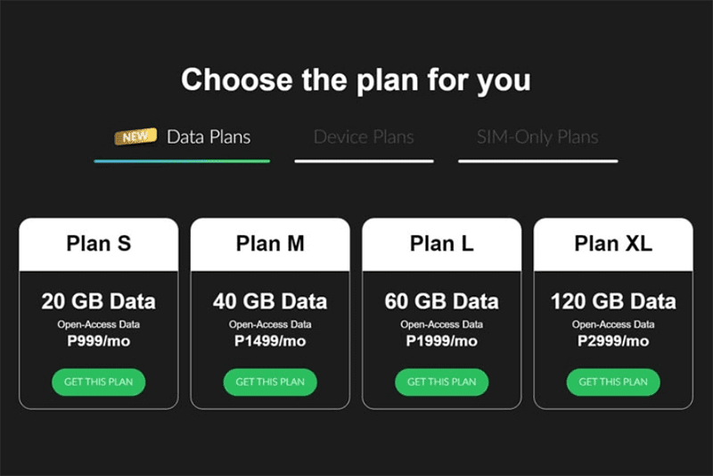
Background (cont’d)
Passive income
Notes:
As we all know, mobile data is a precious commodity these days. If your internet service provider offers a limited data plan, you know how expensive crossing that line can get. On the other hand, if you have more bandwidth than you need or you're blessed with a flat-rate connection, you could sell it and make some extra money. This is where the IPRoyal Pawns app comes in.

Slide 4
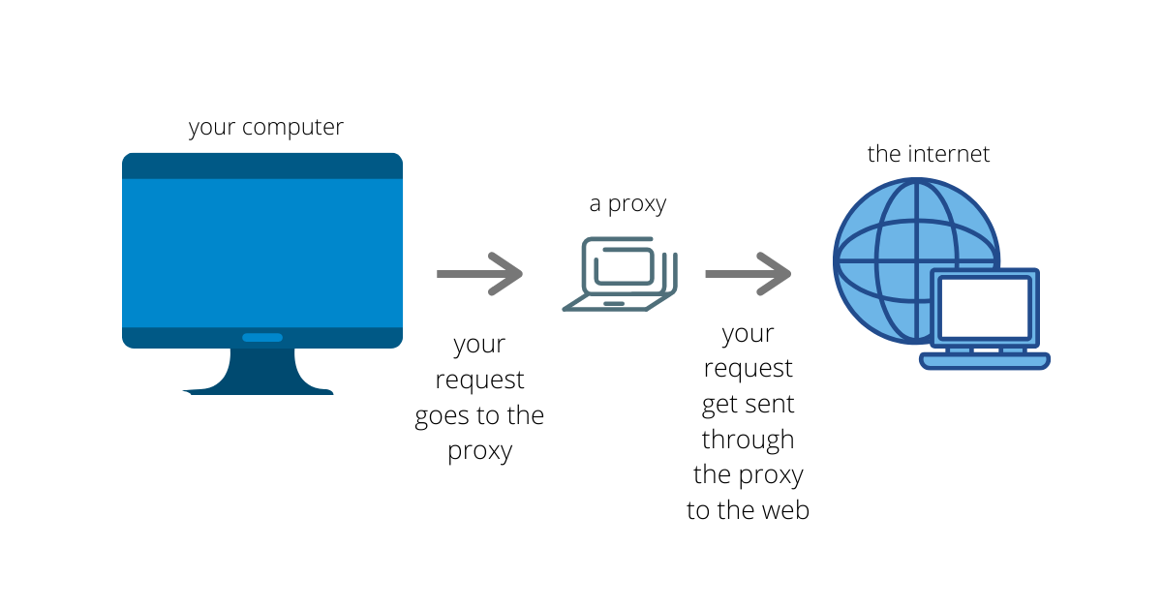
Background (cont’d)
How does IPRoyal work?
Access the web from your location
share your internet traffic via your device with single IP address
Notes:
By sharing your internet connection through the IPRoyal Pawns app, business partners can access the web from your location. That way, you help others view the internet as it is perceived by real people - without any location restrictions or censorship.
IPRoyal has developed an Application that enables Users to share their internet traffic via their device with IPRoyal and its Clients. The User’s device becomes a gateway which allows IPRoyal to send and receive internet traffic. This traffic is used by IPRoyal and its Clients. There’s really no point in installing it on multiple computers connected to the same network since the program will only be able to read one IP address.

Slide 5
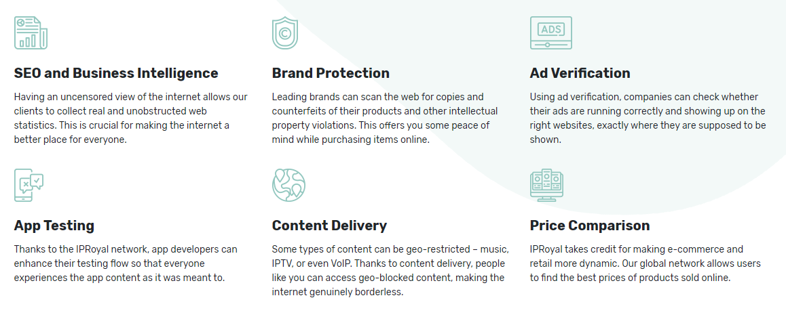
Background (cont’d)
Frequent cases

Slide 6
Background (cont’d)
Safety
clients need to confirm their identity
The app itself has no access to your storage and does not gather any personal data. We only use the information needed to make the service work - your IP address, network speed, and location. All traffic is fully encrypted, so there are no compromises in terms of privacy. We don't bundle any additional software with the installation, and the app itself contains no ads.
IPRoyal Pawns pays cash via PayPal and Bitcon. And it pays you 0.20USD per GB shared.
IPRoyal does not plan or intend to collect any personal information on children below the age of 14 for the purpose of collection and/or processing of personal data of such an individual.

Slide 7
Background (cont’d)
Your rights in relation to your personal information
Access
Modify
Remove
You can also exercise the following rights
Restrict the processing
Oppose the processing
Collect
File a complaint regarding the way IPRoyal use your data.
Notes:
Under the General Data Protection Regulation (GDPR) and the California Consumer Privacy Act (CCPA), You preserve the right to access, modify, and remove your information. In most cases, this can be done by simply signing in and updating your IPRoyal preferences.

Slide 8
Background (cont’d)
Exact data accessed
Email
Payment information
Device information: IP address, version of the operating system you’re running, the model of the device you’re using, current charging state, last seen time stamp, and your physical location (city and country)
Network information: WiFi
Error and crash reports and application usage analytics
Notes:
Your email is used as your username. User payment information is necessary for transferring your earnings to an account of your choice. Device information includes your IP address, version of the operating system you’re running, the model of the device you’re using, current charging state, last seen time stamp, and your physical location (city and country). This information is used to verify if we can use your device’s resources and to access and collect data from public internet resources. Network information includes the current state of your WiFi, so we can avoid using your device when it’s using mobile network data. For the purposes of analyzing and improving our service, we also collect accumulated statistics in relation to the use of our application. This information can include error and crash reports and application usage analytics.

Slide 9
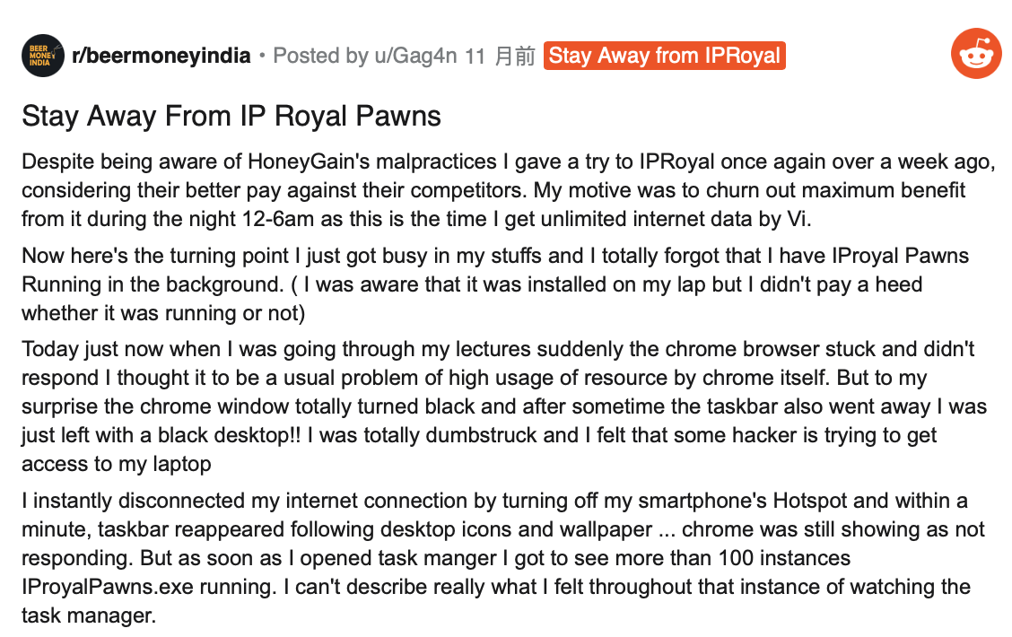
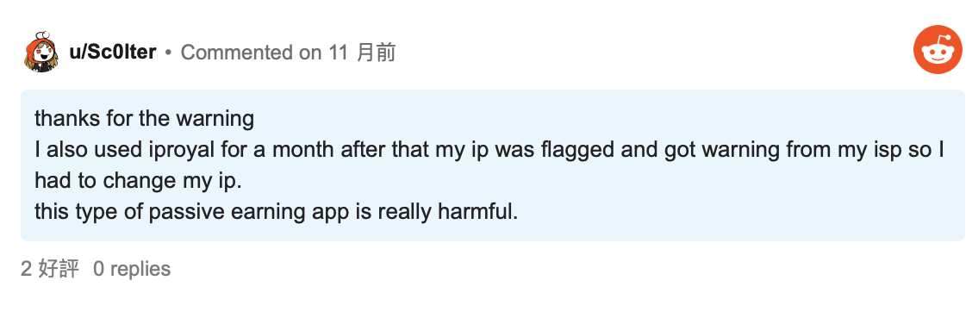
Background (cont’d)
Complaints
Notes:
It turns out to be a common kind of .exe bug, and it can happen to any software. Sometimes app crash and we relaunch it again without closing last application. However it‘s not related with chrome problems or hacking. IPRoyal monitors all traffic that it would be used only on legal cases. Also nobody can connect to your computer through IPRoyal pawns only your IP and your traffic are used. However, there are a bunch of people feels apps like this is really harmful.

Slide 10
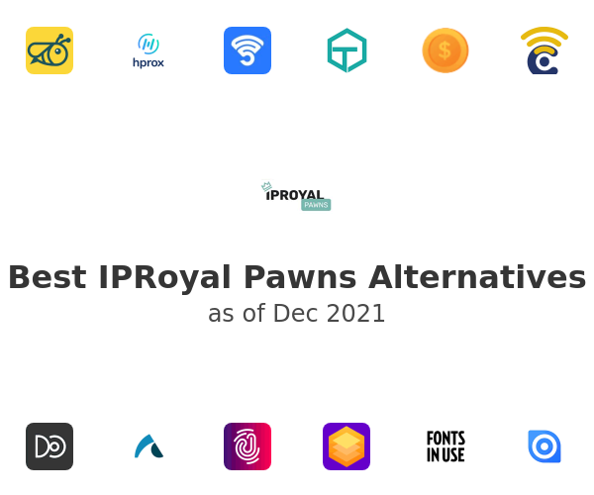
Background (cont’d)
Top Alternatives & Competitors to IPRoyal (Proxy Network)
HoneyGain
PacketStream
Peer2Profit

Slide 11

Background (cont’d)
IPRoyal's insight on Regulatory impasse within the web-scraping industry
“We closely monitor all clients’ requests for unusual patterns,” Toleikis said. “If we notice more requests than usual, we suspend the account immediately and ask the client to provide more details about that particular case”. He also adds that his practice has proved to be 100% effective so far.”
“We always ask people who want to share their internet connection with us to carefully check their country’s laws and make sure they’re not doing anything illegal.”

