Slide 1

Internship Project Presentation
June 2025 – July 2025
Complaint Management System
Yashasvi Grover
221B460 B-13
Under the guidance of Ms. Nainy
Coders Hire Pvt. Ltd

Slide 2
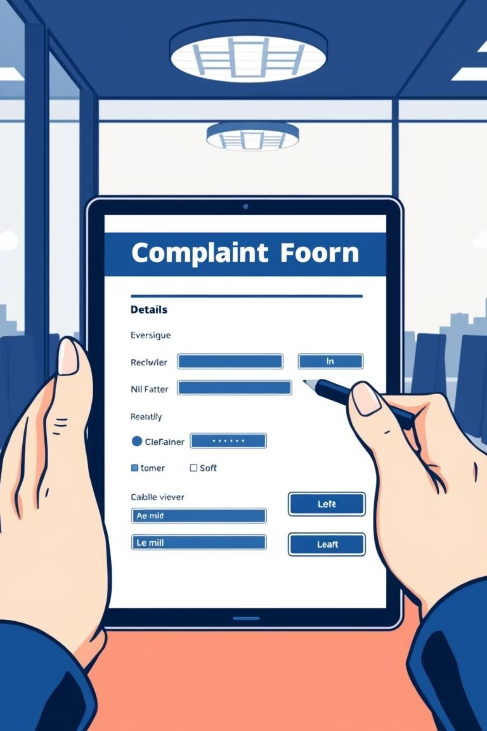
Complaint Management System
Streamlining IT support and organizational processes through an efficient digital platform.

Slide 3
Introduction: The Problem
Frequent technical issues in IT organizations lead to disruptions, impacting productivity and employee satisfaction. Manual handling of complaints results in mismanagement, delays, and lack of accountability.
Lack of Centralization
No Tracking
Inefficiency
Complaints are scattered across various channels.
Users cannot track complaint status; admins struggle to filter.
Complaints are overlooked, misprioritized, or resolved slowly.

Slide 4
Project Overview: CMS
The Complaint Management System (CMS) is a web-based, single-page application developed with HTML, CSS, and JavaScript. It replaces manual processes with a modern digital interface for complaint submission and handling.
User-Friendly
Admin Efficiency
Frontend-Based
Dynamic forms with validation and tooltips.
Dashboard for real-time complaint overview and management.
Simulates real-world functionality without backend or database.

Slide 5
Key Functionalities
Dashboard Overview
New Complaint Form
Visual statistics for Pending, In-Progress, Resolved, and Total complaints.
Form with validation, tooltips, and real-time character count.
PDF Export
Admin Login Panel
Automatic generation of a complaint receipt in PDF format using jsPDF.
Secure login for admin users to manage complaints and admin users.
Filter Options
Responsive Design
Ability to filter complaints based on status and issue type.
Fully responsive layout suitable for desktops, tablets, and smartphones.

Slide 6
Technical Specifications
Hardware
Software
Processor: Intel Core i3 or higher
Frontend: HTML5, CSS3, JavaScript (ES6)
RAM: 4 GB (8 GB recommended)
Libraries: Font Awesome, Google Fonts, jsPDF
Hard Disk: 500 MB free space
Data Storage: localStorage (Web Storage API)
Display: 1024x768 pixels minimum
Environment: Browser-based (Chrome recommended)
Input: Keyboard and mouse
Internet: One-time for external resources
Editor: Visual Studio Code (preferred)

Slide 7



About Coders Hire
Coders Hire is a technology-driven IT solutions company specializing in smart, efficient, and scalable digital systems. The CMS project is an internal initiative to improve IT support efficiency.
Innovation-Driven
Collaborative Culture
Agile Methodologies
Encourages new ideas and prototyping solutions.
Promotes creativity, responsibility, and continuous learning.
Follows agile development principles and flexible work.

Slide 8
System Comparison
Existing System Limitations
Proposed System Benefits
Scattered complaints (emails, verbal)
Structured, formalized handling
No tracking or analytics
Transparent workflow with accountability
Manual prioritization and escalation
Improved admin response time
Time-consuming resolution
Easy user status tracking
Lack of accountability
Digital records, paperless workflow

Slide 9





Feasibility Study
Technical
Client-side, browser-compatible, no server needed.
Operational
Intuitive, simple to use for users and admins.
Economic
No licenses, minimal development cost, saves labor.
Legal & Security
Local data storage, no third-party sharing.
Environmental
Promotes paperless workflow, reduces physical storage.

Slide 10
Results & Outputs
User-Side
Admin-Side
Responsive Complaint Form
Secure Admin Login Panel
Live Dashboard Overview
Unique Complaint ID & Timestamp
Complaint Management Table (sort, filter, update, delete)
Downloadable PDF Receipt
Admin User Management
Confirmation Modal
Mobile Responsiveness
Data Persistence (localStorage)

Slide 11



Conclusion & Future Scope
The CMS is a robust, efficient, and user-friendly solution for complaint handling, built with HTML, CSS, and JavaScript. It's a practical, cost-effective prototype for digitizing internal support systems.
Backend Integration
Notifications
Analytics Module
For scalability and multi-user access.
Email/SMS alerts for status updates.
Visual reports for insights and decision-making.

Slide 12
Thank You !

