Slide 1
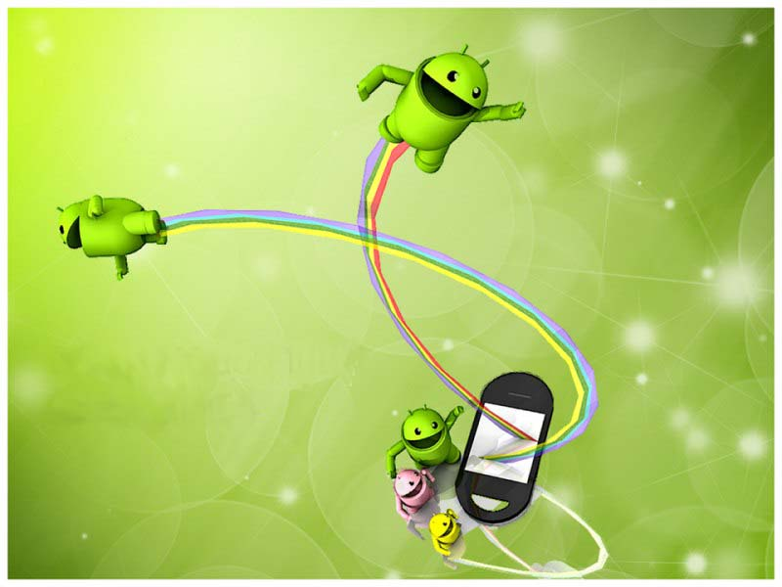

ANDROID
TECHNOLOGY

Slide 2

GROUP MEMBERS
CHIRAG SHAH
HARSH MALDE
HEMANG TAILOR
PALLAVI BHOITE
VIRAL SHAH

Slide 3
INTRODUCTION
WHAT IS ANDROID?
A Software platform and operating system for mobile.
Based on the Linux kernel.
Android was found way back in 2003.
It was developed in Palo Alto, California.
Android was developed by the Andy Rubin, Rich Miner, Nick Sears and Chris White.
Android was purchased by the GOOGLE in AUGUST,2005 for 50 million $.

Slide 4
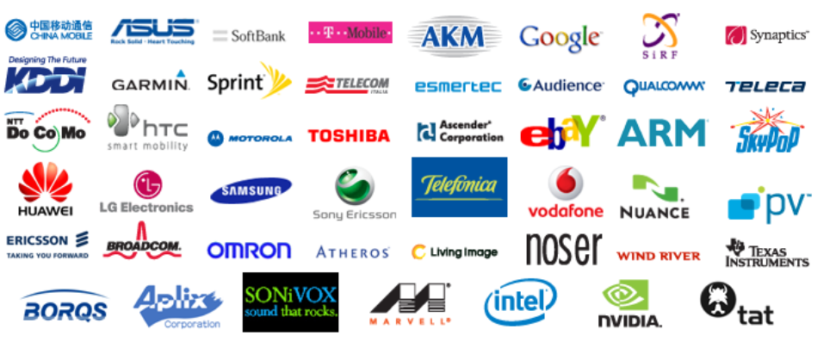
Open handset alliance(oha)
What is OHA?
It’s consortium of several companies.
This group of companies are allowed to use source code of Android and develop applications.
Reason for Nokia not to develop Android Mobiles is Nokia is not part of OHA.

Slide 5
FEATURES OF ANDROID
Android is not a single piece of hardware.
Android supports wireless communication using:-
3G Networks
4G Networks
802.11 Wi-Fi Networks
Bluetooth Connectivity
Android is a multi-process system, in which each application (and parts of the system) runs in its own process.

Slide 6
FEATURES OF ANDROID
Interface that is better then the previous touch screen mobiles.
User gets millions of applications that user can not get in any other mobile operating system.
Android supports advanced audio/video/still media formats such as MPEG-4, H.264, MP3, and AAC, AMR, JPEG, PNG, GIF.
Developing an android application is not tough using SDK(standard development kit) and java emulator we can easily develop applications that we want.

Slide 7
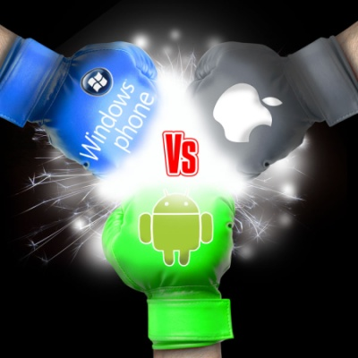
COMPARISON WITH OTHER
OPERATING SYSTEMS
Other then Android there are several other mobile operating system which is used.
Symbian, iOS, windows this are one of the most used mobile operating systems.

Slide 8
Sales comparison of os:-

Slide 9
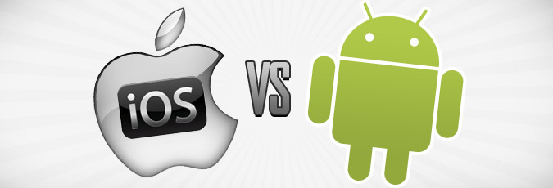


FEATURE | ANDROID | iOS
Ease of use
Voice to text
Gaming
Customizable
Music Player
Notification system
Google voice

Slide 10
iOS vS Android Applications:-

Slide 11
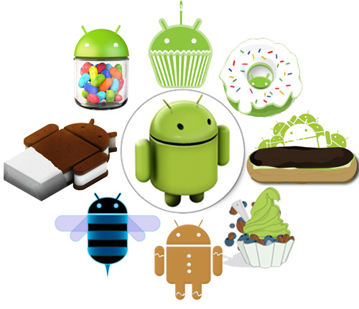
VERSIONS OF ANDROID
Android Beta
First Version of Android.
The focus of Android beta is testing incorporating usability.
Android beta will generally have many more problems on speed and performance.
Android Astro 1.0
First full version of android.
Released on September 23, 2008.
Wi-Fi and Bluetooth support.
Quite slow in operating.
copy and paste feature in the web browser is not present.

Slide 12
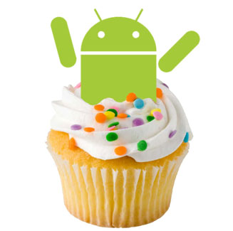
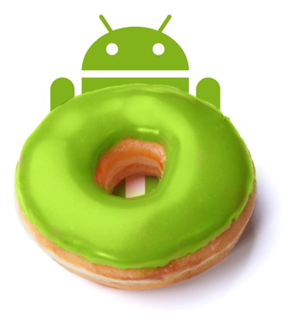
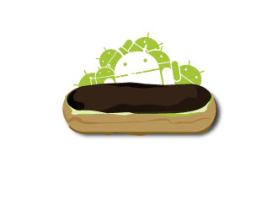
Android Cupcake 1.5
Released on April 30, 2009.
Added auto-rotation option.
Copy and Paste feature added in the web browser.
Increased speed and performance but not upto required level.
Android Donut 1.6
Released on September 15, 2009.
Voice search and Search box were added.
Faster OS boot times and fast web browsing experience.
Typing is quite slower.
Android Éclair 2.0/2.1
Released on October 26, 2009.
Bluetooth 2.1 support.
Improved typing speed on virtual keyboard, with smarter dictionary.
no Adobe flash media support.

Slide 13
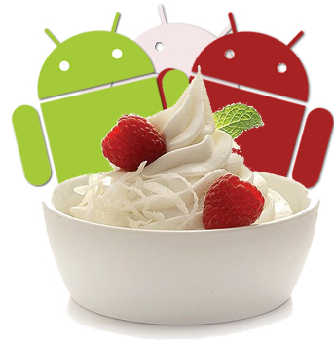


Android Froyo 2.2
Released on May 20, 2010.
Support for Adobe Flash 10.1
Improved Application launcher with better browser
No internet calling.
Android Gingerbread 2.3
Released on December 6, 2010.
Updated User Interface with high efficiency and speed
Internet calling
One touch word selection and copy/paste.
New keyboard for faster word input.
More successful version of Android than previous versions.
not supports multi-core processors.
Android Honeycomb 3.0
Released on February 22, 2011.
Support for multi-core processors
Ability to encrypt all user data.
This version of android is only available for tablets.

Slide 14
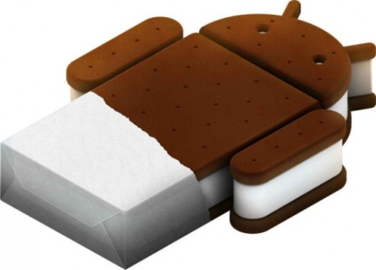

Android IceCreamSandwich(ICS) 4.0
Released on November 14, 2011.
Virtual button in the UI.
A new typeface family for the UI, Roboto.
Ability to shut down apps that are using data in the background.
Android JellyBean 4.1
Released on June 27, 2012.
Latest version of Android.
Smoother user interface.

Slide 15
LIMITATIONS:-
Making source code available to everyone inevitably invites the attention of hackers.
Android operating system uses more amount of battery as compared to normal mobile phones.
As there are so many user sometimes it becomes difficult to connect all the users.
As we call Android is world of applications we continuously need to connected with the internet which is not possible for all the users.

Slide 16
CONCLUSION AND FUTURE SCOPE:-
Android is now stepping up in next level of mobile internet.
There are chances of Android Mobile sales becomes more then iPhone in next two years.
Google may launch another version of android that starts K because Google is launching all the android versions in the alphabetical order.
There are chances of Android may become the widely used operating system in world.

Slide 17
ANY QUESTIONS:-
PLEASE GO TO
WWW.GOOGLE.COM

Slide 18
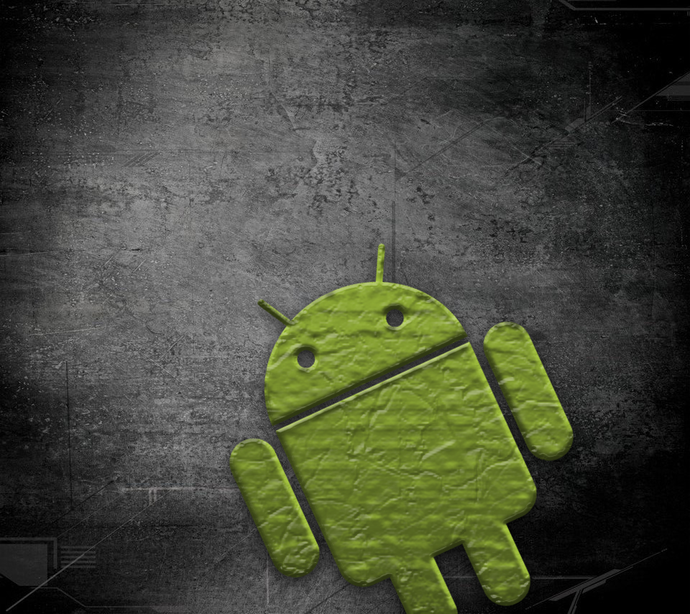
1) Near Field Communication (NFC)
Most Android devices support NFC, which allows electronic devices to easily interact across short distances. The main aim here is to create
a payment option that is simpler than carrying credit cards or cash, and while the market hasn’t exploded as many experts had predicted, there may be an alternative in the works, in the form of Bluetooth Low Energy (BLE).
2) Alternate Keyboards
Android supports multiple keyboards and makes them easy to install; the SwiftKey, Skype, and 8pen apps all offer ways to quickly change up your keyboard style. Other mobile operating systems either don’t permit extra keyboards at all, or the process to install and use them are tedious and time-consuming.
3) Infrared Transmission
The Android operating system supports a built-in infrared transmitter, allowing you to use your phone or tablet as a remote control.

Slide 19
4) No-Touch Control
Using Android apps such as Wave Control, users can control their phones touch-free, using only gestures. Have messy hands but need to turn off your screen or change a song? Simple. This could prove especially useful if you’re driving, so you can keep both eyes on the road.
5) Automation
The Tasker app lets you not only control app permissions but also automate them. Do you only want your location services to be active during the day? Want to create a customized way to start your music—for example, with a voice command and at a certain volume? Tasker can help.
6) Wireless App Downloads
Accessing app stores on any mobile device can be frustrating, but iOS makes it a little more difficult—download an app on your computer, and it won’t sync to your mobile device until you plug in and access iTunes. Using the Android Market or third-party options like AppBrain, meanwhile, let you download apps on your PC and then automatically sync them your Droid, no plugging required.

Slide 20
7) Storage and Battery Swap
Android phones also have unique hardware capabilities. Google’s OS makes it possible to remove and upgrade your battery
or to replace one that no longer holds a charge. In addition, Android phones come with SD card slots for expandable storage.
8) Custom Home Screens
While it’s possible to hack certain phones to customize the home screen, Android comes with this capability from the get-go. Download a third-party launcher like Nova, Apex or Slide and you can add gestures, new shortcuts, or even performance enhancements for older-model devices.
9) Widgets
Apps are versatile, but sometimes you want information at a glance instead of having to open an app and wait for it to load. Android widgets let you display just about any feature you choose, right on the home screen—including weather apps, music widgets, or productivity tools that helpfully remind you of upcoming meetings or approaching deadlines.
10) Custom ROMs
This is a big one. Because the Android operating system is open source, developers can tweak the current OS and build their own versions, which users can download and install in place of the stock OS. Some are filled with features, while others change the look and feel of a device. Chances are if there’s a feature you want, someone has already built a custom ROM for it.

