Slide 1
Hardware Acceleration for Cluster Fault Tolerance in Hybrid CMOS/non-CMOS Memories
Dissertation Defence Yuqi Guo

Slide 2
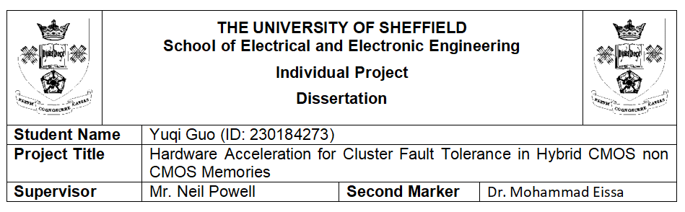
Title

Slide 3
Dissertation Defence School of Electrical and Electronic Engineering The University of Sheffield

Slide 4
1. Motivation and Problem
Why this project matters
Hybrid CMOS/non-CMOS memories offer high density and low cost, but they are vulnerable to spatially correlated cluster faults.
Traditional ECC schemes are often evaluated for independent random errors, not realistic burst faults.
Previous studies mainly relied on simulation; hardware-validated comparison was still missing.
Core research question
Which ECC design gives the best trade-off between fault tolerance, latency, area, power, and storage efficiency on real FPGA hardware?

Slide 5
2. Project Goal and Objectives
Project goal
To design and implement an FPGA-based hardware acceleration platform for fair benchmarking of multiple ECC algorithms under realistic cluster-fault conditions.
Objectives
Implement and compare 6 configurations:
2NRM-RRNS Parallel
2NRM-RRNS Serial
3NRM-RRNS
C-RRNS-MLD
C-RRNS-MRC
RS(12,4)
Evaluate four key dimensions:
fault tolerance
decoding latency
FPGA resource and power cost
storage efficiency

Slide 6
3. Why the Test Platform Is Strong
Advantages of the proposed FPGA test platform
Fair comparison: all algorithms share the same test infrastructure and clock condition.
Hardware validated: results are measured on a Xilinx Artix-7 FPGA, not simulation alone.
Low overhead fault injection: the probabilistic injector uses only two BRAMs.
Scalable experiments: supports 101 BER points from 0% to 10% and 100,000 samples per point.
Extensible architecture: new ECCs can be added with the wrapper interface.
Cross-validated: FPGA curves closely match MATLAB results, increasing credibility.

Slide 7
4. Methodology and Experimental Setup
Evaluation flow
Phase 1: MATLAB simulation for theoretical baseline.
Phase 2: FPGA implementation for hardware validation.
Same encode-inject-decode-compare loop is used for every configuration.
Test settings
Device: Artix-7 xc7a100t (Arty A7-100T)
Clock: 50 MHz
Fault modes:
random single-bit injection
cluster burst injection with burst length 1-15

Slide 8
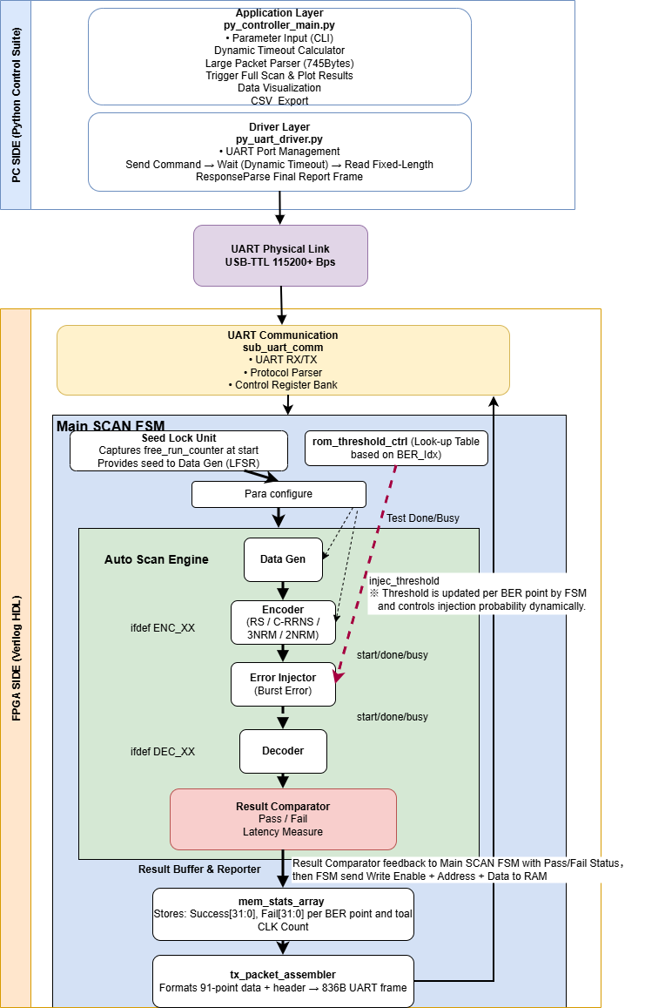
5. FPGA Platform Architecture

Slide 9
Key idea
The PC controls configuration and visualisation, while the FPGA autonomously performs the full BER sweep and uploads consolidated results through UART.

Slide 10
6. Main Innovation: Probabilistic Fault Injection Engine
Key features
Uses a 32-bit Galois LFSR as the pseudo-random source.
Supports both random single-bit and cluster burst injection.
BER is controlled by threshold comparison instead of a fixed schedule.
Boundary-safe burst masks are precomputed offline and stored in ROM.
Why it matters
This makes the platform resource-efficient, reproducible, and reusable for benchmarking different ECC algorithms.

Slide 11
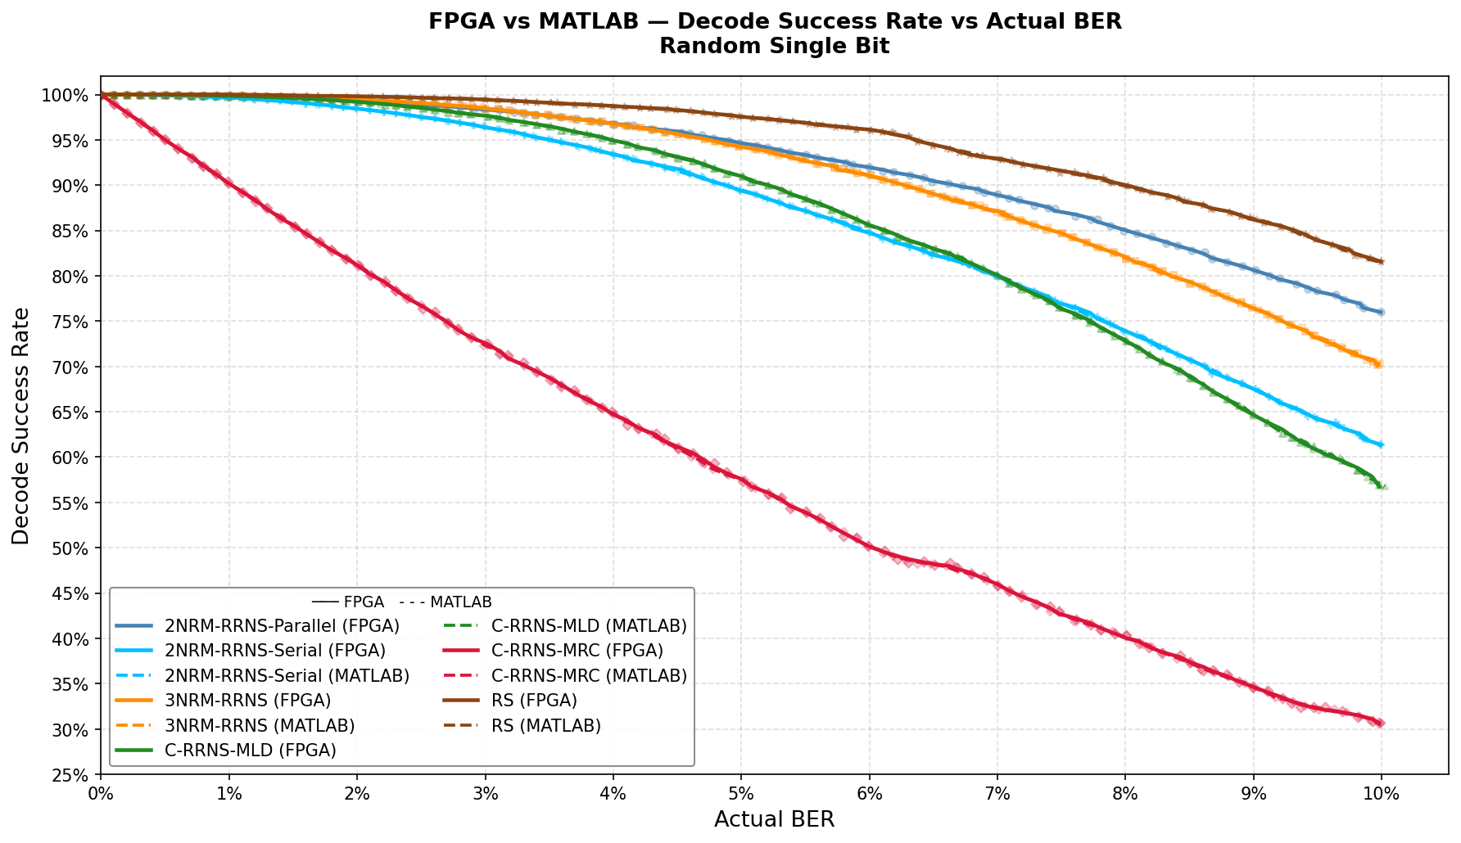
7. Random Single-Bit Results

Slide 12
Main observation
FPGA and MATLAB results are in high agreement.
This validates both the FPGA implementation and the simulation model.
All correcting algorithms perform strongly at low BER, while C-RRNS-MRC degrades quickly because it has no true correction capability.

Slide 13
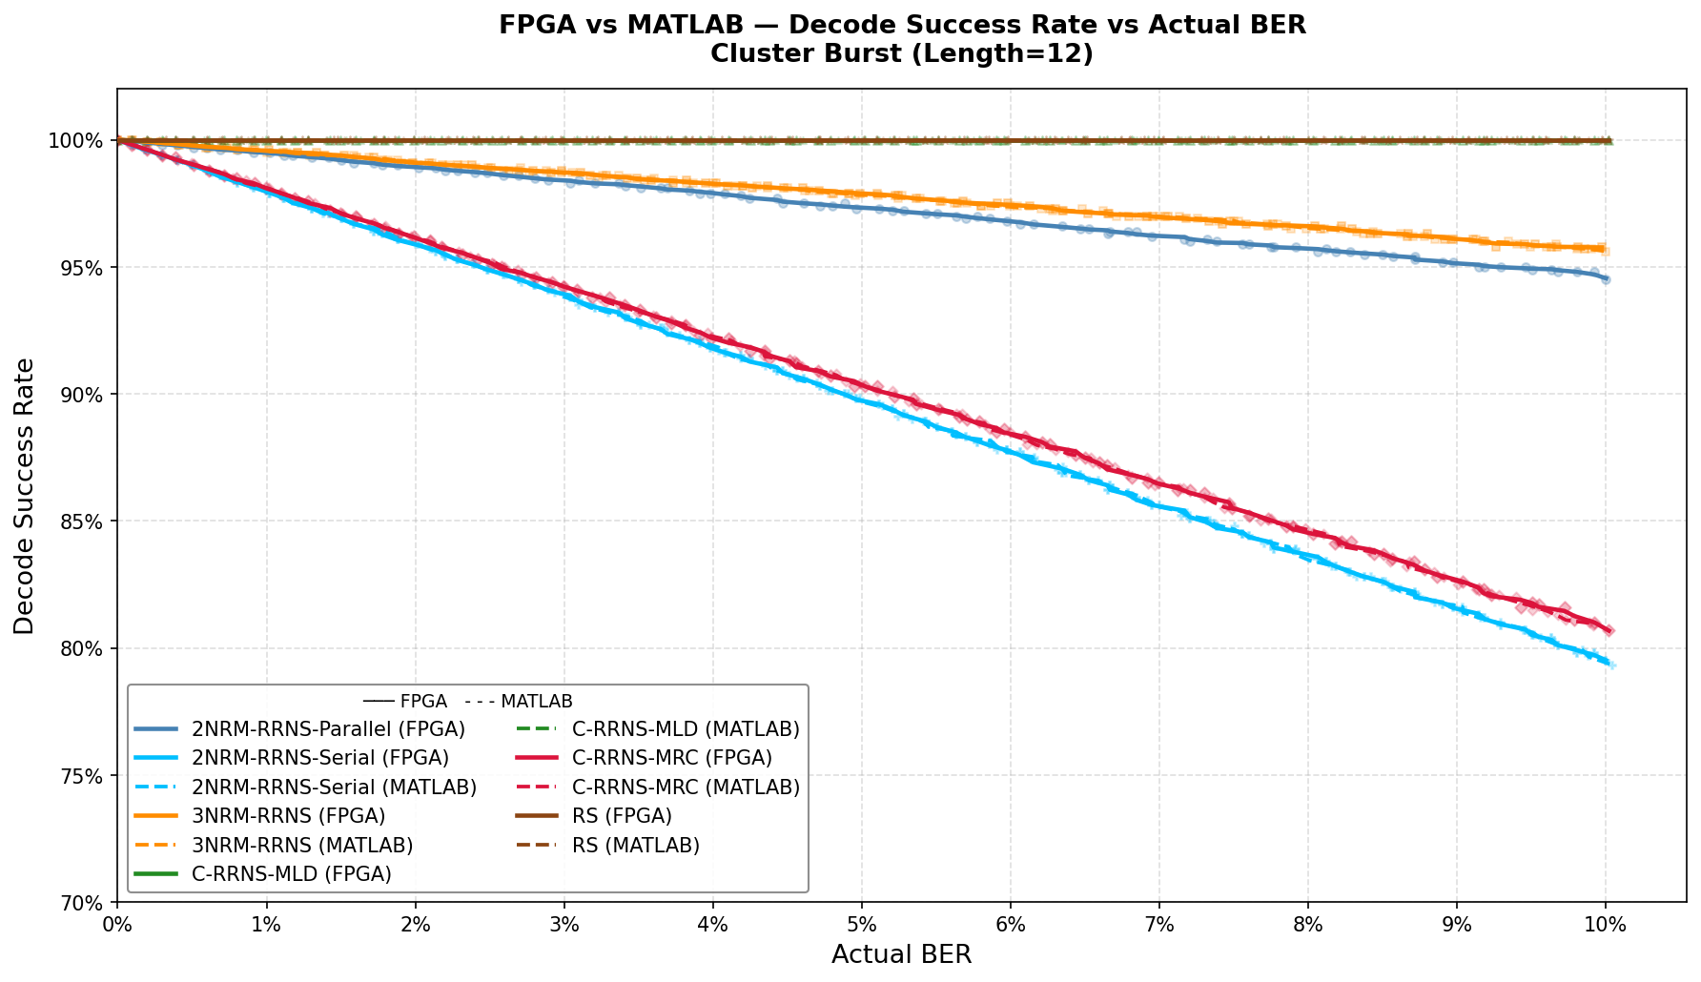
8. Cluster Burst Results at Representative Length L=12

Slide 14
Main observation
C-RRNS-MLD and RS(12,4) provide the strongest burst-fault resilience.
3NRM-RRNS performs better than the 2NRM variants under this harsher burst model.
The ranking under burst faults differs from random-bit testing, which highlights the importance of realistic fault models.

Slide 15
9. Quantitative Comparison of Key Results
Configuration | Max tolerable burst length | Decoder latency (cycles) | Storage efficiency
C-RRNS-MLD | 14 | 928 | 26.2%
RS(12,4) | 13 | 127 | 33.3%
3NRM-RRNS | 11 | 2048 | 33.3%
2NRM-RRNS Parallel | 8 | 24 | 39.0%
2NRM-RRNS Serial | 7 | 1047 | 39.0%

Slide 16
Interpretation
Best reliability: C-RRNS-MLD
Best speed: 2NRM-RRNS Parallel
Best storage efficiency: 2NRM-RRNS

Slide 17
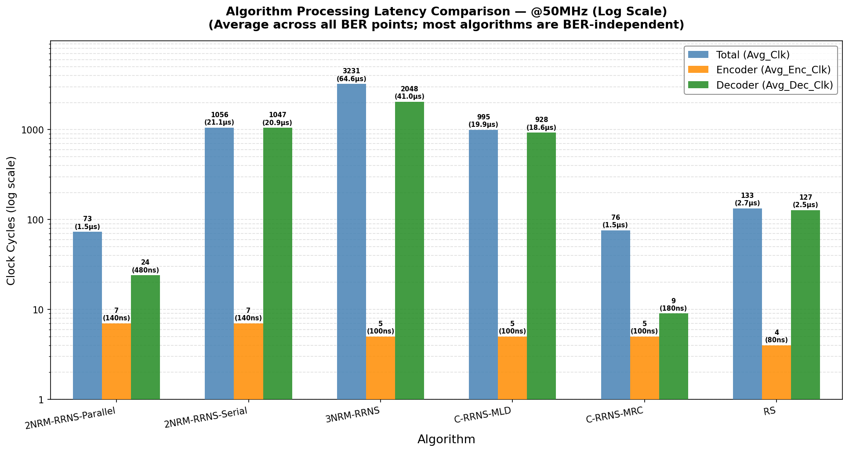
10. Latency Comparison

Slide 18
Conclusion from latency results
The 2NRM-RRNS Parallel decoder is the fastest correcting design.
The parallel implementation achieves a major acceleration over the serial version.
The result clearly exposes the resource-latency trade-off of parallel MLD.

Slide 19
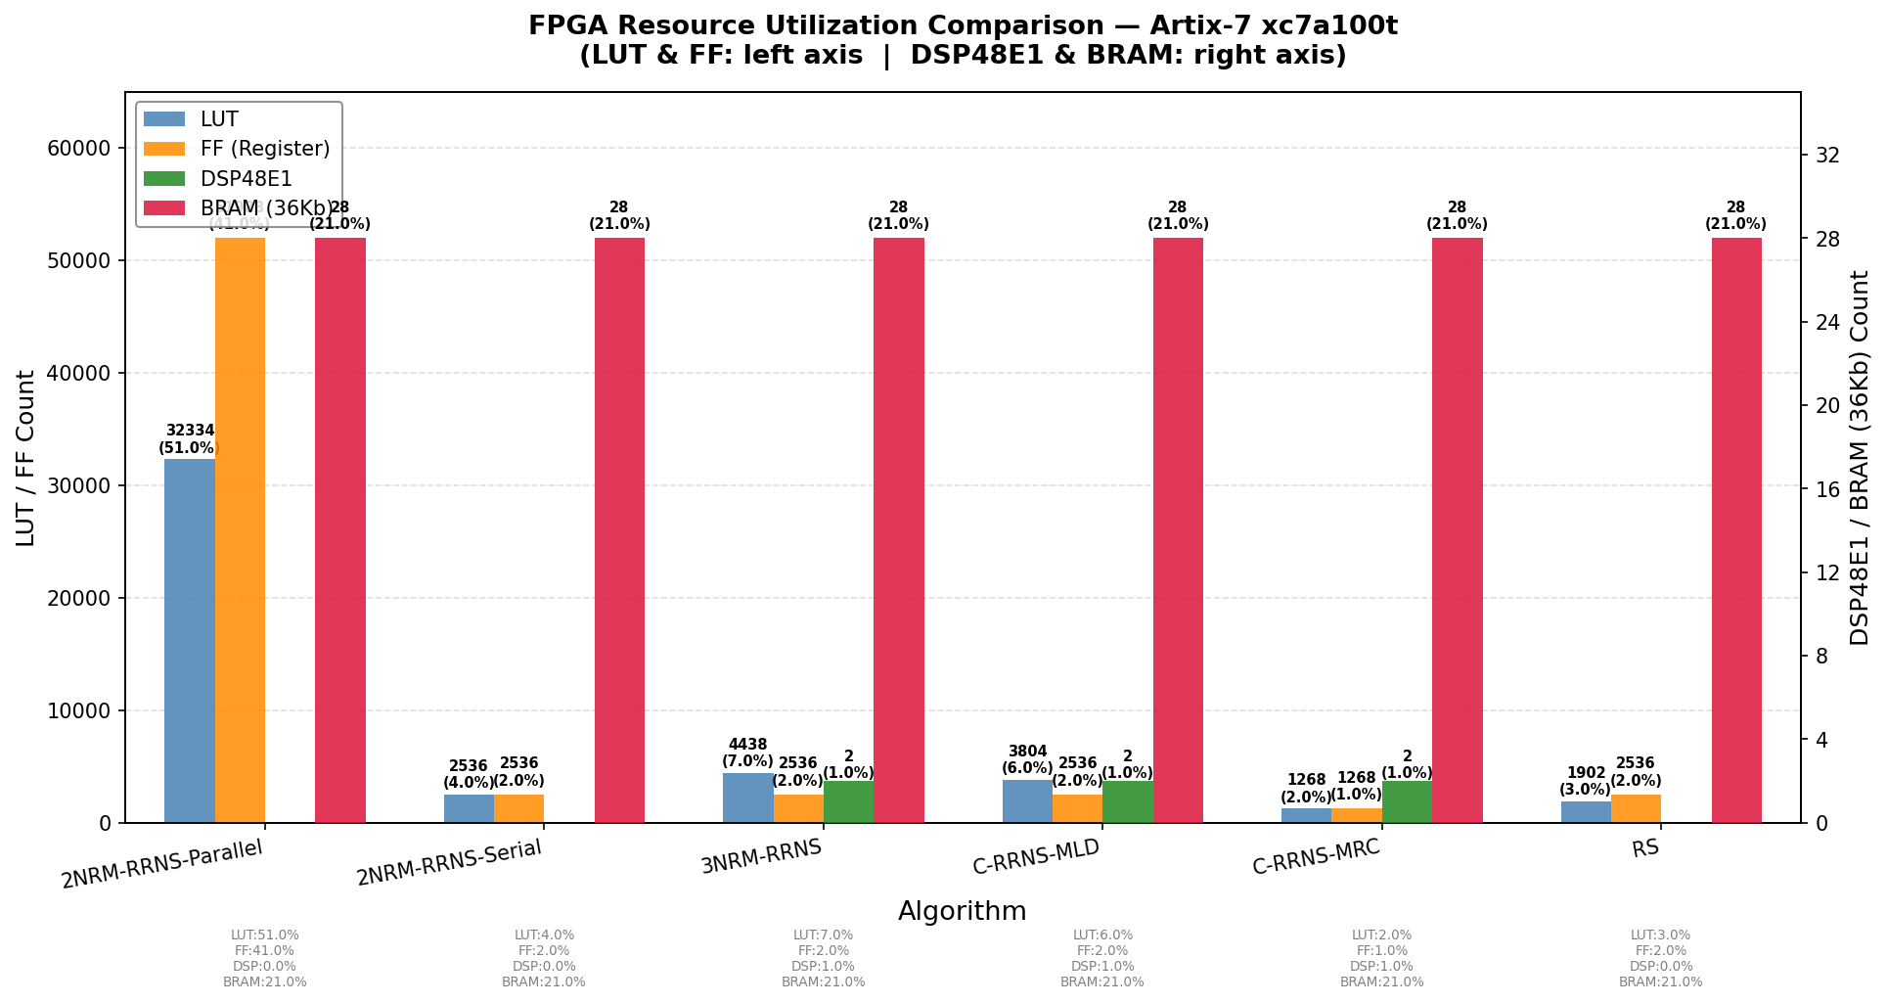
11. Resource and Storage Comparison

Slide 20
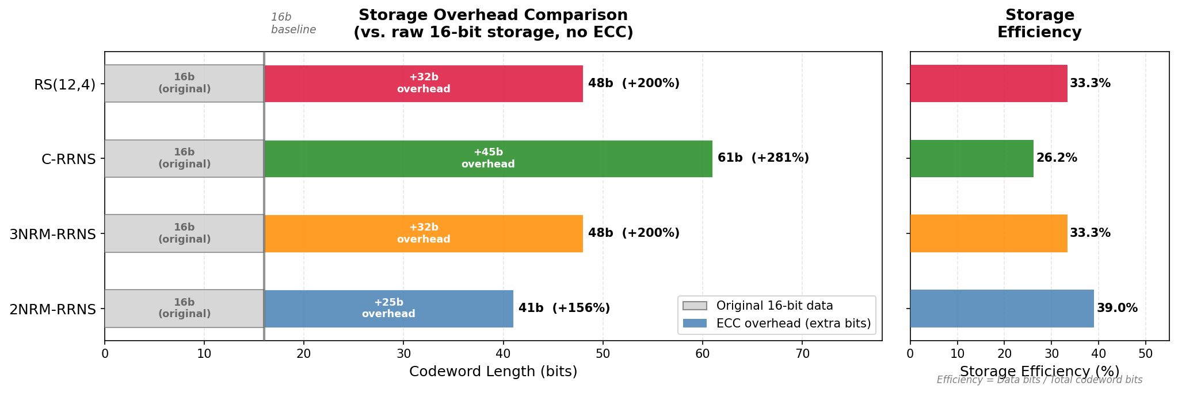

Slide 21
Key message
Parallel speed comes at a high LUT/FF and power cost.
2NRM-RRNS is the most storage-efficient option.
C-RRNS-MLD gives the strongest protection but with larger codeword overhead.

Slide 22
12. Main Conclusions
Major conclusions from the dissertation
The project successfully delivers a working FPGA benchmarking platform for ECC evaluation under cluster faults.
C-RRNS-MLD shows the strongest burst-fault tolerance in the explored design space.
2NRM-RRNS Parallel offers the lowest decode latency, but its area and power cost are high.
2NRM-RRNS provides the best storage efficiency for overhead-sensitive systems.
The close agreement between FPGA and MATLAB results confirms the correctness and reliability of the evaluation method.

Slide 23
13. Contributions and Future Work
Contributions
A reusable FPGA evaluation platform with unified wrappers.
A low-resource probabilistic fault injection engine.
The first hardware-level quantification of the parallel vs serial 2NRM-RRNS trade-off.
Future work
evaluate wider data words and more ECC variants
reduce LFSR correlation with stronger random sources
migrate the framework toward ASIC or real hybrid memory devices

Slide 24
Appendix A. Fault Injection Algorithm
Probabilistic injection procedure
Generate encoded codeword.
Lock one random seed for the full BER sweep.
For each BER point, compute the injection threshold.
Use the 32-bit Galois LFSR to decide whether to inject an error.
If random mode is selected, test valid bits independently.
If burst mode is selected, apply one ROM-based contiguous burst mask.
Decode and compare with the original data to record pass or fail.
Purpose
This appendix shows that the fault injector is not a simple random flip unit, but a controlled and reproducible hardware evaluation algorithm.

Slide 25
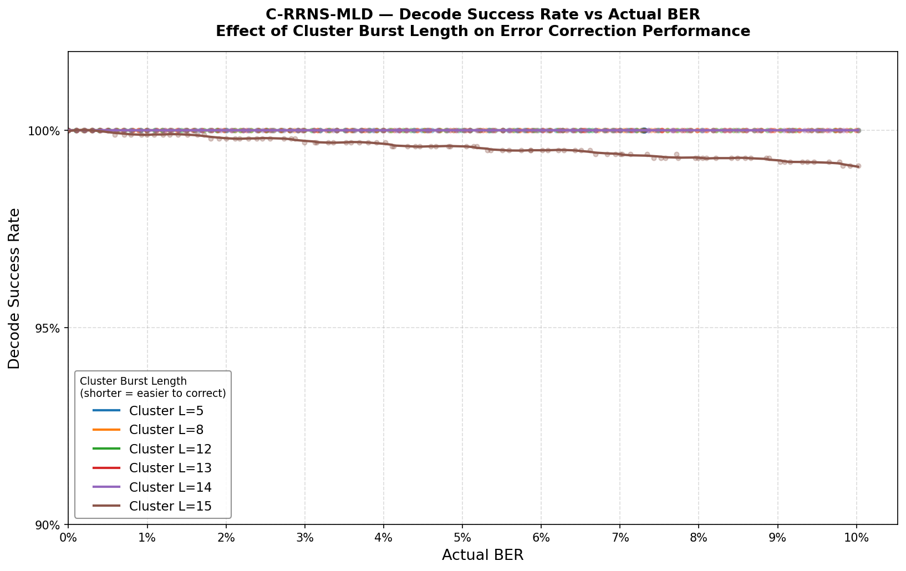
Appendix B. Backup Figure: Burst-Length Impact

Slide 26
Backup message
These curves support the final claim that C-RRNS-MLD provides the best extreme cluster-fault tolerance, with RS as the strongest balanced alternative.

Slide 27
Thank You
Questions?
Thank you for listening.

