Slide 1

Project Title -
Seasonal Agriculture Performance Analysis
Student Name – Yogesh B Gurubetti
College Name – KLE Technological Universty
AICTE STU ID :
STU6a69d1a6114901785319846

Slide 2

PROBLEM STATEMENT
Core Issue: Agricultural performance is heavily influenced by cyclical shifts in weather conditions, resource availability, farming practices, and market dynamics.
The Analytical Gap: Raw agricultural datasets do not intuitively explain how and why farm performance fluctuates across cropping seasons, leaving critical relationships between environmental inputs and economic viability obscured.
Objective: To conduct a rigorous data analytics investigation into a multi-season agricultural dataset (4,000 farms across India) to uncover underlying patterns, test seasonal performance differences statistically, evaluate resource efficiencies, and provide data-driven agricultural planning strategies.

Slide 3
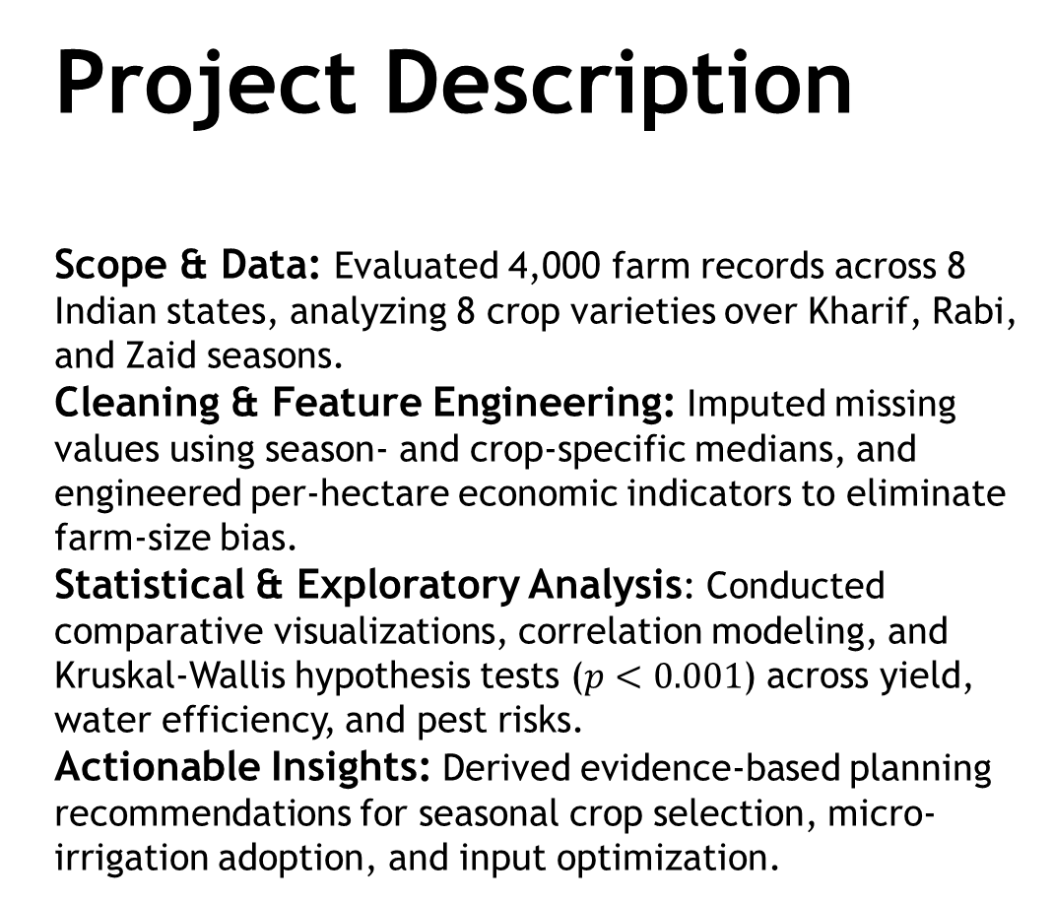
Project Description Scope & Data: Evaluated 4,000 farm records across 8 Indian states, analyzing 8 crop varieties over Kharif, Rabi, and Zaid seasons. Cleaning & Feature Engineering: Imputed missing values using season- and crop-specific medians, and engineered per-hectare economic indicators to eliminate farm-size bias. Statistical & Exploratory Analysis: Conducted comparative visualizations, correlation modeling, and Kruskal-Wallis hypothesis tests ($p<0.001$) across yield, water efficiency, and pest risks. Actionable Insights: Derived evidence-based planning recommendations for seasonal crop selection, micro-irrigation adoption, and input optimization.

Slide 4

WHO ARE THE END USERS?
Agricultural Policymakers & Government Bodies:
Design targeted seasonal subsidies, set fair minimum support pricing, and guide district-level crop rotation mandates.
Farmers & Agronomists:
Select season-appropriate crop portfolios and determine optimal irrigation practices to maximize per-hectare profit.
Agricultural Lending & Insurance Providers:
Evaluate seasonal default risk, price crop insurance premiums accurately, and underwrite farm credit based on empirical success rates.

Slide 5

Technology Used
Core Programming Language: Python 3.10+
Data Ingestion & Wrangling: Pandas, NumPy
Scientific & Inferential Statistics: SciPy (scipy.stats for Kruskal-Wallis H-test, Shapiro-Wilk)
Data Visualization & Analytics Plots: Matplotlib, Seaborn
Interactive Development Environment: Jupyter Notebook / JupyterLab

Slide 6
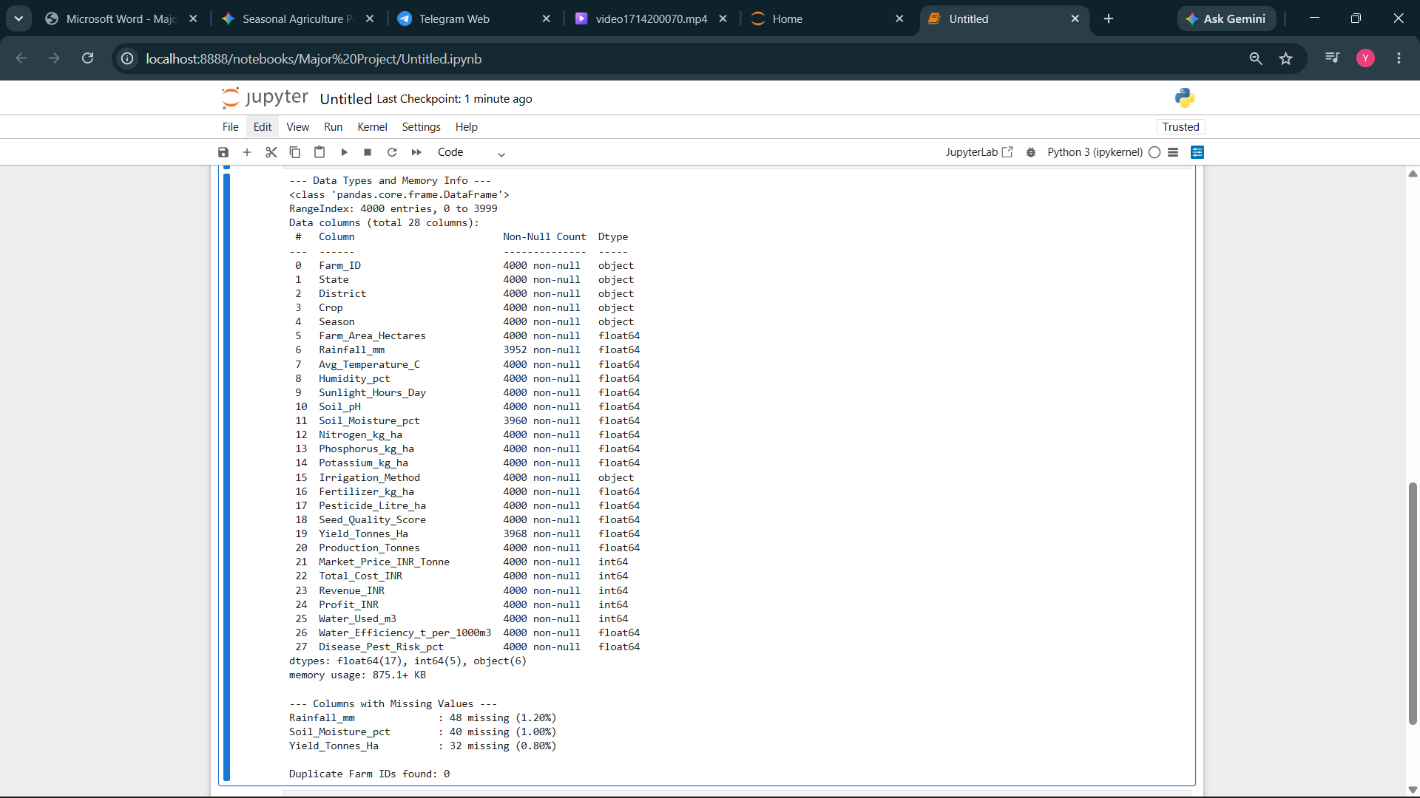
RESULTS
Dataset Ingestion & Verification
Scale: Confirmed 4,000 complete farm records across 28 multi-disciplinary agricultural features.
Entity Integrity: Zero duplicate Farm IDs found, ensuring each entry represents an individual farm entity.
Missing Value Detection: Isolated missing attributes restricted to Rainfall (1.20%), Soil Moisture (1.00%), and Yield (0.80%).
Type Safety: Cleanly categorized into 17 floating-point values, 5 integers, and 6 categorical indicators.

Slide 7
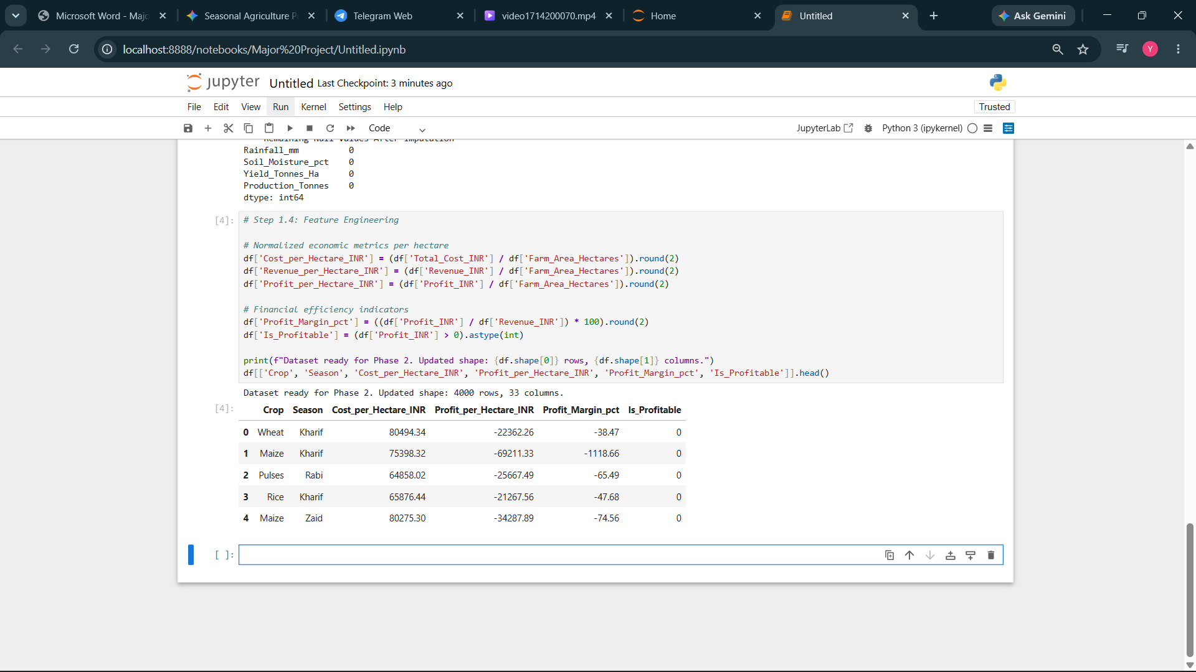
RESULTS
Subgroup Imputation & Metrics
Targeted Imputation: Replaced missing values using subgroup medians by Season (Rainfall, Moisture) and Crop-Season pairs .
Mathematical Consistency: Recomputed Production Tonnes to preserve the exact identity with Yield and Area.
Per-Hectare Normalization: Engineered Cost/Ha, Revenue/Ha, and Profit/Ha to enable fair farm-scale comparisons.
Economic Indicators: Computed Profit Margin percentages and a binary Profitability classification indicator.

Slide 8
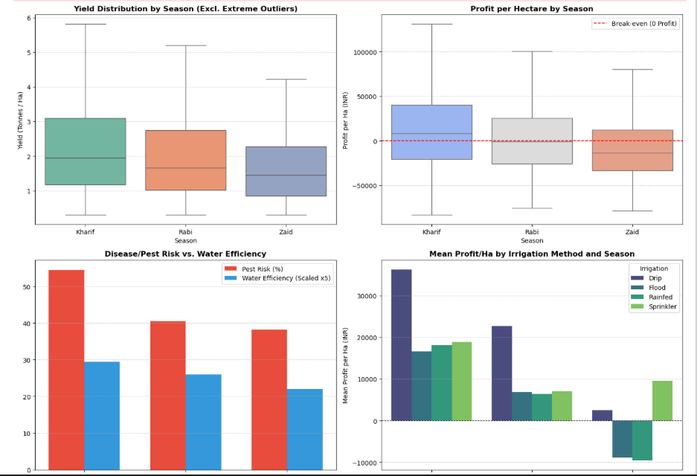
RESULTS
Multi-Panel Performance Findings
Kharif Supremacy: Recorded peak mean yield (5.63 t/ha) and highest profit (mean ₹21,881/ha; 58% profitable).
Rabi Stability: Sustained steady production (5.09 t/ha mean) and moderate returns (₹10,361/ha) under cool weather.
The Zaid Deficit: Exhibited net negative median profits (-₹13,760/ha; 36% profitable) due to heat and water stress.
Irrigation Divergence: Drip irrigation preserved positive net margins across all seasons, whereas flood suffered steep summer losses.

Slide 9
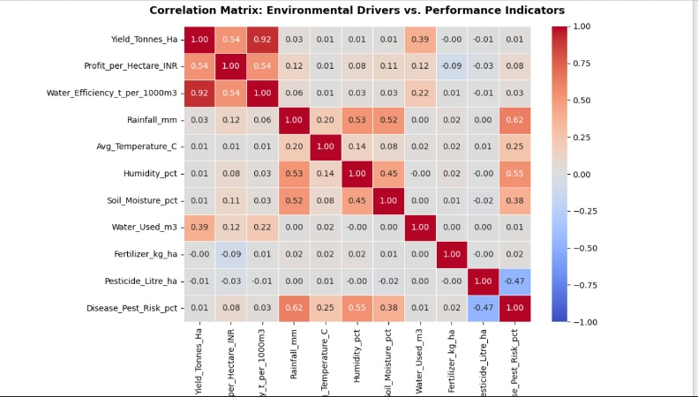
RESULTS
Correlation & Driver Discovery
Water Efficiency Drives Economics: Water efficiency strongly correlates with net profit per hectare (r = 0.54) and yield (r = 0.92).
Precipitation and Pest Threat: Natural rainfall strongly amplifies pest/disease risk (r = 0.62) and relative humidity (r = 0.53).
Fertilizer Decoupling: Chemical fertilizer exhibits near-zero correlation with yield (r = -0.00), demonstrating diminishing returns.
Pesticide Efficacy: Chemical pesticide application demonstrated an effective negative association with pest risk (r = -0.47).

Slide 10
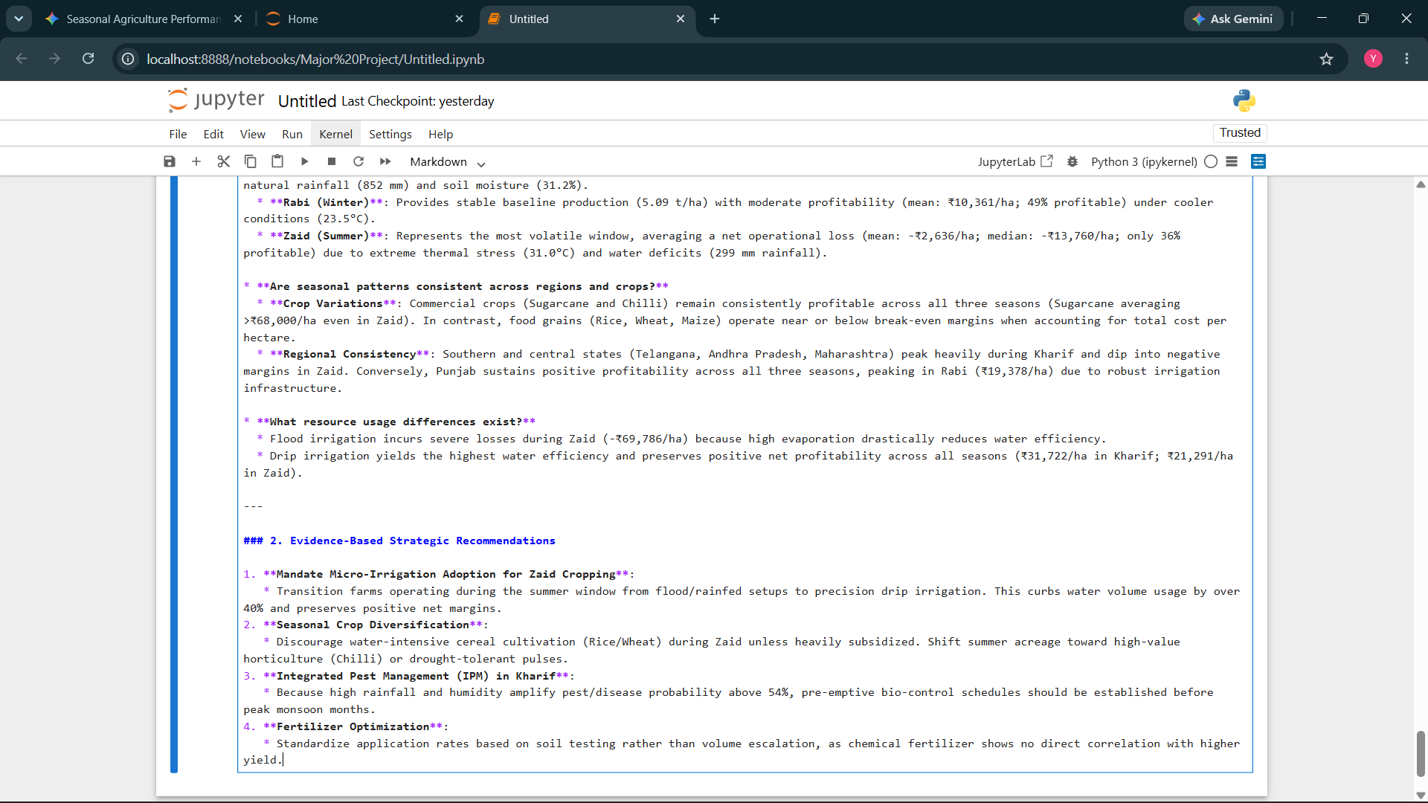
RESULTS
Evidence-Based Conclusions
Crop Resilience: Commercial crops (Sugarcane, Chilli) maintain robust profitability across all seasons (>₹51,000/ha in Zaid).
Grain Vulnerability: Food staples (Rice, Wheat, Maize) operate near break-even, suffering heavy negative margins during summer.
Micro-Irrigation Mandate: Enforcing drip irrigation in Zaid eliminates evaporative waste and reverses negative cash flows.
Monsoon IPM: Recommends preventive bio-pesticide scheduling prior to peak Kharif humidity to counter pest spikes.

Slide 11
Future scope
Supervised Machine Learning Models: Build Random Forest and XGBoost regression models to predict harvest yield and profit margins based on pre-sowing weather forecasts.
IoT & Remote Sensing Integration: Ingest satellite-derived vegetative indices (NDVI) and real-time IoT soil sensors for dynamic irrigation scheduling.
Climate Stress Testing: Simulate extreme weather events (heatwaves, delayed monsoons) to stress-test farm resilience across vulnerable districts.
Farmer Decision Support System (DSS): Develop a web-based dashboard (Streamlit / FastAPI) providing localized crop and irrigation recommendations.

Slide 12
GitHub Link
https://github.com/ygurubetti/Seasonal-Agriculture-Performance-Analysis/tree/main

Slide 13

VOIS Course completion certificate - Course name- Data Visualization

Slide 14
Thank you
Project: Seasonal Agriculture Performance Analysis
Presenter: Yogesh Gurubetti
GitHub: https://github.com/ygurubetti/Seasonal-Agriculture-Performance-Analysis/tree/main
Email: ygurubetti@gmail.com
.

