Slide 1

The Influence Mechanism of Self-endorsement of We-media Short Videos
Presenter 陈羿泓
Instructor 王涛

Slide 2
Research Background
Huge User Base
Physical Economy Recission
We-media Short Videos Booming
By June 2022, the number of short video users was 962 million, an increase of 28.05 million compared with December 2021, accounting for 91.5% of the total netizens.
Information Fragmentation Era
Source：第50次《中国互联网络发展状况统计报告》
Notes:
版权声明：300套精品模板商业授权，请联系【锐旗设计】:https://9ppt.taobao.com，专业PPT老师为你解决所有PPT问题！

Slide 3
Research Background
New Business Model
We-media Short
Videos Booming
New Approach
to Endorsement
Huge User Base
Notes:
版权声明：300套精品模板商业授权，请联系【锐旗设计】:https://9ppt.taobao.com，专业PPT老师为你解决所有PPT问题！

Slide 4
Why Self-Endorsement?
Notes:
版权声明：300套精品模板商业授权，请联系【锐旗设计】:https://9ppt.taobao.com，专业PPT老师为你解决所有PPT问题！

Slide 5
Why Self-Endorsement?
·Features of we-media short videos
Ⅰ. The content is highly related to the main body of the account.
II. Hardly any border between the publisher and the viewer.
III. High in vividness, immediacy, and large scale of freedom
Notes:
版权声明：300套精品模板商业授权，请联系【锐旗设计】:https://9ppt.taobao.com，专业PPT老师为你解决所有PPT问题！

Slide 6
Why Self-Endorsement?
·Relatively low in cost
Identity Endorsement
Limited by the range of options, cost-effective is not high
Authoritative Endorsement
Costs are high, and with the proliferation of titles in recent years, endorsements have become less valuable
Notes:
版权声明：300套精品模板商业授权，请联系【锐旗设计】:https://9ppt.taobao.com，专业PPT老师为你解决所有PPT问题！

Slide 7
Theoretical Background
Social word-of-mouth adoption model
Perceptual interactivity
Theories
Word-of-mouth credibility
TAM
Notes:
版权声明：300套精品模板商业授权，请联系【锐旗设计】:https://9ppt.taobao.com，专业PPT老师为你解决所有PPT问题！

Slide 8
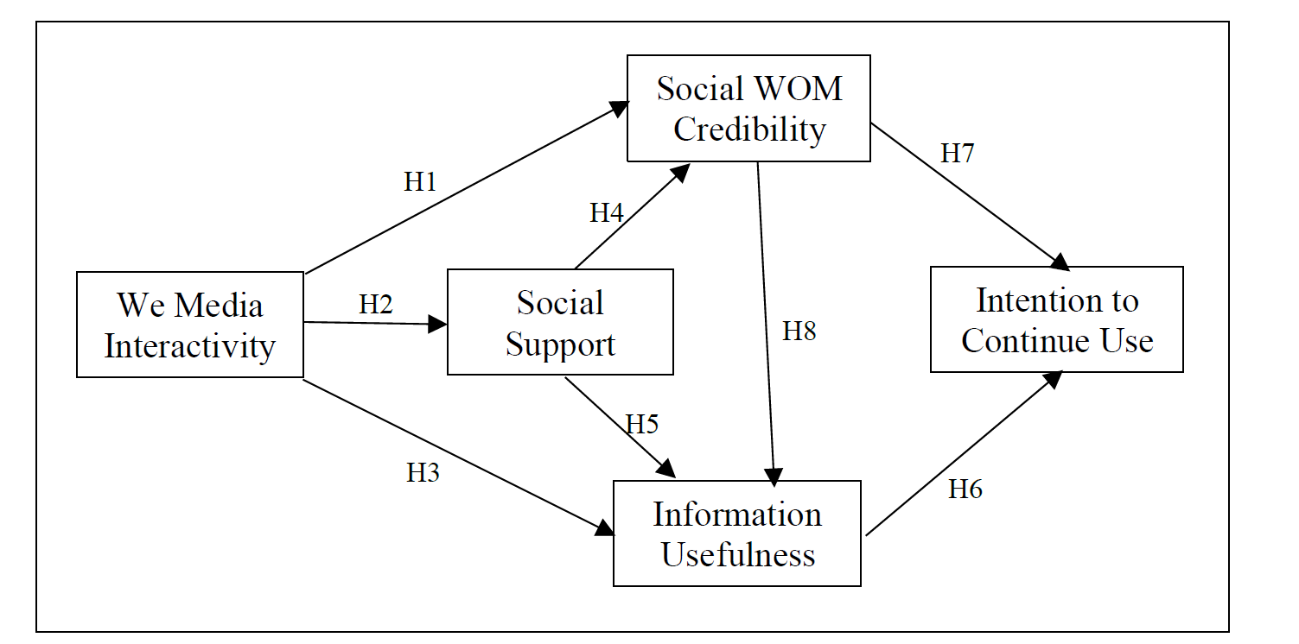
Research Design
Notes:
版权声明：300套精品模板商业授权，请联系【锐旗设计】:https://9ppt.taobao.com，专业PPT老师为你解决所有PPT问题！

Slide 9
Data from Questionnaires
Reliability Test
Cronbach’s alpha：0.816～0.934
CR: 0.790～0.935
AVE: 0.633～0.781
KMO: 0.954
Overview
·296 Valid Questionnaires
·24.15% under 20 years old, 52.74% between 20 and 30 years old, 23.12% older than 30 years old
·81.19% of the participants have been browsing short-form videos for more than 2 years.
·More than half of the respondents were educated on the level of a bachelor’s degree.
Validity Test
Content validity: All the variables in this study were derived from existing literature, thus exhibiting strong content validity
Convergent validity: All the factor loadings for the items exceed the recommended level of 0.6 and are significant at p<0.001
Goodness of Fit
χ2/df.=1.33，GFI=0.995，AGFI=0.933，NFI=0.971，IFI=0.993，RMSEA=0.035

Slide 10
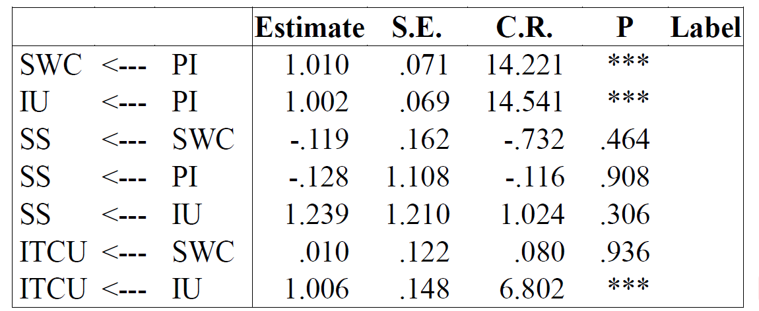
Conclusion
Perceived Interactivity
The credibility of WOM information
Perceived Interactivity
Information usefulness
Information usefulness
Intention to continue the use

Slide 11
Conclusion
·Speculated Reasons
Difference between short videos and traditional social media content.
Users may seek information but not emotional comfort.
·Insignificance in all the hypotheses about social support
*** p<0.01; ** p<0.05; * p<0.1

Slide 12
Implications
Short Video Publishers
Achieve Endorsement
Enhance Interactivity
Maintain the Users
Short Video Platforms

Slide 13
Greatly appreciate your questions and comments!
Presenter
陈羿泓
Instructor
王涛

