Slide 1
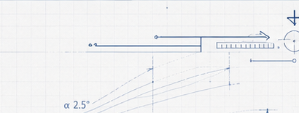
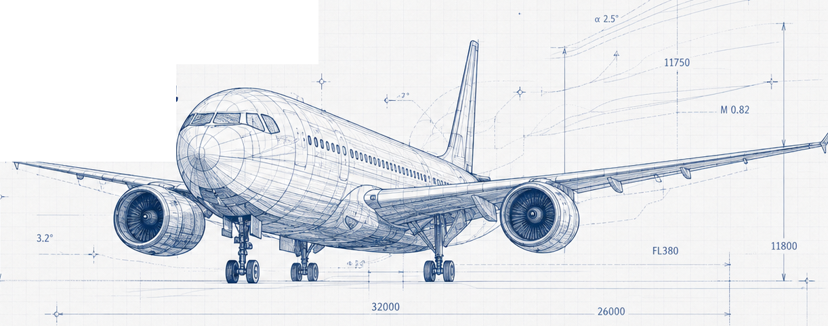
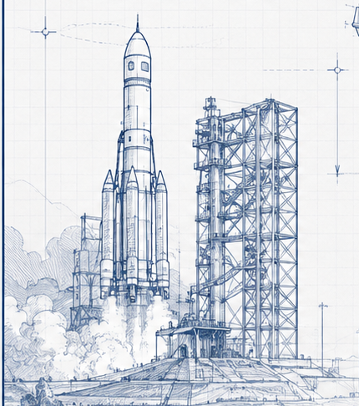






航空航天类
探索飞行器如何安全、高效、智能地
驾驶天空与星辰
专业方向
核心课程
适合人群
升学路径
就业前景
航空航天 | 探索 · 工程 · 未来
Notes:
[Sources] Visual reconstruction based on the user-provided reference image: E:/志愿填报视频资料/03.PPT图片格式/航空航天类/ChatGPT Image 2026年7月29日 00_18_23 (1).png
Major title, subtitle, footer, navigation labels, and selected dimension labels are rebuilt as editable PPT text.
Aircraft blueprint, rocket launch blueprint, technical micro-markings, and navigation icons are retained as cropped image assets to preserve line-art texture.

