Slide 1

Fraudly™
Barak, Demetria, Gina, Jarrod, Joanna

Slide 2
Data
Found 9% of the requests were Frauds

Slide 3
Feature engineering
Numerical
Email domains
Found countries with higher rates of fraud
Number of total tickets to sell
Previous history of the users
Event country = posting country?

Slide 4
Feature engineering
NLP on ‘description’
Topic analysis:
Topics found: dinner party, education, social networks, logistics, business, university, club logistics, workshop, club amenities.
Exclamation points
Caps proportion

Slide 5
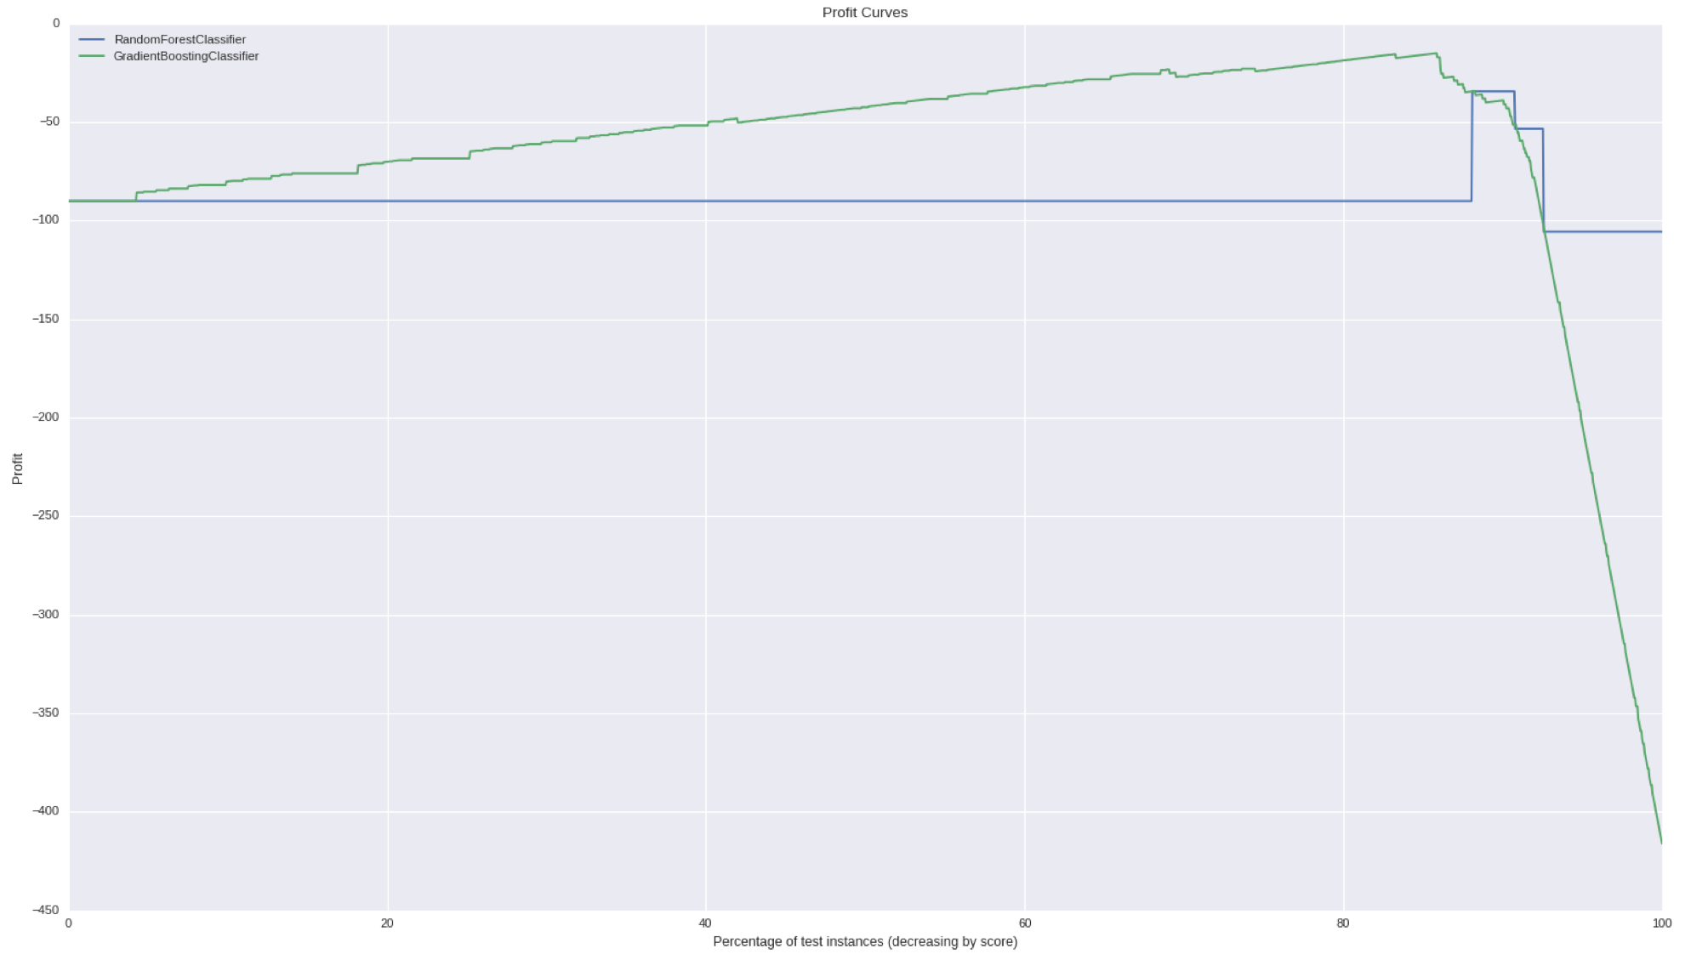

Profit curve for our models
The cost of false positives was chosen as the median the possible losses in fraud cases = 4225. For example, an fraudulent event with 1000 tickets with $30/each represents a loss of $3000.
 | Was Fraud | Was Not-Fraud
Predicted Fraud | 0 | - $100
Predicted No-Fraud | - $4225 | 0
Profit
Profit

Slide 6
The Fraudly Model
In order to predict fraud, we ran several models and decided to use Gradient Boosting Classifier (GBC) model with 22 features. The most important ones are shown here:
Previous activity of the client
Has previous payouts
Number of tickets sold for the event
Sale duration
Length of the description

Slide 7
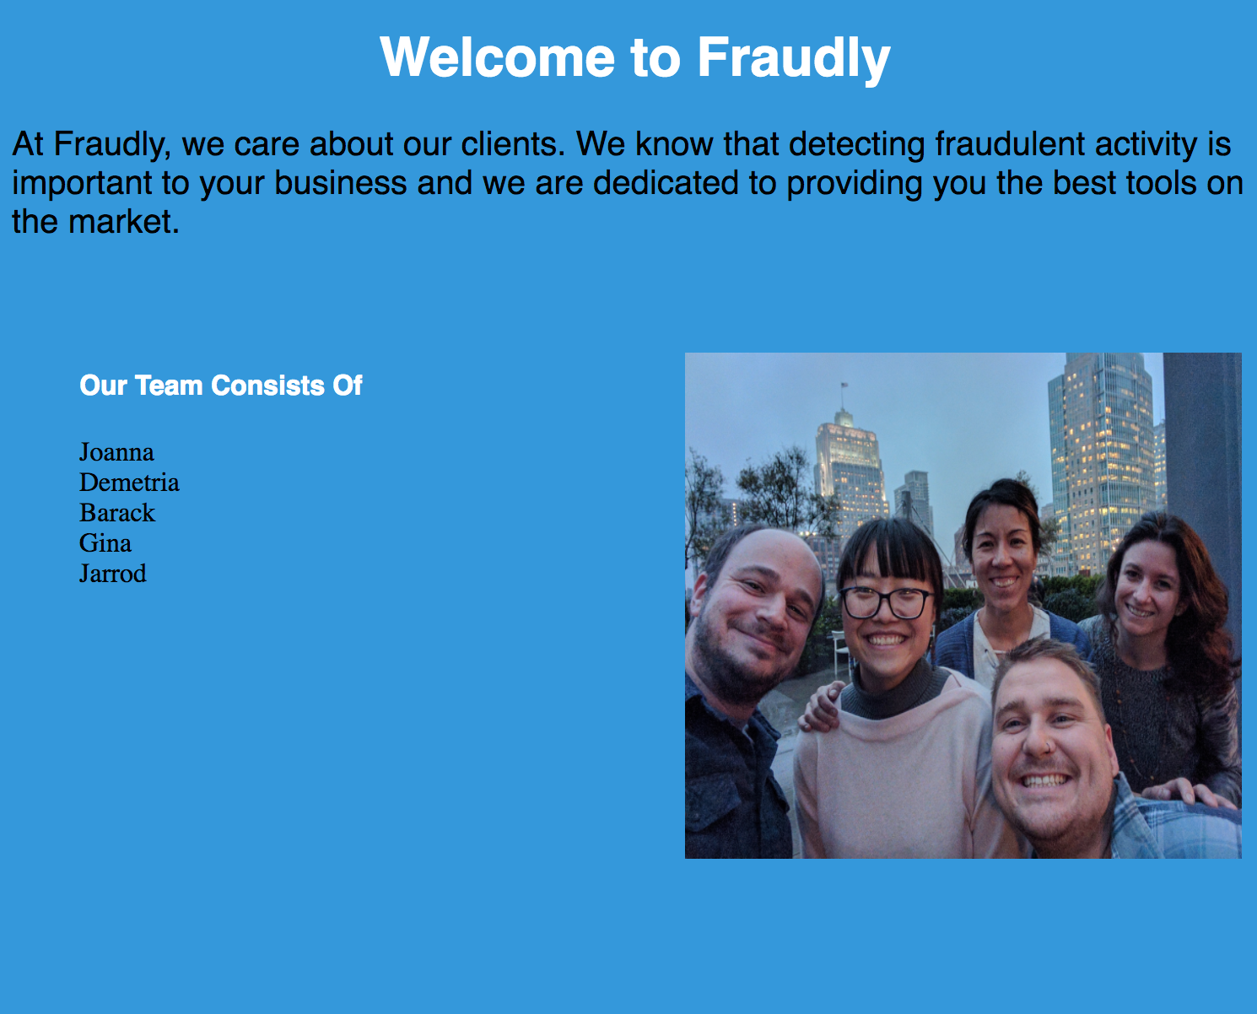

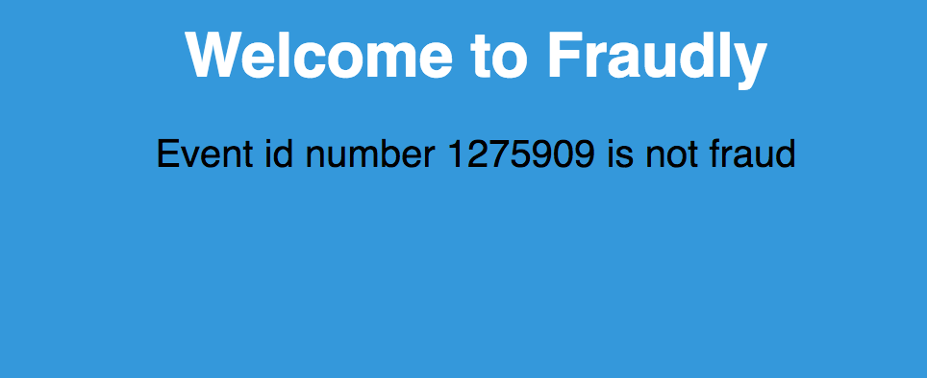
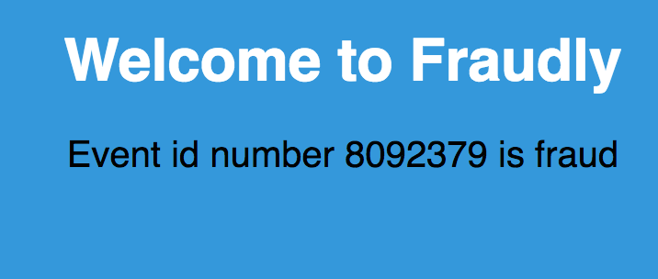
Screen-shots

Slide 8
Fraudly v.2.1
Fraudly 2.1 will have the ability to offer batched events for ease of identification.
It will also include the top reasons why we classify each event as fraud.
Add topic features.

Slide 9
EXTRA (for data scientists)

Slide 10
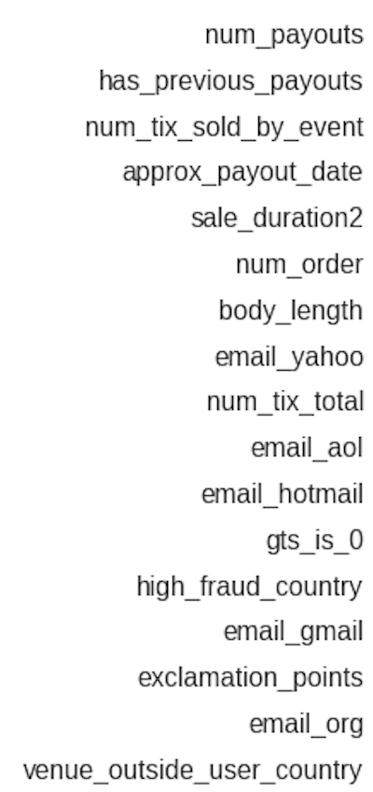
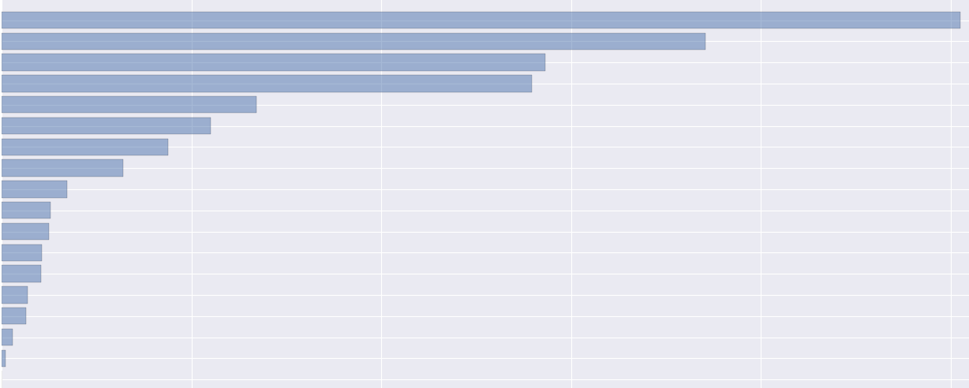
The Fraudly Model - Important Features
Gradient Boosting Classifier model with 21 features. The most important ones are shown here:

Slide 11
Confusion matrix for test data
Recall = 0.929
Precision = 0.898
f1_score = 0.9135
Accuracy = 0.984
TP = 354 | FP = 27
FN = 40 | TN = 3881

Slide 12
App
Created a MongoDb database pulling data points from the website.
The app right now pulls a data from this database and makes a prediction.

