Slide 1
Motion Tracking Comparison of HTC Vive and Vicon
Yuanqing Hong, Xin Jin

Slide 2
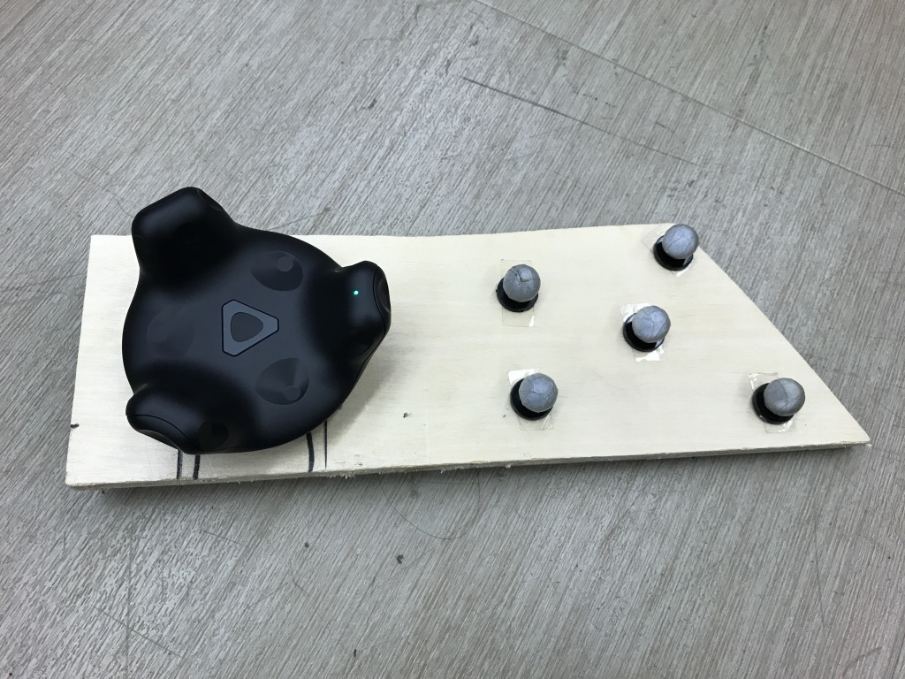
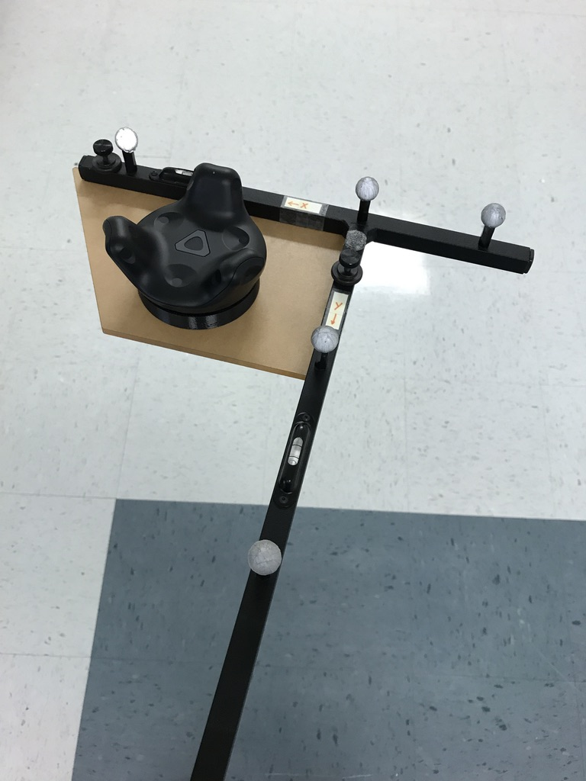
Method
Tracker
Computer2
Unity
UDP
Computer1
Vicon
Labview
Wand

Slide 3
Experiments
3 Sets of Data
Geometric Error for Position
RMS
Max
Set1: Translation Movement
2.7mm
10.2mm
Set2: Rotation Movement
6.7mm
30.2mm
Set3: Random Movement
5.0mm
24.3mm
(movement range: around 1 meter)

Slide 4
Orientation
Rotation Matrix
Euler Angles
Quaternion
Vicon
Vive
Step1
Vicon
Vive
Step2
Vicon
Vive
Step3
Vicon
Vive
ZYX
XYZ

Slide 5
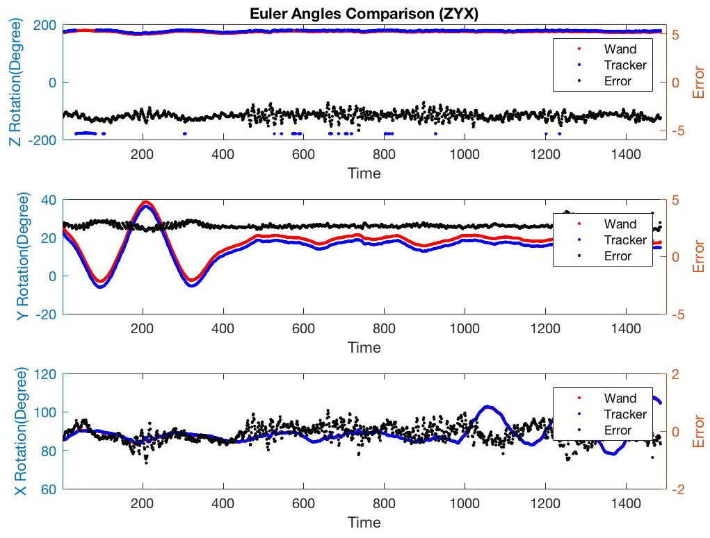
Set1: Translation Movement
Euler Angles: Z-Y-X
Error (degrees)
RMS
Max
Z
3.5
5.0
Y
2.6
3.9
X
0.2
1.1

Slide 6
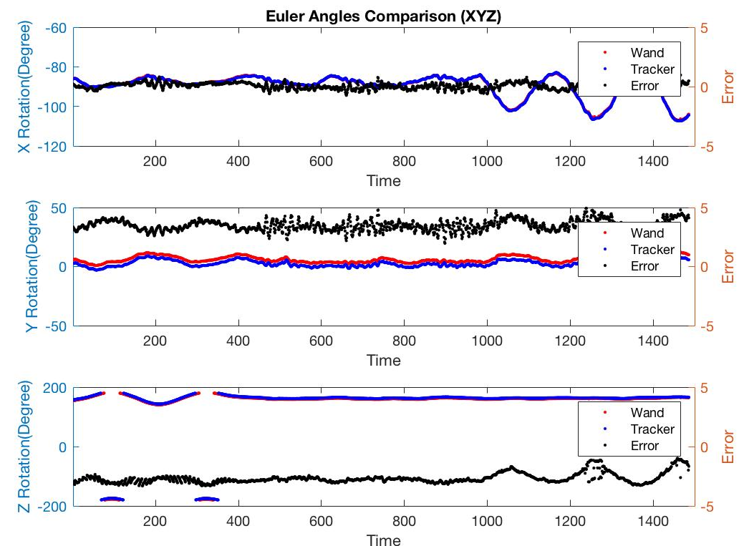
Set1: Translation Movement
Euler Angles: X-Y-Z
Error (degrees)
RMS
Max
X
0.27
3.5
Y
3.5
4.9
Z
2.7
3.3

Slide 7
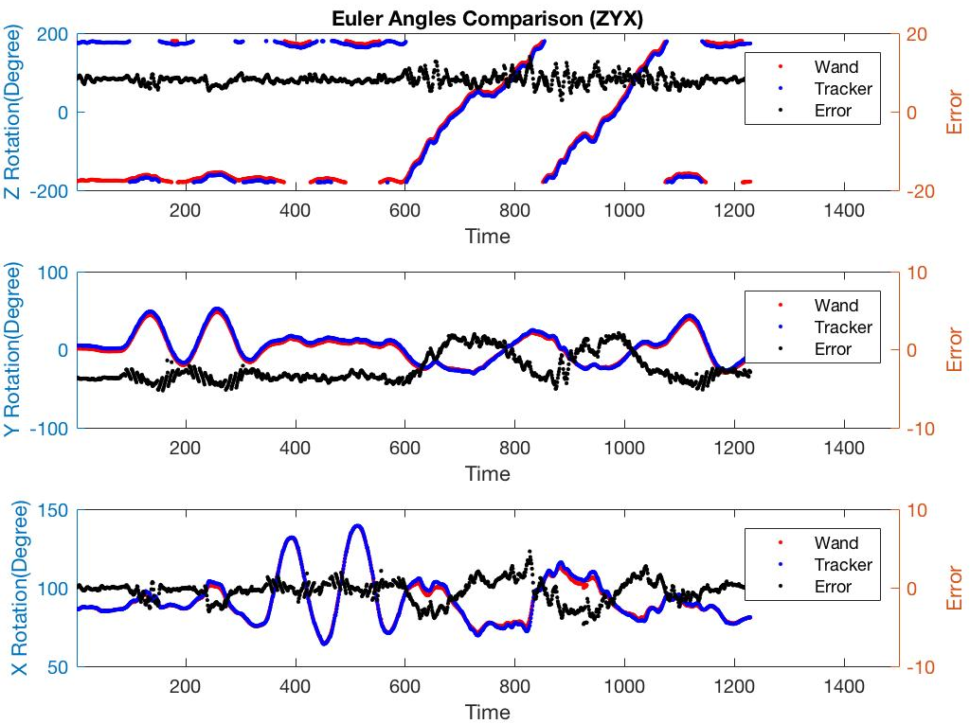
Set3: Rotation Movement
Euler Angles: Z-Y-X
Error (degrees)
RMS
Max
Z
8.2
14.0
Y
3.1
5.2
X
1.4
4.6

Slide 8
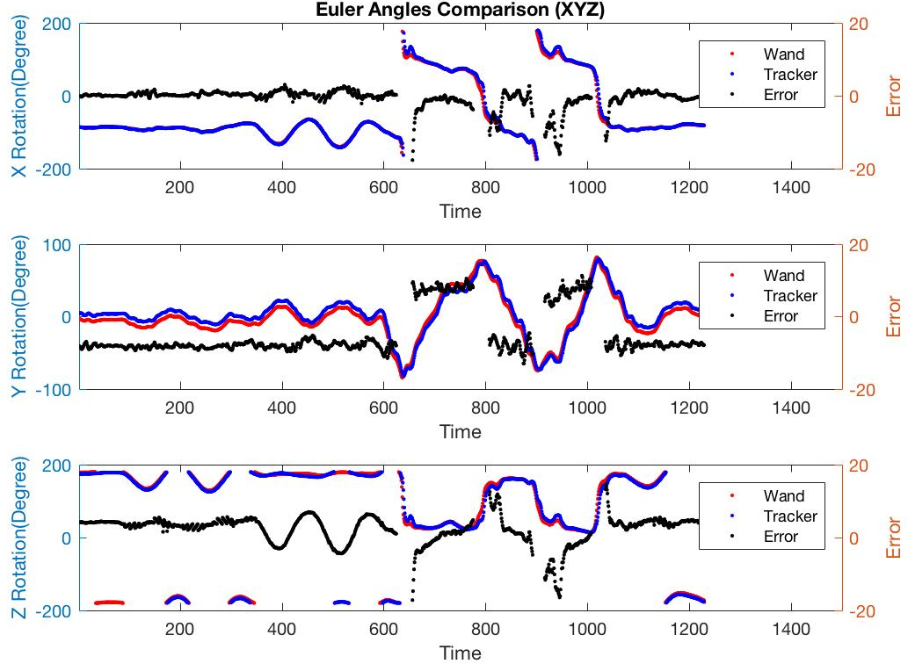
Set3: Rotation Movement
Euler Angles: X-Y-Z
Error (degrees)
RMS
Max
X
2.7
17.6
Y
7.9
12.9
Z
4.5
17.1

Slide 9
Summary
Orientation Error for Euler Angles (Z-Y-X)
RMS
Max
Z
3.5
Z
5.0
Set1: Translation Movement
Y
2.6
Y
3.9
X
0.2
X
1.1
Z
3.7
Z
6.1
Set2: Rotation Movement
Y
2.2
Y
3.0
X
0.3
X
2.0
Z
8.2
Z
14.0
Set3: Random Movement
Y
3.1
Y
5.2
X
1.4
X
4.6
(Unit: degrees)

Slide 10
New Experiment
Computer2
Computer2
Unity
LocalFile
Unity
UDP
Computer1
Computer1
Vicon
Labview
Vicon
LocalFile
Synchronized by system clock
Vicon Sampling Time: 240Hz (193Hz)
Vive Sampling Time: 120Hz (89Hz)

Slide 11
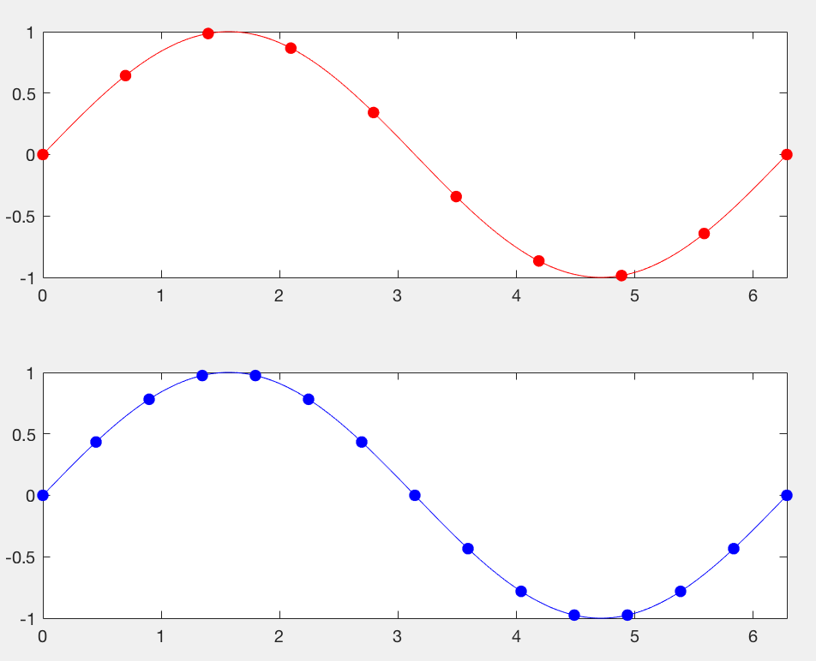
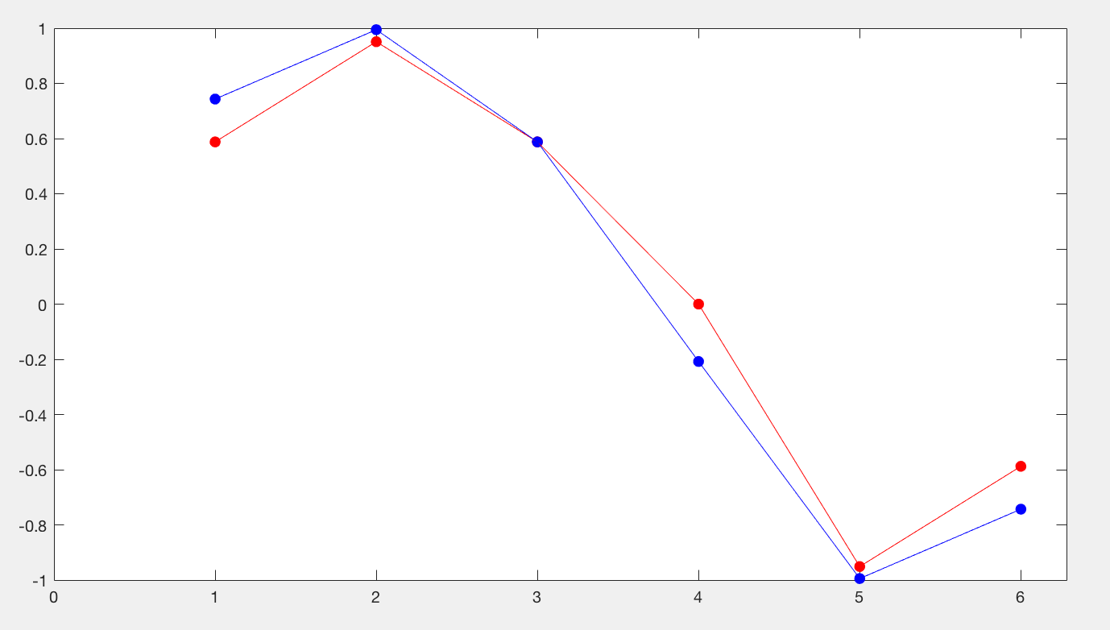
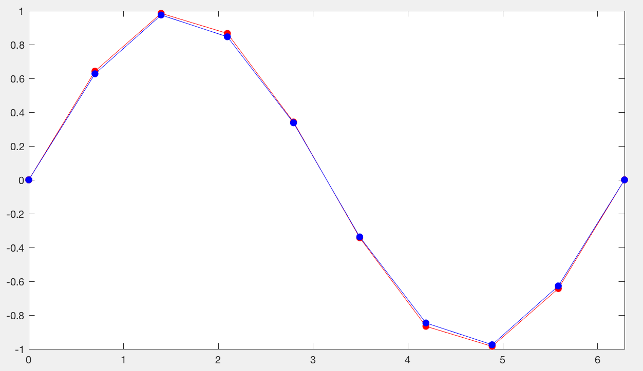
Methods
Previous Method
Current Method

Slide 12
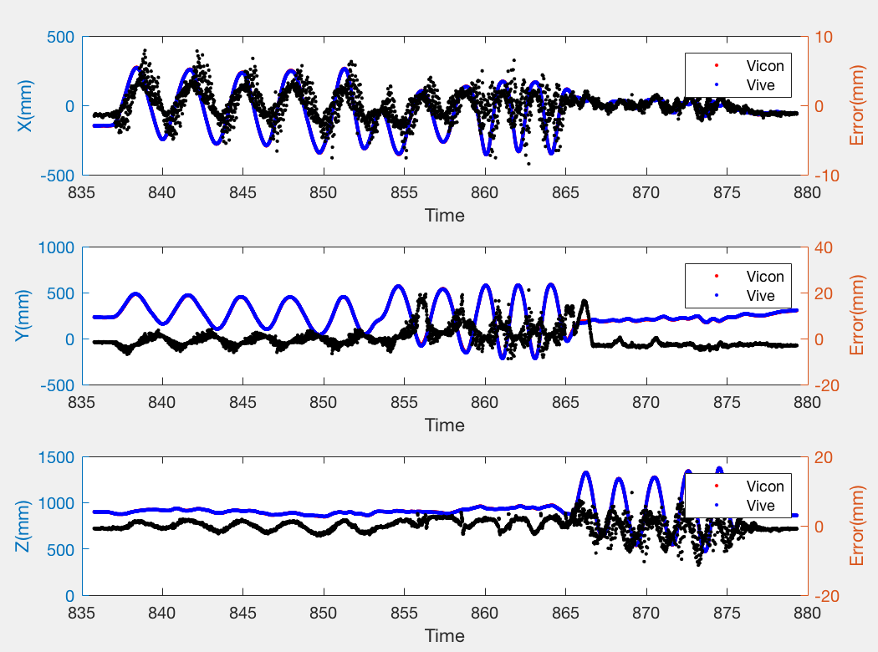
Translation Movement
Error (mm)
RMS
Max
X
1.9
7.9
Y
4.2
21.1
Z
2.1
11.6

Slide 13
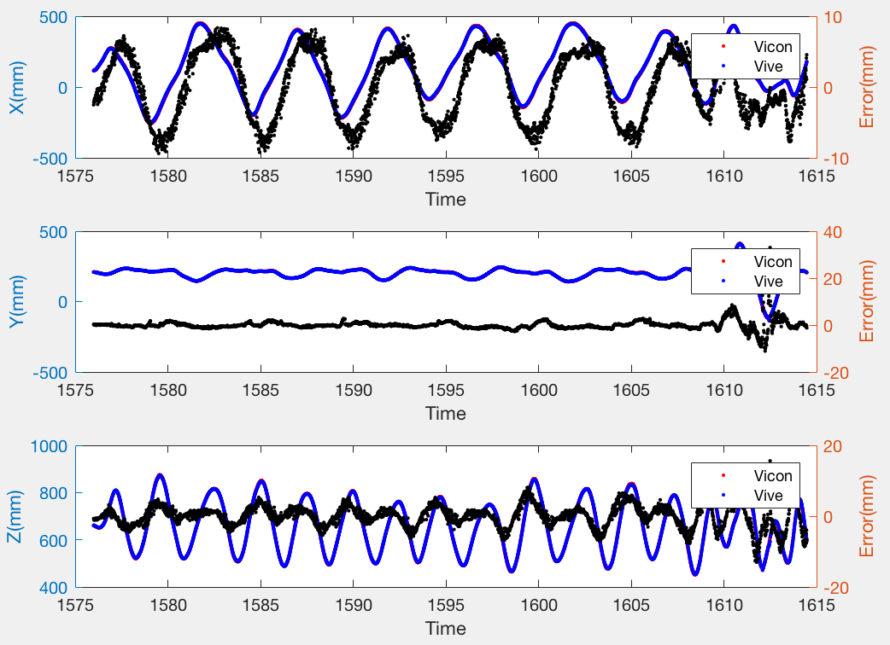
Rotation Movement
Error (mm)
RMS
Max
X
4.6
8.3
Y
2.0
33.0
Z
3.1
15.6

Slide 14
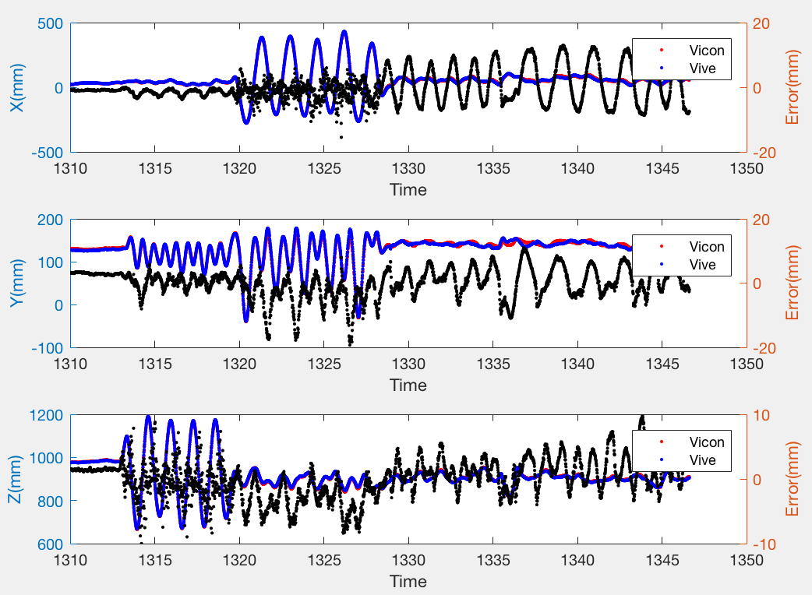
Random Movement
Error (mm)
RMS
Max
X
4.9
13.0
Y
4.6
10.9
Z
3.0
9.8

Slide 15
Comparison
Geometric Error Comparison
RMS
Max
RMS
Max
Set1: Translation Movement
2.7mm
10.2mm
5.1mm
22.7mm
Set2: Rotation Movement
6.7mm
30.2mm
5.9mm
36.5mm
Set3: Random Movement
5.0mm
24.3mm
7.4mm
20.8mm
Previous Method
Current Method

